Slide 1


Working in partnership with employers to drive growth of Digital Industries
Julie Feest
Customer & Partner Director
e-skills UK

Slide 2
THE E-SKILLS UK GROUP
e-skills UK is an employer-owned not-for-profit company, licensed by government as the voice of employers on IT skills.
Our mission is to ensure the UK has the IT-related skills to compete in the global economy.
We offer
A unique forum to address the skills issues no company can fix on its own;
The ability to work collectively, with government backing, to ensure the education and training infrastructure meets the needs of the sector;
Access to employer-designed training solutions that improve productivity and business competitiveness.

Slide 3
E-SKILLS UK VISION
Our vision is that the UK is recognised as a global leader in delivering business value from technology.
This means:
The IT workforce will be recognised as the best in the world for solving business
problems and increasing business competitiveness across all sectors;
Managers and leaders in every sector will have the ability to fully exploit the strategic
potential of technology, establishing the UK as the most competitive nation with the most
productive businesses;
All individuals will have the digital literacy needed for full participation in employment
and society; and
Educators will have the knowledge and skills to support the development of a world-
class IT skills pool.

Slide 4
OPERATING ENVIRONMENT
Business priorities
Entry to the sector: 129,000 new people are needed a year into IT roles but pipeline issues constrain recruitment & growth (ref. gender, educational curriculum, new entrant programmes)
Strategic skills: global leadership opportunity is constrained by inadequate supply of strategic skills (data analytics, cyber security, e-commerce, mobile, cloud…)
SME growth: high growth cluster growth constrained by tech skills shortages
Government / funding
Focus is on economic & employment growth, with the Information Economy now one of 11 strategic sectors in the Industrial Strategy
There is significant opportunity for employer bodies in ‘Employer Ownership of Skills’ / Industrial Partnership strategy, and local strategies - noting the rise of the local agenda and devolution of funding to Local Enterprise Partnerships (LEPs)
There is no ‘protection’ assumed for SSCs: employers lead in whatever formats they choose and funds opening up to any employer consortia

Slide 5
2013-14 WORK PORTFOLIO OVERVIEW
Schools
Careers
- BigAmbition
- BringITon
Curriculum
- GCSE
CC4G
Higher Education & Further Education
ITMB degree
Software Development for Business degree
Degree accreditation
Pre-Apprenticeships / Traineeships
Workforce skills
IT Professional Profile
IT Professional Profile Manager
IT Learning Pathways
Strategic Skills Development
Apprenticeships
IT Industry Gold Apprenticeships
Training Provider accreditation
Digital Capability
Digital literacy
IT Guide for SMEs
The Cyber Academy
Industry Standards: National Occupational Standards, Apprenticeship frameworks / specifications
Research
Future Talent
IT Workforce
Wider Workforce

Slide 6
Use of Digital Technology
Projects and interactive software, developed with rigour, to help pupils acquire skills and knowledge in an engaging and effective way through Behind the Screen
Bringing technology they use into the classroom e.g. Iphone and Apps dev
Create a resource bank of video, audio, images, documents, web-links, guides to using open-source software, background industry-relevant information
Video clips on range of jobs and help with employability and company profiles on Careers website
Guru lectures provided in University lectures
Access to latest technology with support of our employers e.g Raspberry Pi to excite students, challenges on ‘Internet of Things’
Communities to share thoughts and ideas for e.g. Apprentices across different companies
Most importantly, building the strategic skills required to grow the economy and where skills shortages exist in the future

Slide 7

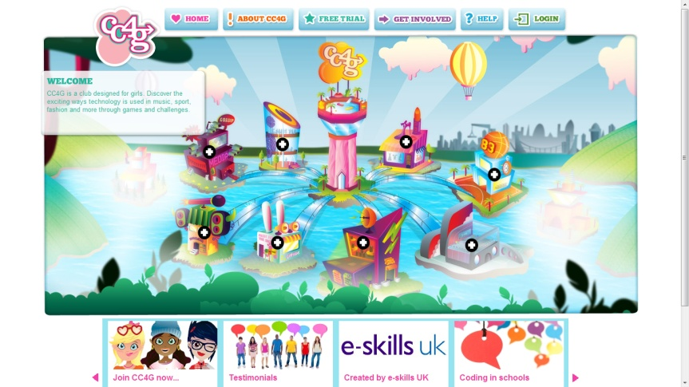
Computer Clubs for Girls (CC4G) -an out-of-the-box after-school club to encourage girls to love IT
Since 2005, more than 135,000 girls in over 3,800 schools have experienced CC4G
84% say they are more likely to consider further education or a career in technology
Since 2005, more than 135,000 girls in over 3,800 schools have experienced CC4G

Slide 8
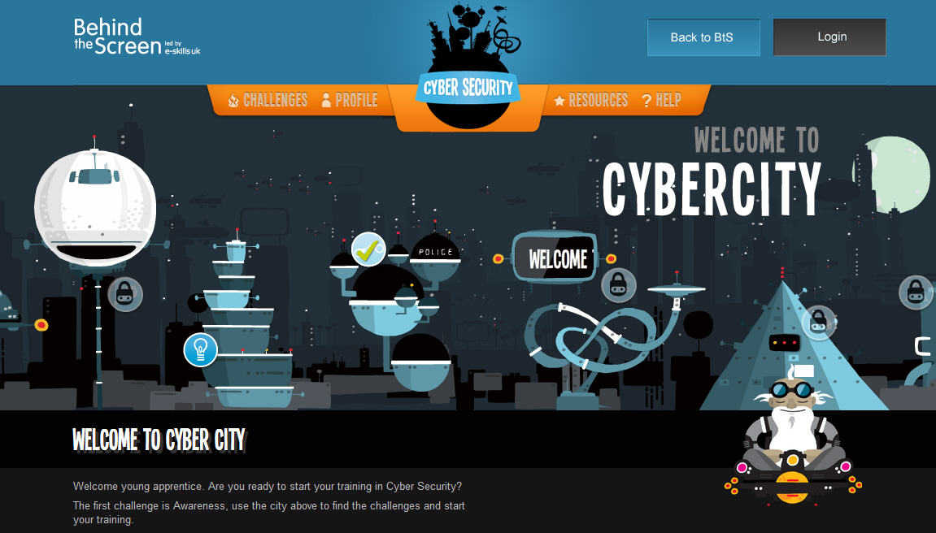
Cyber City
Dynamic image with moving space craft
Guru character provides ‘wisdom’ throughout the project to the trainee ‘Cyber Ninjas’
Students access the content through links from the cityscape or from top navigation bar

Slide 9

Training content
Training content (resources) include games, documents, infographics and a comic book
Documents are described as Ninja Notes and are informative, concise and visually appealing

Slide 10
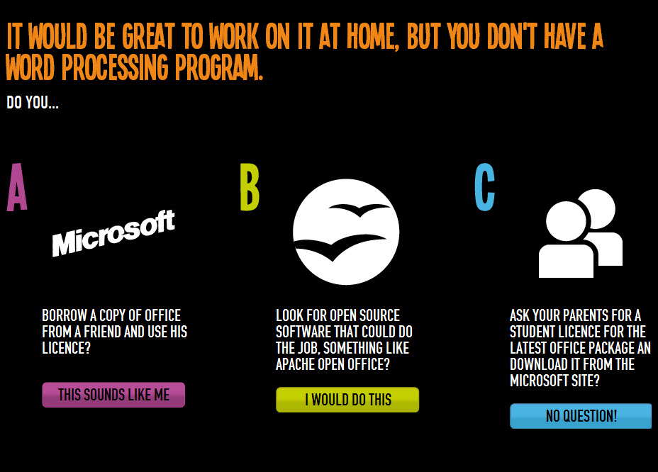
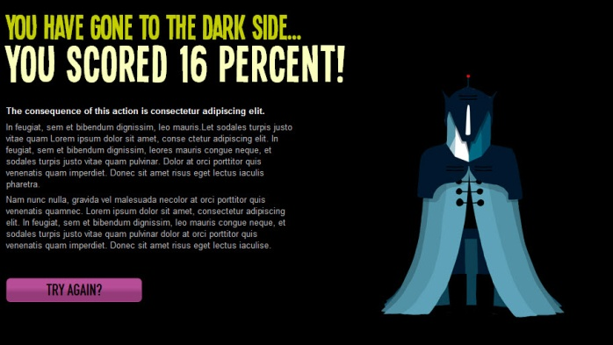
Training content
Role play games – students take the role within a scenario and have to make choices in response to questions
Choices lead to a score and feedback on performance

Slide 11
Thank You

