Slide 1
Digital Technologies and school-to-work transition
The new ICT and computing curriculum
John Woollard March 2013

Slide 2
Abstract
This presentation charts the developments in the ICT and computing curriculum that have occurred over the past 18 months that were made in response to pressures from industry, commerce, academia and schools.
The perceptions of what ICT used to be was identified in Voices. The description of what ICT had become, the expectations of what ICT does and the how school-based ICT could be developed was scrutinised and declared by the Royal Society and a new approach to teaching ICT was proposed in the Computing at School curriculum.
The political perspective is reflected in the 4 announcements beginning in January 2012: the use of the term computer science with regard to school ICT, disapplication of the National Curriculum for ICT, the BCS and RAEng curriculum proposal and the draft National Curriculum for Computing.
The plenary identifies a number of implications for social justice and inclusion in education that relate to the constructs of enfranchisement, equality of opportunity and safeguarding.

Slide 3
to be addressed…
How is digital technology used to deliver education?
How are digital skills taught in schools?
How does digital technology shape young people’s learning?
How does students’ informal learning of technology feed into the formal school context?
How does digital technology translate into post-compulsory education career choices?

Slide 4
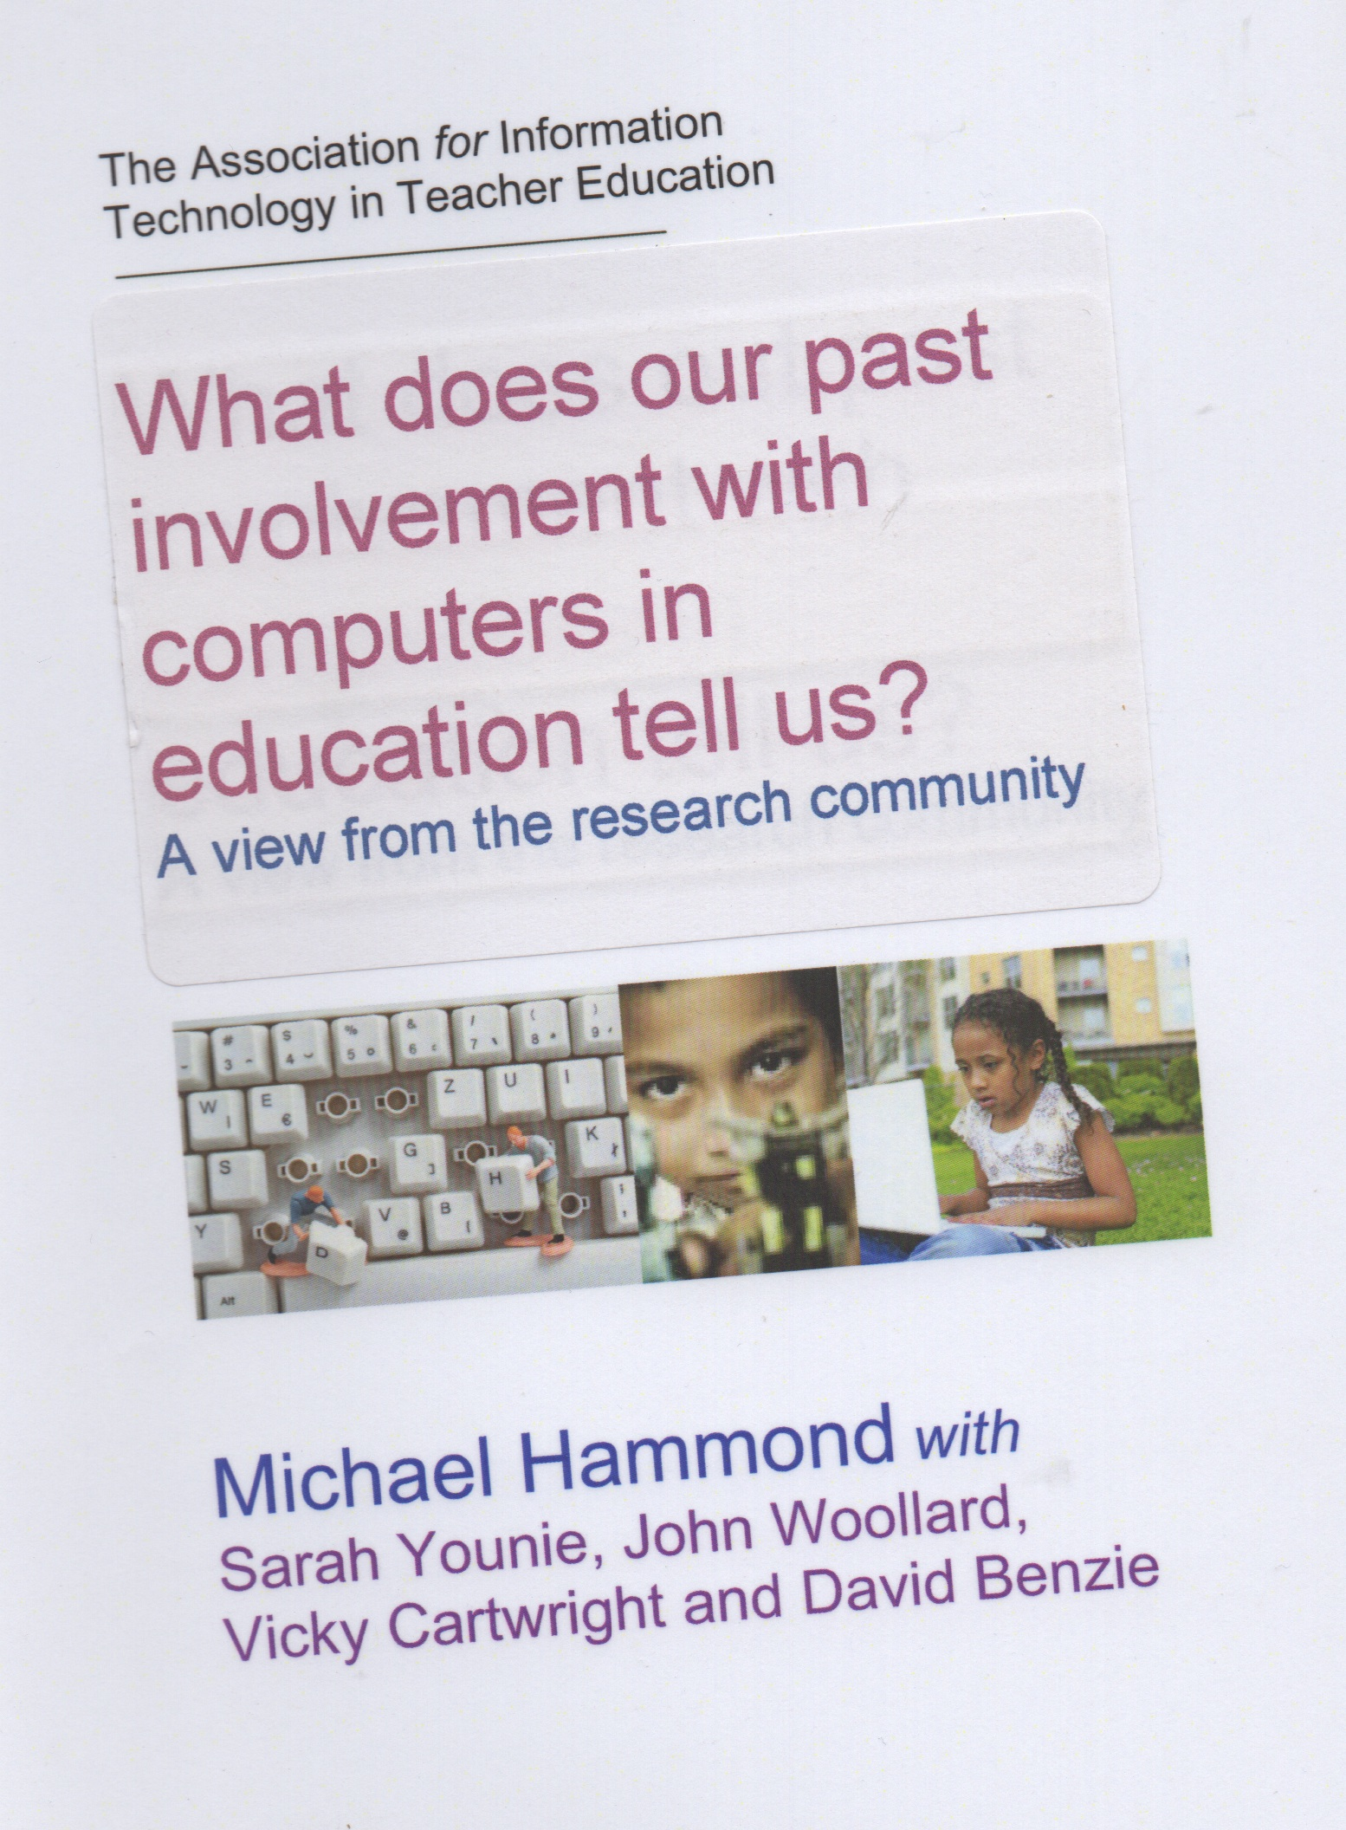
Voices project
“A common refrain was that while technology had had a huge impact on leisure and social activity in general, schools were not keeping pace:
And nothing has changed except that divide has got more profound, I think, and we are just giving prescriptive education in schools. But the things that are really important to kids, the real experiences that are going to impact on their lives happen elsewhere. And that’s going more so for me, not less so. So schools in a sense are just not keeping up with the changes.”
Hammond, M. (2008) What does our past involvement with computers in education tell us? A view from the research community [http://www2.warwick.ac.uk/voicesbook.pdf]

Slide 5
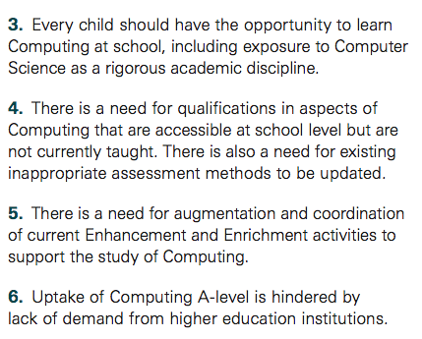
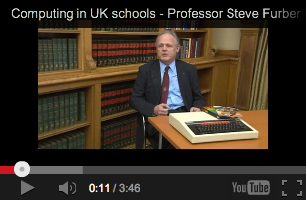
Steve Furber

Slide 6
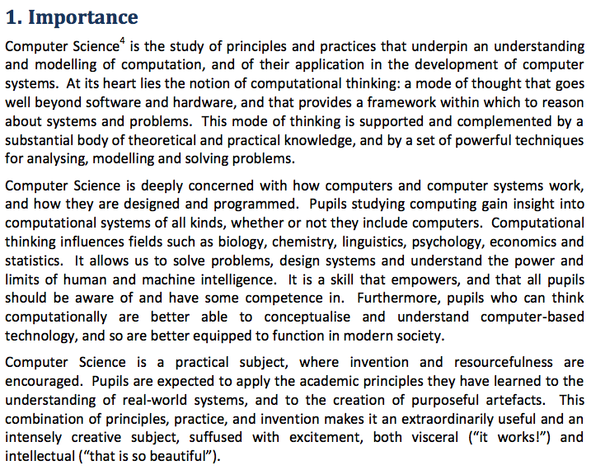

Slide 7
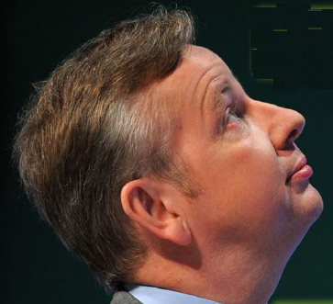
Developments
“computer science”
“disapplication”
proposed curriculum
draft National Curriculum

Slide 8
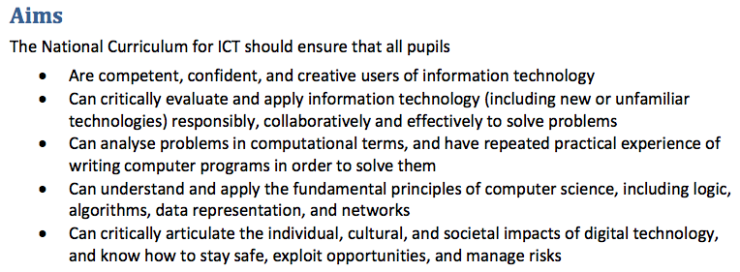

Slide 9
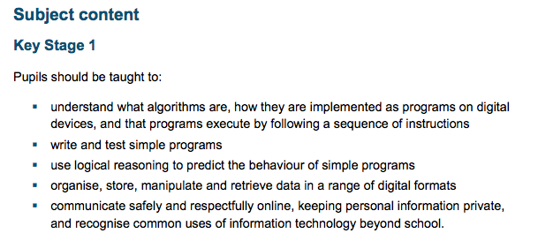
key stage 1
Notes:
KS1 reflects the issues of the changing curriculum

Slide 10
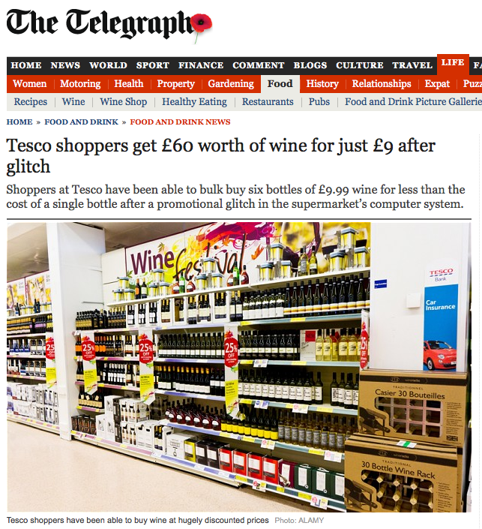
Cheap wine

Slide 11
other curriculum considerations
IT the productive and creative use of technology
DL Digital literacy
TEL Technology Enhanced Learning
ICTAC teaching of the ICT PoS in other subjects
Subject specific ICT
Extra-curricula ICT/computing/computer science
ICT - school infrastructure: BYOT 1to1

Slide 12
The context of SJIE
Social justice and inclusion in education
issues of:
gender
ability
age
motivation
safety

