Slide 1
Hays Recruitment

Slide 2

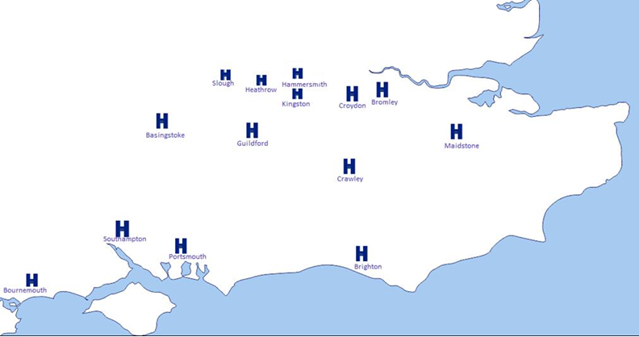
OUR OFFICES
The UK & Ireland’s largest and most successful recruitment business.
Every day, we match thousands of candidates to the right jobs across 22 different specialist areas.
9,000 employees across 32 countries in over 250 offices
Accountancy & Finance
Senior Finance
Construction & Property
Engineering
Digital & Information Technology
Human Resources
Marketing
Office Support
Personal & Executive Assistants
Procurement, Supply Chain & Logistics
Education
Social Care

Slide 3


HOW DO YOU MAKE YOUR APPLICATION STAND OUT?

Slide 4



Your CV
Contact details
Personal Summary
Experience
https://www.hays.co.uk/resources/career-advice/cv-tips-and-structure

Slide 5

Their Needs
Read the job description carefully
Call to find out more (yes, really!)
Research the organisation, their values and sector
Your Message
Think ‘how is my CV relevant?’ MAKE IT!
Use key terms and duties from the job advert that can marry to your experience
Point out relevant experience and key skills to the role
Write a cover letter

Slide 6

What’s Missing?
Betty Sue Smith
Bettysue.smith@gmail.com
About Me:
Looking for a new role since being unemployed due to the pandemic
Work experience
2017 - Present
Next
Store Supervisor
What is their message?
What are they looking for?
Does this make them stand out?
Not enough information
What are their daily duties?
2015 - 2017
Harrod’s (Fragrance)
Sales Assistant
System skills and abilities
Education and qualifications
History & International Relations | Oxford Brookes |September 2009 – July 2013
A Levels | Shiplake College |
No specific details on qualifications or results
No skills included, what are they good at?
Does this relate to the job description?
6

Slide 7
We know more about Betty because she has added her ‘introduction
Short description of each position and daily duties
Betty Sue Smith
0123456789
Bettysue.smith@gmail.com
About Me:
I am an experienced and professional Store Manager with exceptional attention to detail, good time management and great customer service skills. I have always worked within the retail industry and feel very passionate about providing the best customer service to my customer.
I am now looing for a new role and a chance to progress and development my skills and talents. I would like to apply for the role as Store Manager at your Luxury Fragrance Store, Maybells. I have experience in managing a team of 10, managing the day-day running of the store, producing all monthly and weekly reports and presenting these. I also train my colleagues and perform all monthly 1-1’s and KPI’s.
Work experience
2017 - Present
Next
Store Supervisor
Duties & responsibilities include:
Managing the day-to-day running of the store
Reporting into the Store Manager, stepping up when away
Supervising a team of 10
Weekly reporting and presenting business updates
Processing monthly payroll for employees
Training new staff members
2015 - 2017
Harrod’s (Fragrance)
Sales Assistant
Duties & responsibilities include:
Coach new employees on the brands
Present to the store manager
Upsell products
Profit protection training
Achieved KPI’s monthly
Help set up all new designs on the stand
System skills and abilities
Full proficiency with Microsoft Office packages including:
Word, Excel and PowerPoint
SAP
Spanish Fluent
Education and qualifications
History & International Relations | Oxford Brookes |September 2009 – July 2013
● 2:2 Bachelor of Arts
A Levels | Shiplake College |
● History - B
● Geography - B
● Business - C
Most recent experience at the top
BONUS: Added education
7

Slide 8
THE DO’s and THE DON’TS
Do add whether you will require a sponsorship to work in the UK
DO add things like, if you can drive, if you have any hobbies or if you are a member of a club or society
DO add your Qualifications, School education and Degrees
Do add a cover letter to help the Hiring Manager find out more about you
Do not add unnecessary information e.g Parents Names, Date of Birth, Place of Birth etc
Do not add confidential information like your National Insurance number
Do not add whether you are a parent or have any dependants
Do not add pictures of yourself

Slide 9
THE INTERVIEW
Read the Job Description
Find out about the company, their values, their goals (OR) Don’t be afraid to ask!
Prepare notes but don’t read off a script
Most importantly, talk about yourself
Why are you best suited to the job?
What could you offer the business?
Why should they employ you?
Be ENTHUSIATIC
9

Slide 10


ANY QUESTIONS?
Laura Baker – Talent Partner
10

Slide 11

THANK YOU

