Slide 1
Designing Video for Learning What does the research tell us? Dr John Schulz 22/06/2020

Slide 2
Outline
Using Video to assist Learning
Chronological
Creating Video for Learning
Transmission principles
Production Values, Length, Presence, Cognition
Integration principles
Pedagogy Design, Pedagogy Tools

Slide 3
Using Video to assist Learning
Early Views
Denning 1992
Hempe 1999
Pros
demonstrations
dramatization
visual experience
emotional appeal
Cons
Just -- talk talk talk
no good for philosophy or abstract information
no good for intellectual argument (heavily filtered in editing)

Slide 4
Using Video to assist Learning
provide content and information
illustrate a concept or principle
present alterative viewpoints
apply content to real world applications
serve as a stimulus of a learning activity
provide good/bad applications to critique
grab attention/commercial break
Berk (2009)

Slide 5
Using Video to assist Learning
can evoke affective and emotive responses
assists learning
adds context
control
missed classes
positive affect on behaviour
positive affect on student outcomes
Kay (2012)

Slide 6
Using Video to assist Learning
Interactivity with content
the learner relates to visual content, whether verbally, by note taking or thinking, or by applying concepts
Engagement
the learner connects to the visual content, becoming drawn in by video, whether on demand or in real time
Knowledge transfer and memory
the learner may remember and retain concepts better than with other instructional media.
Greenberg and Zanetis (2012)

Slide 7
Using Video to assist Learning
Video can take a variety of forms:
can be used to replace or substitute
can be used to supplement existing
can augment existing methods
(web cameras allow not only recording of a lecture but also live viewing of the lecture from remote locations)
can involve creative use
teacher created
student created (Pegrum, 2014 – deep learning)
McGarr (2009)
Puentedura (2012)

Slide 8
Using Video to assist Learning
Hill and Nelson (2011)
good for learning facts but not comprehension.
Mitra et al (2010)
a decline in intellectual rigor as it requires an oversimplification of concepts
there is an emphasis on entertainment and not learning
encourages passivity not active learning.
Chester et al (2011
not a replacement for face-to-face teaching, as it not as engaging, not interactive and it lacks a human touch.

Slide 9
Activity
Think of a video you have used to help you learn?
What was the video?
How/where did you find it?
What made it good?

Slide 10
Creating Video for Learning
Lowe and Schnotz (2014)
uptake of instructional animations and videos is more likely based on “intuition” (p. 532) rather than a systematic approach to developing good instructional design practices
Fyfield et all (2019)
improve the design of actual videos themselves, as a confusing, boring, or poorly produced video is unlikely to contribute to an effective learning environment.
standalone or part of a wider lesson

Slide 11
Creating Video for Learning - literature
Practitioner
based on video production or teaching practices
Empirical
Experimental
See Mayer and his colleagues
Quasi-experimental and/or Case Study approaches
Manipulate physical/technical aspects and see affect on learning / engagement / satisfaction / motivation
Conflict – “what works” vs “scientific evidence”
Koumi (2013)

Slide 12
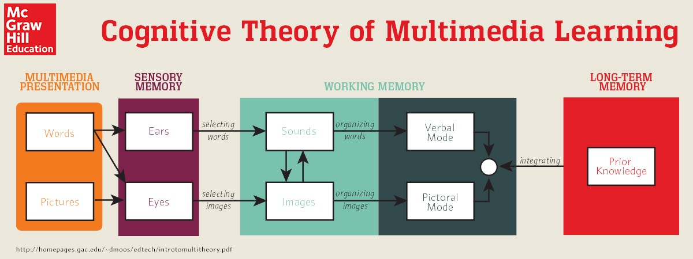
Mayer, R. E. (2003) Cognitive theory of multimedia learning.

Slide 13
Transmission
Principles
Mayer, R. E. (2003) Cognitive theory of multimedia learning.

Slide 14
Integration
Principles
Mayer, R. E. (2003) Cognitive theory of multimedia learning.

Slide 15
Transmission
Principles
Integration
Principles
Mayer, R. E. (2003) Cognitive theory of multimedia learning.

Slide 16
Transmission
Principles
Integration
Principles
Production Values
DIY vs Professional
Styles
Length
Presence
Cognition
Pedagogy
Overall Design
Individual Tools

Slide 17
Creating Video for Learning - transmission
Production values
Not Hollywood (Johannes 2016)
Different purpose, different audience, different pedagogy
Production values not linked to learning
(Guo et al, 2014; Hansch, et al 2015, Harrison 2019)
Production Values vs engagement/authenticity
Filming Techniques (Crook & Schofield 2017)
cross cutting c/u … affect the connection with the video
depth of field … overbearing presence
jump cut … narrative disruption
scripts … miss the improvisation element
décor … important for video maybe not for lecture

Slide 18
Creating Video for Learning - transmission
Production values
Styles
Scagnoli et al 2015
Studio Recorded
Self recorded
Screen casting
narrated Slides
Chorianopoulos 2019
Teacher centric
Screen centric

Slide 19
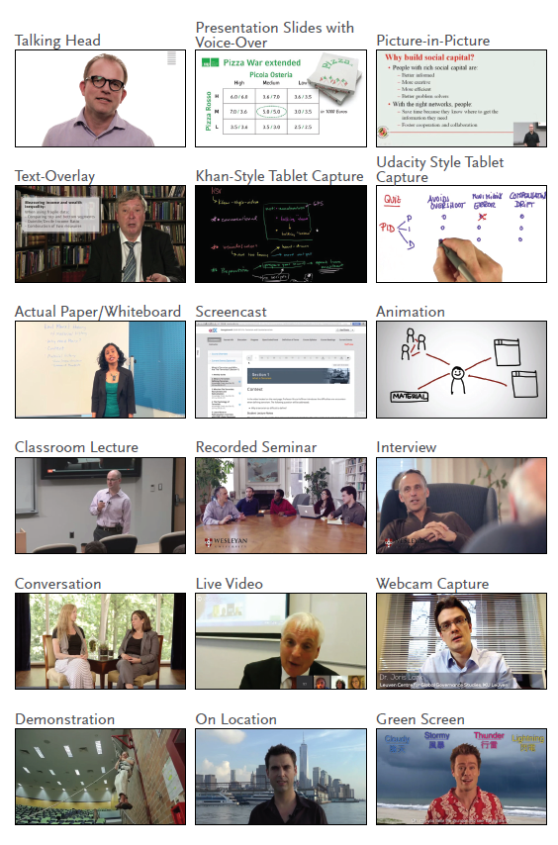
Creating Video for Learning - transmission
Production values
Styles
Hansch 2015

Slide 20
Creating Video for Learning - transmission
Length
Most cited - Guo et al (2014)
sweet spot 6 minutes
but ignores context, audience, presenter
Frydenberg 2008 – bite size chunks
Thomson et al 2014 – function of audience expectations
Harrison 2015 – 5-10 minutes (related to outcomes style etc)
Lagerstom et al 2015 – 12-13 minutes
Leonard 2015 – 5-20
Johnannes 2016 – 5-15
Geri 2017 – 10 minutes
Harrison 2019 – like long for deeper opportunities

Slide 21
Creating Video for Learning - transmission
Presence
a charismatic or compelling speaker
animated, easy to understand . interested in the topic
disliked monotone speakers
speakers who did not look at the camera
or those who appeared nervous.
contain real-life examples
to offer something new
(Leonard, 2015)

Slide 22
Creating Video for Learning - transmission
Presence (or social presence)
Borup 2012
presents teacher as a real person & emotional connection
Lyons 2012
related to learning efficacy and satisfaction
Empirical research
Yi et al 2018
the effect of continuous vs intermittent presence
Pi et al 2020
eye gauze--affect attention and learning
body position does not

Slide 23
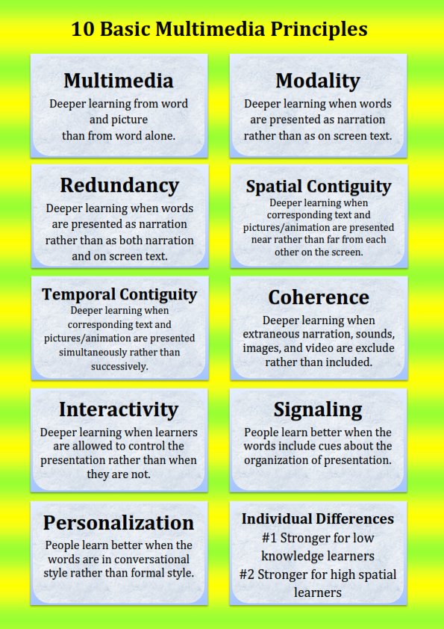
Creating Video for Learning - transmission
Cognitive Load
Clark & Mayer, 2016

Slide 24
Creating Video for Learning - transmission
Cognitive Load
Clark & Mayer, 2016
Van der meij et al 2013
temporal cueing
pausing
Segmenting
Brame 2016
signalling, weeding, matching modality
Student engagement
short, conversational, enthusiastic

Slide 25
Transmission
Principles
Integration
Principles
Production Values
DIY vs Professional
Styles
Length
Presence
Cognition
Pedagogy
Overall Design
Individual Tools

Slide 26
Creating Video for Learning - integration
Pedagogy
Overall Design
Schwartz et al (2007)
Ou et al (2016/19)
Hung et al (2018)
Voronkin (2019)
Koumi (2007)

Slide 27
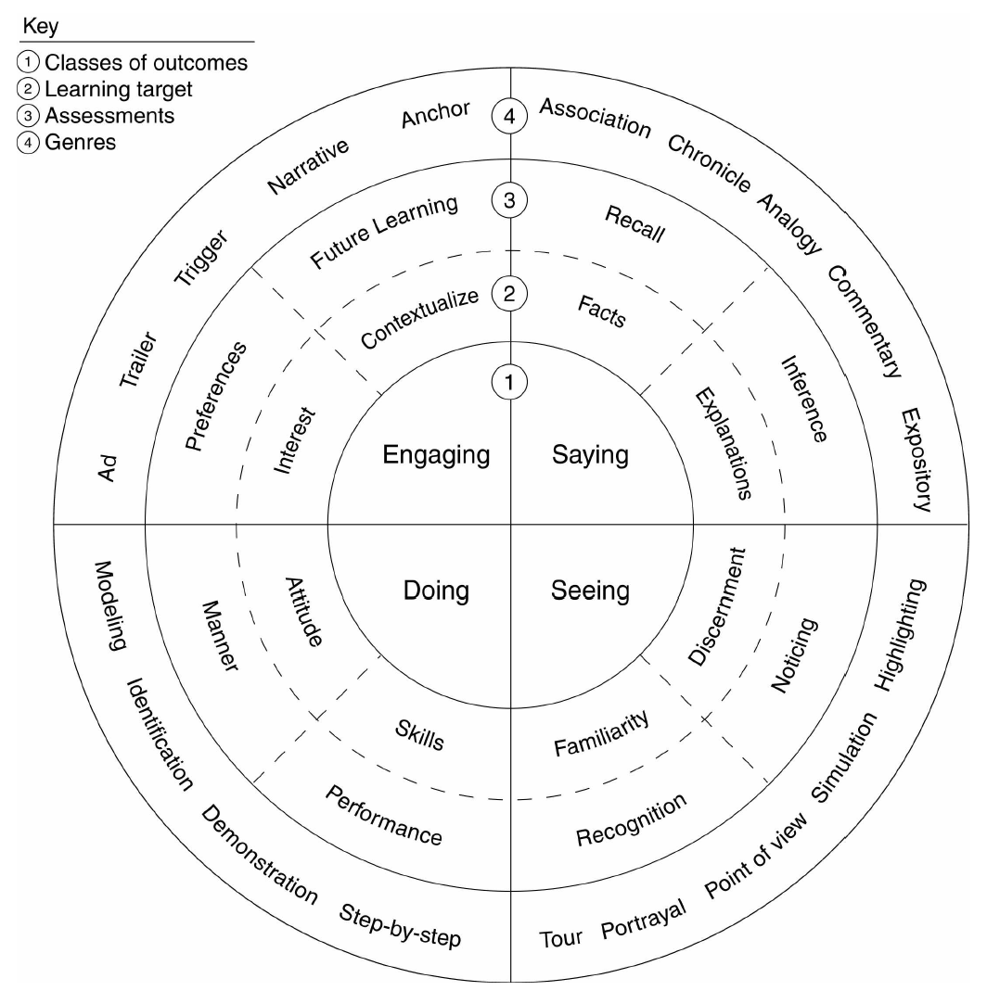
Creating Video for Learning - integration
Schwartz et al (2007)

Slide 28
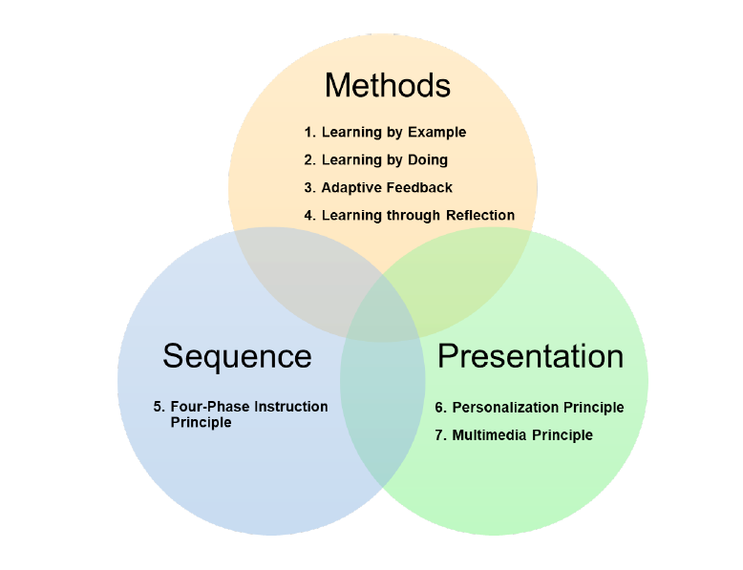
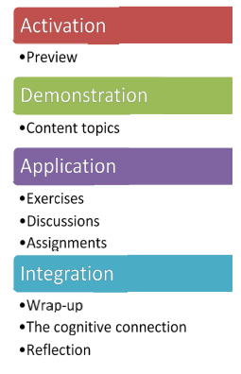
Creating Video for Learning - integration
Ou et al (2016/19)

Slide 29
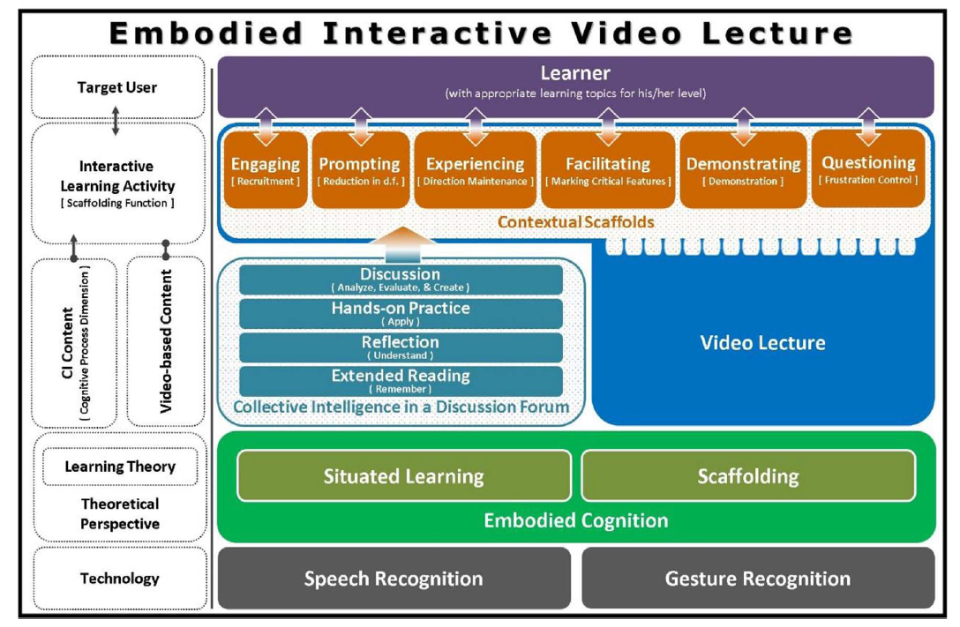
Creating Video for Learning - integration
Hung et al (2018)

Slide 30
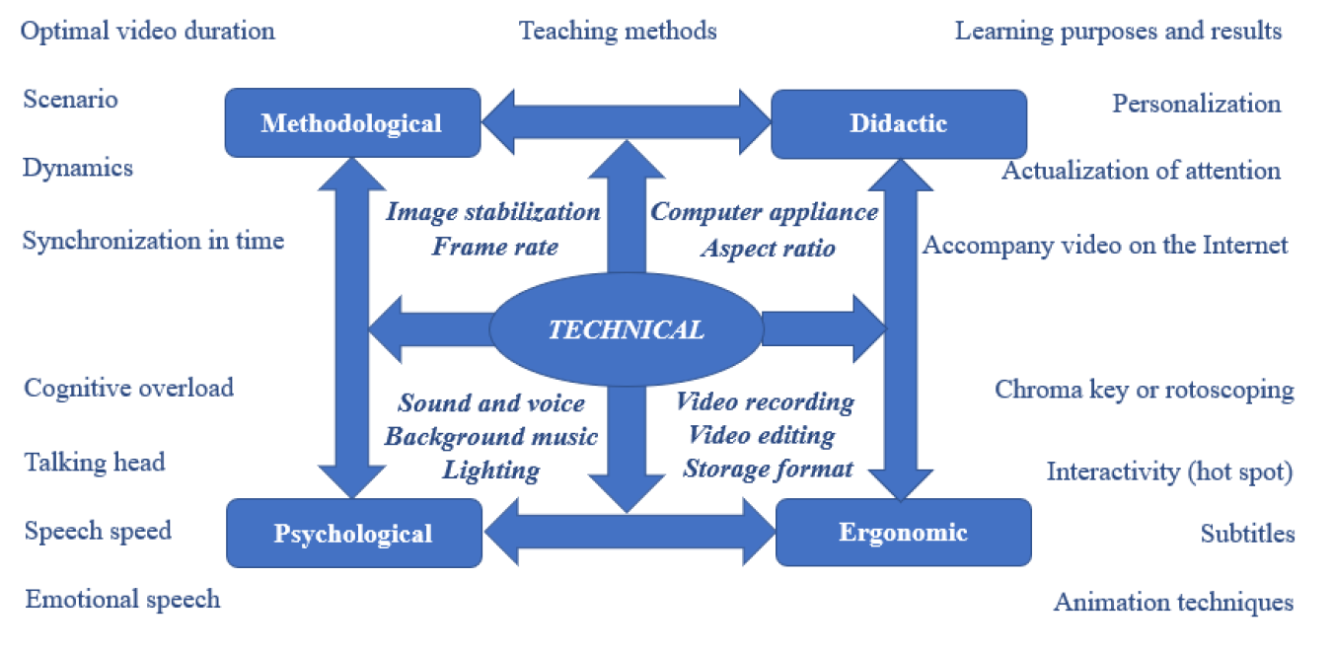
Creating Video for Learning - integration
Voronkin (2019)

Slide 31
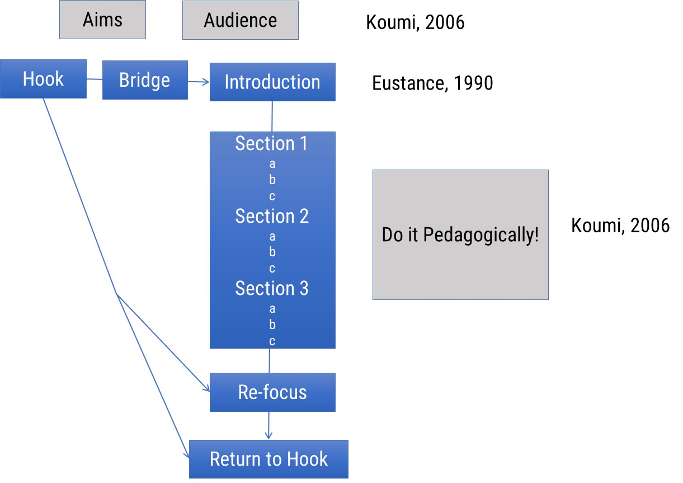
Creating Video for Learning - integration
Koumi (2007)

Slide 32
Creating Video for learning - integration
Individual Tools
Scotto di Carlo (2014)
Analysis of TED talks
Organisation, argument, stance, credibility, engagement
Muller et al (2007)
improving learning with multimedia by including misconceptions

Slide 33
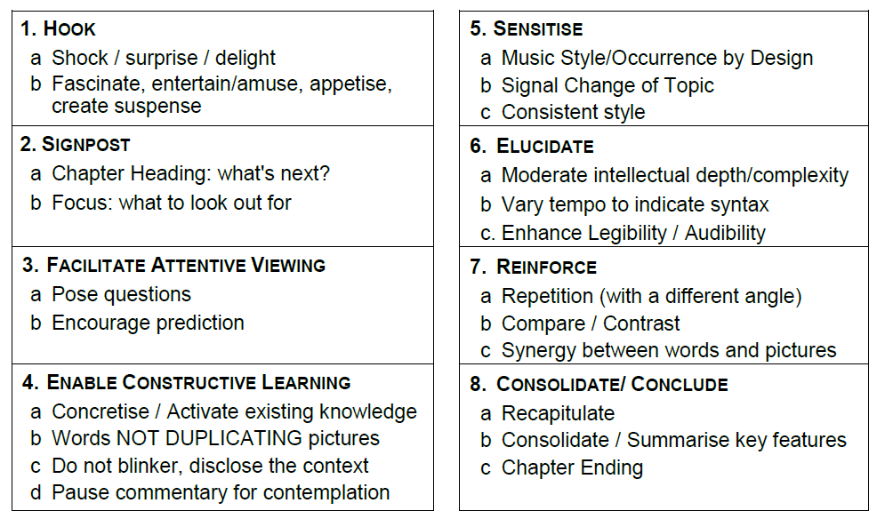
Creating Video for Learning - integration
Koumi (2007)

Slide 34
Abdous, M. H., & Yoshimura, M. (2010). Learner outcomes and satisfaction: A comparison of live video-streamed instruction, satellite broadcast instruction, and face-to-face instruction. Computers & education, 55(2), 733-741.
Andrist, L., Chepp, V., Dean, P., & Miller, M. V. (2014). Toward a video pedagogy: A teaching typology with learning goals. Teaching sociology, 42(3), 196-206.
Bakkay, M. C., Pizenberg, M., Carlier, A., Balavoine, E., Morin, G., & Charvillat, V. (2019). Protocols and software for simplified educational video capture and editing. Journal of Computers in Education, 6(2), 257-276.
Beheshti,M., Taspolat, A., Kaya, S.O. & Sapanca, F. H. (2018). Characteristics of instructional videos. World Journal on Educational Technology: Current Issues. 10(1), 061-069
Berg, R., Brand, A., Grant, J., Kirk, J., & Zimmermann, T. (2014). Leveraging recorded mini-lectures to increase student learning. Online Classroom, 14(2), 5-8.
Berk, R. A. (2009). Multimedia teaching with video clips: TV, movies, YouTube, and mtvU in the college classroom. International Journal of Technology in Teaching & Learning, 5(1).
Bianchi, L. J. (2019). The Role of Graphics in Video Lectures (Master's thesis, University of Waterloo).
Bolliger, D. U., Supanakorn, S., & Boggs, C. (2010). Impact of podcasting on student motivation in the online learning environment. Computers & Education, 55(2), 714-722.
Borup, J., West, R. E., & Graham, C. R. (2012). Improving online social presence through asynchronous video. The Internet and Higher Education, 15(3), 195-203.
Borup, J., West, R. E., & Graham, C. R. (2013). The influence of asynchronous video communication on learner social presence: a narrative analysis of four cases. Distance Education, 34(1), 48-63.
Brame, C. J. (2016). Effective educational videos: Principles and guidelines for maximizing student learning from video content. CBE—Life Sciences Education, 15(4), es6.
Brittain, S., Glowacki, P., Van Ittersum, J., & Johnson, L. (2006). Podcasting lectures. Educause quarterly, 3(24), 10.
Carmichael, M., Reid, A., & Karpicke, J. D. (2018). Assessing the impact of educational video on student engagement, critical thinking and learning: The current state of play. white paper, Sage Publishing, available at: https://au. sagepub. com/en-gb/oce/press/what-impact-does-video-have-on-student-engagement (accessed 6 June 2018).

Slide 35
Chester, A., Buntine, A., Hammond, K., & Atkinson, L. (2011). Podcasting in education: Student attitudes, behaviour and self-efficacy. Journal of Educational Technology & Society, 14(2), 236-247.
Choe, E. (2017). Optimizing Video for Learning: A Case Study-Based Primer of Informal, Educational, Digital Video Best Practices. Educational, Digital Video Best Practices (May 15, 2017).
Chorianopoulos, K. (2018). A taxonomy of asynchronous instructional video styles. International Review of Research in Open and Distributed Learning, 19(1).
Collier-Reed, B. I., Case, J. M., & Stott, A. (2013). The influence of podcasting on student learning: a case study across two courses. European Journal of Engineering Education, 38(3), 329-339.
Crook, C., & Schofield, L. (2017). The video lecture. The Internet and Higher Education, 34, 56-64.
Cruse, E. (2006). Using educational video in the classroom: Theory, research and practice. Library Video Company, 12(4), 56-80.
Deng, H., Shao, Y., Tang, Y., & Qin, Z. (2014, October). How micro lecture videos trigger the motivation of learners of Coursera: A comparative study based on ARCS mode. In 2014 International Conference of Educational Innovation through Technology (pp. 117-122). IEEE.
Dinmore, S. (2019). Beyond lecture capture: Creating digital video content for online learning–a case study. Journal of University Teaching & Learning Practice, 16(1), 7.
dissertation. Nova Southeastern University. Retrieved from NSUWorks, Graduate School of Computer and Information Sciences."
Evans, C. (2008). The effectiveness of m-learning in the form of podcast revision lectures in higher education. Computers & education, 50(2), 491-498.
Frydenberg, M. (2006, November). Principles and pedagogy: The two P’s of podcasting in the information technology classroom. In Proceedings of ISECON (Vol. 23).
Fyfield, M., Henderson, M., Heinrich, E., & Redmond, P. (2019). Videos in higher education: Making the most of a good thing. Australasian Journal of Educational Technology, 35(5), 1-7.

Slide 36
Geri, N., Winer, A., & Zaks, B. (2017). Challenging the six-minute myth of online video lectures: Can interactivity expand the attention span of learners?. Online Journal of Applied Knowledge Management (OJAKM), 5(1), 101-111.
Guo, P. J., Kim, J., & Rubin, R. (2014, March). How video production affects student engagement: An empirical study of MOOC videos. In Proceedings of the first ACM conference on Learning@ scale conference (pp. 41-50).
Hampe, B. (1999). What video does well in education–and what it doesn’t. Syllabus Magazine, 13, 12-14.
Hansch, A., Hillers, L., McConachie, K., Newman, C., Schildhauer, T., & Schmidt, J. P. (2015). Video and online learning: Critical reflections and findings from the field. HIIG Discussion paper 2015-02.
Harris, H., & Park, S. (2008). Educational usages of podcasting. British Journal of Educational Technology, 39(3), 548.
Harrison, D. J. (2015). Assessing experiences with online educational videos: Converting multiple constructed responses to quantifiable data. International Review of Research in Open and Distributed Learning, 16(1), 168-192.
Harrison, T. (2019). How distance education students perceive the impact of teaching videos on their learning. Open Learning: The Journal of Open, Distance and e-Learning, 1-17.
Heilesen, S. B. (2010). What is the academic efficacy of podcasting?. Computers & Education, 55(3), 1063-1068.
Hibbert, M. C. (2014). What makes an online instructional video compelling? Educause review
Hill, J. L., & Nelson, A. (2011). New technology, new pedagogy? Employing video podcasts in learning and teaching about exotic ecosystems. Environmental Education Research, 17(3), 393-408.
Horvath, J. C. (2014). The neuroscience of PowerPointTM. Mind, Brain, and Education, 8(3), 137-143.
Hung, I. C., & Chen, N. S. (2018). Embodied interactive video lectures for improving learning comprehension and retention. Computers & Education, 117, 116-131.
Johanes, P., & Lagerstrom, L. (2016, June). Online Videos: What every instructor should know. In Proceedings of the 2016 American Society of Engineering Education Annual Conference & Exposition (pp. 26-29).

Slide 37
Jones, T., & Cuthrell, K. (2011). YouTube: Educational potentials and pitfalls. Computers in the Schools, 28(1), 75-85.
Kay, R. H. (2012). Exploring the use of video podcasts in education: A comprehensive review of the literature. Computers in Human Behavior, 28(3), 820-831.
Kizilcec, R. F., Papadopoulos, K., & Sritanyaratana, L. (2014, April). Showing face in video instruction: effects on information retention, visual attention, and affect. In Proceedings of the SIGCHI conference on human factors in computing systems (pp. 2095-2102).
Koumi, J. (2013). Pedagogic design guidelines for multimedia materials: A call for collaboration between practitioners and researchers. Journal of Visual Literacy, 32(2), 85-114.
Koumi, J. (2015). Learning outcomes afforded by self-assessed, segmented video–print combinations. Cogent Education, 2(1), 1045218.
Lagerstrom, L., Johanes, P., & Ponsukcharoen, M. U. (2015, June). The myth of the six-minute rule: Student engagement with online videos. In Proceedings of the American Society for Engineering Education (pp. 14-17).
Lamb. R. (2015). A Makeover for the Captured Lecture: Applying Multimedia Learning Principles to Lecture Video. Doctoral
Leonard, E. (2015). Great expectations: Students and video in higher education. Sage white paper. Retrieved November 25, 2016.
Lin, S., Zimmer, J. C., & Lee, V. (2013). Podcasting acceptance on campus: The differing perspectives of teachers and students. Computers & Education, 68, 416-428.
Lyons, A., Reysen, S., & Pierce, L. (2012). Video lecture format, student technological efficacy, and social presence in online courses. Computers in Human Behavior, 28(1), 181-186.
Mayer, R. E., & Estrella, G. (2014). Benefits of emotional design in multimedia instruction. Learning and Instruction, 33, 12-18.
McGarr, O. (2009). A review of podcasting in higher education: Its influence on the traditional lecture. Australasian journal of educational technology, 25(3).
Mitra, B., Lewin‐Jones, J., Barrett, H., & Williamson, S. (2010). The use of video to enable deep learning. Research in Post‐Compulsory Education, 15(4), 405-414.

Slide 38
Moussiades, L., Kazanidis, I., & Iliopoulou, A. (2016). Developing effective educational videos for blended learning. In Proceedings of the 1st International association for blended learning conference (IABL2016), Kavala, Greece.
Moussiades, L., Kazanidis, I., & Iliopoulou, A. (2019). A framework for the development of educational video: An empirical approach. Innovations in Education and Teaching International, 56(2), 217-228.
O’Bannon, B. W., Lubke, J. K., Beard, J. L., & Britt, V. G. (2011). Using podcasts to replace lecture: Effects on student achievement. Computers & Education, 57(3), 1885-1892.
Ou, C., Goel, A. K., Joyner, D. A., & Haynes, D. F. (2016, April). Designing videos with pedagogical strategies: Online students' perceptions of their effectiveness. In Proceedings of the Third (2016) ACM Conference on Learning@ Scale (pp. 141-144).
Ou, C., Joyner, D. A., & Goel, A. K. (2019). Designing and Developing Video Lessons for Online Learning: A Seven-Principle Model. Online Learning, 23(2), 82-104.
Park, B., Plass, J. L., & Brünken, R. (2014). Cognitive and affective processes in multimedia learning. Learning and Instruction 29 (2014) 125–127
Parson, V., Reddy, P., Wood, J., & Senior, C. (2009). Educating an iPod generation: undergraduate attitudes, experiences and understanding of vodcast and podcast use. Learning, Media and Technology, 34(3), 215-228.
Pegrum, M., Bartle, E., & Longnecker, N. (2015). Can creative podcasting promote deep learning? The use of podcasting for learning content in an undergraduate science unit. British Journal of Educational Technology, 46(1), 142-152.
Pi, Z., Hong, J., & Yang, J. (2017). Does instructor's image size in video lectures affect learning outcomes?. Journal of Computer Assisted Learning, 33(4), 347-354.
Pi, Z., Xu, K., Liu, C., & Yang, J. (2020). Instructor presence in video lectures: Eye gaze matters, but not body orientation. Computers & Education, 144, 103713.
Scagnoli, N. I., McKinney, A., & Moore-Reynen, J. (2015). Video lectures in eLearning. In Handbook of research on innovative technology integration in higher education (pp. 115-134). IGI Global.
Schneider, F. M., Weinmann, C., Roth, F. S., Knop, K., & Vorderer, P. (2016). Learning from entertaining online video clips?Enjoyment and appreciation and their differential relationships with knowledge and behavioral intentions. Computers in Human Behavior, 54, 475-482.

Slide 39
Schwartz, D. L., & Hartman, K. (2007). It is not television anymore: Designing digital video for learning and assessment. Video research in the learning sciences, 335-348.
Scotto di Carlo, G. (2014). The role of proximity in online popularizations: The case of TED talks. Discourse Studies, 16(5), 591-606.
Stephenson, J. E., Brown, C., & Griffin, D. K. (2008). Electronic delivery of lectures in the university environment: An empirical comparison of three delivery styles. Computers & Education, 50(3), 640-651.
Stoerger, S. (2013). Using video to foster presence in an online course. In Enhancing instruction with visual media: Utilizing video and lecture capture (pp. 166-176). IGI Global.
Thomson, A., Bridgstock, R., & Willems, C. (2014). "" Teachers Flipping Out"" beyond the Online Lecture: Maximising the Educational Potential of Video. Journal of Learning Design, 7(3), 67-78."
van der Meij, H., & van der Meij, J. (2013). Eight guidelines for the design of instructional videos for software training. Technical communication, 60(3), 205-228.
Voronkin, O. (2019, June). Educational Video in the University: Instruments, Technologies, Opportunities and Restrictions. In ICTERI (pp. 302-317).

