Slide 1
LESSON OBJECTIVES: - Understand how different sources can be cross-referenced to find new information about little-known individuals - Be able to analyse two types of maritime source
Discover Maritime History: The Socio-Economic Position of Mariners

Slide 2
SOCIO-ECONOMIC POSITION:
Definition
A measure of a person’s financial and social affluence compared to others in their society, for example, looking at their income, occupation, residency, community engagement etc.

Slide 3
SOURCES!
Most individuals appear in at least some government surveys or assessments
Most of the information in these sources is shallow
But can enrich that information by:
1) Using large quantities of data (like in the database)
2) Cross-referencing multiple sources together

Slide 4
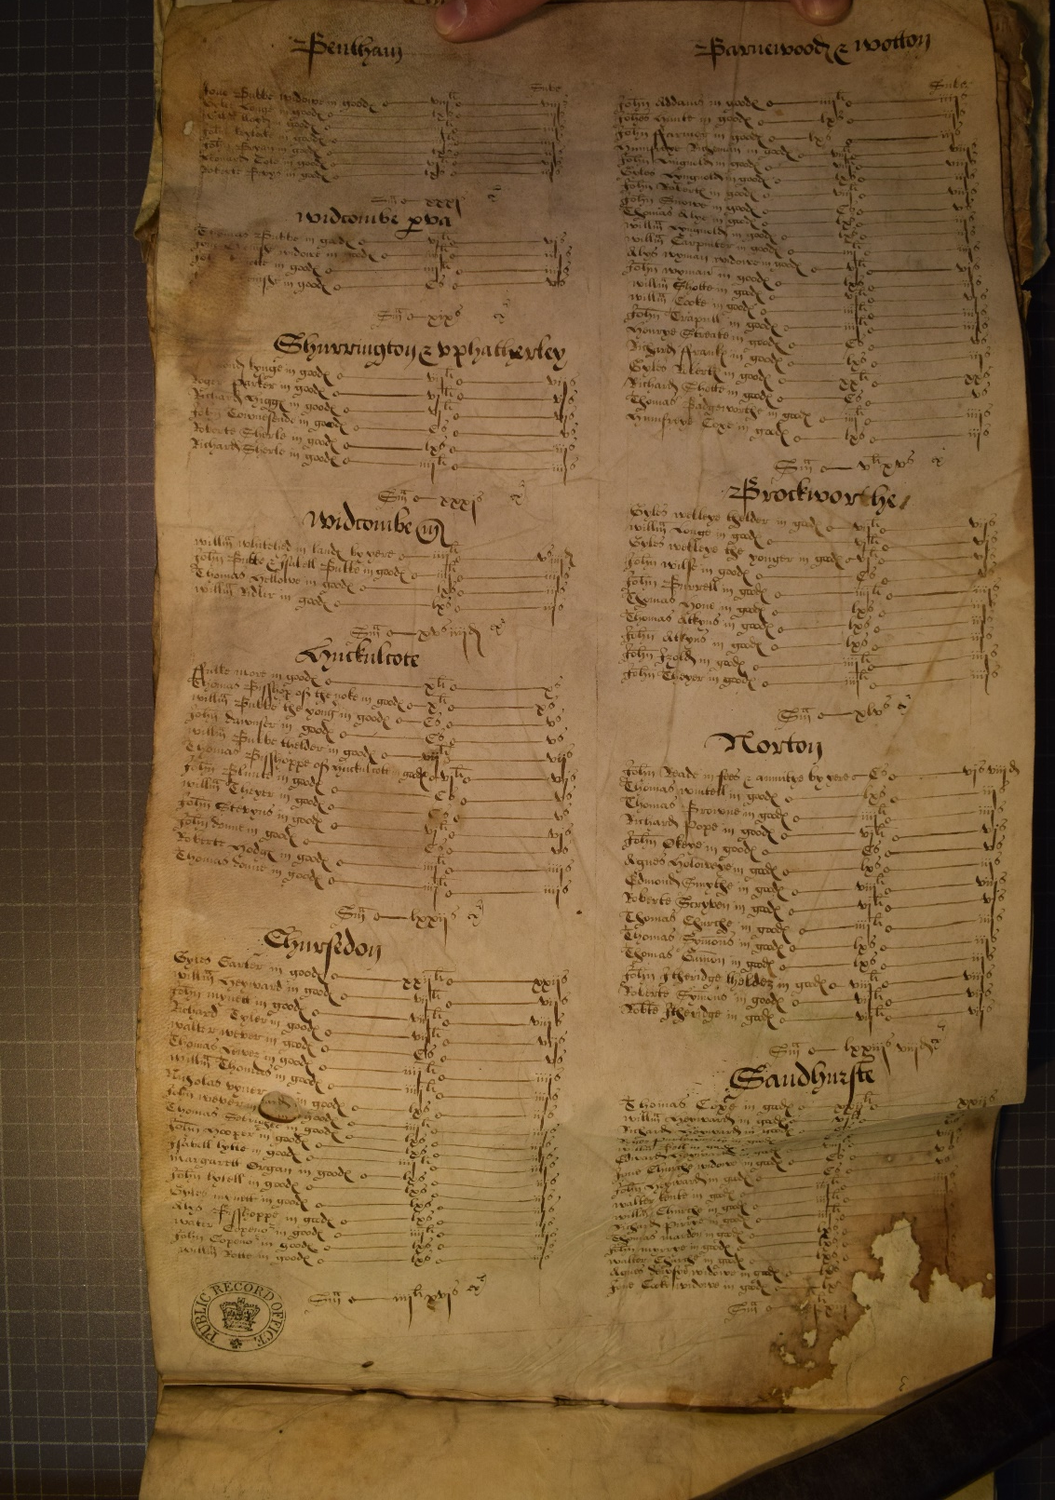
LAY SUBSIDY RETURNS
Tax records that include:
Names of individuals who were rich enough to be taxed
Residencies of those people
Value of their goods or lands
Amount of tax they paid
Photo credit: www.marinelives.org/wiki/MarineLives

Slide 5
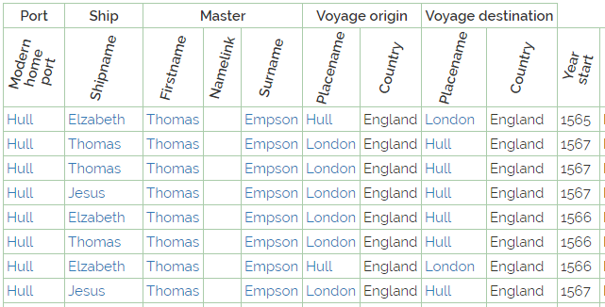
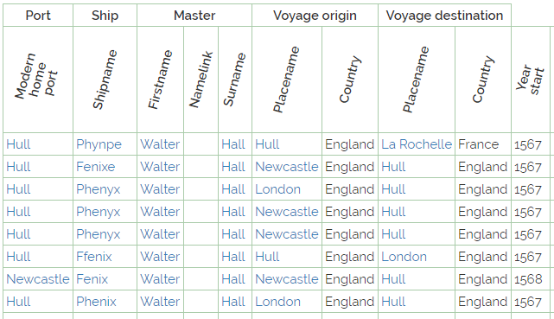

Slide 7
What have we learnt?
What does this data say about the range of individuals that were involved in maritime commerce?
What does this data say about the wealth that could be accumulated through maritime commerce?
What does this data say about the socio-economic position of individuals that traded only within England compared to those that traded overseas?

