Slide 1
LESSON OBJECTIVES: - Be able to list the primary skills needed by a mariner to undertake a voyage - Understand that these skills changed depending on nature of the voyage
Discover Maritime History: Maritime Skills and Navigation

Slide 2
RECAP:
- Saw last week that John Holford had dual-skill to act as fisherman and shipmaster
THIS WEEK:
Will look at what those skills were
And, briefly, how they were aquired

Slide 3
Crew on an Early Modern vessel
Shipmaster – responsible for overseeing all elements of the voyage and making decisions.
Boatswain – oversaw the activities of the mariners, ensuring rigging and sails were correct and also sometimes disciplining the mariners.
Mariner/ “common” seamen – numerous individuals on board who practically sailed the vessel.
Master’s boy – specifically boys (not men) who carried out menial tasks on the ship.

Slide 4
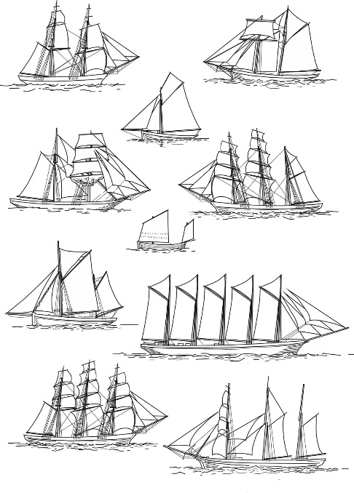
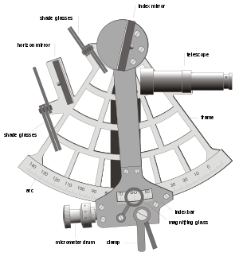
The skills required to command a ship:
Practical sailing skills
Navigation skills
Legal knowledge

Slide 5
The skills required to command a ship:
Shipmaster fully trained and incredibly knowledgeable
Without these skills they would be unhireable & open to breaking law – could end up at HCA
Practical sailing skills
Large ships required particular knowledge and skill – not all shipmasters could command all ships
But all had substantial general knowledge of rigging, course under sail, effective management of a crew etc.
& knew how to respond to crises like storms or taking on water – could effectively command with crew in crisis

Slide 6
The skills required to command a ship:
Some shipmasters had extensive navigation skills and use complex systems involving the stars
Navigation skills

Slide 7
https://youtu.be/Bh5kHTBr0gU

Slide 8
The skills required to command a ship:
But this type of advanced navigation was not needed for every voyage
Some shipmasters had extensive navigation skills and use complex systems involving the stars
Career coastal mariners only had to follow the coastline to stay on track
Navigation skills
However, navigation skills did make shipmasters more hireable, especially later on
And other more basic skills would suffice for short-distance overseas voyages

Slide 9
The skills required to command a ship:
Might also need to make a decision about punishing crew that broke a rule, sometimes even whether or not to carry out a capital punishment
Specific maritime laws dictated the actions a shipmaster was supposed to take during crisis
Shipmaster would need to be able to make a decision within the law in the heat of a crisis
In these cases, shipmaster would need to have the knowledge and sense to weigh up issuing a punishment against the risk of mutiny
Legal knowledge

Slide 10
Two routes to becoming a shipmaster
Formal apprenticeship
Involved formal training under a skilled master
Intensive and well-rounded training
Expensive = wealthy families only
Fast track to high-paying jobs
Progression through the ranks
Had to start at the bottom (usually as a master’s boy or very low-paid crew)
Informal training – no guarantee of skill/knowledge acquisition & no guarantee of work
Dominated by poorer families that could not afford proper apprenticeship

