Slide 1
LESSON OBJECTIVE: - Understand how modern technology can help to expand historical research
Discover Maritime History: New Developments

Slide 2
Historiography
The study of the way history has been and is written – the history of historical writing
A document or artefact created during the time period you are examining
Primary sources

Slide 3
High Court Admiralty records
1
Customs records
2
Works of Richard Hakluyt
3

Slide 4
Common limitations of early historical research

Slide 5
Common limitations of early historical research
Sources very complicated and contain a lot of information= historians have to sample

Slide 6
Common limitations of early historical research
Sources very complicated and contain a lot of information= historians have to sample
Sample often the richest, most powerful, most socially important

Slide 7
Common limitations of early historical research
Sources very complicated and contain a lot of information= historians have to sample
Sample often the richest, most powerful, most socially important
= those who were less wealthy or that belonged to minority groups were overlooked

Slide 8
Recent maritime historians have tried to overcome this limitation by looking at:
Seafarers and merchants of low wealth and low social standing
Women involved in maritime commerce
Non-white and non-Christian people involved in maritime commerce

Slide 9
Recent maritime historians have tried to overcome this limitation by looking at:
Seafarers and merchants of low wealth and low social standing
Women involved in maritime commerce
Non-white and non-Christian people involved in maritime commerce
SOURCES?
SOURCES?

Slide 10
In pairs:
Write down some reasons you think we lack primary sources for minority or marginalised groups

Slide 11
Why do we lack sources for these groups?
Relatively low literacy rates
Writing tools very expensive
Rarely appeared in government documents because not involved in (or excluded from) politics
Chroniclers like Hakluyt most interested in exception, not the norm
Or – in some cases – were excluded due to societally engrained racism, xenophobia and misogyny

Slide 12
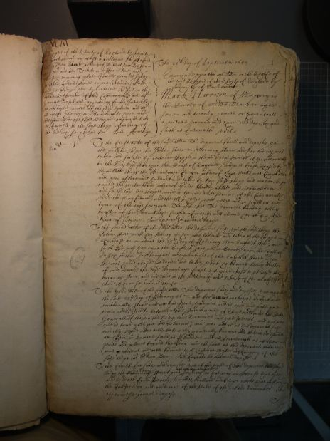
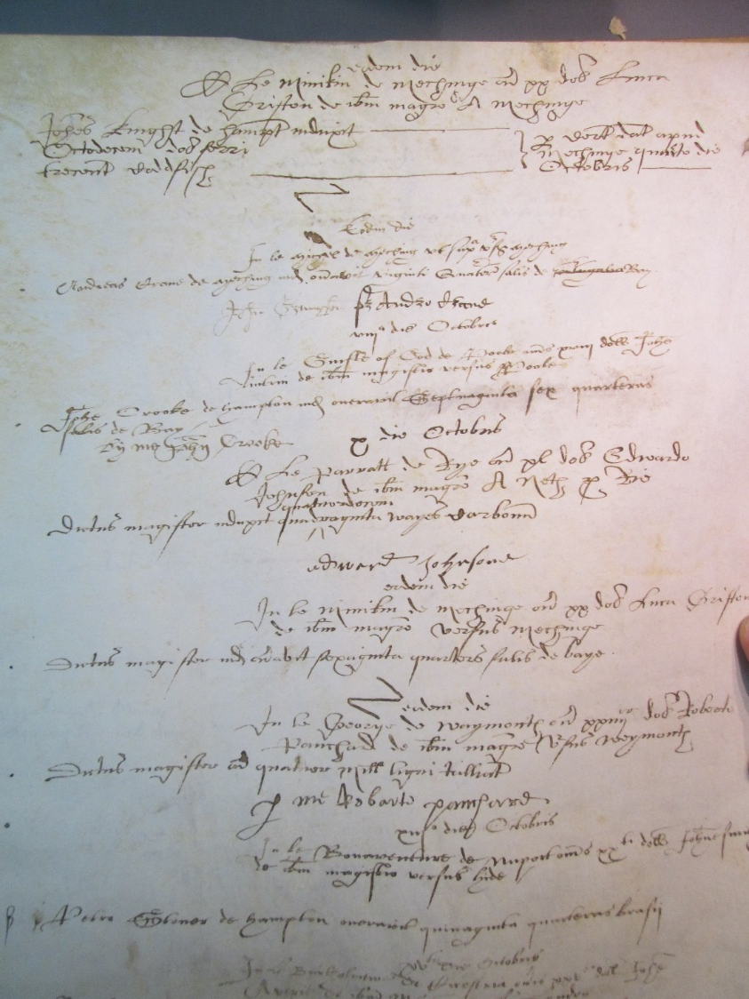
We have to re-think the records that do exist

Slide 13
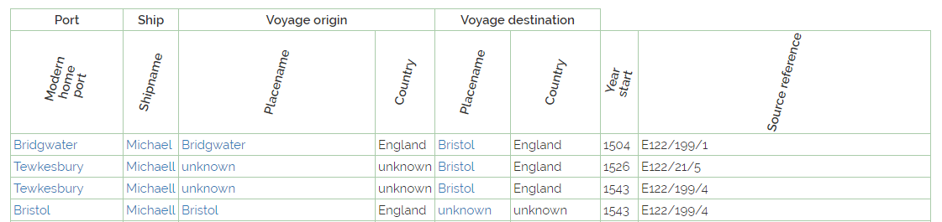
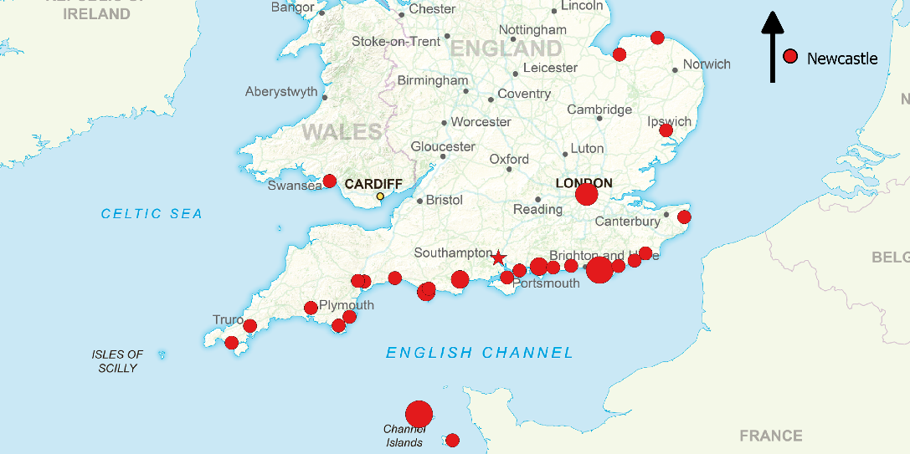

Slide 14
ACTIVITY
Medieval and Tudor Ships Database…
http://medievalandtudorships.org/search_advanced/

Slide 15
What have we learnt?
• What can this data add to our understanding of how John Holford ran his business?
• What does this suggest about his position in the town?
• What does this data tell us about how individuals engaged in coastal commerce?

