Slide 1
LESSON OBJECTIVES: - Be able to explain what “historiography” means - Identify key types of primary sources - Understand the benefits and pitfalls of different types of primary sources
Discover Maritime History: Historiography and Traditional Methods

Slide 2
HISTORIOGRAPHY:
“The study of the way history has been and is written – the history of historical writing"

Slide 3
What is a “primary source”?

Slide 4
What is a “primary source”?
A primary source is a document or artefact created during the time period you are examining

Slide 5
What is a “primary source”?
A primary source is a document or artefact created during the time period you are examining
- A primary source provides a first hand account about a historical topic

Slide 6
What is a “primary source”?
A primary source is a document or artefact created during the time period you are examining
- A primary source provides a first hand account about a historical topic
A primary source is not a historian’s interpretation of a historical topic

Slide 7
Types of primary source
Visual/ audible /tangible
Written - official
Written - personal
Written - literary

Slide 8
Types of primary source
Visual/ audible /tangible
Written - official
Photographs
Audio recordings and oral histories
Video recordings
Artefacts such as pottery, furniture, personal possessions
Paintings
Clothing, costumes
Government publications
Civic records such as house deeds, tax records, records of civic organisations, groups or companies
Government speeches
Public opinion polls
Newspapers, magazines
Written - personal
Written - literary
Diaries
Autobiographies
Journals
Letters
Scrapbooks
Films
Books
Television shows
Websites
Social media

Slide 9
Primary sources in English maritime history…

Slide 10
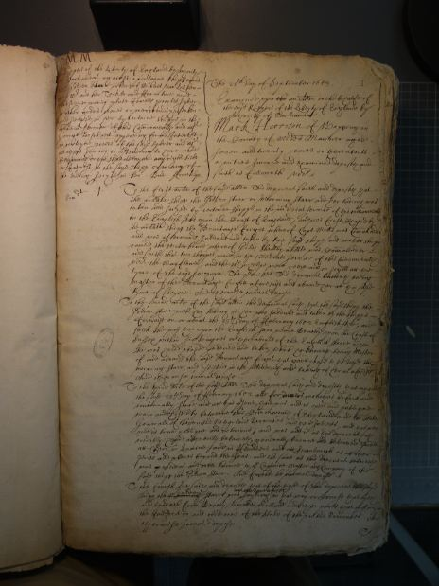
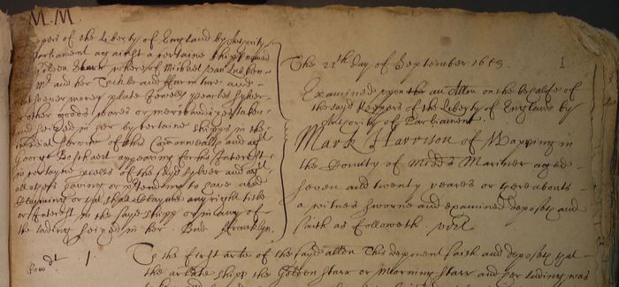
1. Records of the High Court Admiralty
Photo credit: www.marinelives.org/wiki/MarineLives

Slide 11
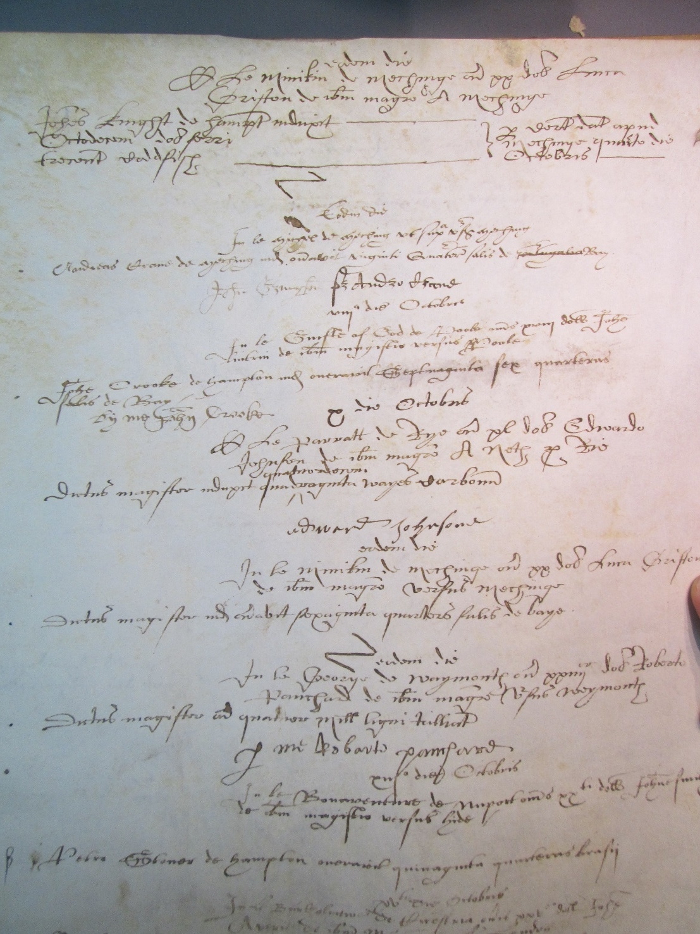
2. Customs records
Photo credit: www.medievalandtudorships.org

Slide 12
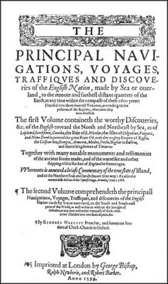
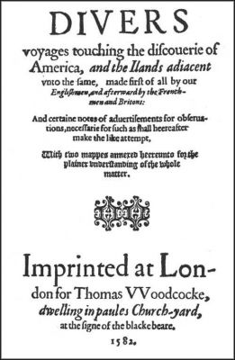
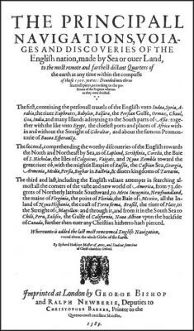
3. Works of Richard Hakluyt
Photo credit: www.hakluyt.com

Slide 13
Activity:
On your hand out, note what might be good and bad about these sources in terms of what they can tell us about English maritime history.
Hint: Think about what details they do contain, what details they are lacking, and think about the practical concerns of working with documents like this.

Slide 14
1. Records of the High Court Admiralty
PROS
Very detailed, contain lots of information about life at sea, how seafaring was undertaken, culture on ships, commercial trends etc.
Can see how seafarers settled disputes and the role of the government in ensuring lawful seafaring
CONS
Very difficult to work with – difficult to read, very long and descriptive, very time consuming!
Therefore, can only realistically sample small sections
Only see the disputes, not normal activity, so limited to rare occasions when disputes were bad enough to refer to the HCA

Slide 15
2. Customs records
PROS
Contain very detailed information about commercial activity, ships used, men involved in maritime trade, taxes paid, inner-workings of maritime commerce
Should include details of all voyages undertaken and therefore provide a full image of trade
CONS
Recorded all trade across whole country = literally millions of individual voyages recorded = very time consuming
Therefore usually only a small sample can be used
Could be open to manipulation by corrupt officials and so do not include smuggled goods

Slide 16
3. Works of Richard Hakluyt
PROS
Provide more details of life on board vessels than the other sources, including first-hand experiences (generally more social than commercial in nature)
Provide us information about the political environment and political disputes involving seafaring
Printed so easy to work with
CONS
Written to be entertaining/interesting = could have exaggerated or misrepresented stories of merchants and explorers
He had a clear political agenda – he wanted the authorities to read his works and implement his policies – therefore skewed towards his ideas and beliefs, not necessarily 100% truthful

Slide 17
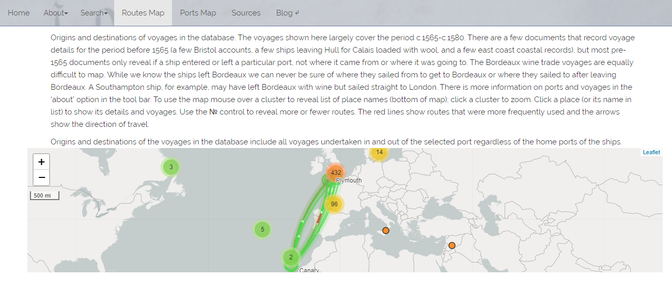
Next week: modern technology and history

