Slide 1
LESSON OBJECTIVES: - Understand that the nature of trade and commerce changed over time - Understand how commercial trends link to English expansion discussed in lesson 1
Discover Maritime History: Trade and Commerce in Early Modern England

Slide 2
Naval requisition of merchant ships
Voyages of discovery
1
2
Privateering
Establishment of East India Company
3
4

Slide 3
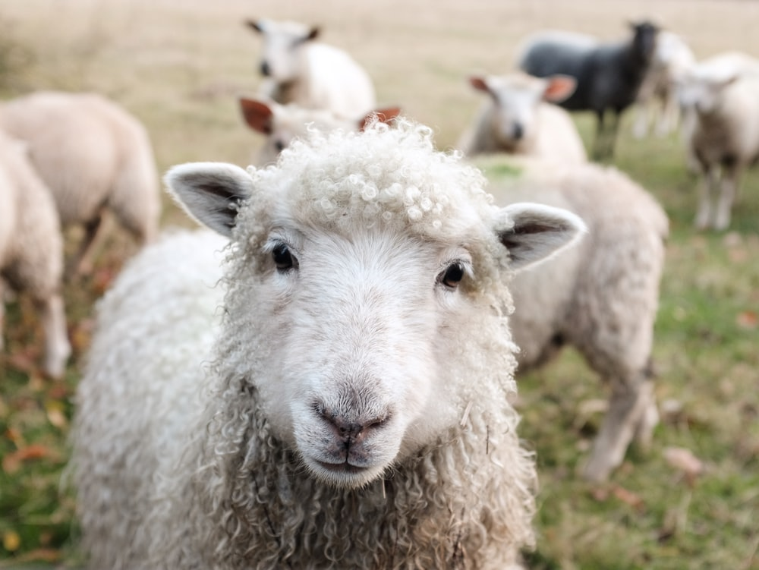
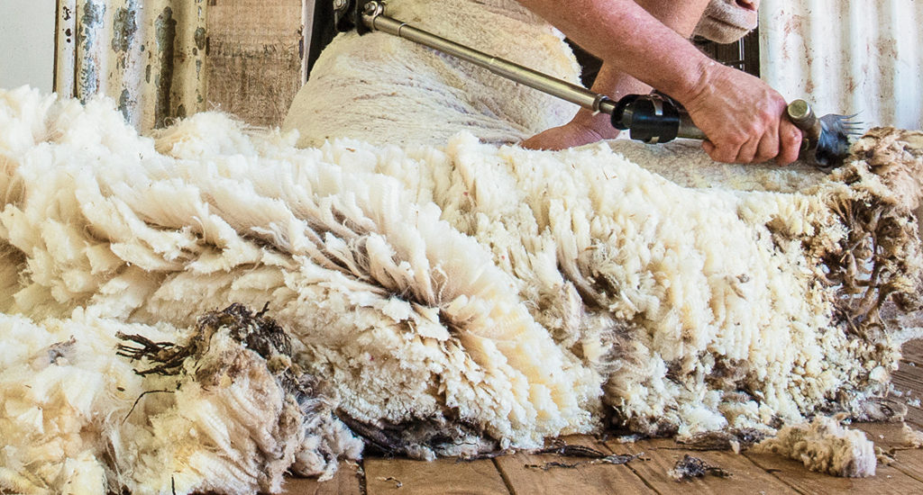
MEDIEVAL ENGLAND

Slide 4
MEDIEVAL ENGLAND
1520s – 1550s

Slide 5
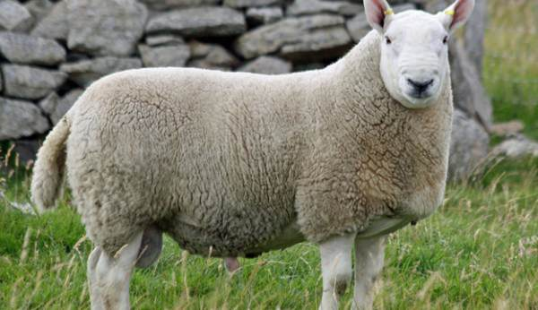
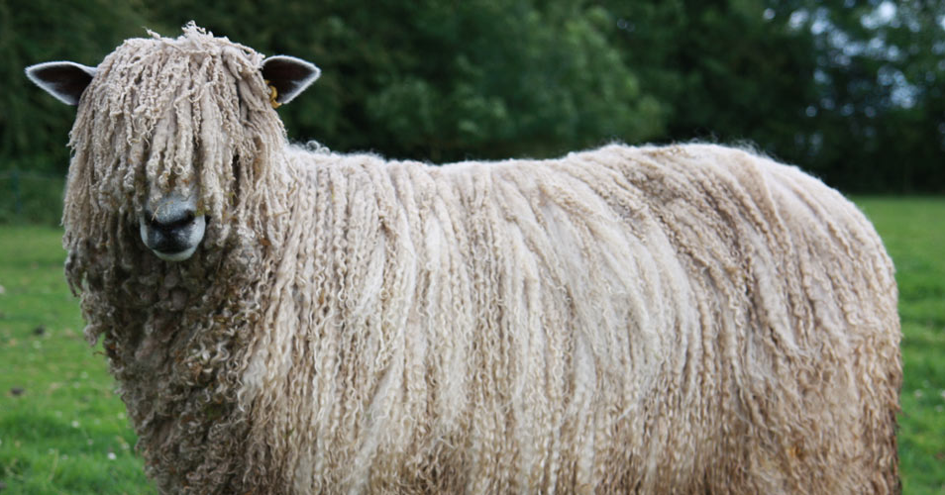
1520s – 1550s
>1550

Slide 6
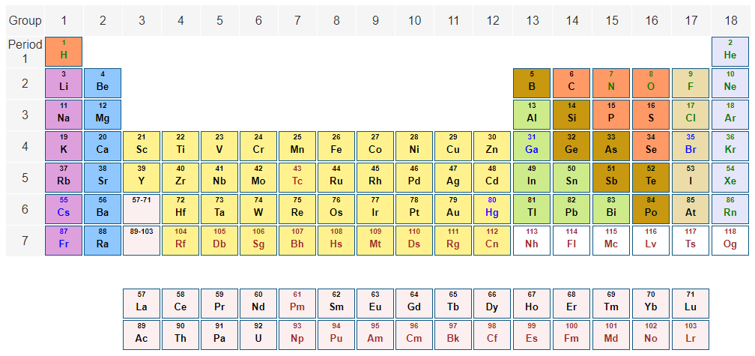
England also exported tin (from Cornwall) and lead throughout, but less important than wool and cloth

Slide 7
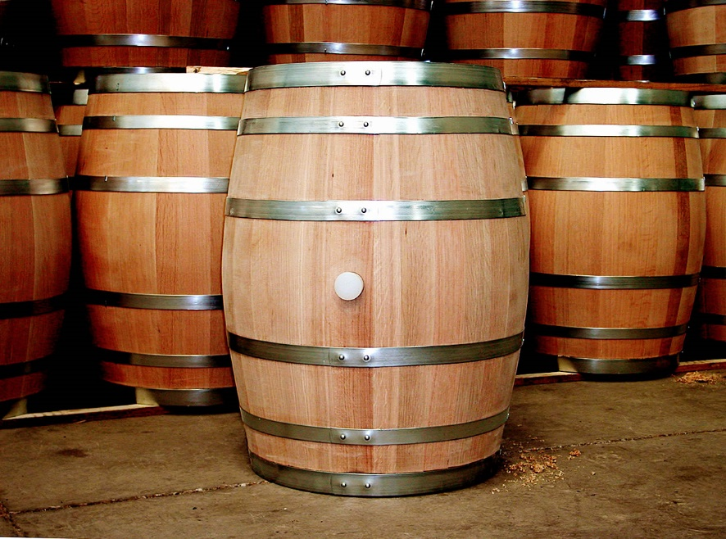
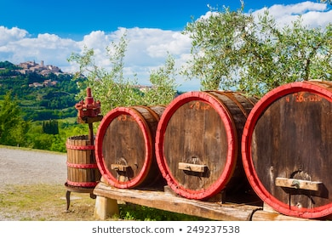
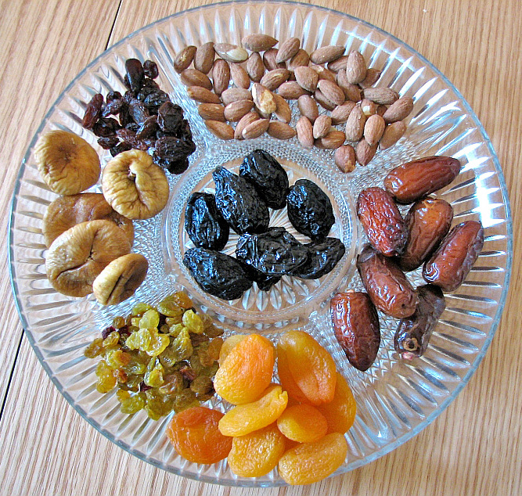
England’s traditional imports were mostly wine, dried fruits, olive oil, silver, iron

Slide 8
In pairs:
Considering what you’ve just learnt – can you predict what these vessels may have been carrying?
SHIP | VOYAGE START | VOYAGE END | YEAR
SHIP | VOYAGE START | VOYAGE END | YEAR
SHIP | VOYAGE START | VOYAGE END | YEAR

Slide 9
In pairs:
Considering what you’ve just learnt – can you predict what these vessels may have been carrying?
SHIP | VOYAGE START | VOYAGE END | YEAR
Possible cargo: cloth or wool
SHIP | VOYAGE START | VOYAGE END | YEAR
SHIP | VOYAGE START | VOYAGE END | YEAR

Slide 10
In pairs:
Considering what you’ve just learnt – can you predict what these vessels may have been carrying?
SHIP | VOYAGE START | VOYAGE END | YEAR
Possible cargo: cloth or wool
SHIP | VOYAGE START | VOYAGE END | YEAR
Possible cargo: Cornish tin
SHIP | VOYAGE START | VOYAGE END | YEAR

Slide 11
In pairs:
Considering what you’ve just learnt – can you predict what these vessels may have been carrying?
SHIP | VOYAGE START | VOYAGE END | YEAR
Possible cargo: cloth or wool
SHIP | VOYAGE START | VOYAGE END | YEAR
Possible cargo: Cornish tin
SHIP | VOYAGE START | VOYAGE END | YEAR
Possible cargo: wine, dried fruit

Slide 12
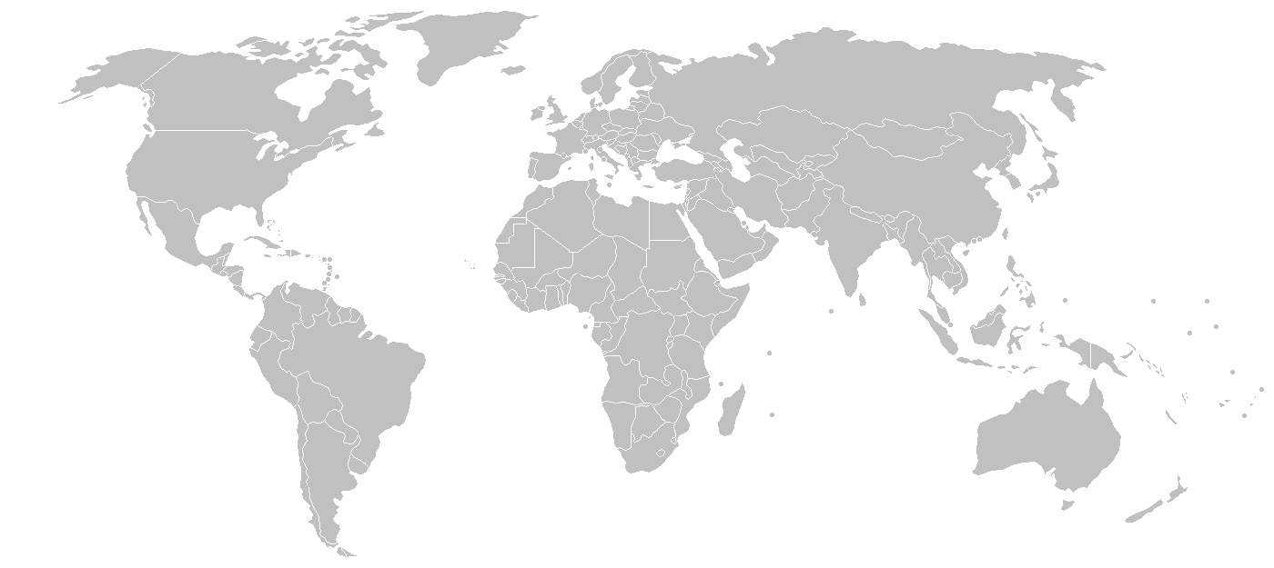
New markets

Slide 13
New markets
Tobacco
Sugar

Slide 14
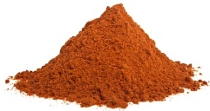
New markets
Textiles
Tea
Tobacco
Spices
Sugar

Slide 15
WHY DOES THIS MATTER?
Expansion into new territories = wealth, global political power, eventually British Empire
But traditional maritime markets important backdrop & allowed that expansion to happen
= all commercial maritime activity important in understanding broader historical trends

Slide 16
RECAP:
What have we learnt?

