Slide 1
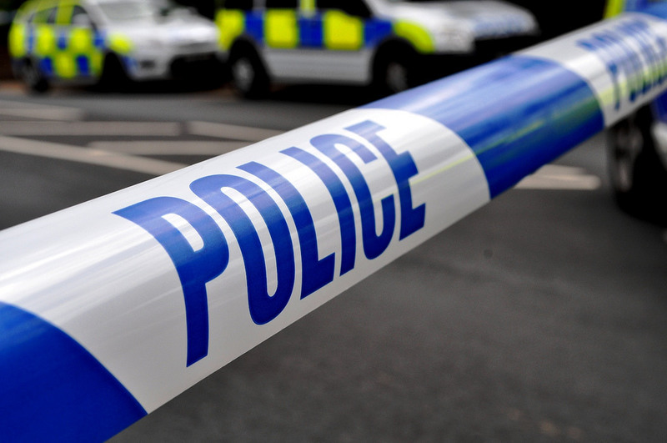
Forensic Lab 3
Document analysis
Notes:
https://www.flickr.com/photos/94418464@N08
http://www.ureveal.com/governmental/

Slide 2
The crime scene
The Forensic team found a map of the hospital crumpled up on the floor. They believe it was used by the burglar as the Chief Executive’s Office has been marked on it.
Initial tests carried out on the paper indicate it was printed on a laser printer.

Slide 3
The Laser printer
Laser printers work in a similar way to traditional photocopiers except manufacturers have built in a special feature that many people do not know about.
This feature has been added to try and stop counterfeiting by criminals.

Slide 4
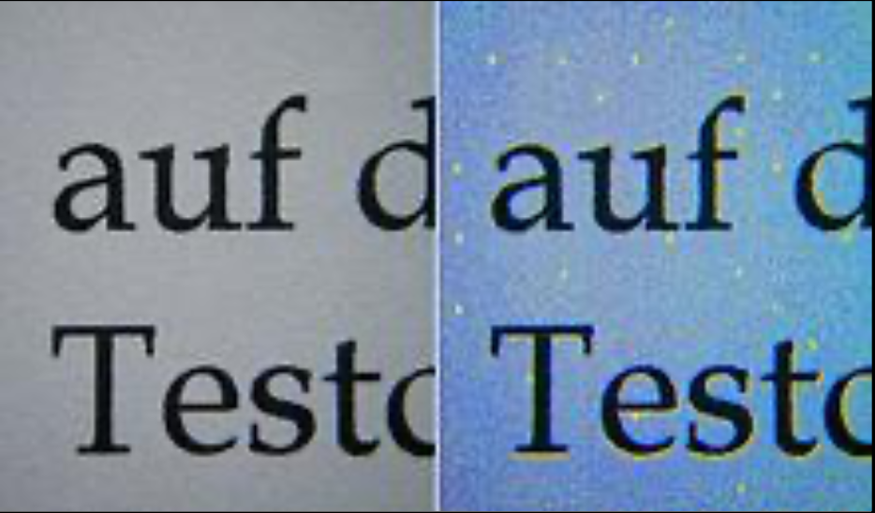
Yellow dots
Most laser printers print an invisible tracking code on the paper being printed. The code is formed from a series of yellow dots which are hidden in colour printing.
These codes are unique to every printer, rather like a fingerprint, and can provide information on the exact machine that was used.
Notes:
http://www.instructables.com/id/Yellow-Dots-of-Mystery-Is-Your-Printer-Spying-on-/

Slide 5
Hidden in Plain Sight
Yellow dot maps are just one way of hiding messages in plain sight, or steganography. Historically people have used similar methods to pass information to each other concealed in seemingly harmless messages.
During WWII Allies intercepted an envelope sent by German spies in Mexico City to Lisbon. The spies had taped a series of tiny dots inside the envelope, hiding a secret memo for their contacts in Lisbon asking for supplies.
Notes:
http://www.instructables.com/id/Yellow-Dots-of-Mystery-Is-Your-Printer-Spying-on-/

Slide 6
Real life crime
Money is the most common things that forgers will
try and counterfeit. One of the most famous
criminal counterfeiters was a man called Albert
Talton who is believed to have printed around $7
million dollars in fake bank notes. This criminal
mastermind even refilled his ink cartridges in a
famous computer store chain.
His gang were only caught because an US Secret
Service agent noticed one of them paying for some
fast food using a fake $20 note.

Slide 7
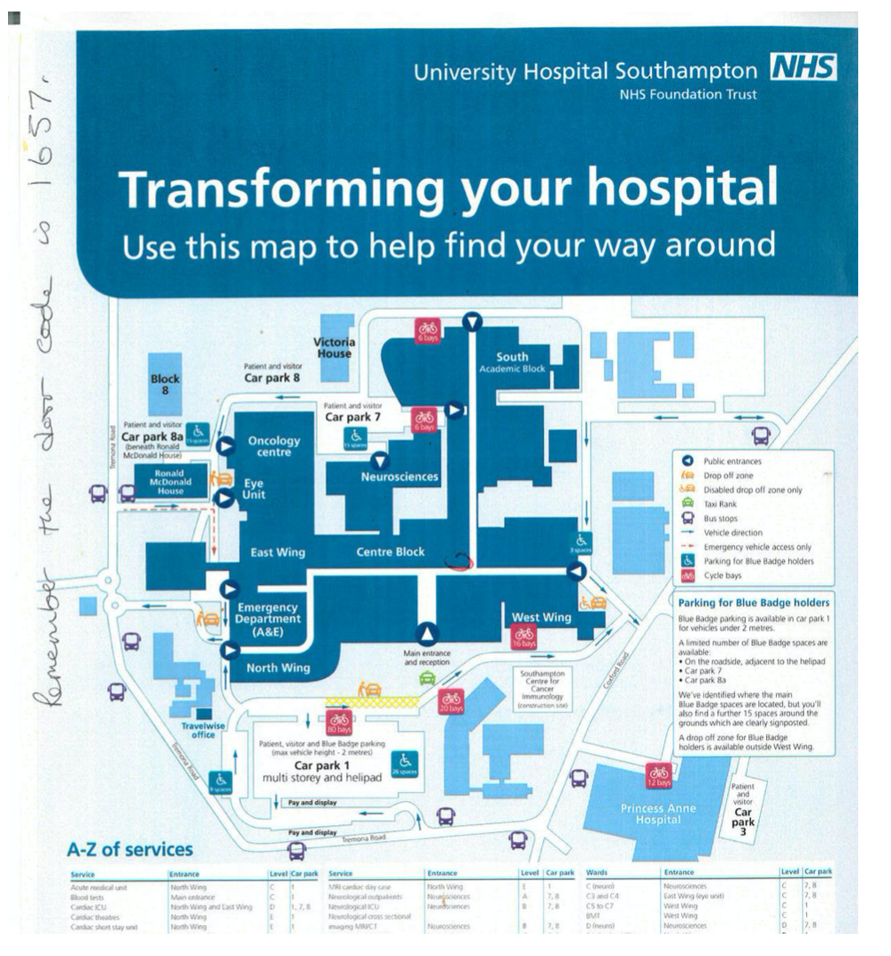
Examine printer samples
The Forensic team want you to examine the map from the crime scene and determine which printer the thief used.

Slide 8
Examine printer samples
7 of the suspects have access to one of four laser printers within the hospital.
The Forensic team have sent printed sample images from each laser printer. These have been scanned using a high resolution microscope in the Biomedical Imaging department of Southampton General Hospital and enhanced so the yellow dots appear black.
Carefully examine them and identify the repeating series of dots which make up the tracking code.

Slide 9
Crime Scene Map
Look at the repeating dot pattern found on the crime scene map. Compare this pattern to the samples from the different printers, and see if you can work out which printer the thief used!

Slide 10
Printer Samples

Slide 11
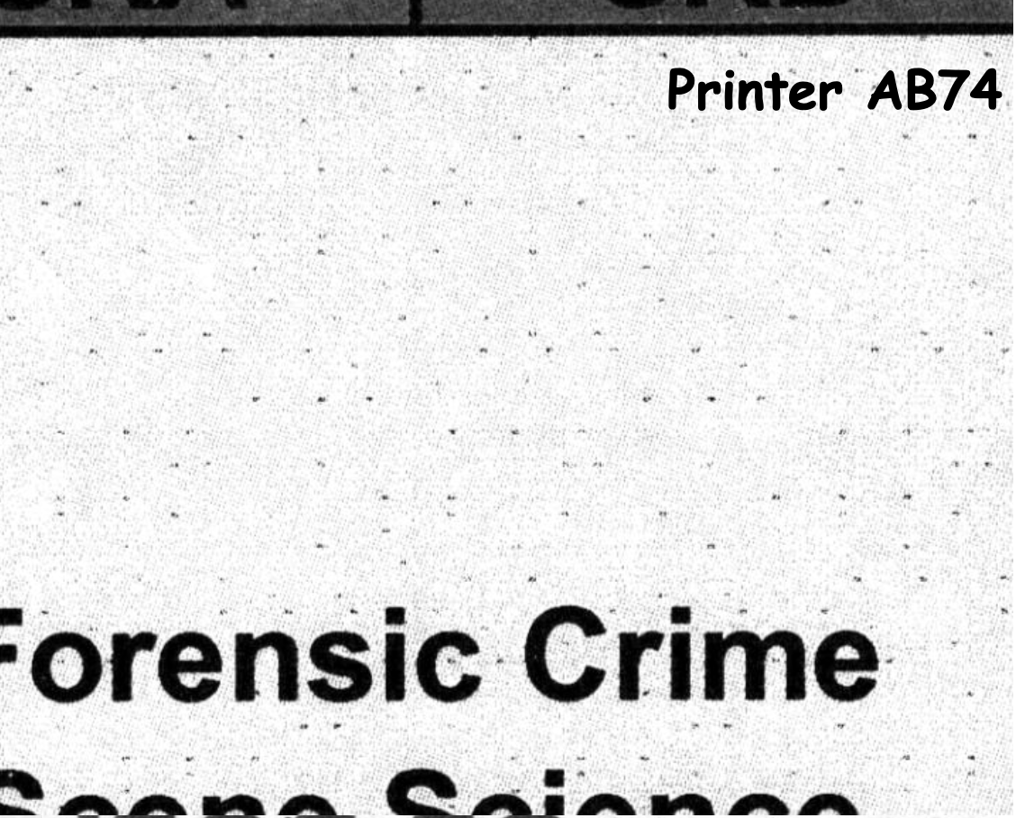
Printer Samples

Slide 12
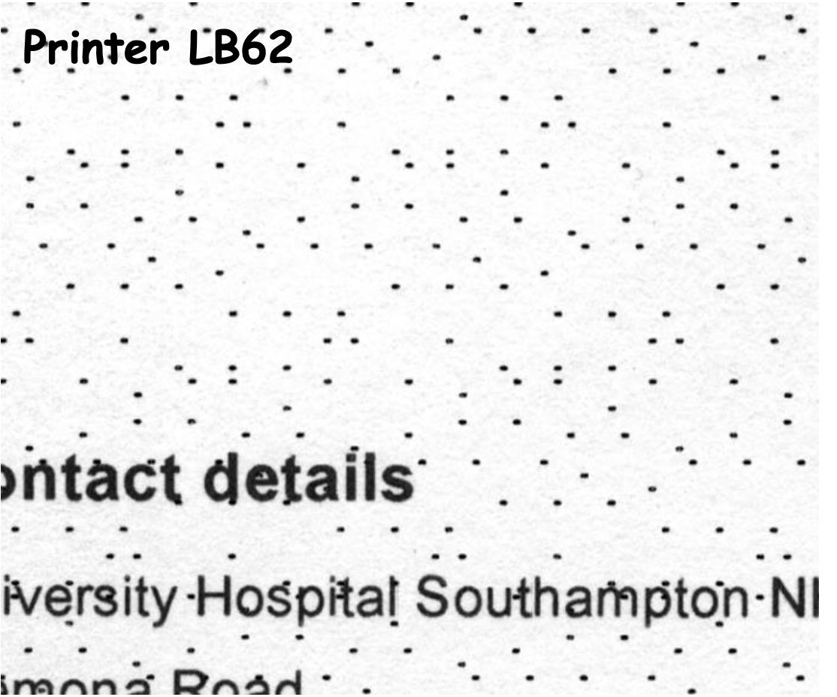
Printer Samples

Slide 13
Printer Samples

Slide 14
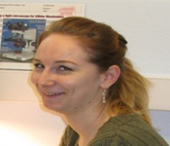
Laser Printer Access
Printer LF57: Suspects A, C and D
Printer LB62: Suspects B, E and F
Printer LB72: Suspect C
Printer AB74: Suspect G
Can you rule out any suspects based on your analysis of the samples and their printer access?

Slide 15
Paper quality
Paper quality can also provide a lot of forensic information. Forensic experts will look for a set of characteristics such as thickness, grammage and moisture content to try and match evidence found at a crime scene with a suspect.
Image source: http://www.leelofland.com/wordpress/2009/06/
Notes:
http://www.leelofland.com/wordpress/2009/06/

Slide 16
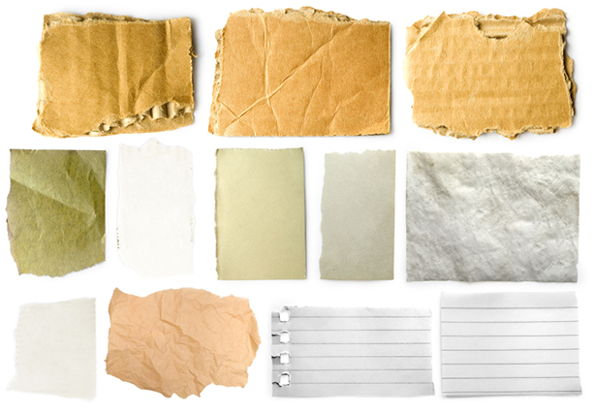
Examples of characteristics
Notes:
https://recyclenation.com/2014/08/understanding-recyclability-of-different-paper-grades/

Slide 17
Real life crime.
In 1983, a German magazine bought and published
some newly discovered diaries written by Adolf
Hitler. They paid £3.7 million and then sold on
the publishing rights to other newspapers such as
The Times.
At the time handwriting experts had looked at
them and agreed that they were written by Hitler.
However further tests revealed that the diaries
had been written on paper which had been
bleached using a chemical not available until 1954.
Hitler killed himself on 30th April 1945

Slide 18
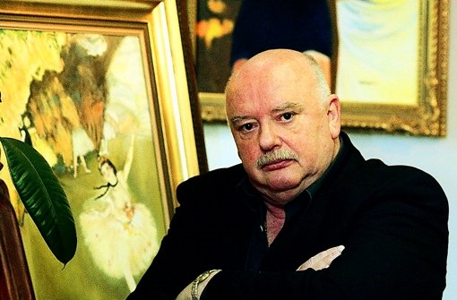
Konrad Kujau
CONVICTED
Image source: https://alchetron.com/Konrad-Kujau-789178-W/
Convicted of fraud
Punishment – 4½ years in prison
Notes:
https://alchetron.com/Konrad-Kujau-789178-W

Slide 19
Crime Scene Map
You now need to investigate the quality of the different papers taken from the printers.
You will need to calculate the quality of each paper sample and compare them with the quality of the paper from the crime scene to help you.

Slide 20
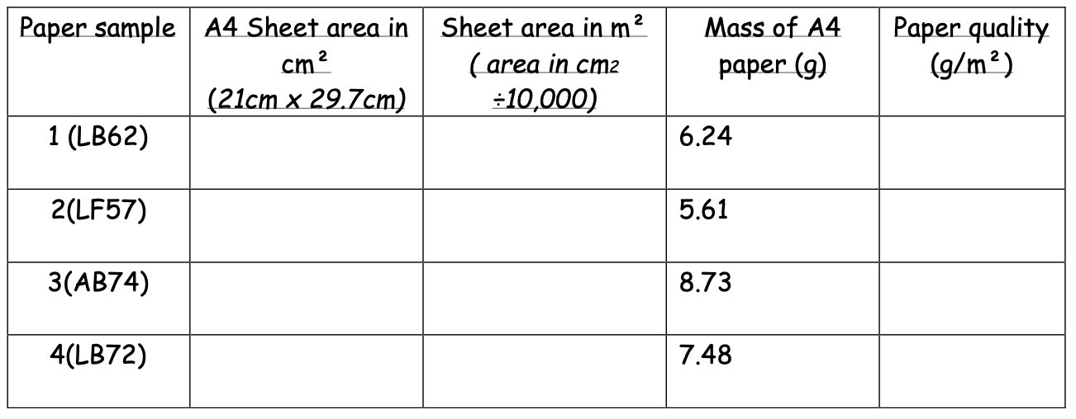
Calculate paper quality
Copy and complete this table. Use the values given to help you calculate the quality of each sample.
The paper used by the criminal was believed to be 100g/m². Compare your calculated values to help determine which printer was used.

Slide 21
Laser Printer Access
Printer LF57: Suspects A, C and D
Printer LB62: Suspects B, E and F
Printer LB72: Suspect C
Printer AB74: Suspect G
Can you rule out any suspects based on your calculations and their printer access?

