Slide 1
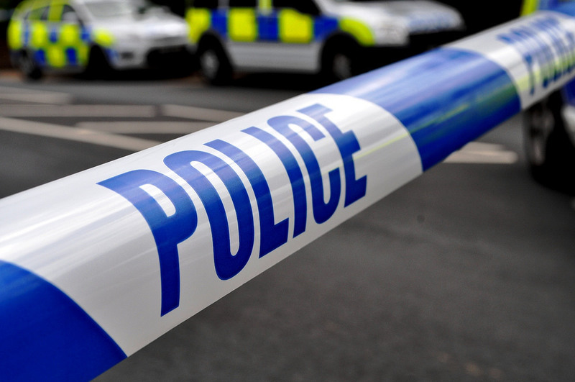
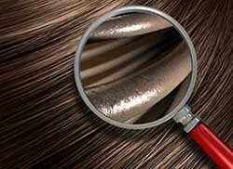
Forensic Lab 2
Fibre analysis
Notes:
https://www.flickr.com/photos/94418464@N08https://
http://www.forensicmag.com/article/2015/04/four-states-auditing-cases-involving-flawed-fbi-hair-analysis

Slide 2
The crime scene
The Forensics team have made a thorough search of the office carpet. The cleaner always comes to dust and vacuum at 6.00pm. Several different fibres were discovered; animal as well as human.
Notes:
http://scienceforwriters.blogspot.co.uk/2015/08/better-low-cost-dna-hair-analysis-for.html#!/2015/08/better-low-cost-dna-hair-analysis-for.html

Slide 3
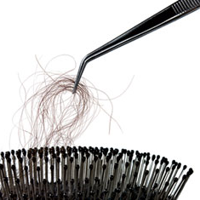
What is classified as a fibre?
A fibre is a thin thread of a natural or man made material.
Fibres are gathered at a crime scene with tweezers, tape, or a vacuum.
They generally come from clothing, curtains, wigs, carpets, furniture, and blankets.
Image Source: http://www.popularmechanics.com
Notes:
http://www.popularmechanics.com/science/health/a4548/4325797

Slide 4
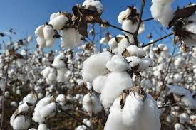
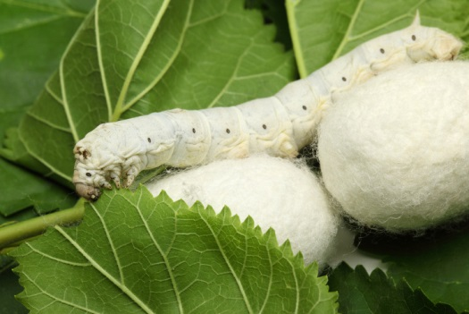
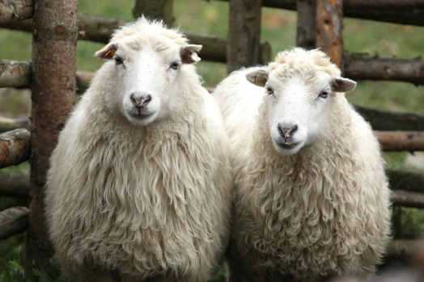
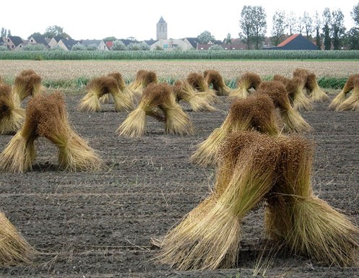
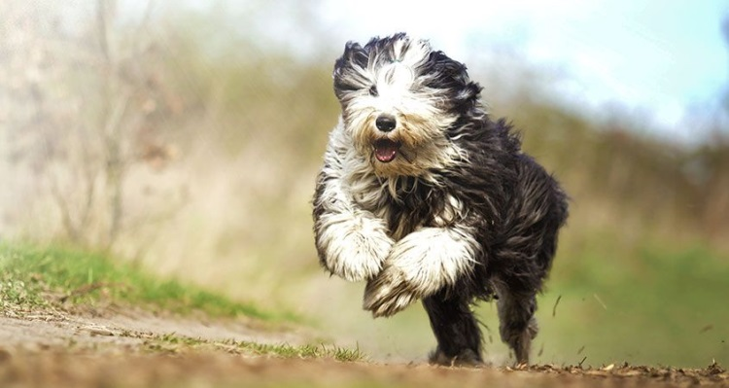
Natural Fibres
Cotton from a plant
Silk from the silk worm
Wool from sheep
Image source: http://creativecountrylife.com/?p=1514
Image source: http://inhabitat.com
Image source http://en-bure-bure.blogspot.co.uk/2012/02/ecological-felted-slippers-from-skudden.html
Linen from the flax plant
Hair fibres from animals
Image source http://www.belgianlinen.com
Image source https://www.cesarsway.com
Notes:
http://creativecountrylife.com/?p=1514
http://inhabitat.com/mit-creates-silk-pavilion-with-the-help-of-6500-silkworms/
http://en-bure-bure.blogspot.co.uk/2012/02/ecological-felted-slippers-from-skudden.html
https://www.cesarsway.com/dog-care/grooming/dog-fur-tells-a-lot-about-a-dog-health

Slide 5
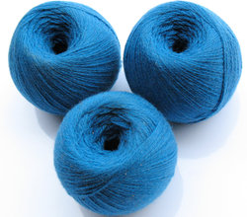
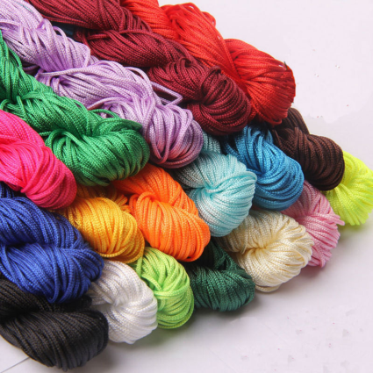
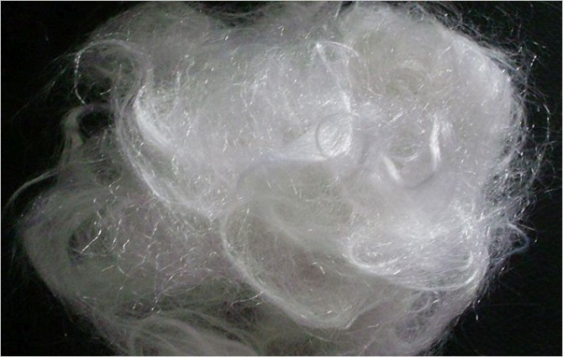
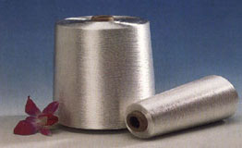
Man-made Fibres
More than half of all fibres used in clothes are man-made.
They include:
Image source https://dir.indiamart.com
Nylon
Acrylic
Image source https://www.aliexpress.com
Polyester
Image source: http://www.fibre2fashion.com
Rayon
Image source http://www.swicofil.com
Notes:
Http://www.fibre2fashion.com/news/polyester-news
https://www.aliexpress.com/w/wholesale-craft-nylon.html
https://dir.indiamart.com/impcat/acrylic-fiber.html
http://www.swicofil.com/products/200viscose.html

Slide 6
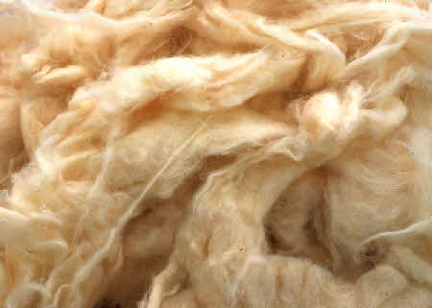
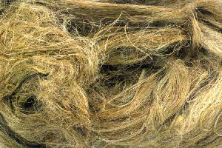
Natural Fibres
Plant fibres are made from a substance called cellulose.
Cotton is the most commonly used plant fibre which means the identification of a more unusual plant fibre at the crime scene could be significant.
Cotton
Linen
Image source http://www.wildfibres.co.uk/
Notes:
http://www.wildfibres.co.uk/

Slide 7
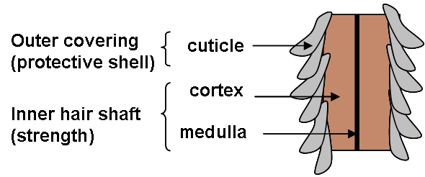
Hair
Individual strands of hair consist of a living part called the follicle and the rest, the shaft, which is dead.
The shaft is divided into 3 layers: the outer cuticle, the cortex and the internal medulla.
Image source: http://www.naturalinspiration.co.uk
Notes:
http://www.naturalinspiration.co.uk/blogs/hair/what-is-moisturised-hair/

Slide 8
Forensic analysis
Forensic scientists can look at hair under the microscope to find out a lot of information including:
which part of the body the hair came from
if it is Animal or human
if the hair has been dyed or bleached
if the hair has been straightened
DNA analysis, especially at the follicle.

Slide 9
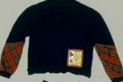
Real life crime.
Little Melissa Brannen was 5 years old when she went missing from a
Christmas party in 1989. Police suspected a man called Caleb Hughes of
abducting her but, without a body, they were going to struggle to prove it.
During a thorough search of his car forensic experts found clothing fibres.
One type was a rare rabbit fur that matched the coat that Melissa’s
mother had been wearing and the others came from a blue jumper. Police
managed to track down an identical jumper to the one Melissa had been
wearing when she disappeared.
The fibres matched proving she had been in his car.
Image source: http://www.charleyproject.org
Notes:
http://www.charleyproject.org/cases/b/brannen_melissa.html

Slide 10
Caleb Hughes
CONVICTED
Image source: http://www.charleyproject.org
Convicted of abduction
Punishment – 50 years in prison
Notes:
http://www.charleyproject.org/cases/b/brannen_melissa.html

Slide 11
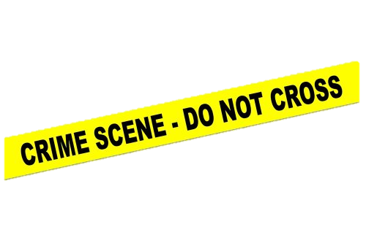
The Hospital crime scene
The Forensic team have mounted some of the hairs found in the office. They appear to be from some animals.
After interviewing the suspects we know the following:
-Suspect H has a pet rabbit
-Suspect C is a researcher working with mice.
-suspect B and E each have a cat.
-suspects F hunts rabbits and has dogs.
-suspect D has a Ferret
-suspect A has no pets and is allergic to animal fur.
-the CEO each has a dog.

Slide 12
Identifying the animal fibres
The Biomedical Imaging Unit at Southampton General Hospital have used one of their high powered Scanning Electron microscopes to produce some high resolution images of the three fibres. These images of the fibres found at the scene will be presented on the next slide.
Draw what these sample fibres look like for your reference.
Can you see any differences between them?
What animal do you think they have come from? (use the identification sheet on the next slide to help)
Notes:
Samples are cat rabbit and dog.

Slide 13
Sample 1
Sample 3
Sample 2

Slide 14
Animal Hair identification Sheet
Image sourced: Derek Owens

Slide 15
Can you eliminate any suspects?
Scientists often need to use a high powered microscope to see the fine detail of a fibre. The Biomedical Imaging Unit at Southampton General Hospital have used one of their high powered Scanning Electron microscopes to produce some high resolution images of sample hairs from different animals to help you.
Examine the images carefully on the next slide, looking back at the drawings you made from the 3 samples and note down any differences you can see.
From looking at the scanning electron microscope images, confirm or refute your initial thoughts on which animals the fibres came from. Compare your findings with the animals each suspect has access to and see if you can rule anyone out!

Slide 16
Cat
Chinchilla
Ferret
Guinea Pig
Animal Hair identification Scanning Microscope Reference (Biomedical Imaging- Southampton Hospital)
Rabbit
Horse
Mouse
Dog

