Slide 2
There has been an armed robbery at Southampton General Hospital, and you’re the only one who can solve the crime!
A painting by famous modernist artist Roger Ackroyd was stolen last week from the CEO’s office
Fiona Dalton, CEO of the University Hospital Southampton had received the painting as a donation earlier that day and it was due to be taken to an auctioneers
Her office has a locked door and is in a corridor with restricted passcode access
Police have sorted through over 8000 members of hospital staff and found 8 prime suspects based on CCTV footage. They need you to analyse the evidence from the crime scene and catch the culprit!

Slide 3
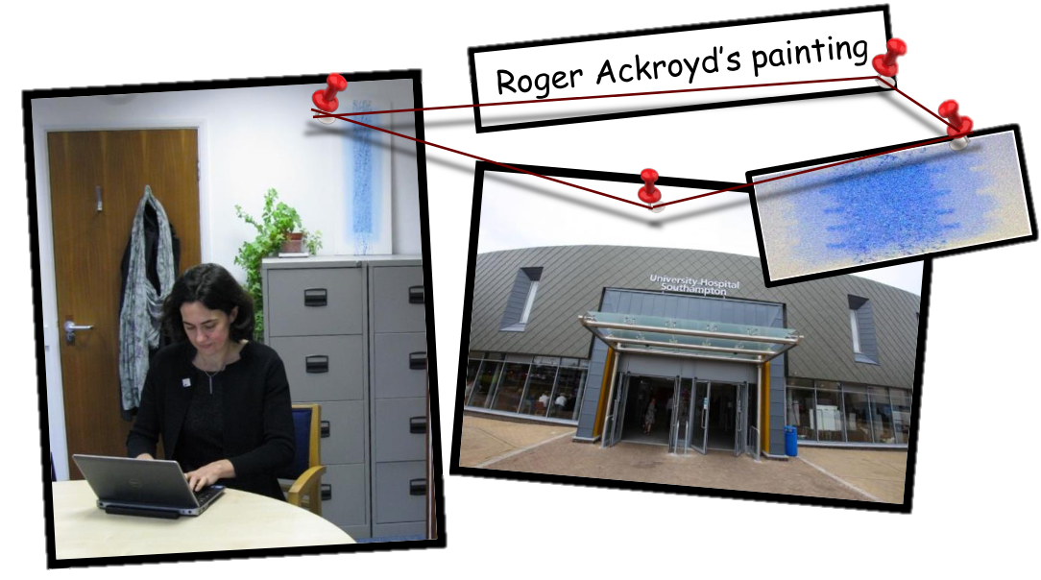

Slide 4
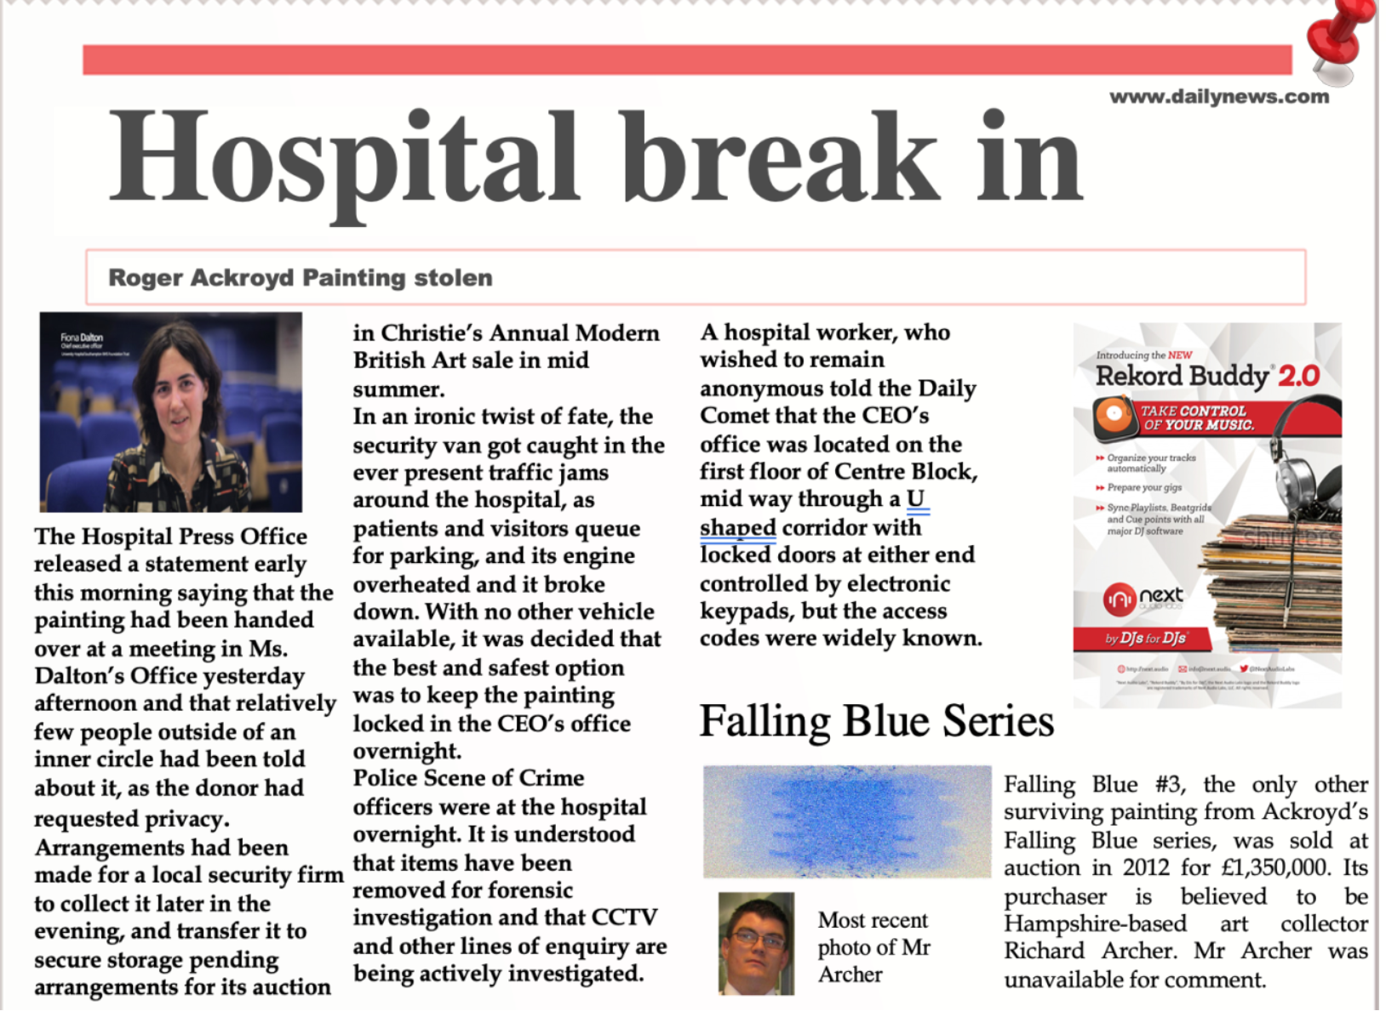
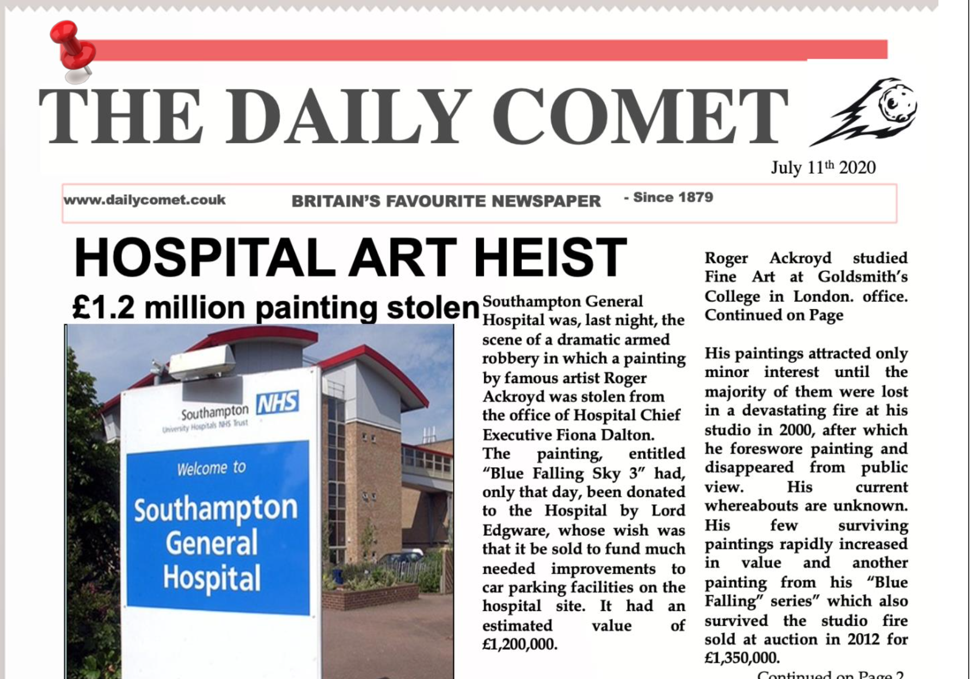

Slide 5
Initial Police Findings
The CEO’s office can only be accessed by a corridor with passcode-protected security doors at both ends (but the codes aren’t changed often and are known to many hospital staff)
No CCTV coverage in the corridor, but footage from the area nearby places 8 suspects close to the crime scene
The thief made it through the security doors, then shot the lock out of one of the office doors to get in
Police recovered a printed map of A4 paper, which they believe was used by the thief. They also found some unidentified fibres on the carpet of the office, a bullet casing, and a fingerprint on the inner door of the office.

Slide 6
The Suspects
CCTV analysis identified 8 members of hospital staff who approached the corridor between 7:15pm (when the CEO left work) and 2:30am (when the theft was discovered)
They were all interviewed later that day, fingerprints were taken, and their skin and clothes swabbed for gunshot residue
You have been provided with a table of the suspects and the suspect interviews to help you solve the case

Slide 8
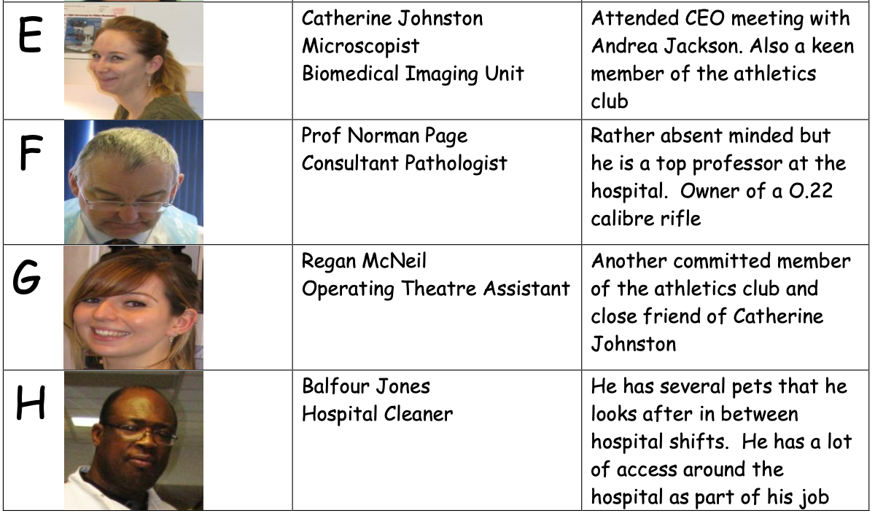

Slide 9
The Evidence
Police found the following evidence, which they need you to analyse to solve the crime
A fingerprint from the inner door handle of the office
An unidentified fibre from the carpet of the office
A printed map of the hospital used by the thief, which has been analysed for ‘tracking dots’ left by the laser printer
A bullet cartridge found near the door of the office

Slide 10
Draw a table to help you keep track of your findings!
You will need a row for each of the 8 suspects, and a column for each of the 6 analyses you will carry out.
You can add to your table as you go along. This will help you keep track of the suspects.

Slide 11
Now it’s time for you to start investigating!

