Slide 1
Universal design for learning - Supporting all of your students
Tamsyn Smith, Digital Learning
Notes:
MA in Applied Linguistics for Language Teaching or MA TESOL Studies programmes
Tamsyn Smith: tms2g12@soton.ac.uk

Slide 2
Creating an Accessibility checklist

Slide 3
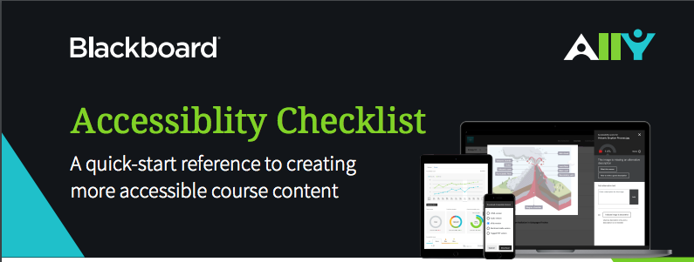
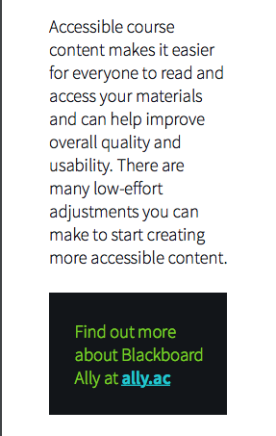
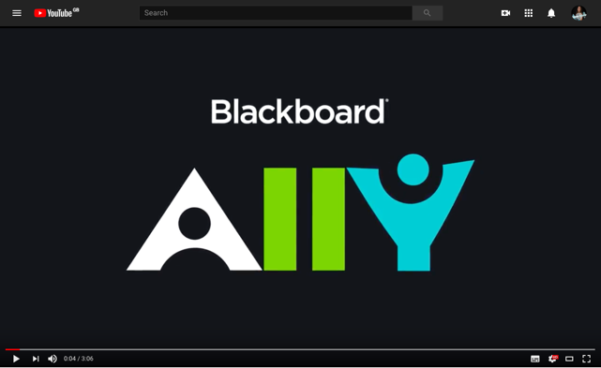
Blackboard Accessibility Checklist
Notes:
Blackboard Accessibility Checklist downloaded from: https://www.ed.ac.uk/files/atoms/files/ally_accessibility_checklist.pdf
90% students prefer to have captions with videos (University of Oregon) - e.g. can watch videos in places where sound is not accessible.
Mobile use - headings etc makes it better as don’t have to zoom etc It becomes responsive
Short video about Blackboard Ally: https://youtu.be/FmUTPI4sujo

Slide 4
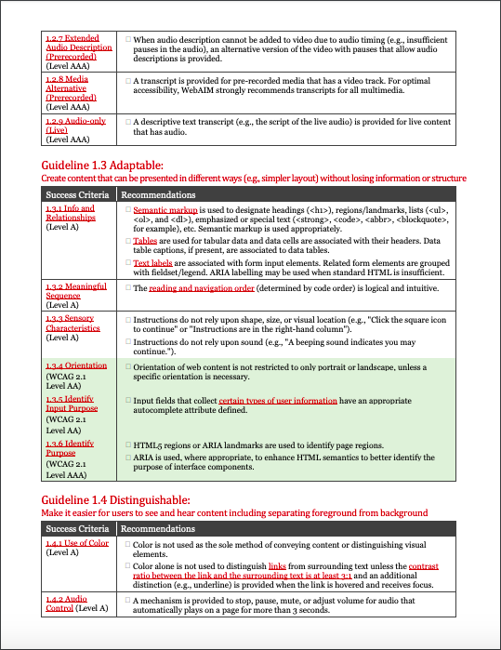
WebAIM’s WCAG2 Checklist
Notes:
WebAIM's WCAG 2 Checklist: https://webaim.org/standards/wcag/checklist
https://webaim.org/standards/wcag/WCAG2Checklist.pdf

Slide 5
Prioritise
Short term
What do you need to do now to make your online content more accessible?
Medium term
What are you aiming to do for the next semester?
Long term
How will you make sure that all of your content is accessible?
This Photo by Unknown Author is licensed under CC BY
Notes:
Consider different kinds of documents e.g. Word documents, powerpoints and videos

