Slide 1


Slide 2

2018 Awards
(student nominations)

Slide 3
Shortlist:
ARTD2084 | Games design & art | HUMA2008 | The life & afterlife of the Vikings | PSYC1018 | Individual differences: personality & intelligence
BIOL2039 | Animal behaviour | MANG1001 | Financial accounting 1 | PSYC2019 | Research methods & data analysis III
CHIN9025 | Chinese language stage 1B | MANG6134 | Risk taking & decision making | SESA2023 | Propulsion
ECON3008 | Macroeconomic policy 3 | MATH1060 | Multivariable calculus | SOES1008 | Earth & ocean systems
ENGL2080 | Queens, devils & players in early modern England | MEDI3044 | Child health | SOES1009 | The living earth
HIST3228 | Emperor Julian & the last pagans of Rome | MEDI6078 | Allergy dissertation | SOES2017 | Ecological processes in the marine benthos
HPRS1023 | Scientific basis of cardiovascular, respiratory & sleep science | PHYS6005 | Electricity & magnetism | UOSM2010 | Global challenges
HPRS1026 | Scientific basis for healthcare sciences | PHYS1022 | Cosmology & the early universe

Slide 4

“Well organised, nothing too little, nothing too much - Goldilocks!“

Slide 5
Comments
Proportion of respondents
Notes:
Go to Blackboard site

Slide 6
Award Winners

Slide 7
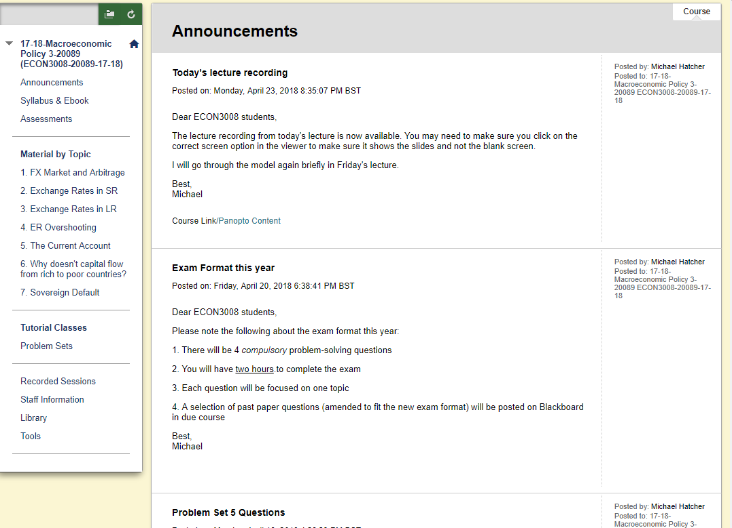
ECON3008 Macroeconomic Policy 3
Excellent menu & clear layout makes it easy to navigate

Slide 8
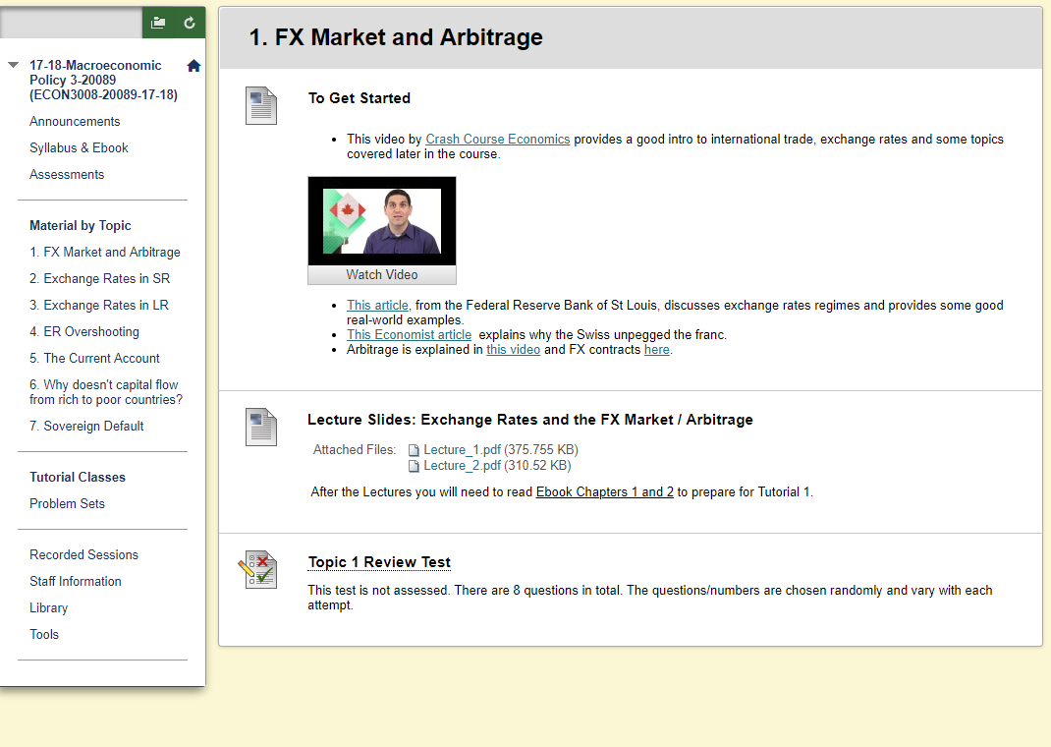
ECON3008 Macroeconomic Policy 3
Pre-lecture activities and post-lecture quiz each week

Slide 9
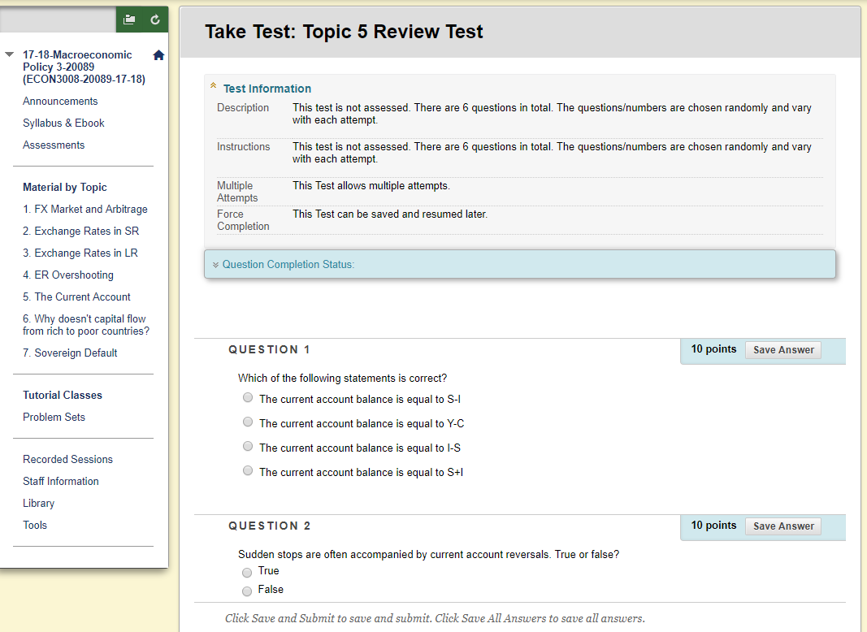
ECON3008 Macroeconomic Policy 3
Opportunities for self-assessment

Slide 10
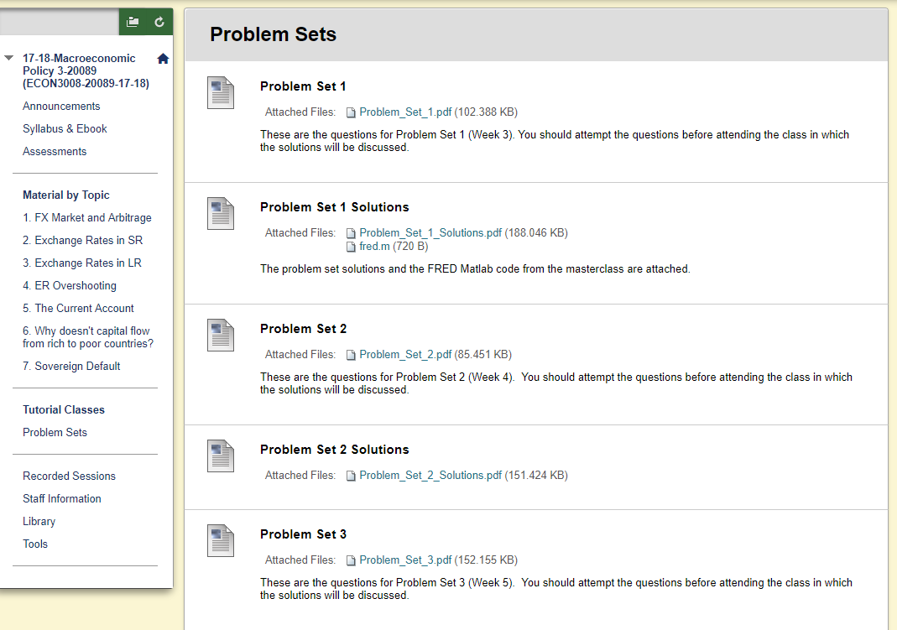
ECON3008 Macroeconomic Policy 3
Weekly problem sets

Slide 11
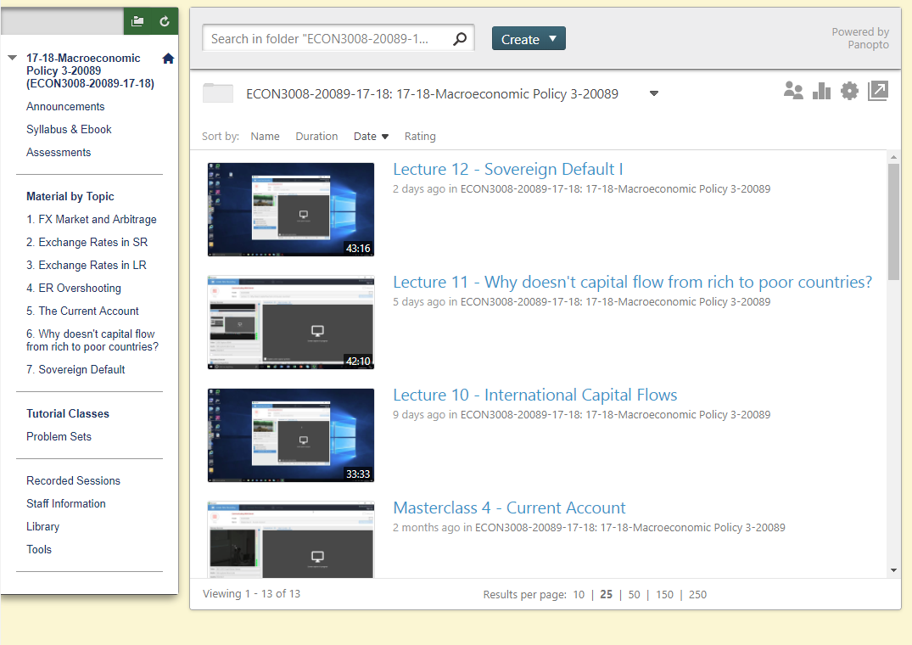
ECON3008 Macroeconomic Policy 3
Clearly labelled lecture recordings

Slide 13
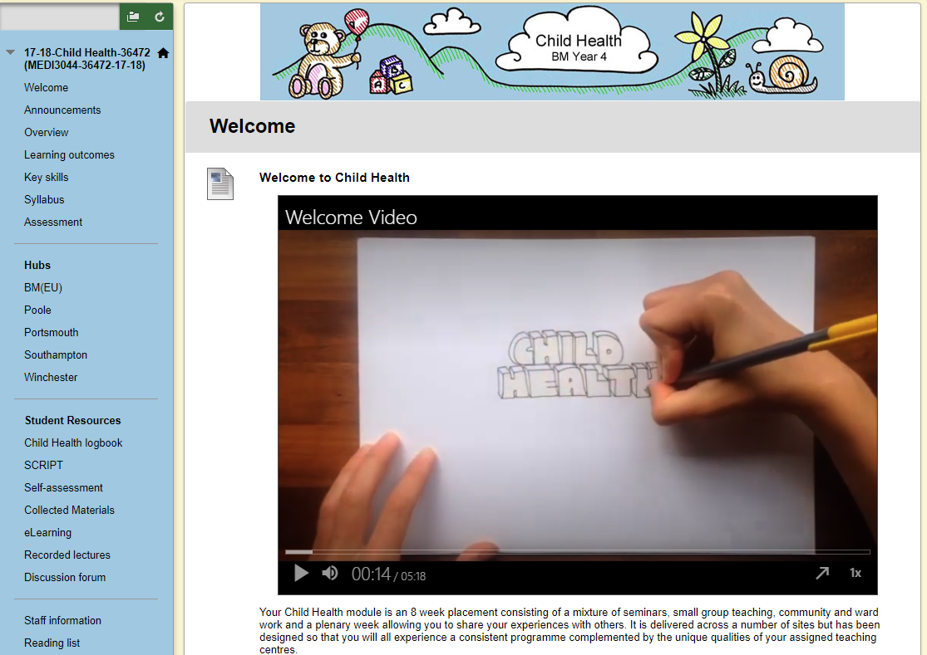
MEDI3044 Child Health
Inviting welcome video to introduce module

Slide 14
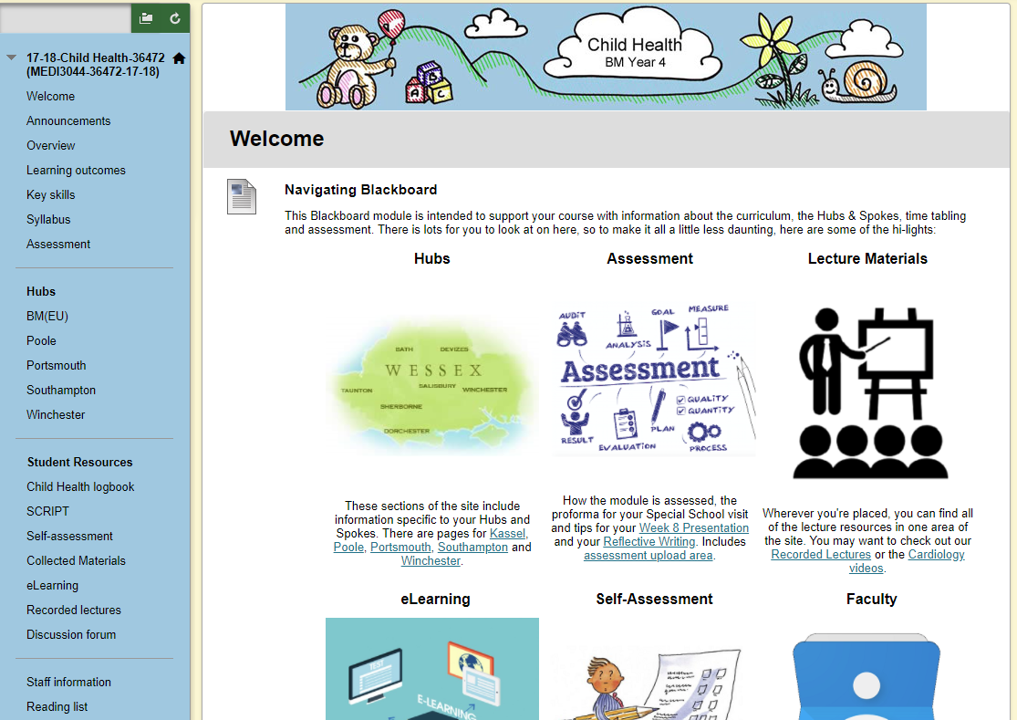
MEDI3044 Child Health
Detailed menu and visual guide to aid navigation

Slide 15
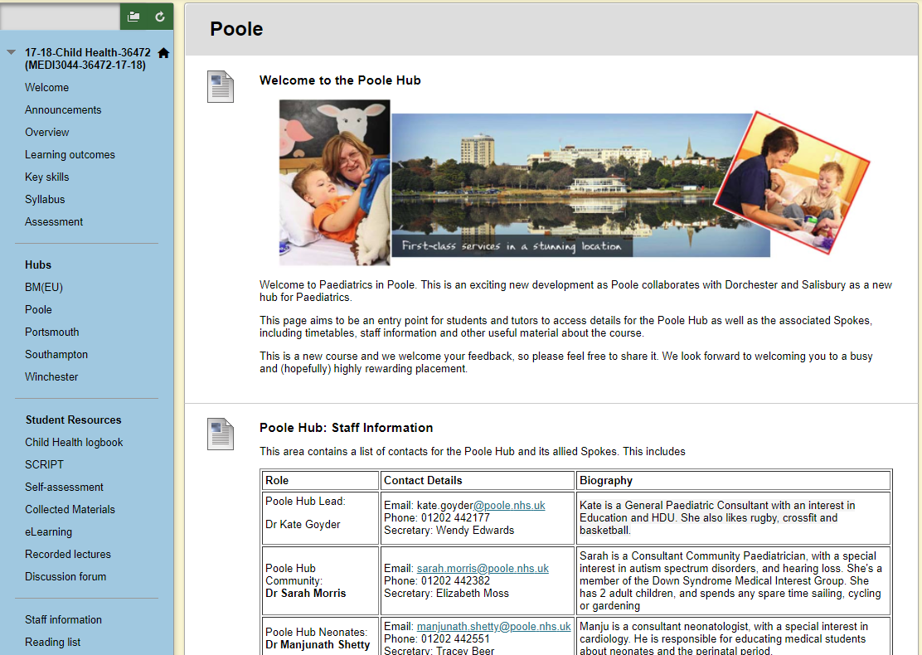
MEDI3044 Child Health
Individual ‘hub’ pages for placement information

Slide 16
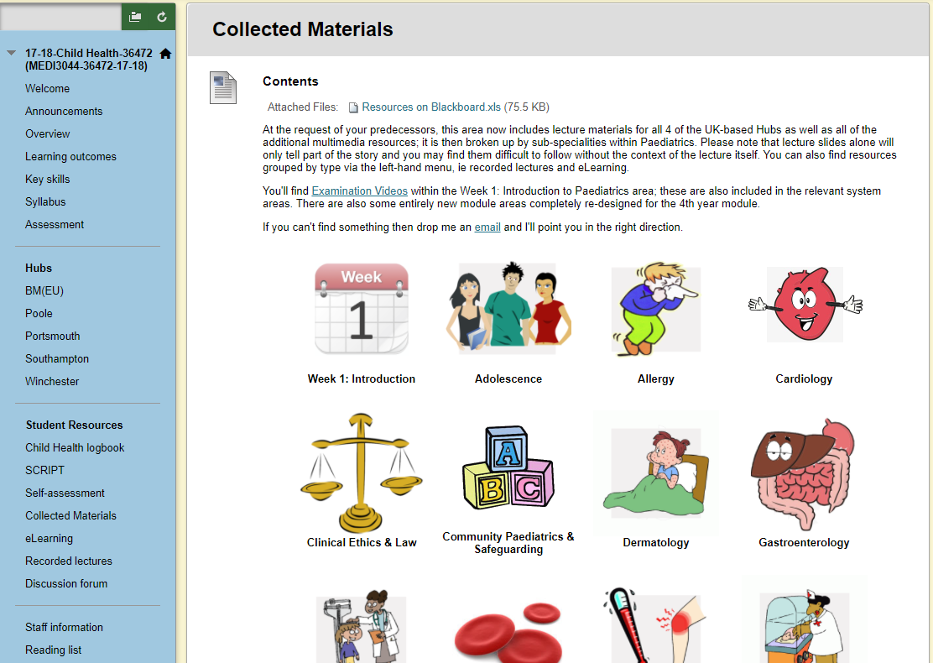
MEDI3044 Child Health
A wealth of materials, helpfully organised

Slide 17
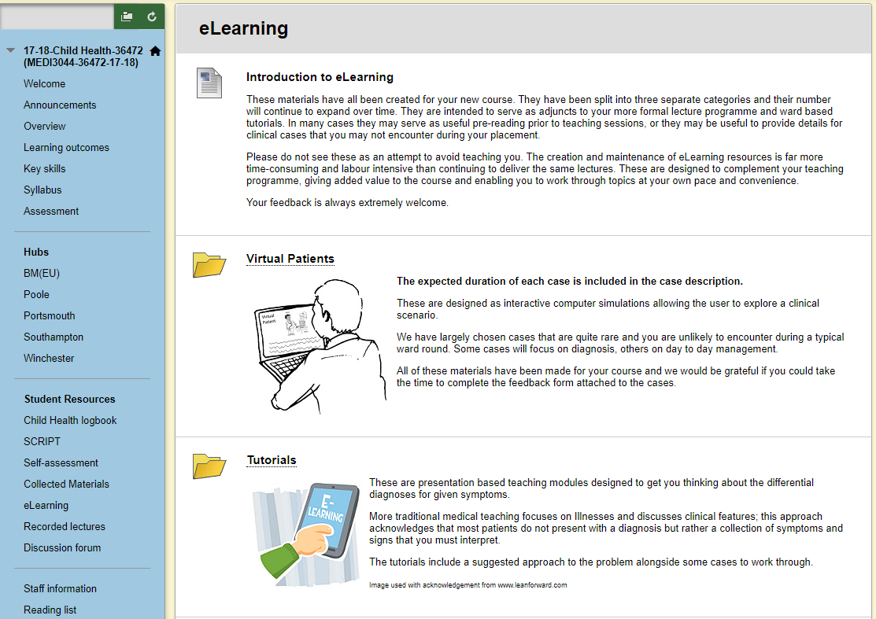
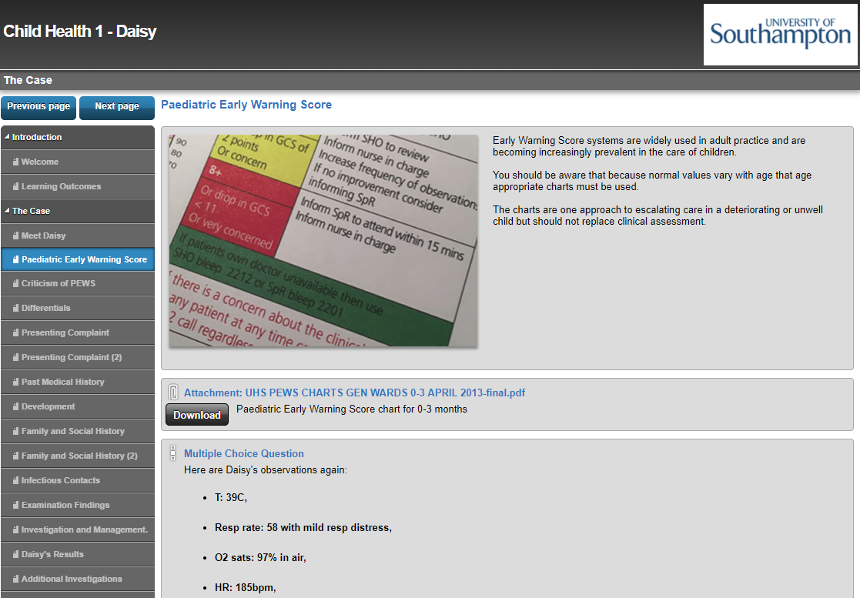
MEDI3044 Child Health
Interactive cases and resources for independent learning and self-assessment

Slide 19
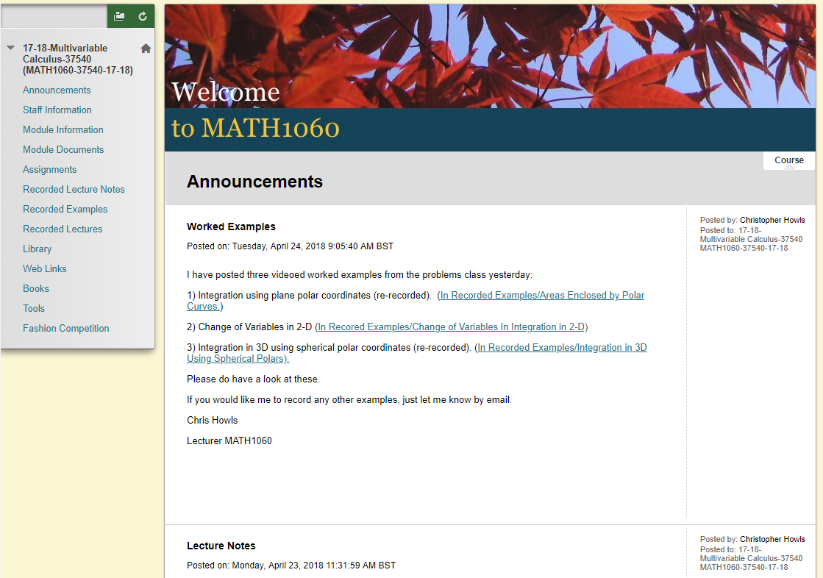
MATH1060 Multivariable Calculus
Clear labelling and organisation throughout

Slide 20
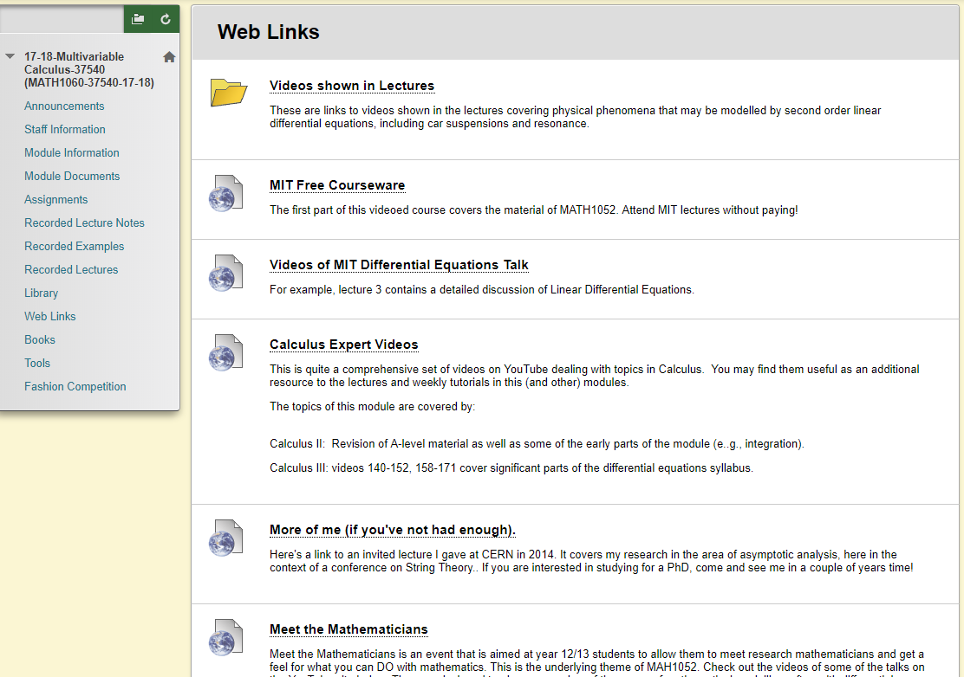
MATH1060 Multivariable Calculus
Helpful context accompanying resources

Slide 21
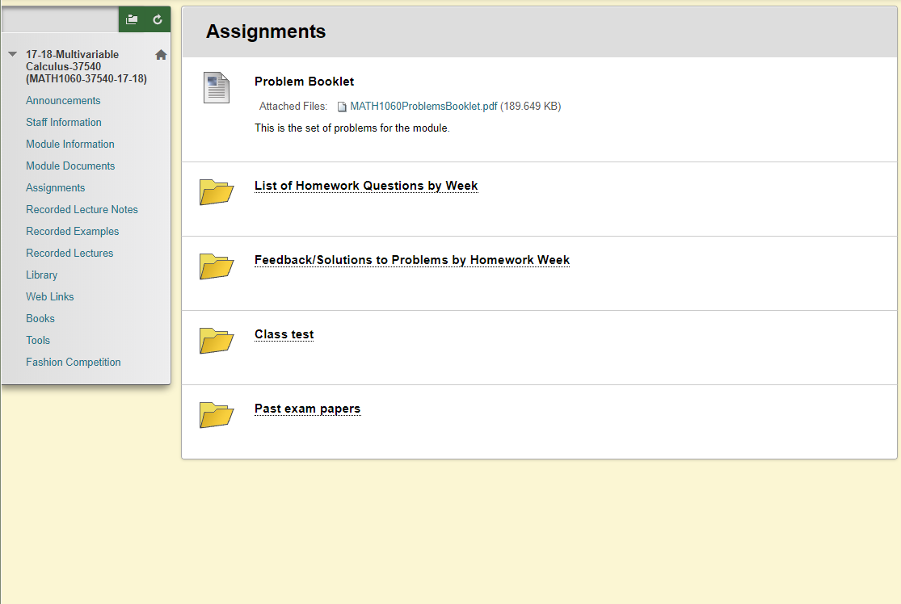
MATH1060 Multivariable Calculus
Assessment support and opportunities to practise

Slide 22
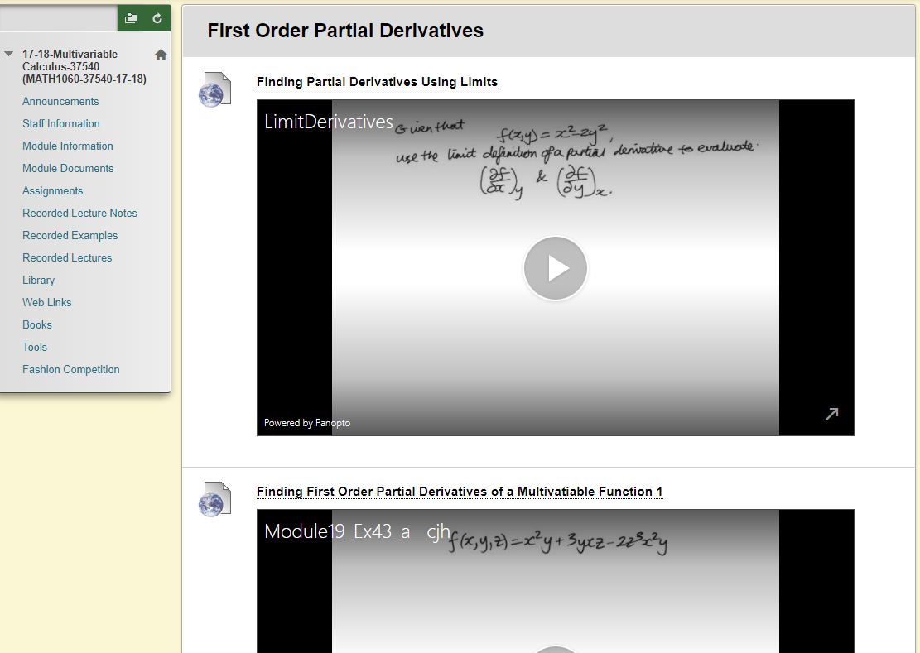
MATH1060 Multivariable Calculus
Recorded versions of lecture notes and worked examples

Slide 23
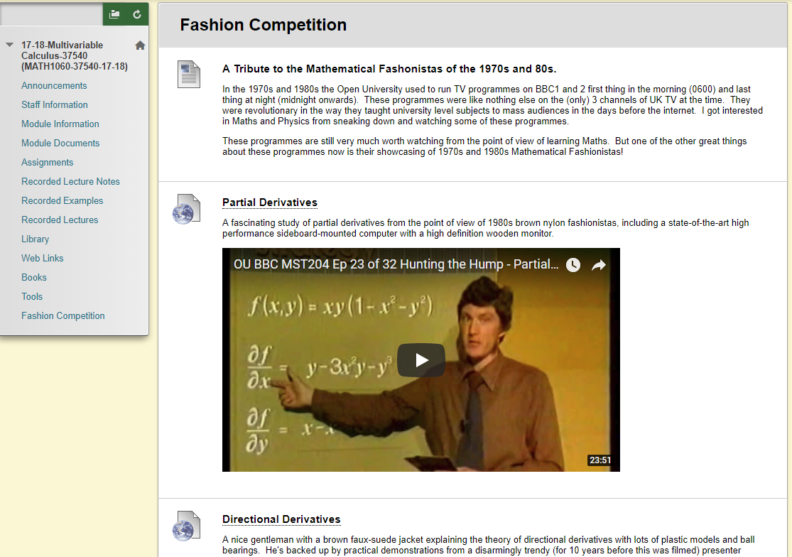
MATH1060 Multivariable Calculus
Content presented in an entertaining and informative way

Slide 24
Staff self-nominated award

Slide 25
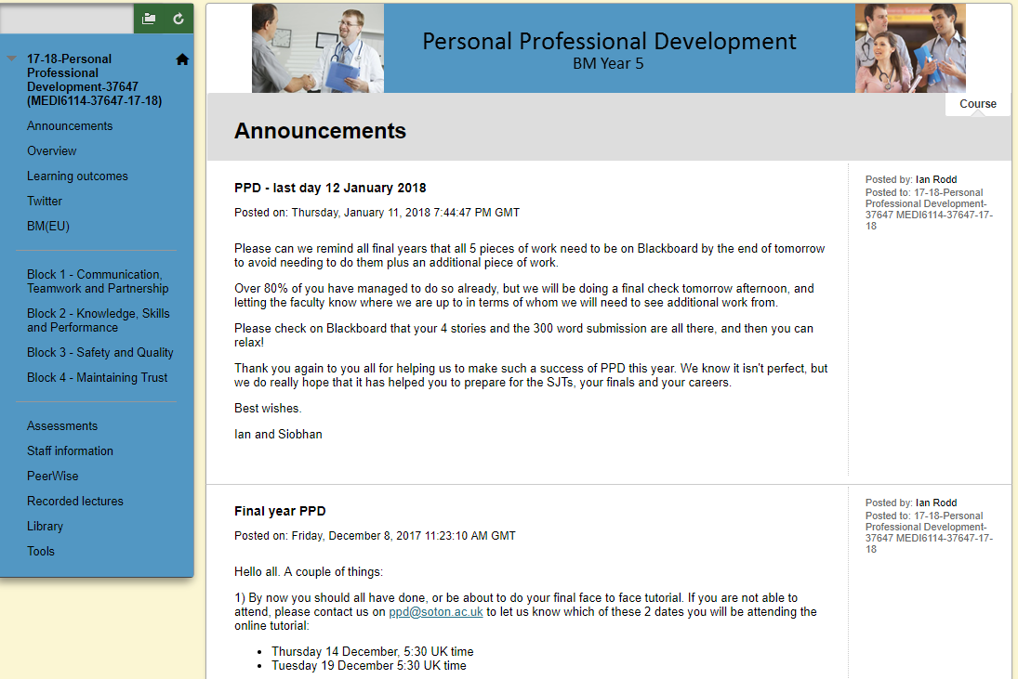
MEDI6114 Personal Professional Development
Self-study module for students to work through while on placement

Slide 26
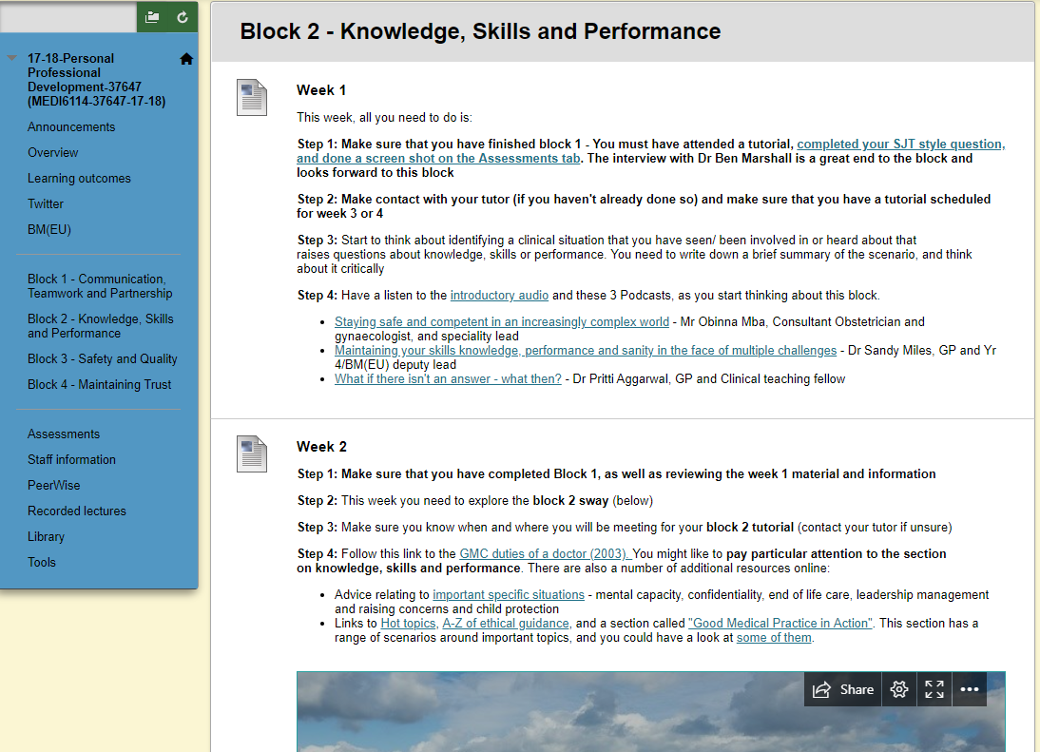
MEDI6114 Personal Professional Development
Helpful guidance throughout

Slide 27
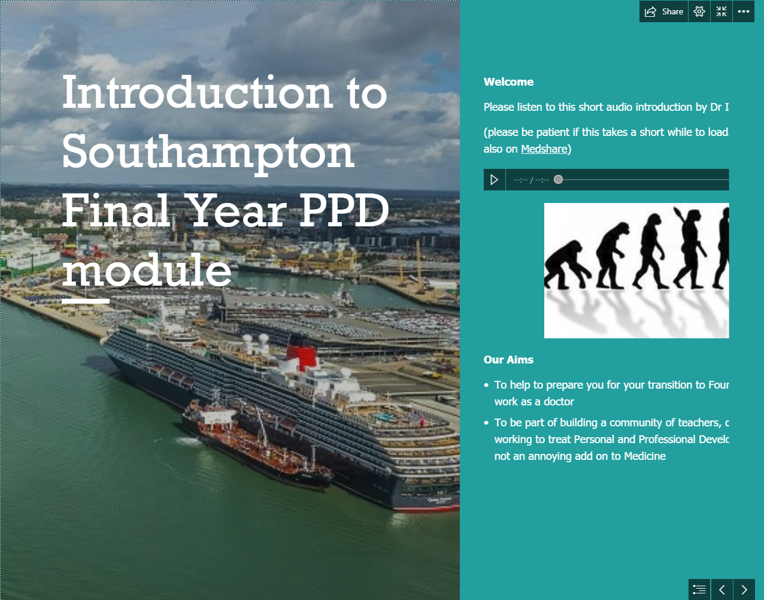
MEDI6114 Personal Professional Development
Sway presentations introduce each section in an engaging way

Slide 28
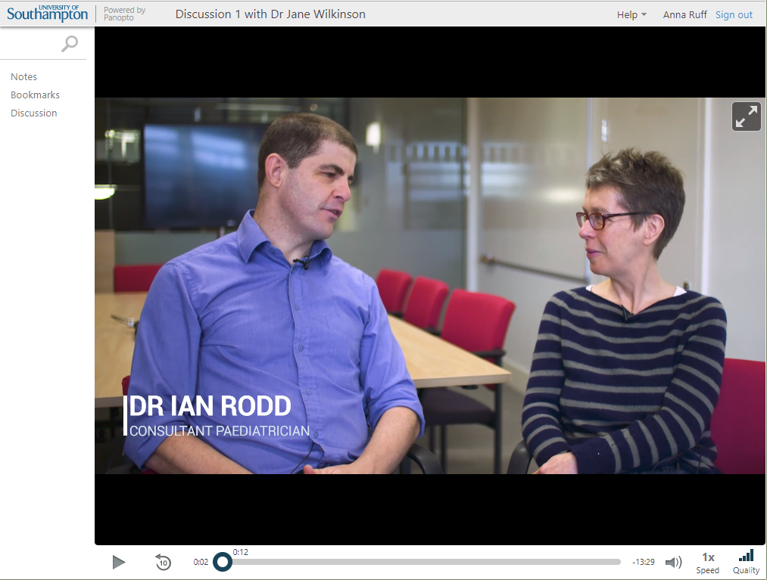
MEDI6114 Personal Professional Development
A range of resources, including podcasts and videos

Slide 29
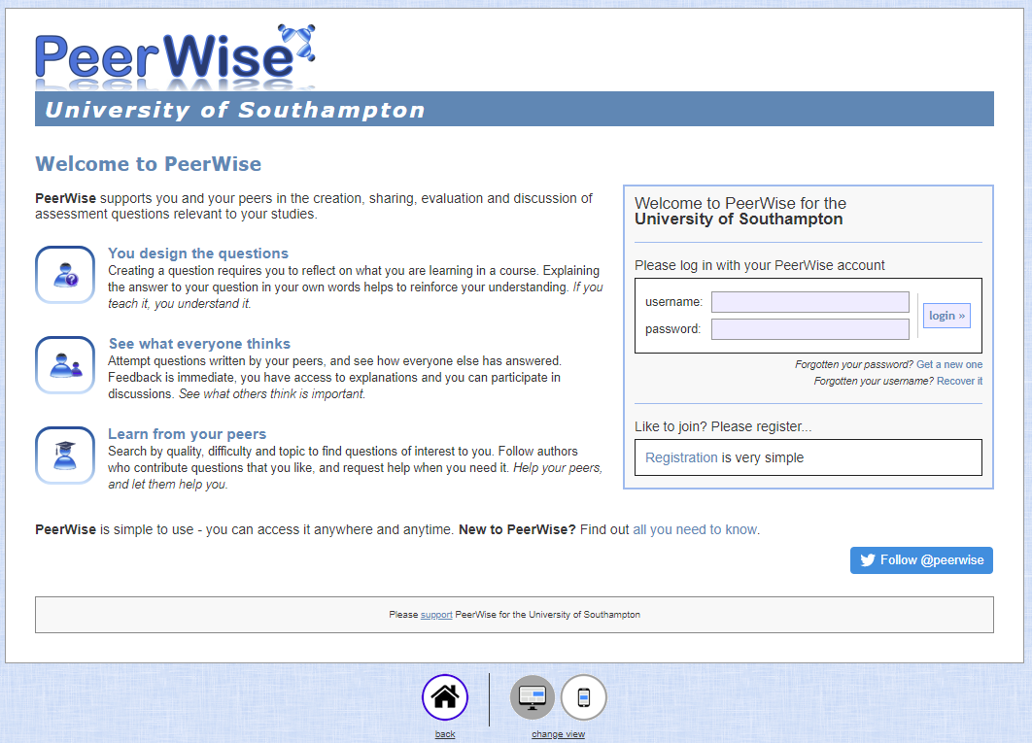
MEDI6114 Personal Professional Development
Students involved in sharing content

Slide 30
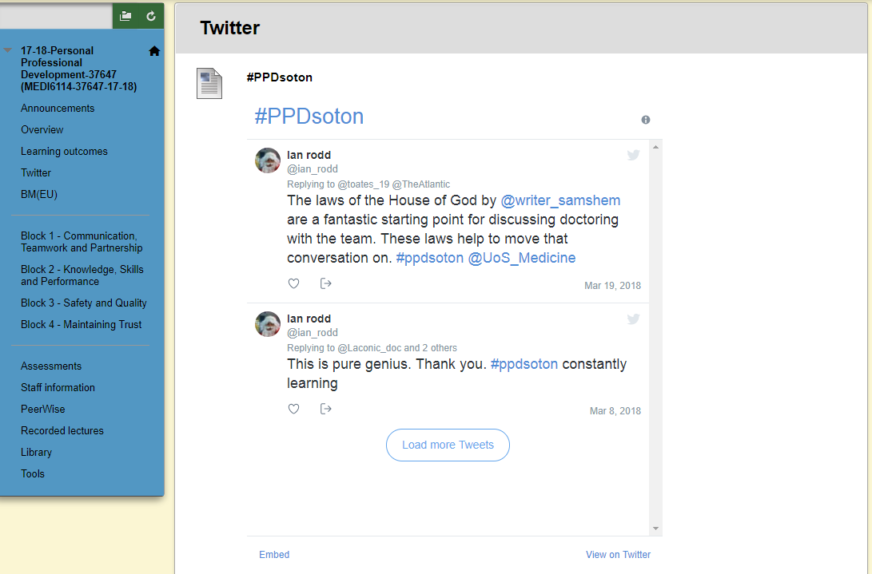
MEDI6114 Personal Professional Development
Regular updates through Twitter feed

