Slide 1


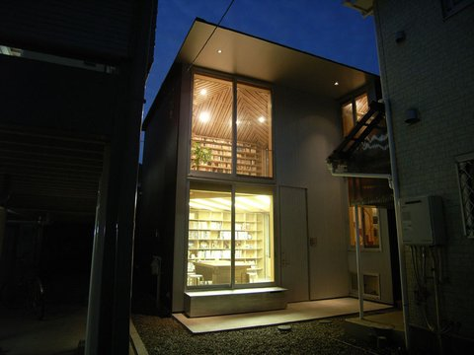

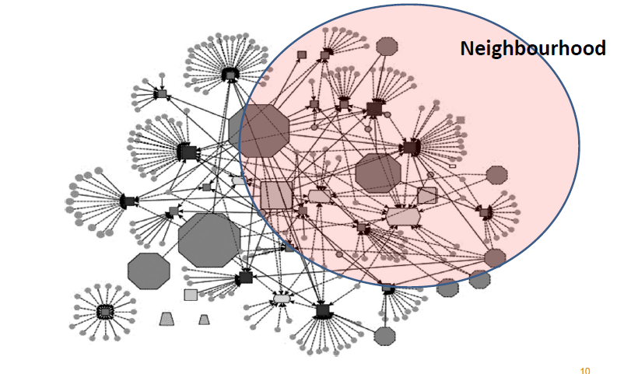
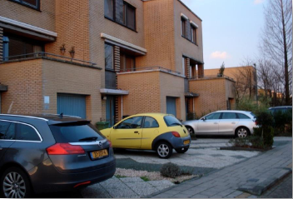
The Home as Business: Macroeconomy and Microspaces
Dr Darja Reuschke

Slide 2
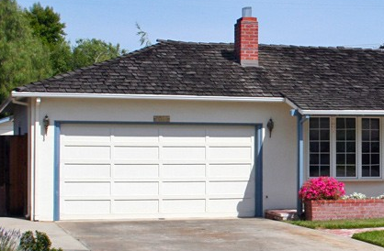
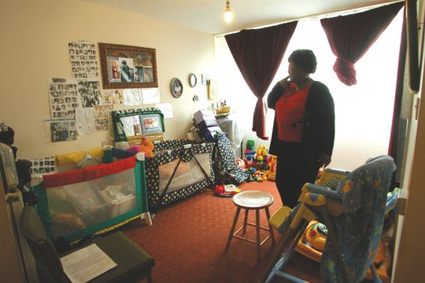
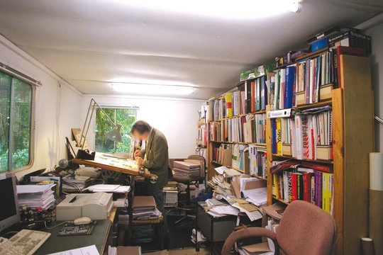
The home as place for business and self-employed work
Photo courtesy of Ivan Raszl
Photo courtesy of Frances Holliss

Slide 3
Structure of presentation
Context: Rise in self-employment
Self-employment and home-based businesses in the literature
Drivers of UK home-based self-employment
Housing and home-based self-employment
Conclusions

Slide 4
Self-employment rise in the UK
Source: BIS, 2016, 4

Slide 5
S/emp without employees
Source: Derived from Eurostat LFS database
Notes:
83% without employees

Slide 6
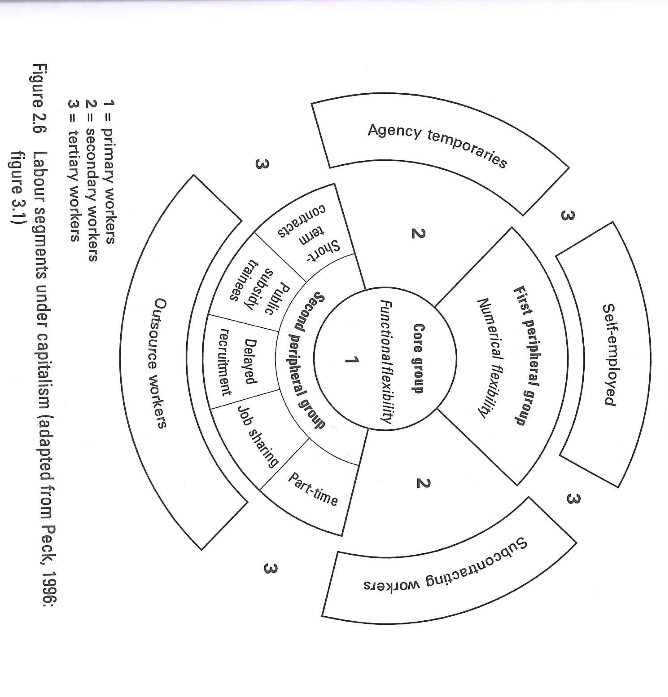
Self-employment in the literature
Core-periphery model
Flexible (large) firm
Nonstandard employment
(Hipp et al., 2015, Kalleberg, 2000, 2013)

Slide 7
Trend in number of private sector enterprises by number of employees, UK, 2000-2014,
(2000 = 100)
Source: Derived from BIS BPE 2014
Notes:
Micros growing more rapidly than any other size category.
Large businesses are reducing in number, including during the noughties boom - although all types of businesses have increased in last two years

Slide 8
Beyond core/periphery
Source: BIS, 2016, 7

Slide 9
Networks and project economy
Powell, 1990; Grabher, 2002
Source: BIS, 2016, 35
Notes:
New technology and teleworking

Slide 10
Portfolio work and bounderyless careers
Changing occupational career pathways beyond organisational careers (Arthur and Rousseau, 1996; De Filippi and Arthur, 1994; Peiperl and Baruch, 1997)
Proactive, autonomous and self-directed
(Fraser and Gold, 2001; Sullivan, 2001)
High satisfaction from work because of opportunity to develop abilities; meaningful and interesting work
Tight labour markets help moving between workplaces
(Carnoy et al., 1997)
Transferable professional skills (Handy, 1990, 1994)
Notes:
ca. 9% freelance

Slide 11
Home-based business literature
Work/life balance, part-time work and gender
(Thompson et al., 2009; Walker et al. 2008; Loscocco and Smith-Hunter 2004)
Mumpreneurship (Ekinsmyth, 2011)
‘Lifestyle’ or ‘hobby’ businesses
Low costs and no need for commercial premises
(Vorley and Rodgers, 2014; Mason et al., 2011)
Avoidance of commuting
(Mason and Reuschke, 2015; Vorley and Rodgers, 2014)

Slide 12
Measurement and data
UK Labour Force Survey
Primary and secondary employment
  Employment status (self-reported)
  “[In your main/second job] do you work mainly …
    In your own home
    In the same ground or building as your home
    In difference places using home as a base
    Or somewhere quite separate from home?”
Since 1992 (with one gap year)

Slide 13
What drives home-based s/emp?
Female part/time employment?
Necessity push?
A labour market phenomenon?

Slide 14
Continuous upward trend
Dotcom crisis
Recession 1990-1993
UK long boom 1993-2007
Great recession 2008-2010
Post-recession/recovery 2011-2015
Source: UK Labour Force Survey, own calculations

Slide 15
Rising proportion of women
Source: UK Labour Force Survey, own calculations

Slide 16
Industry composition
SIC1992 | 1994-1997 | 2004-2006 | 2013-2015 | HBS | all employment 1994/97-2013/15
a/b: agriculture, hunting & forestry, fishing | 10.3 | 6.7 | 7.5 | -2.8 | -0.35
d:manufacturing | 7.0 | 5.6 | 5.4 | -1.6 | -8.26
f:construction | 23.7 | 26.9 | 19.6 | -4.1 | 0.1
g:wholesale, retail & motor trade | 11.6 | 8.1 | 7.1 | -4.5 | -2.85
h:hotels & restaurants | 5.0 | 1.9 | 2.1 | -2.9 | 0.14
i:transport, storage & communication | 4.0 | 5.4 | 4.7 | 0.7 | -0.05
j:financial intermediation | 1.1 | 1.3 | 1.6 | 0.5 | -0.51
k:real estate, renting & business activity | 15.2 | 19.6 | 25.5 | 10.3 | 5.19
m:education | 3.6 | 3.8 | 4.9 | 1.3 | -1.22
n:health & social work | 6.2 | 6.0 | 6.8 | 0.6 | 3.11
o:other community, social & personal | 9.5 | 11.4 | 12.8 | 3.3 | 0.8
Source: UK Labour Force Survey, own calculations

Slide 17
Home-based s/emp by industry sectors and gender
 | Males | Females
Production | 38% | 7%
Agriculture | 6% | 3%
Professional, scientific, technical | 12% | 15.8%
Administrative and support services | 7.8% | 10.1%
Information and communication | 7.1% | 4.5%
Education | 4.2% | 8.2%
Health and social work | 1.5% | 16.2%
Arts, entertainment and recreation | 4.8% | 6.5%
Other service activities | 2.6% | 10.4%
Source: UK Labour Force Survey, own calculations

Slide 18
Home-based s/emp characteristics
 | 1994-1997 | 2004-2006 | 2013-2015
Is 2nd employment (% of HBS) | 10.1 | 7.3 | 9.3
Is part-time (% of HBS) | 30.5 | 29.3 | 36.3
Is female part-time (% of HBS) | 18.6 | 17.7 | 21.6
Is women with dep children (% of HBS) | 16.4 | 13.9 | 17.7
% Women with dep children of …
Home-based self-employed women |  |  | 49.0
Self-employed women |  |  | 48.2
Employee women |  |  | 43.5
Notes: Pooled non-clustered data, weights applied
Source: UK Labour Force Survey, own calculation
Notes:
91% no employees
Rise in HBS not because of 2nd employment
Pt HBS significantly increased, this is linked to a rising number of women who are home-based self-employed
Overall, however, of all HBS only just above one fifth is female home-based self-employment so literature too narrow
Women with dep children also higher in self-employment more generally. So not the home per se that is a relevant factor here but perhaps the flexibility s/emp provides, or on negative side labour market segmentation

Slide 19
Necessity push
Indicators | 1994-1997 | 2004-2006 | 2013-2015
Looks for new job to replace main job (% pt main HBS) | 4.3 | 2.1 | 3.3
Looks for new job to replace main job (% ft main HBS) | 2.1 | 1.5 | 2.0
Looks for additional job (% pt HBS) | 5.0 | 2.6 | 5.0
Underemployment: Would like to work longer hrs (% main HBS) | 7.7 (1997) | 7.7 | 12.3
Reason for PT job: could not find FT job
% pt HBS | 14.9 | 7.9 | 16.1
% pt s/emp | 16.0 | 8.7 | 18.3
% pt employees | 13.3 | 9.9 | 20.9
Notes: Pooled non-clustered data, weights applied
Source: UK Labour Force Survey, own calculation
Notes:
91% no employees
Proportion of those who want to leave HBS for another job are rather low and lower now then they were in 1990s after the recession. Now underemployment very high, so people often want to work as HBS but cannot find enough contracts/clients.

Slide 20
Secondary workforce
Indicators | 1994-1997 | 2004-2006 | 2013-2015
Subcontracting
% HBS | - | 15.2 | 10.7
% self-employed | - | 15.1 | 12.2
Whether left paid job in last 3 months
% HBS | 1.7 | 1.2 | 0.9
% Self-employed | 1.7 | 1.4 | 1.2
% Employees | 2.9 | 2.5 | 1.8
Notes: Pooled non-clustered data, weights applied
Source: UK Labour Force Survey, own calculation
Notes:
91% no employees
Some necessity push/labour market effects but less so for HBS than for self-employment

Slide 21
Home-based self-employment and housing

Slide 22
Meanings/functions of home
Source: Blunt, A. and Dowling, R. (2006), p. 10
Notes:
Home is defined in urban geography and cultural geography as material place and emotional place. Home is understood as shelter, security …
However, Workplace – traditionally; term house in English meant the place where people lived and worked.
Link between home and work features in gender studies but here the role of women as domestic workers and not as place of paid work
criticises the separation of public and private sphere / production and reproduction.

Slide 23
Dimensions of housing
Physical structure of home
  Size and layout, e.g. spare room
  Attached premises in semi-/detached houses, e.g. garage, hut in garden
  Ground level v upper level (flat)
Housing tenure
  Flexible use in homeownership
  Restrictions in social housing (in UK)
  Private renting sector without security of tenure in UK
Housing equity as financial resource
  House sale
  Security of loan/overdraft on owned home
Notes:
Housing is crucial for home-based self-employment.
First is the physical structure of the home.

Slide 24
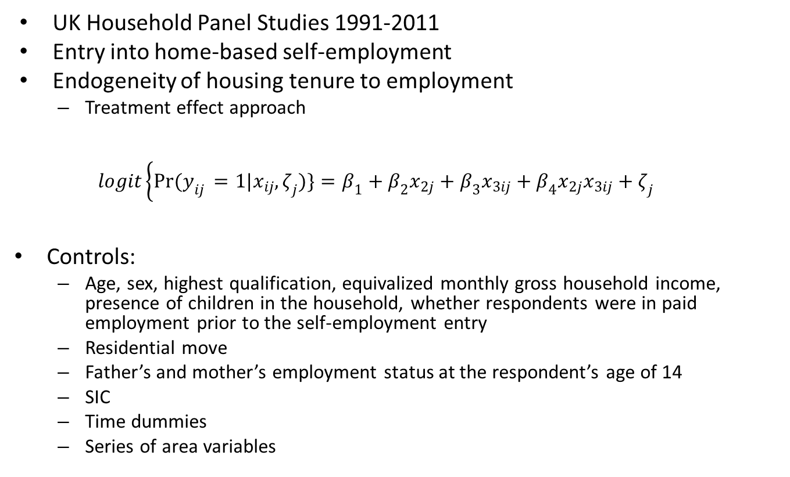
Data and model
UK Household Panel Studies 1991-2011
Entry into home-based self-employment
Endogeneity of housing tenure to employment
  Treatment effect approach
  $$logit\left\{Pr(y_{ij }=1|x_{ij},ζ_{j})\}=β_{1}+β_{2}x_{2j}+β_{3}x_{3ij}\right.+β_{4}x_{2j}x_{3ij}+ζ_{j}$$
Controls:
  Age, sex, highest qualification, equivalized monthly gross household income, presence of children in the household, whether respondents were in paid employment prior to the self-employment entry
  Residential move
  Father’s and mother’s employment status at the respondent’s age of 14
  SIC
  Time dummies
  Series of area variables
Notes:
A random-intercept logistic regression model was specified using a generalized linear model with fixed effects for the coefficients $x_{ij}$and an individual-specific random effect $ζ_{j}$

Slide 25
Housing effects in the UK context
Home-based self-employment
House type Detached house is facilitator Flat is hindrance
Large dwelling space (person-per-room)
Housing wealth Living in expensive house No effect of increase in housing equity
Outright ownership No difference between mortgage owners, private renters and social renters Not flexibility in using space but reduced housing costs

Slide 26
Conclusions - Macroeconomy
Continuation of an upward trend since 2001 with some necessity push but underemployment (low pay) greater problem
Changing workforce and changing economy
  Decline in production (manufacturing, energy, water)
  Increase in business and personal services
  Professional, administrative and support services amongst women rather than work/life balance

Slide 27
Conclusions - Microspaces
Blurring of work and home,
particularly in detached houses
Suburbs as spaces of economic
activity
Meanings/functions of home
  Incubator
  Financial security to experiment with
  self-employment
  Facilitator of flexibility, adaption
Source: Holliss, 2015, 36
Notes:
Suburbs – fieldwork in Germany and UK
Adaptation: moving business in the home

Slide 28
d.reuschke@soton.ac.uk
www.workandhome.ac.uk
D. Reuschke (2016) Importance of Housing for Self-employment. Economic Geography 92(4): 378-400
Reuschke, D. & Houston, D. (2016): Importance of Housing and Neighbourhood Resources for Microbusinesses. European Planning Studies 24 (6): 1216-1235
Acknowledgement: This research is funded through the ERC Starting Grant 639403 WORKANDHOME ERC-StG-2014

