Slide 1
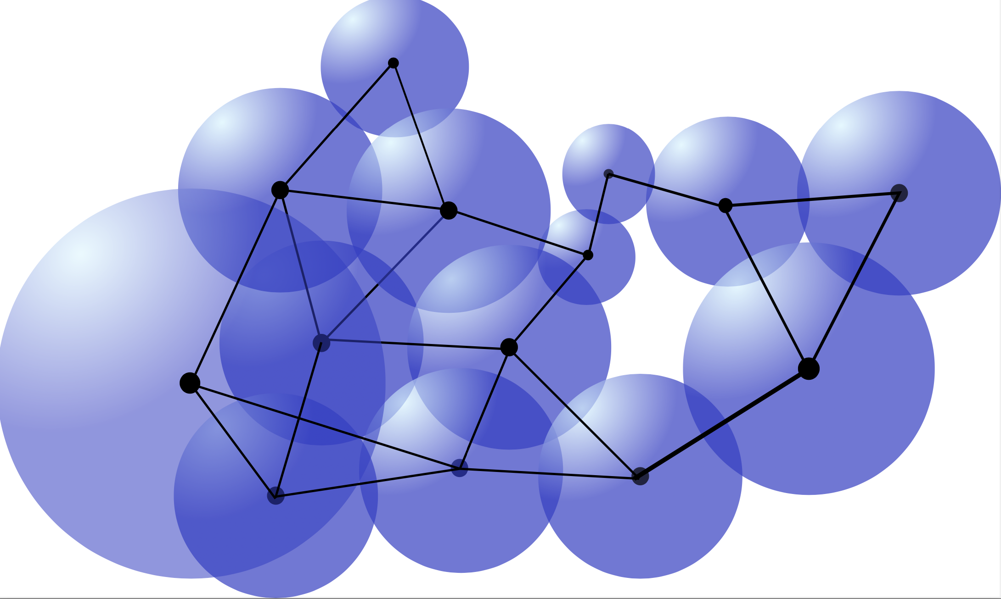
New Quantum Toolkit for
Simulating Fundamental Physics
Sergii Strelchuk
University of Cambridge
UKLFT Annual Meeting
May 2022

Slide 2
“Nature isn't classical, dammit, and if you want to make a simulation of nature,
you'd better make it quantum mechanical, and by golly it’s
a wonderful problem, because it doesn't look so easy.”
R. Feynman

Slide 3
Outline
Simulating Fermionic Systems Using Optimal Fermion Enumeration Schemes
Tensor Network approaches

Slide 4
Simulating Fermionic Systems
Using Optimal Fermion
Enumeration Schemes

Slide 5
Overview

Slide 6
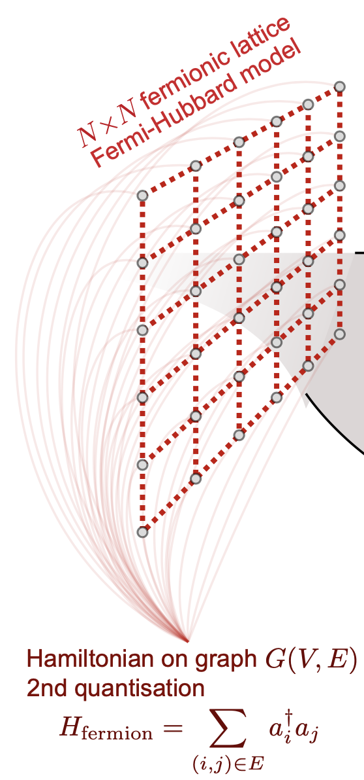
Solving difficult fermionic problems
+quartic terms

Slide 7
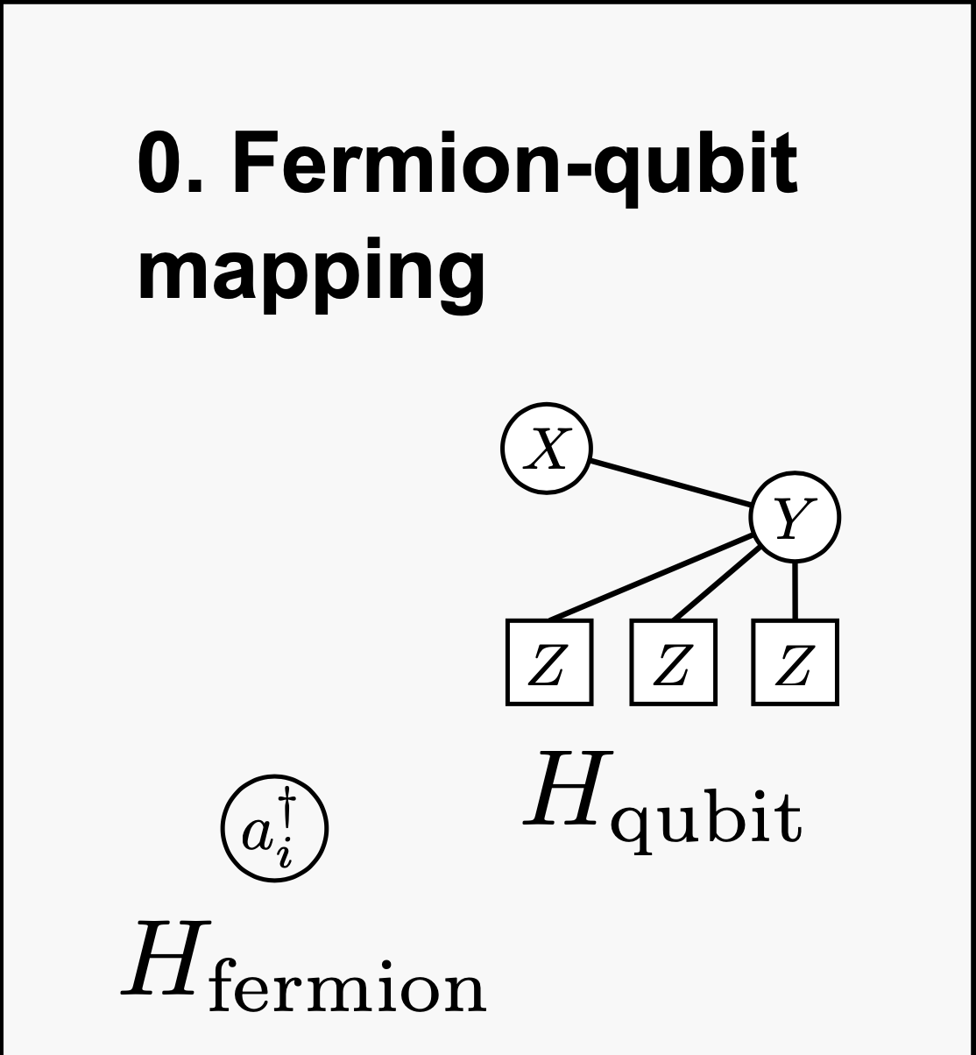
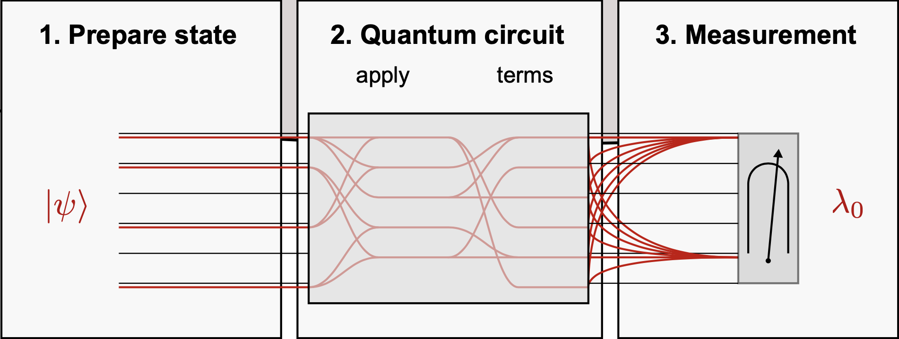
How to solve a typical instance of fermionic Hamiltonian
on a quantum computer
Problem: local fermionic interactions result in non-local qubit interactions
non-local qubit interactions lead to large quantum circuits
Easy in 1D: just use Jordan-Wigner mapping!
2D+ ? Very hard to preserve locality

Slide 8
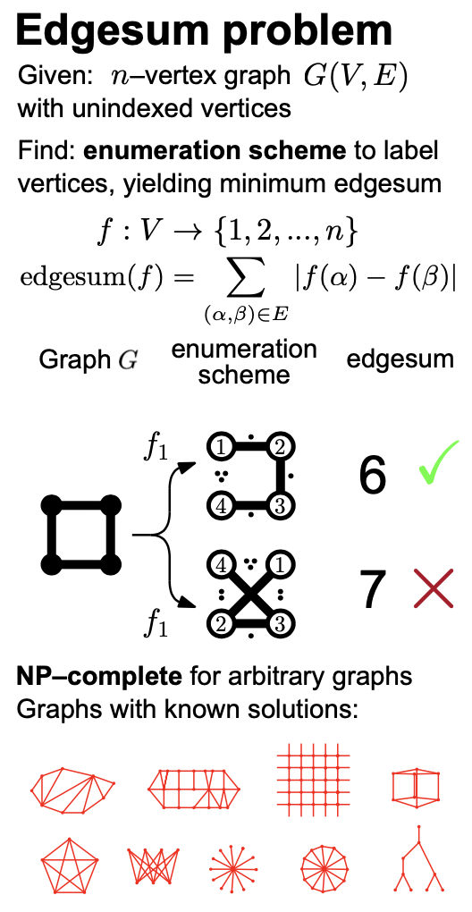
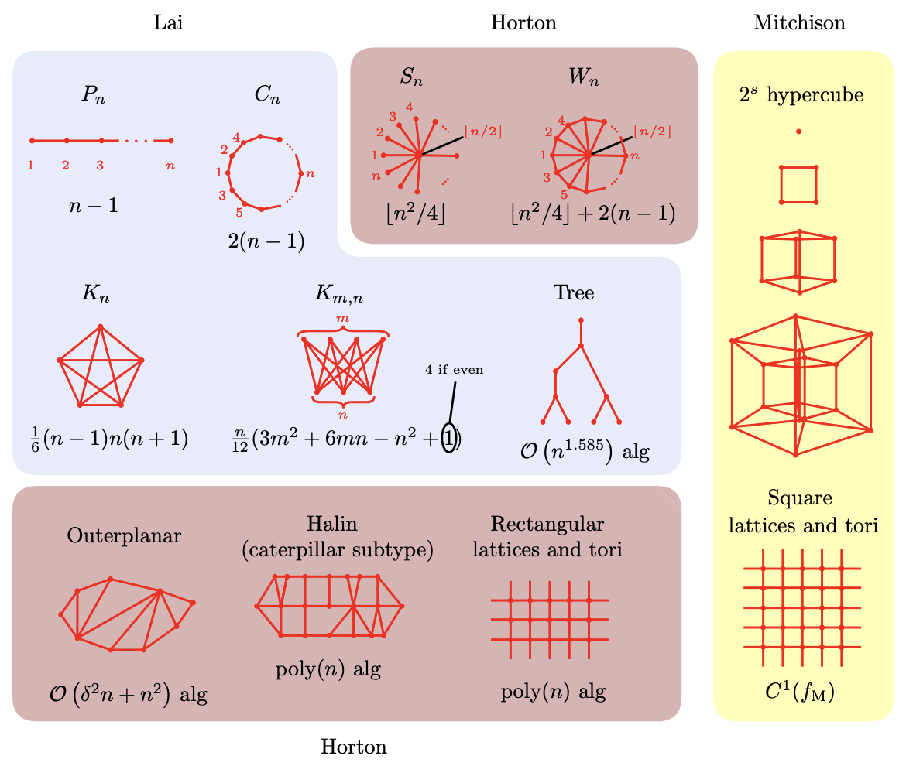
The role of fermion enumeration schemes
How to quantify the interaction cost? Edgesum problem
Connectivities for which optimal Edgesum solution
can be found efficiently

Slide 9
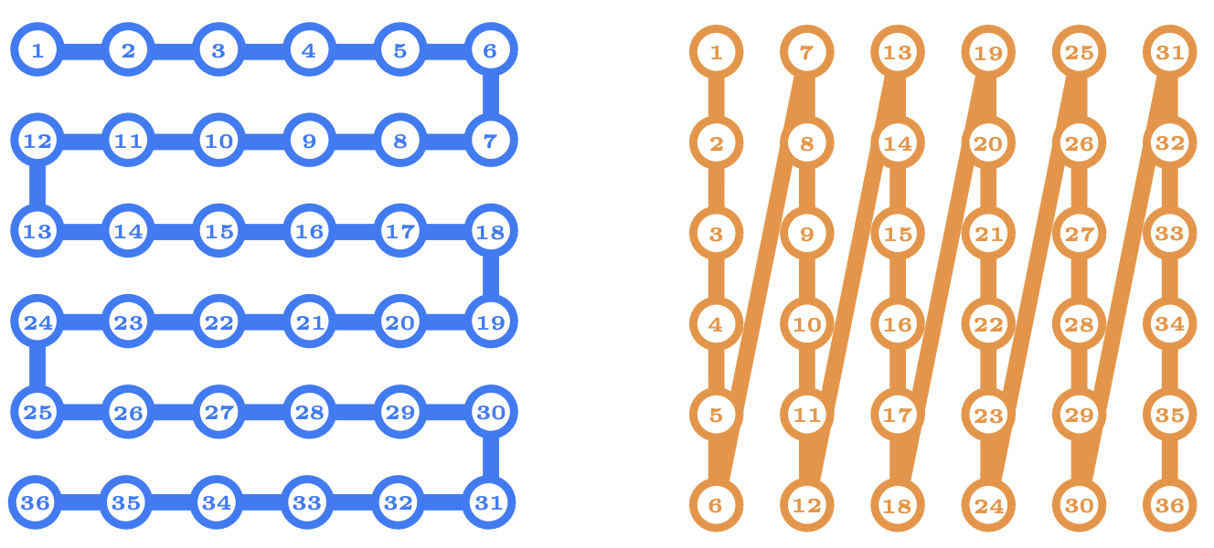
Fermion enumeration schemes for the 2D lattice
Verstraete, Cirac ‘05
De-facto standard for 2D fermionic systems

Slide 10
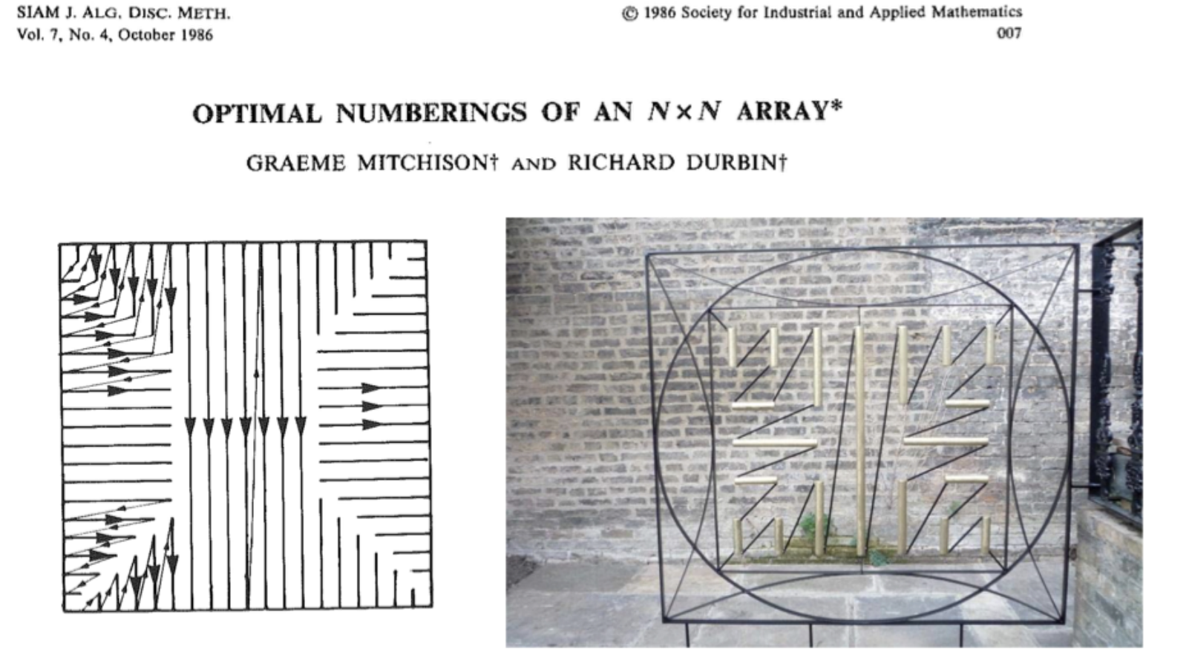
Which is the best fermion enumeration scheme?
It turns out that the most efficient way to label fermions is related to the work of
Graeme Mitchison and Richard Durbin when they studied the organisation of nerve
cells in the brain cortex!

Slide 11
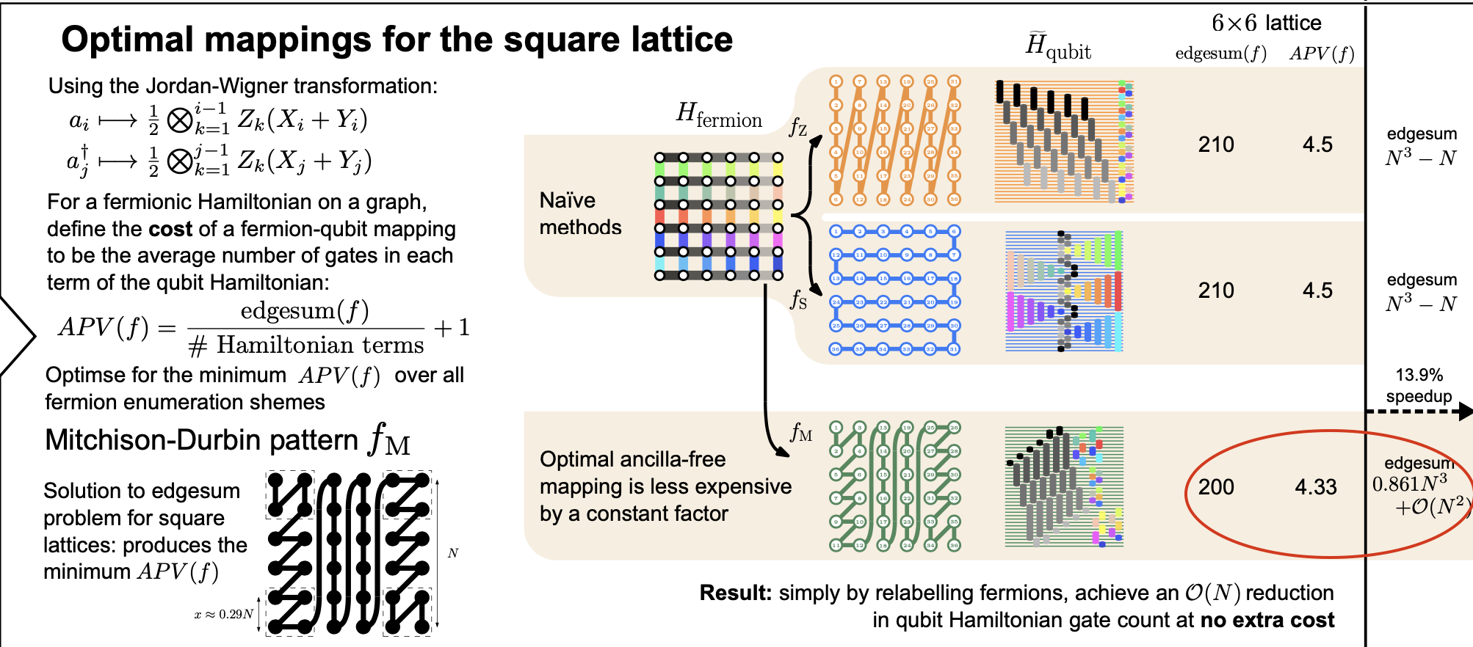
Which is the best fermion enumeration scheme?
No ancillary qubits needed!

Slide 12
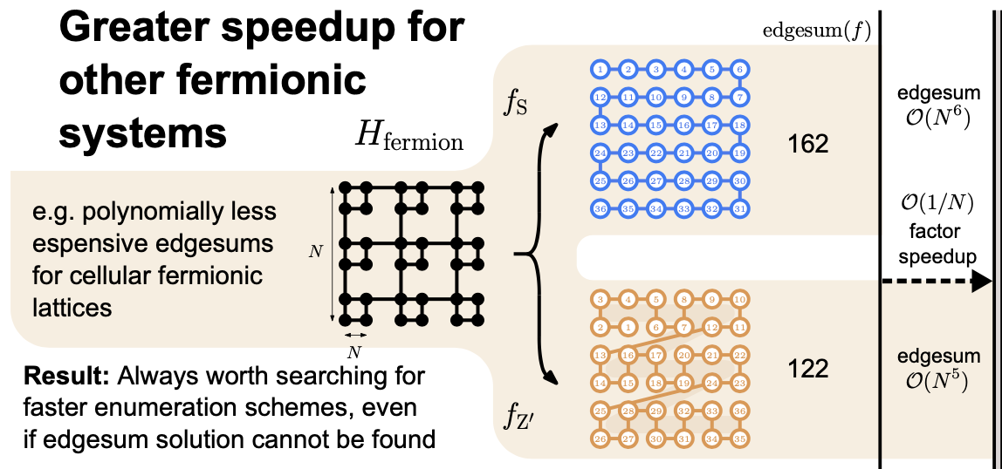
Adding just 2 ancillary qubits
37.9%

Slide 13
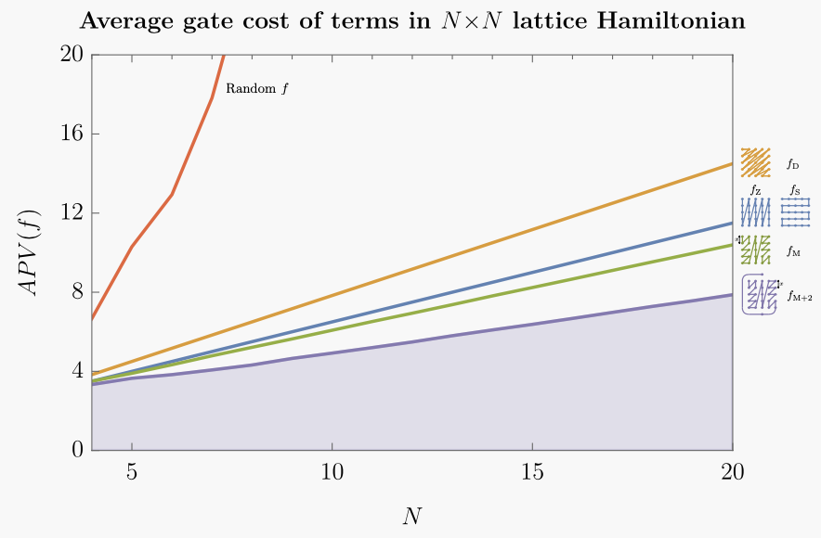
The benefits of selecting the best possible enumeration
M. Chiew, S. Strelchuk Optimal fermion-qubit mappings arXiv:2110.12792v2

Slide 14
Tensor Network Approaches

Slide 15
Tensor Network Approaches
Tensor networks in quantum computing/information theory are used to represent states of the system which belong to small but physically relevant subset of a larger Hilbert space.
Example: Matrix Product State ansatz
Ai’s represent (generally complex) matrices of small dimension
Very efficient when it comes to ‘contracting tensors’, i.e. finding an order of
Matrix multiplications (matrices are low-rank)
Despite working well only in 1D, it found a number of recent applications
see for example Silvi, Pietro, et al. "Tensor network simulation of an SU (3) lattice gauge theory in 1D.”
PRD 100.7 (2019): 074512.

Slide 16
Higher-dimensional systems
MPS no longer works. Need more powerful tensor network ansatze like PEPS (projected entangled pair states)
Finding the optimal contraction order of general tensor networks is very expensive: it is no easier to find contractions than to directly simulate quantum systems on a classical computer.
When the there is no ‘structure’ of the problem, i.e. we are dealing with uniformly ‘random’ objects such as quantum circuits in 2D+ that are made of random gates, then it is unlikely that we’d be able to contract/simulate efficiently.
Random systems are not very physical but that’s one of the few regimes where we can prove things
Real world physical systems are *not* random, so there is hope that by making use of the structure of the problem we can do much better!
T. Wahl, S. Strelchuk (to appear)

Slide 17
Tensor Network contraction via Sphere Separation
We derive rigorous bounds on the classical simulation time of general tensor network contractions
in d dimensions. Using the Sphere Separator theorem, we prove that a tensor network can be
contracted in subexponential time in the number of tensors if these have a finite-ranged connectivity.
In practice, numerics is a LOT faster than subexponential, even as the system size grows
Idea [planar separator theorem]: any planar graph can be split into smaller pieces by removing
a small number of vertices. The removal of O(sqrt(n)) vertices from an n-vertex graph can partition
the graph into disjoint subgraphs each of which has at most 2n/3 vertices.
Correspondence between different graphical representations of a tensor network contraction: Conventionally, each tensor is indicated by a dot whose legs
correspond to the indices of the tensor. Legs connected by lines indicate that the corresponding index is contracted. Each tensor is endowed with a sphere, and only
intersecting spheres can correspond to tensors with one contracted index. In the our example, up to k = 3 spheres overlap at any point.

