Slide 1
Transforming the Way that People Grieve
By Naida Balafkan and Ashton Kingdon

Slide 2
Content
The Story Of Us- Video
Research
Ethical Consideration
Technical Requirements
Business Models

Slide 4
The Story of Us
A new Paradigm of Grief and Mourning
A Bespoke Social Networking Application designed to Unite people in their grief
A Practical Approach to Grief Support
We aim to coincide with advances in technology and correlate with society’s relationship with grief
.

Slide 5
Interviews Conducted with Professionals who have a combined experience of over 100 years working within the funeral business
Marketing Strategies
Ethical Concerns

Slide 7
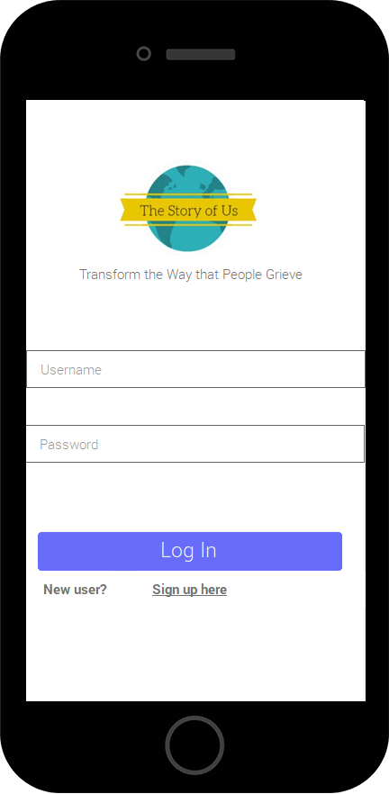
Application Mock-up

Slide 8
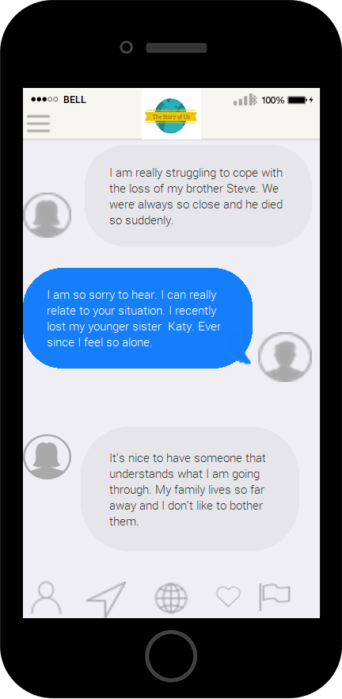

Slide 9
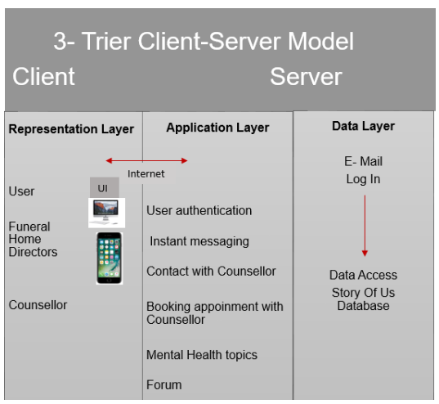
System Architecture

Slide 10
Business Model
registered Users have access to all features
Free of charge
Revenue Streams: Funeral Homes and Charities

