Slide 1



Digital Data Infrastructures: interrogating the social media data pipeline.
Les Carr and Susan Halford, Web Science Institute, University of Southampton.
Based on a paper by Susan Halford, Mark Weal, Ramine Tinati, Les Carr and Catherine Pope in New Media and Society, http://journals.sagepub.com/doi/abs/10.1177/1461444817748953

Slide 2

Introduction: what do we mean by ethics?
Minimalist (legal)
Regulated practice: consent, confidentiality/anonymity & the right to withdraw
Representational responsibility: methodological and epistemological

Slide 3





Social Media Data
From social media practices and effects … to data
An unexpected gift bringing rich research opportunities
Enthusiasm - the telescope - the macroscope …
‘… it is as if the inner workings of private worlds have been pried open’ (Latour 2007)
Scepticism:
‘[w]hatever value big data may have for “knowing capitalism”, its’ value to social
science has … [f]or the present at least, to remain very much open to question’
(Goldthorpe 2016)

Slide 4
We have conducted a survey of 10,000 people.
We don't know how these 10,000 people were selected as the company that collected the data for us won't share this information, but we know that at some point they said something about Southampton or Portsmouth.
These may not be 10,000 unique individuals; we have no way of knowing. Some people may have filled the form in multiple times. Some of the forms ( up to 20%) may have been filled in by computer algorithms. We don't know which is which.
Different people have filled in different variations of the form. We don’t know which is which.
We have categorised people into those from Southampton and those from Portsmouth based on location information they have either supplied (very rarely), that we have inferred.
We have analysed the data using a small, not exhaustive, quite subjective set of positive and negative words to give each person a happiness rating from 1-10. Based on this we can say with a p=0.05 level of certainty that people living in Southampton are happier than people living in Portsmouth.

Slide 5
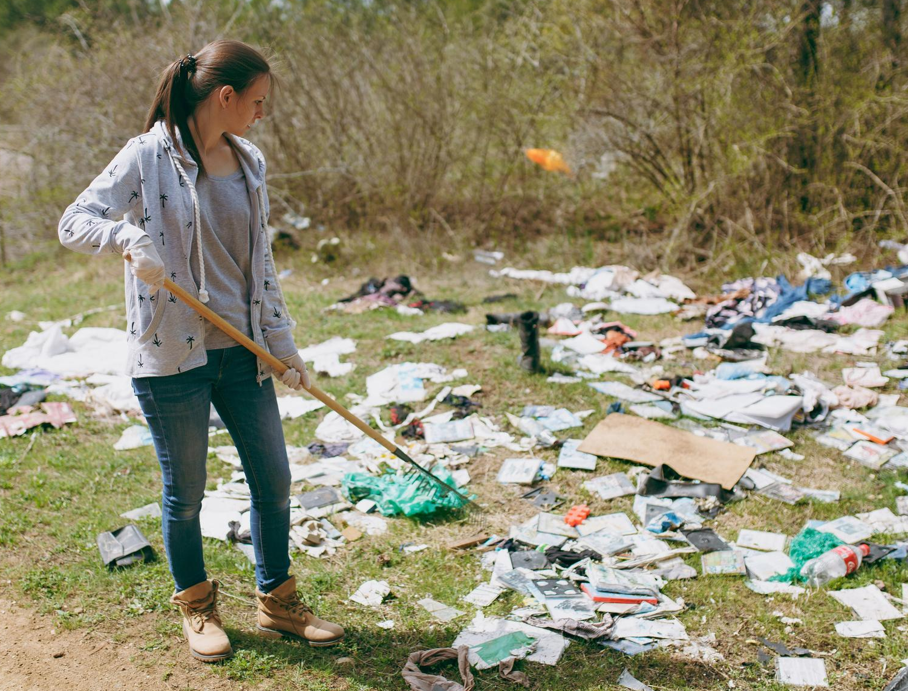
“For this paper, a number of interviews had been conducted, transcribed and printed by other researcher(s) for unknown reasons. The resulting printouts were torn into shreds, mixed up and dumped. I have used some of these found statements and interpreted them against my research questions.”

Slide 6
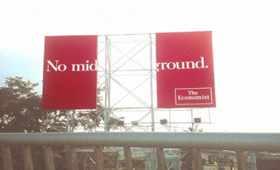
A middle path, between giving in and getting out (Gehl 2015)

Slide 7

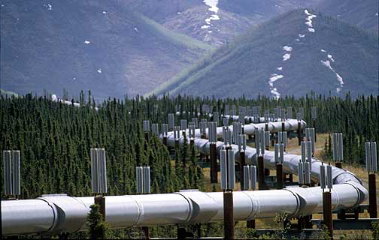
The Data Pipeline
Sociotechnical
Iterative
Core to the generation of data
Core to the circulation of data
Methodological implications?

Slide 8
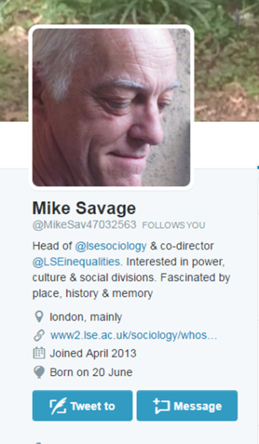
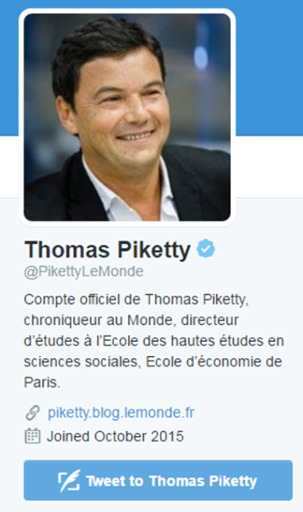
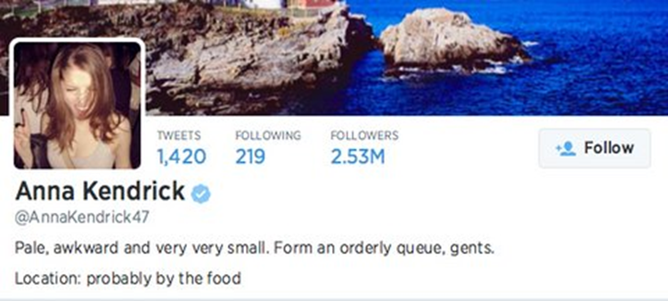
1: Population
Demographics
Location
GPS location enabled - <3%
Jakarta 2.86%
Moscow 0.77%

Slide 9
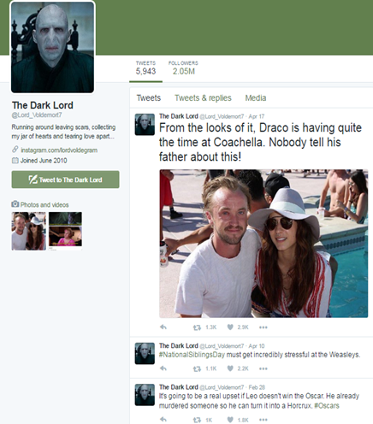
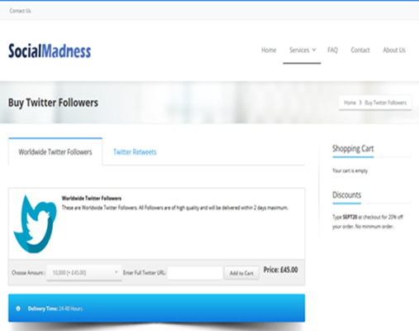
1: Population
Demographics
Location
Users – sovereign individuals?
Add corporate account image

Slide 10
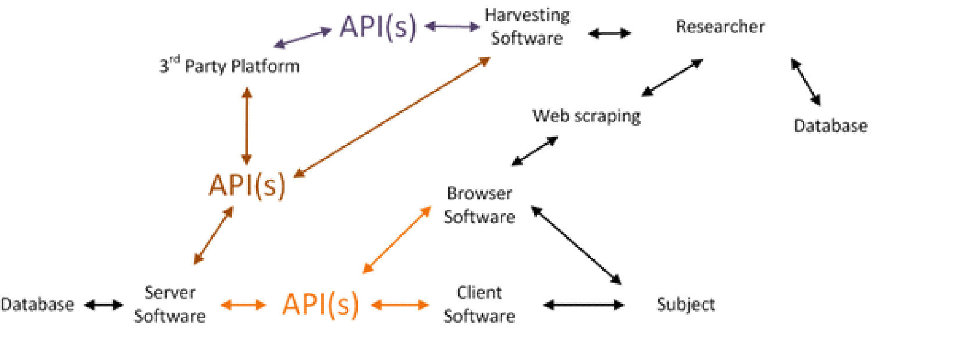
2: Sample
How the data are harvested shapes the sample
The API shapes the sample e.g. % data streams, real time/historic
Rate limiting

Slide 11


3: Method
Instruments for data collection
Affordances
For example: functionalities, data bases – shape data in specific ways over time

Slide 12
 |  | Population | Sample | Method of data production
Database |  | Storage design and method shapes the types of information recorded about users. | Historic data storage decisions and technical query limitations may shape what data are included in samples. | Considerations of cost, performance and business requirements for data storage may shape what data are collected and stored and how.
Server Software |  | Determines who or what has access to the service, and what information is required to set up an account. | Server capacity may restrict data volume delivered; geographical location of server may affect data delivered. | Operates data management (e.g. spam removal and moderation, load balancing) shaping what data are collected.
API |  | APIs may not recognise all characters (languages) effectively; or be available to all operating systems/software development toolkits | A variety of differently structured samples may be available. | Defines the scope and volume of what data can be collected, stored and queried.
Harvesting Method |  | Harvesting methods construct different views of the populations. Web scraping may be more likely to access the population of currently active users, which could be different to the population accessed via historical searches using an API. | Web scraping will by-pass ‘official’ data samples, offering data from a sample of web pages. This sample may be affected by the ‘filter bubble’ of the person accessing the web pages. Use of third party data may introduce additional sampling effects. | Different harvesting methods have access to different types of data about the population and sample.
Client Software |  | Different clients may generate different information about the population. On some platforms you may know what client generated the content (this used to be the case on Twitter), on many though you can’t know this. | Some clients (apps) may receive more data than others (if harvesting through a client). | Different clients may produce distinctive forms of data and metadata e.g. some may add geographic data by default, some might link directly to shared or re-shared material.
Subject |  | Different subjects – human/non-human, demographically distinct – may characterise particular platform populations. | User activities may shape sampling methods (e.g. official samples may focus on central or highly active users.) | User practices and meanings shape the data generated and the claims that can be made from these.

Slide 13
The basic tenets of ethical practice include the fundamental rights of human dignity, autonomy, protection, safety, maximization of benefits and minimization of harms, or, in the most recent accepted phrasing, respect for persons, justice, and beneficence.

Slide 14

Conclusion
Recognise the limits of what we can and can’t know about social media data
Key steps
Transparency
Consider implications of data construction for research questions
Knowledge claims
Creative data assemblages

