Slide 1


When Virtual Networks meet Physical Networks
Perils of Data Mining for Real-time Transport Information
Ben Waterson
Data Mining: Exploring the Ethical Dilemmas, 14th June 2018

Slide 2
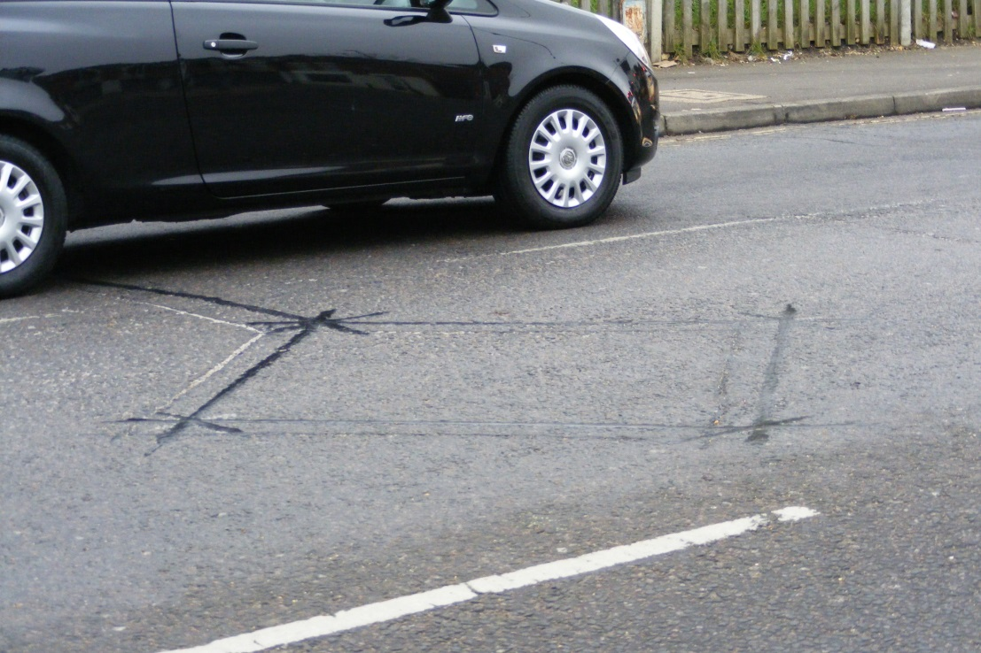
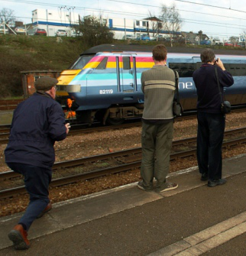
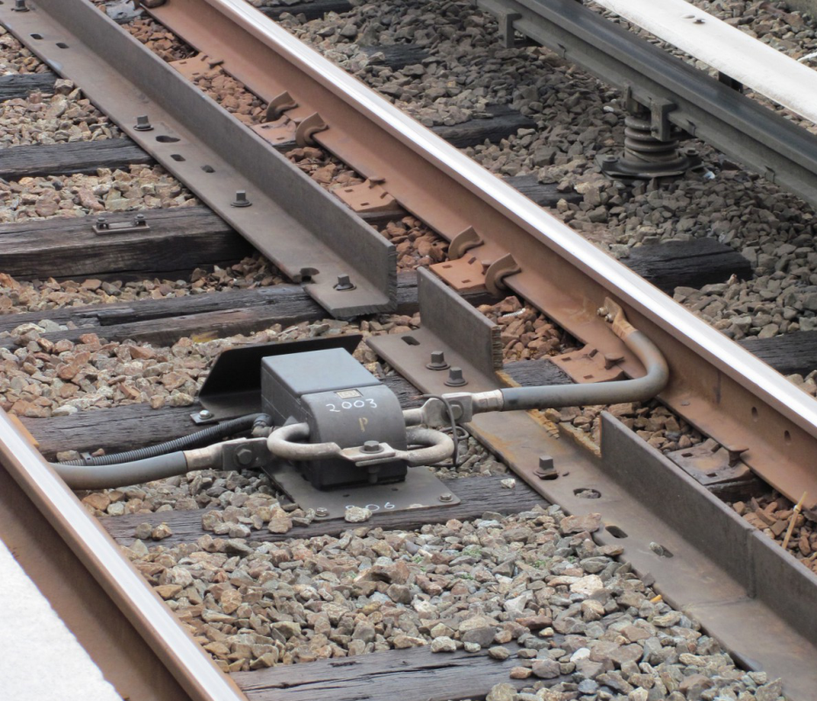
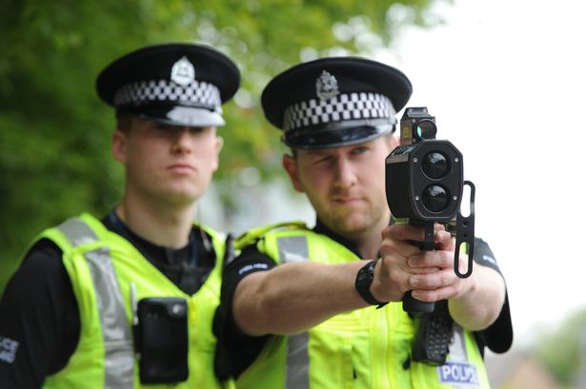
A (Very Brief) History of Transport Data Mining
http://www.eadt.co.uk
http://www.walesonline.co.uk
http://ggwash.org
Notes:
2

Slide 3
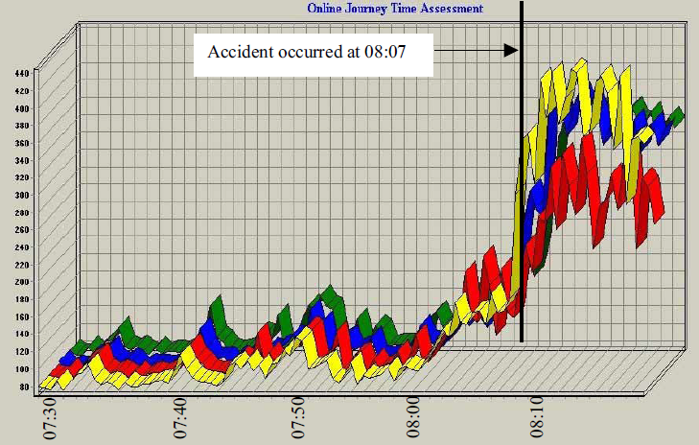
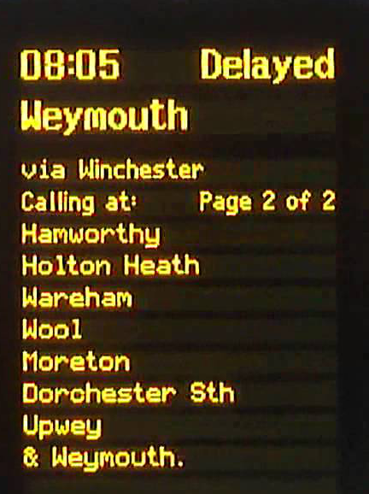
A (Very Brief) History of Transport Data Mining
Notes:
3

Slide 4
Transport Information Aims
Infrastructure Data
Accurate
Social Media Data
Tracking Data
Timely
Relevant
Notes:
4

Slide 5
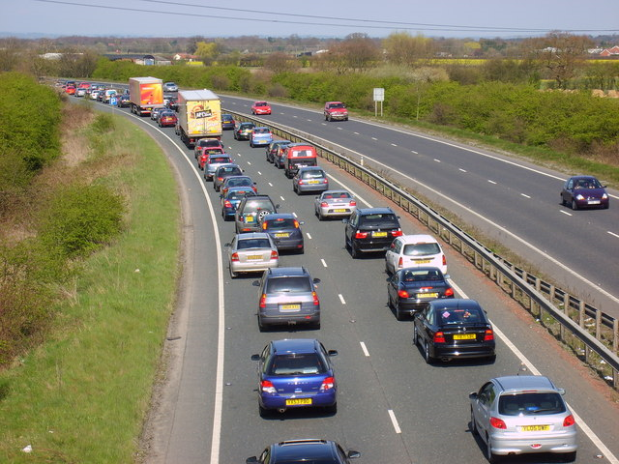
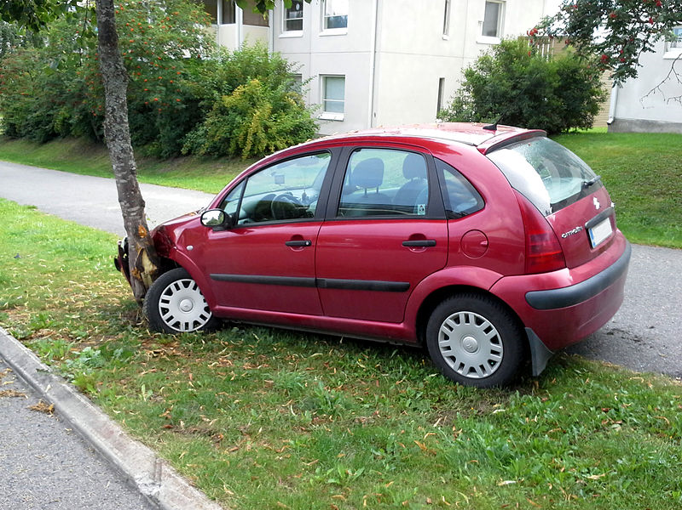
The Importance of Location.....
In virtual networks (of people or systems) physical location is not important
In transport networks however precise physical location is often critical
© Sam Kelly
© Tommi Nummelin
Notes:
5

Slide 6
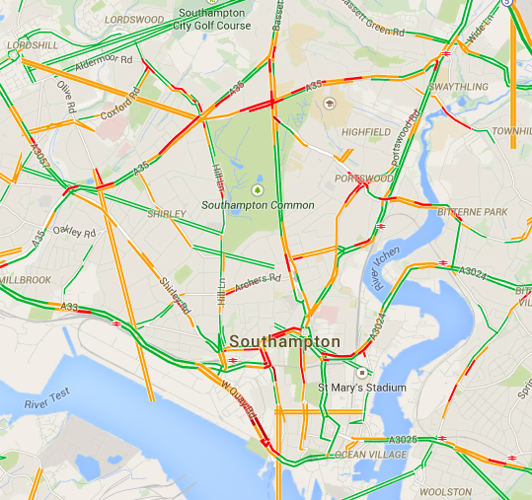
Tracking Data
The best source of real time traffic conditions is the vehicles that are actually experiencing it
The problem is that one vehicle does not represent typical conditions
But it is NOT just a big-data number crunching question
http://www.google.co.uk/maps
Notes:
6

Slide 7
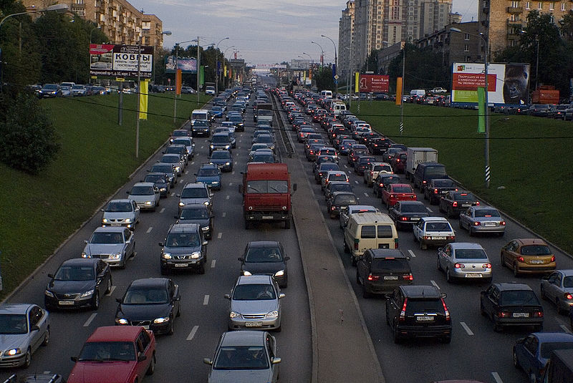
Social Media Data
© Basil Arteomovue
Notes:
7

Slide 8
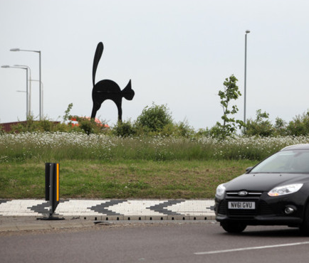
#Congestion
The GOOD ....
The BAD ....
The Just Strange ....
@RHALtd
Overnight closures on A1 at Black Cat
starting 17 October 2014 #Roads #Congestion‏‏
‏‏@afrojunkman
Busy watching tail-lights #congestion #trafficjam
http://www.bedfordshire-news.co.uk
@SinusBuster
To help clear your #congestion, try this Grilled Stuffed Jalapeno Chiles with Grilled Red Pepper-Tomato Sauce recipe http://buzz.mw/bcz1o_f
Notes:
8

Slide 9
#delays / #delayed
The GOOD ....
The BAD ....
The Just Strange ....
@TheProspect1
Everyday this week @crosscountryuk the 18.16 Taunton to Exeter has been #delayed
‏@jenwilsonTO
Hey commuting friends, the subway is super, super broken this morning #delays
‏@keepingupwithky
OMG! I want to freak out and be all, "I KNOW #WHOKILLEDSAM!" but...I'm on dvr. So you guys all freaked out a half hour ago. #delayed
‏@JonnyMcGarrigle
Based on a car ride with mum earlier she approves of the new @ThoseGhosts EP #delays and the @WonderVillains debut #rocky
Notes:
9

Slide 10
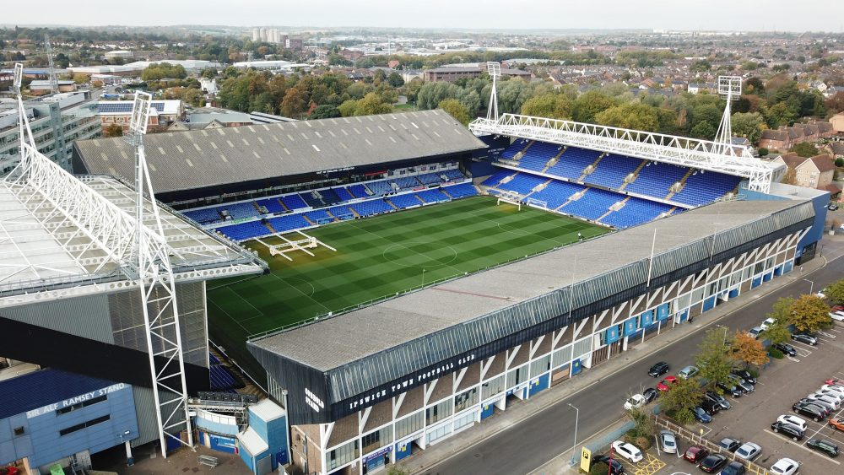
Ethics : Jumping to Conclusions.....
http://lwi.co.uk
Notes:
10

Slide 11
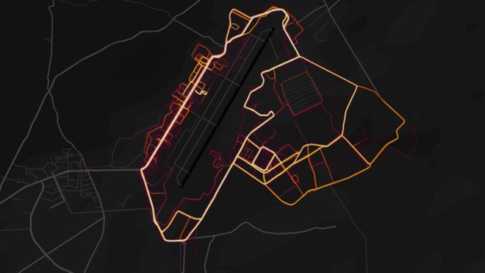
Ethics : Inadvertent Disclosure.....
http://www.bbc.co.uk
Notes:
11

Slide 12
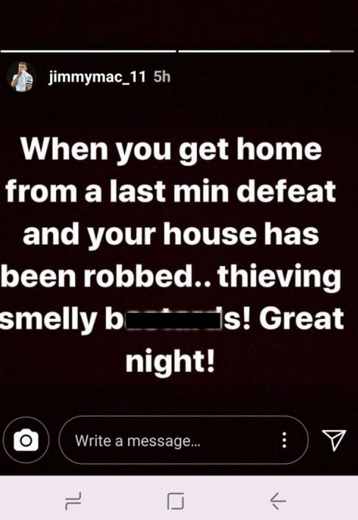

Ethics: Extended Absence.....?
http://www.dailymail.co.uk
http://www.sportbible.com
Notes:
12

Slide 13

Ethics : Tracking Individuals.....
For Regular Travel
Your mobile phone has probably worked out where you live and where you work.
It knows your usual travel routes and times.
It knows where you are.
For Irregular Travel
You have booked train tickets to the airport.
You have booked flights to some faraway location (plus a hotel for two weeks).
And you have just sent a (public) social media message saying:
Notes:
13

Slide 14
When Virtual Networks meet Physical Networks
Perils of Data Mining for Real-time Transport Information
Ben Waterson
Data Mining: Exploring the Ethical Dilemmas, 14th June 2018

