Slide 2
The RDTZ
Optimising the Southampton Network Architecture
18th April 2018
Simon Lane
Senior Network Architect
iSolutions

Slide 3
The RDTZ Brief
Perform µViz tests at 1 Gbps
Deploy perfSONAR node alongside µViz datastore
Deploy perfSONAR node outside campus border firewalls
Upgrade µViz datastore to 10 Gbps
Deploy External DTN outside campus border firewalls
Do some tests
Observe impact on the network

Slide 4
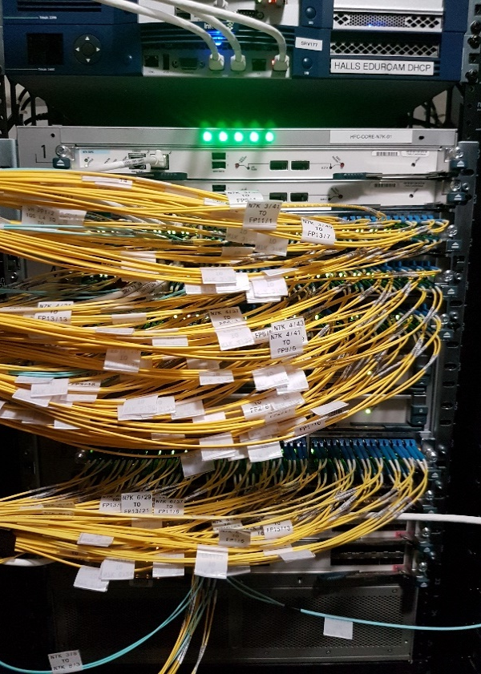
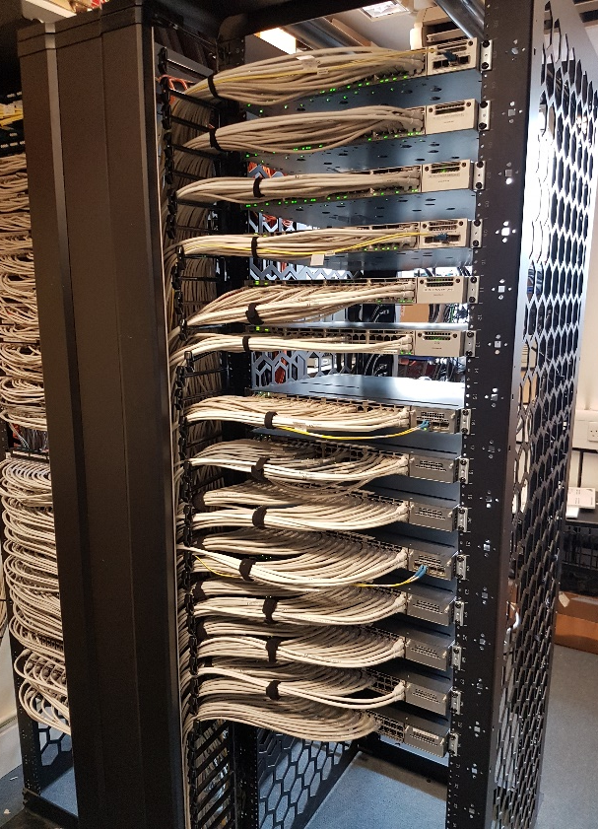
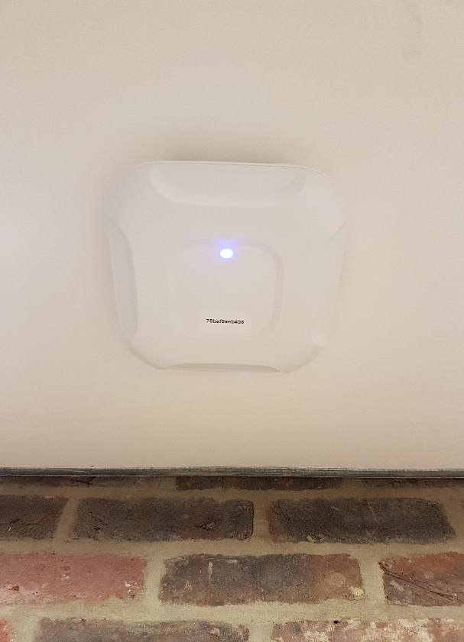
Network Architecture - LAN
Core Switches
4* Cisco Nexus
140* 10 Gbps
Edge Stacks
1,160* Cisco Catalyst
10 / 1 Gbps
Wireless APs
2,800* Cisco APs
a/b/g/n/ac →1.3 Gbps

Slide 5
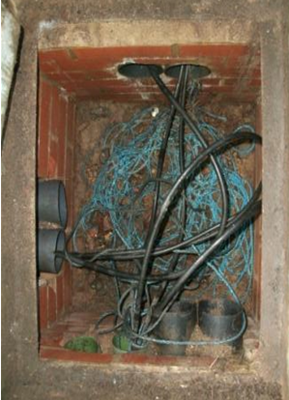
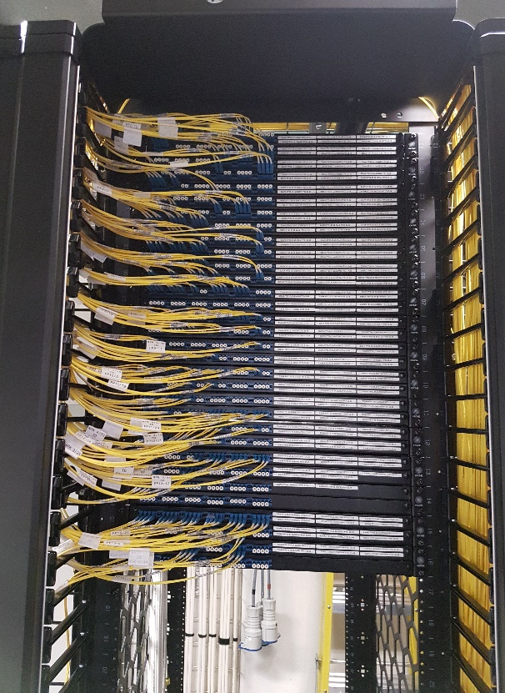
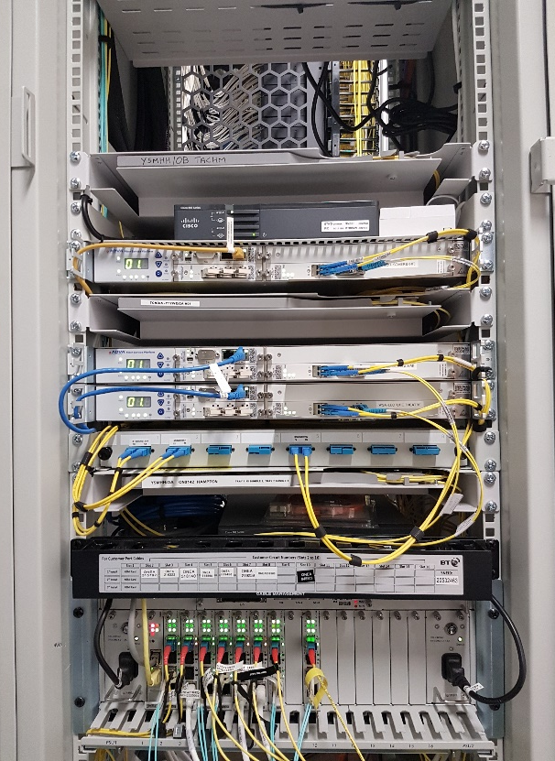
Network Architecture - Infrastructure
Ducts
Resilient routes
Avoid major buildings
Fibre
30Km new cables
750Km singlemode fibre
Wide-Area Circuits
BT, Virgin Media, SSE
Up to 10 Gbps

Slide 6
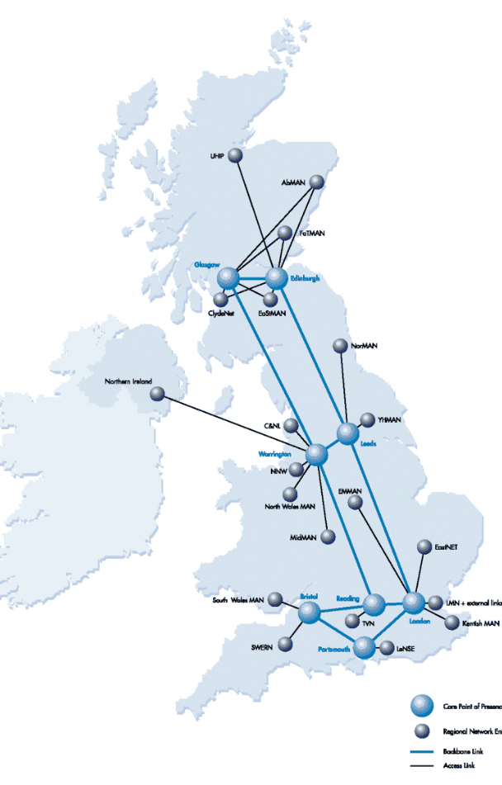
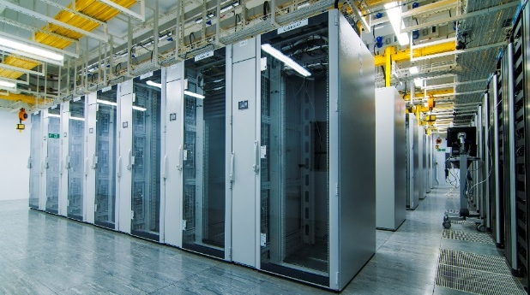
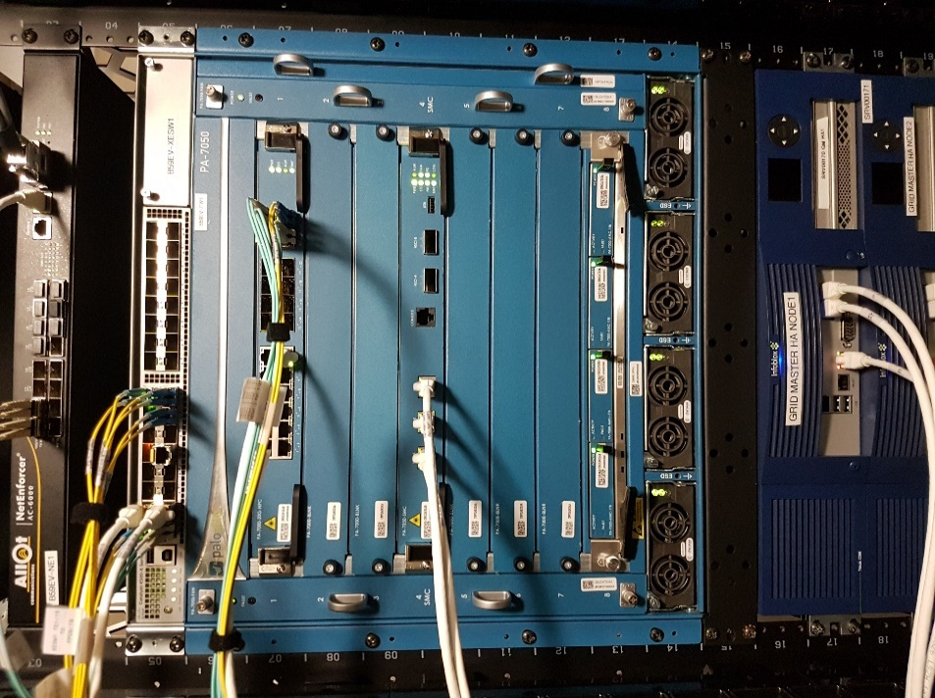
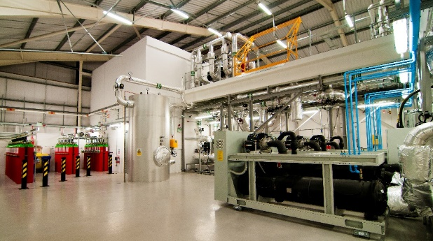
Network Architecture - External
Border Firewalls
2* Palo Alto 7050
HA failover pair
Internet
2* 10Gbps to JANET
Data Centre
1* 10Gbps to JANET
4* 10Gbps to Highfield

Slide 7
Local Area Network

Slide 8
Wide Area Network

Slide 9
µ-VIS
Principally located in building 5 on Highfield campus
X-Ray scanners
Data-store and workstations mostly co-located
10 Gbps network internally and over fibre to building 54
External facilities
Diamond Light Source generates large data sets
up to 20 TBytes for analysis and visualisation locally
Standard 1Gbps University Network connection (CAT 5e)
may be perceived as too slow or impractical for big transfers
however the network appears to have some capacity available …

Slide 10
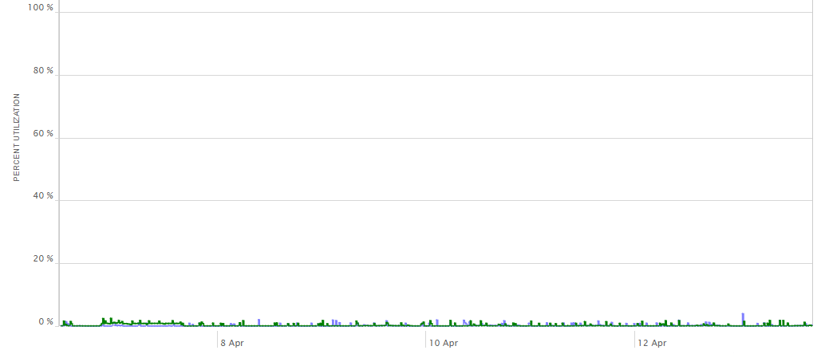
Capacities – Edge Buildings
Switch stack up to 8 switches (64 Gbps stacking capacity)
48* 1 Gbps ports per switch
2* 10 Gbps to Highfield core (LACP sharing)
Typical switch stack uplink utilisation

Slide 11
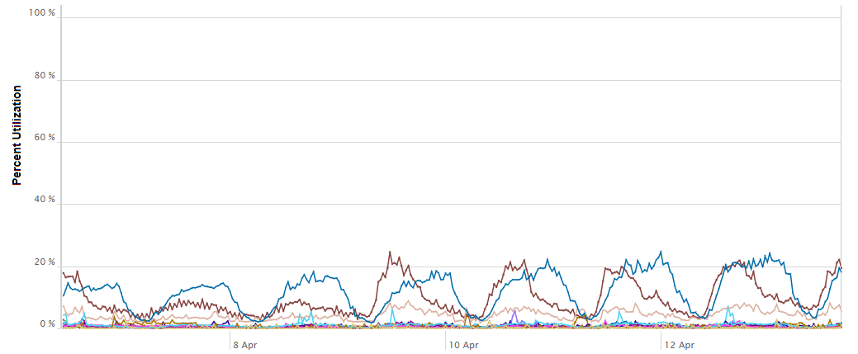
Capacities – Highfield Core
140* 10Gbps interfaces active on each chassis
550 Gbps per slot on chassis
15 Tbps switching capacity
Typical interface utilisation

Slide 12
Capacities – JANET links
2 Highfield links in use (DC link is disaster recovery)

Slide 13
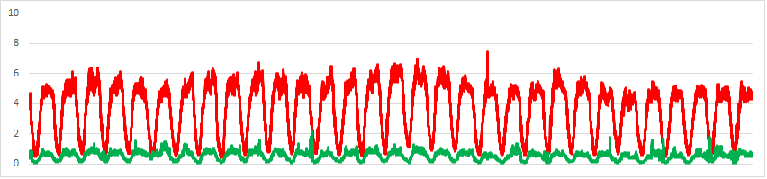
Capacities - Firewall
Application Aware Next Generation firewall
Threat signatures updated daily from Global Cloud
Active/Passive stateful failover
About 15 Gbps throughput capability with current blades
10 Gbps external interface, 2* 10 Gbps internal interfaces
Typical firewall throughput

Slide 14
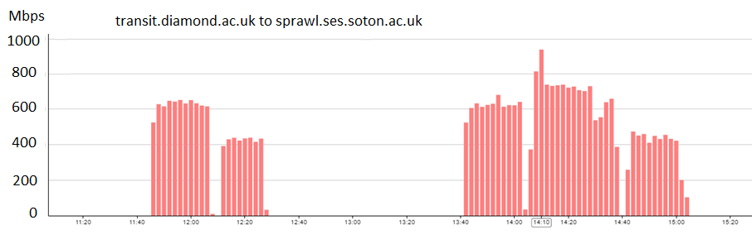
µ-VIS 1 Gbps Results
Installed Globus on µ-VIS server and tested transfers from Diamond Light Source
Peaked at 900 Mbps

Slide 15
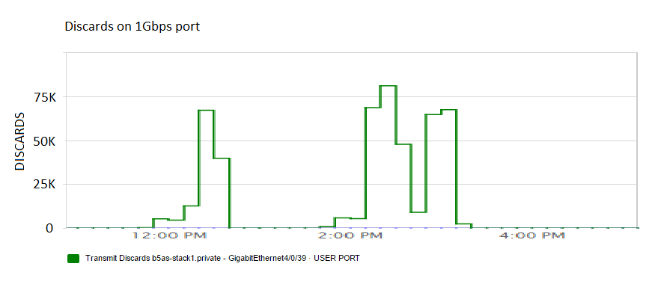
µ-VIS 1 Gbps Results
However a significant number of packet discards at the 1Gbps port.
Presumed due to buffer overflow in edge stack on transition from 10 Gbps to 1 Gbps

Slide 16
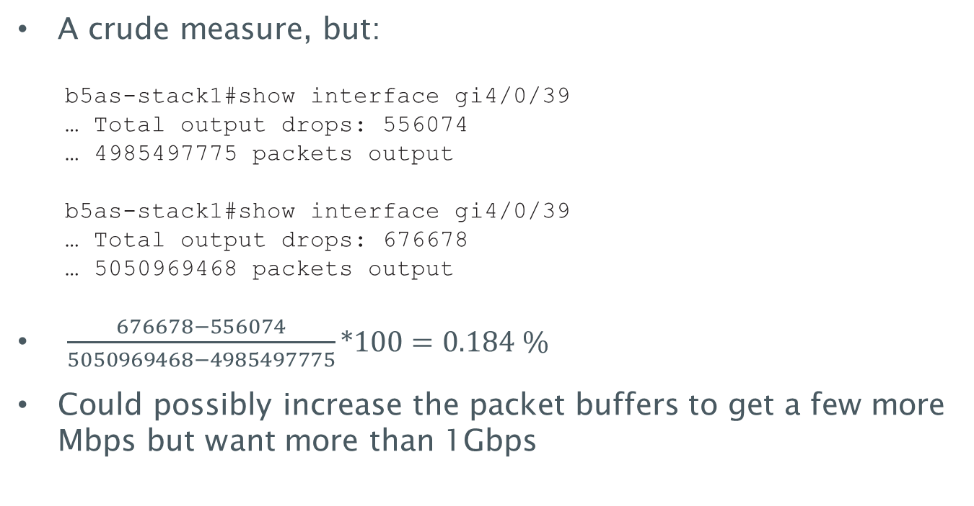
Packet loss rate at edge switch port
A crude measure, but:
b5as-stack1#show interface gi4/0/39
… Total output drops: 556074
… 4985497775 packets output
b5as-stack1#show interface gi4/0/39
… Total output drops: 676678
… 5050969468 packets output
$\frac{676678−556074}{5050969468−4985497775}∗100=0.184 \%$
Could possibly increase the packet buffers to get a few more Mbps but want more than 1Gbps

Slide 17
perfSONAR
Looks at end-to-end network performance
packet loss, latency, throughput
Mesh of perfSONAR nodes
Compare inside/outside of UoS network
Is the Research DMZ model likely to be of benefit here?

Slide 18
Deploy perfSONAR
External server:
Dell PowerEdge R610 Intel(R) Xeon(R) CPU E5520 @ 2.27GHz (2 CPU, 8 cores) 24GB RAM CentOS Linux release 7.3.1611 (Core)
Internal server:
Dell PowerEdge R210 Intel(R) Xeon(R) CPU X3470 @ 2.93GHz (1 CPU, 8 cores) 8GB RAM CentOS Linux release 7.3.1611 (Core)
Both built from the perfSONAR Toolkit ISO
Application specific rules in campus firewall where possible (iperf, traceroute, icmp, ssl, web-browsing)

Slide 19
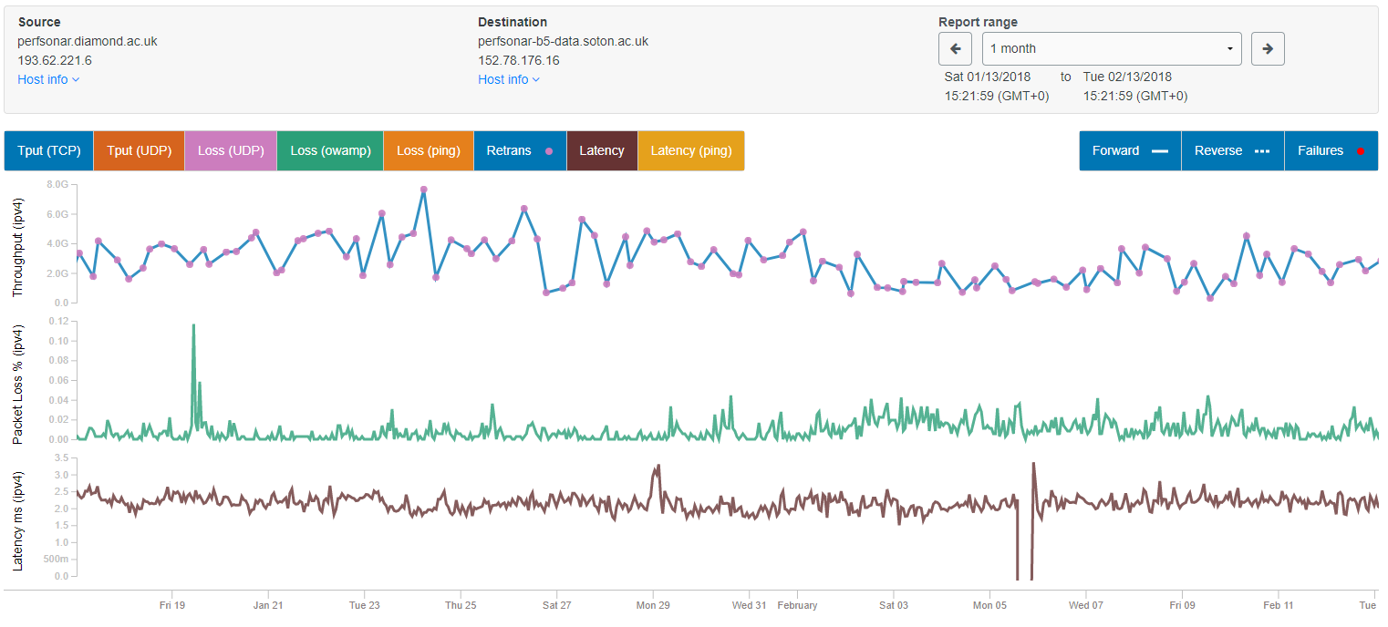
perfSONAR Results
Diamond to Internal perfSONAR (building 5)
http://perfsonar.diamond.ac.uk/

Slide 20
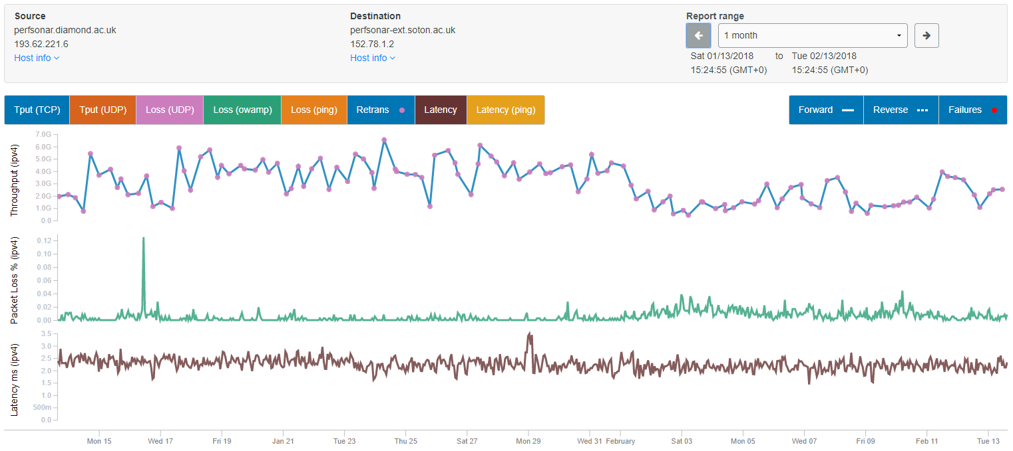
perfSONAR Results
Diamond to External perfSONAR
http://perfsonar.diamond.ac.uk/

Slide 21
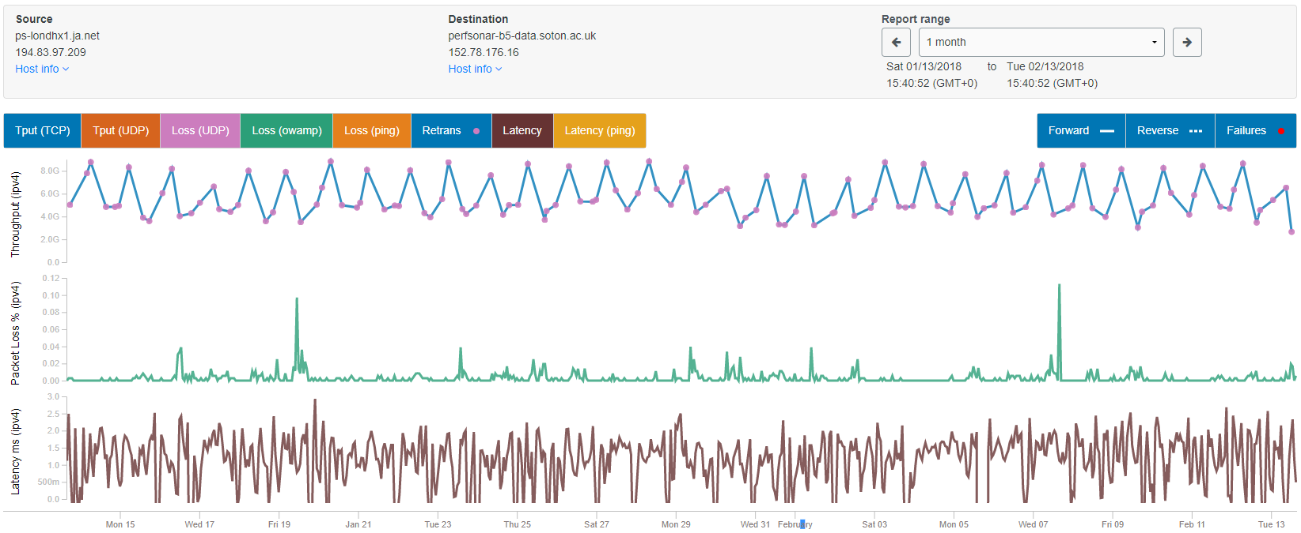
perfSONAR Results
ps-londhx1.ja.net to Internal perfSONAR (Building 5)
http://ps-londhx1.ja.net/

Slide 22
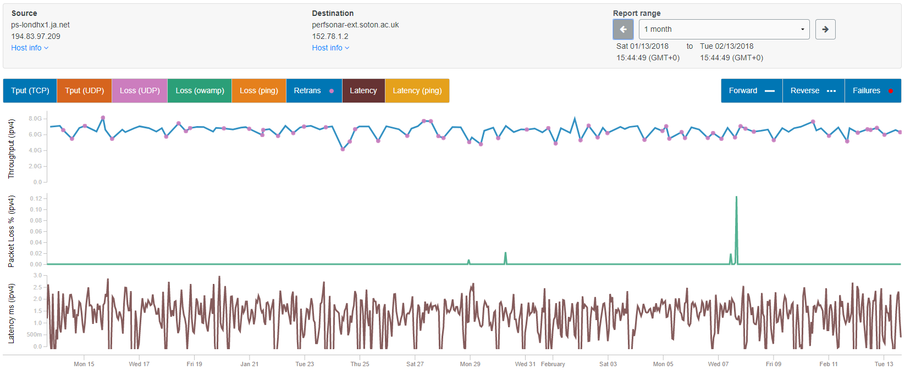
perfSONAR Results
ps-londhx1.ja.net to External perfSONAR
http://ps-londhx1.ja.net/

Slide 23
perfSONAR Results
From diamond to internal and external perfSONAR
throughput quite erratic 1 → 5 Gbps
packet loss typically <0.02%
From JANET to external perfSONAR
throughput fairly consistent 6 → 7 Gbps
zero packet loss most of time, good for high RTT transfers
From JANET to internal perfSONAR
firewall / LAN introduces small loss, typically <0.02%
throughput more erratic than external node 4 → 8 Gbps
higher peak may be result of CPU differences in perfSONAR nodes

Slide 24
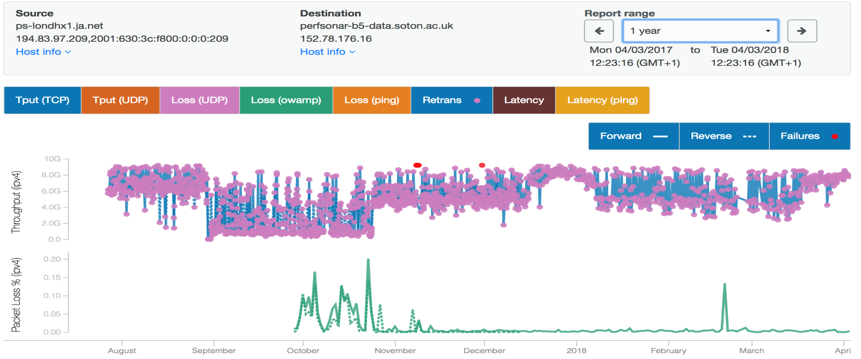
Network Hiccup
Content update affects iperf throughput tests
Palo Alto content update released and withdrawn
Palo Alto software upgrade

Slide 25
perfSONAR Conclusions
Should be able to get > 1Gbps to internal hosts, but may be quite erratic – day/night, term/vacation
Firewall / LAN introduces some packet loss
Hosts outside the firewall could perform more consistently well due to low packet loss and no contention on firewall interfaces

Slide 26
µ-VIS 10 Gbps connection
Upgrade µ-VIS to 10 Gbps campus connection
CAT 5e cable will not do 10 Gbps
spare single-mode fibre available to µ-VIS
spare 10 Gbps port on edge switch stack…
… plug it in
Some operational concerns as had not deployed 10 Gbps to “user space” before.
short tests initially
monitoring systems alerted to high utilisation
no other impact observed

Slide 27
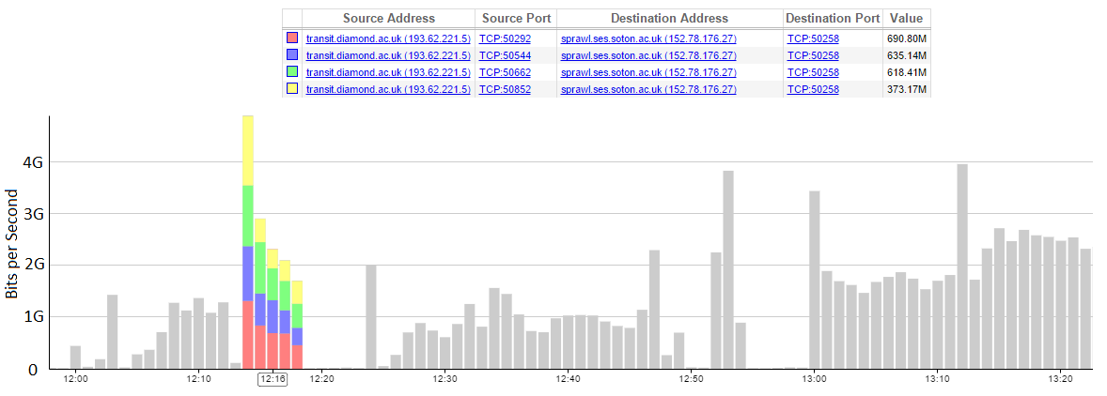
µ-VIS 10G Globus Results
Richard will say more about the results achieved
Early test below shows 4 concurrent streams up to 4 Gbps

Slide 28
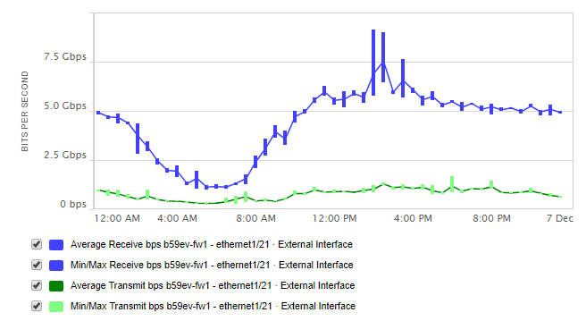
µ-VIS 10G Globus Results - Firewall
Firewall external interface peaking to 9.2 Gbps
No detrimental effects observed

Slide 29
Deploy External Globus DTN
Server to hand
Dell PowerEdge 720 24 CPUs x 2.399 Ghz (2 socket 12 core) Intel XEON CPU E5-2695 256GB Memory 300 GB SSD, 2TB HDD Intel X520 10Gb/SFP+
Red Hat Enterprise Linux 7
Globus Connect Server https://docs.globus.org/globus-connect-server-installation-guide
iptables on host, packet filtering rules (acl) in external switch

Slide 30
External Globus DTN
Deployed as test device only
server hardware probably not optimal for task
not integrated with UoS user accounts
only 2 TByte hard disk, 300 MByte SSD
no direct access to any shared filestore
no service resilience
In current form, can use as a staging post
to work around high RTT, lossy paths perhaps

Slide 31
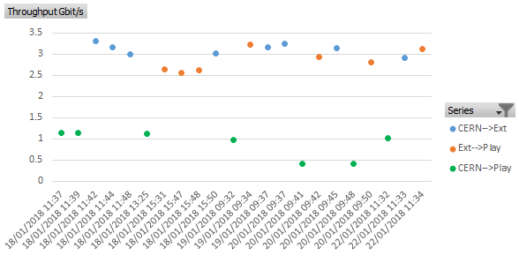
External DTN results
10 GByte file from CERN to a test host (VM) in the DataCentre staged via the DTN, compared to direct.

Slide 32
Project Observations
Capacity of external firewall interfaces probably limiting factor right now
high capacity firewalls and core LAN equipment are expensive
does the value of inspecting a flow diminish for big flows?
perfSONAR measures network performance, and can identify changes in network behaviour affecting large data transfers
Understanding packet loss through the firewall and LAN equipment is difficult
A basic Globus DTN was easy to set up, and easy to use
Globus desktop is equally easy

Slide 33
Project Observations
No negative impact from perfSONAR or Globus transfers
TCP played nicely so far
We haven’t done any work at the DataCentre – where our HPC and most of our storage reside
The Science DMZ could be built at Southampton
we have physical infrastructure across the Highfield campus
requires resources to design, build and monitor
requires understanding of security issues
how do you get the data out of the DMZ once on-site?
which campuses would need it and how would we reach them?
do you need it?

Slide 34
Simon Lane
Senior Network Architect
iSolutions
S.J.Lane@soton.ac.uk

