Slide 1
Research Data Transfer Zones
Professor Tony Hey
Chief Data Scientist
STFC Rutherford Appleton Laboratory
Didcot, OX11 0QX, UK

Slide 2
e-Infrastructure and Research Networks

Slide 3

NSF Task Force on ‘Campus Bridging’ (2011)
The goal of ‘campus bridging’ is to enable the seamlessly integrated use among:
a researcher’s personal cyberinfrastructure
cyberinfrastructure at other campuses
cyberinfrastructure at the regional, national and international levels
so that they all function as if they were proximate to the scientist

Slide 4
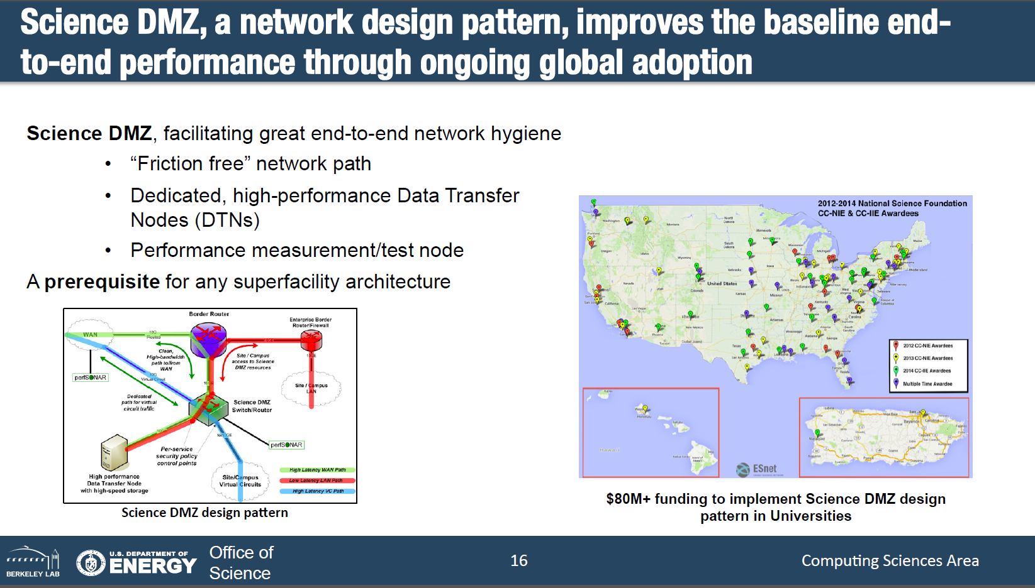

Slide 5
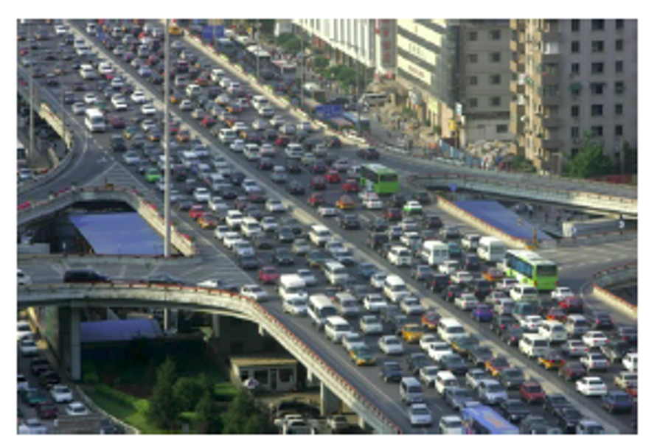
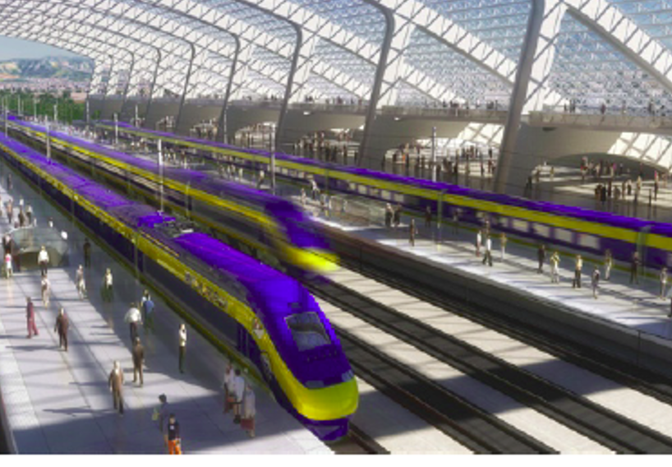
Need for European adoption of ‘Science DMZ’ end-to-end network architecture
Science DMZs implemented at over 100 US universities
NSF invested more than $80M in DMZ campus cyberinfrastructure

Slide 6











The UK Met Office UPSCALE campaign
Automation controller
5 TB per day
100100100001110101
JASMIN
2.5
TB
Data transfer
Data conversion & compression
HERMIT @ HLRS
Clear data from HPC once successfully transferred and
data validated

Slide 7
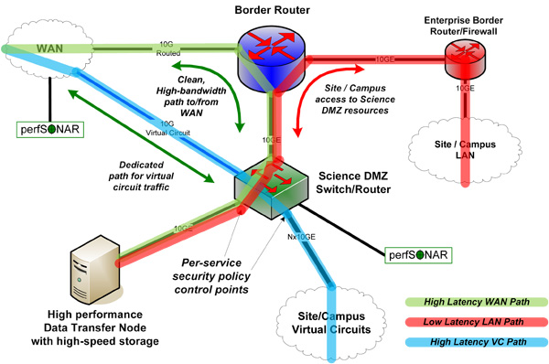
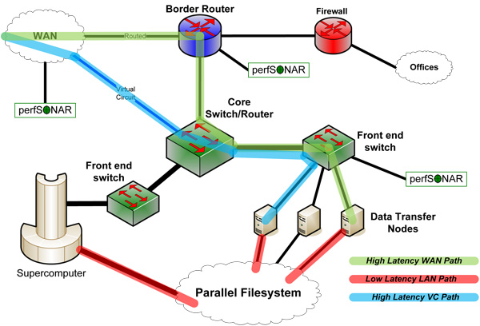
JASMIN Research Data Transfer Zone Architecture
Simple Data Transfer Zone (DTZ)
Supercomputer Center DTZ
http://fasterdata.es.net/science-dmz-architecture

Slide 8
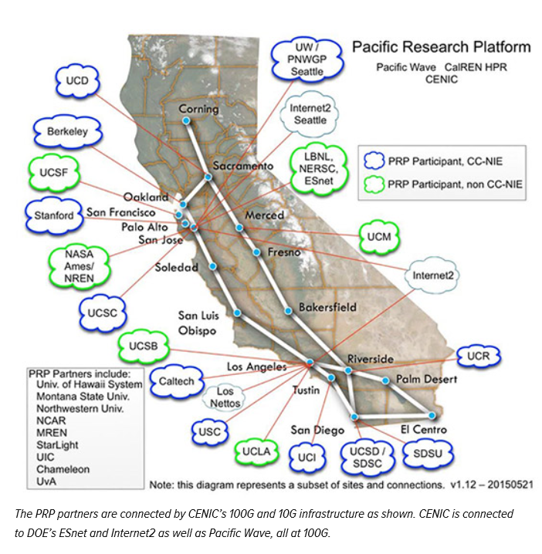
Pacific Research Platform
NSF funding $5M award to UC San Diego and UC Berkeley to establish a science-driven high-capacity data-centric “freeway system” on a large regional scale.
This network infrastructure will give the research institutions the ability to move data 1,000 times faster compared to speeds on today’s Internet.
August 2015
“PRP will enable researchers to use standard tools to move data to and from their labs and their collaborators’ sites, supercomputer centers and data repositories distant from their campus IT infrastructure, at speeds comparable to accessing local disks,” said co-PI Tom DeFanti

Slide 9
e-Infrastructure Annex – High Performance Research Data Networking
Andrew Samsun, Tony Hey (SCD)
Bob Day, Tim Chown, Jeremy Sharp (Jisc)

Slide 10
Rationale
Annex requests funding for high performance research data networking between the UK’s major research facilities and university user sites.
Will provide high bandwidth research data connectivity between generators of high volume datasets at the national facilities and remote users at universities.
Research data sets are rapidly increasing size and there is a need for high bandwidth end-to-end performance of the connecting research network.
This proposal builds on planned enhancements to the Janet network and is supported by the Jisc team.

Slide 11
Proposal has three components:
A programme to establish a UK Research Data Transfer Zone (RTDZ) connecting major university user sites and facilities.
The production of a Data Transfer Toolkit (DTT) to assist users in exploiting the UK RDTZ infrastructure.
Upgrading the core research data networking capacity between key NeI sites and the Janet backbone.

Slide 12
Description of Need (1)
The UK academic research community has several existing as well as numerous emerging data-intensive research disciplines. These communities have an increasing need to rapidly transfer research data between organisations, institutes and facilities both within the UK and internationally.
High bandwidth end-to-end network performance crucial to meet this need. The Janet network currently offers backbone throughput of 200Gbps, rising to 600Gbps by 2017/18, but ‘last mile’ limitations within connected campuses often restrict the performance of data-intensive applications.
Campus network architectures designed to accommodate day-to-day applications and traffic, with cybersecurity models that need to accommodate a wide range of threats. Such campus architectures typically lack the necessary secure ‘fast paths’ to support the data-intensive flows of research data.
Without investment in appropriate local network and systems engineering within the campuses, UK researchers will be hindered by these limitations and not be able to take maximum advantage of the research data generated by the NeI facilities.
Implementation of such research data network enhancements is essential for the efficient exploitation of research data to deliver more and better results.

Slide 13
Description of Need (2)
In the US, NSF’s ‘Campus Cyberinfrastructure’ program has addressed this problem by providing funding for over 100 universities to improve their local network and systems infrastructure in support of data-intensive science applications.
This has been achieved through implementations of Berkeley Lab’s ‘Science DMZ’ model. This describes design patterns for appropriate local network architectures, data transfer node design, tailored cybersecurity policies and incorporates network performance measurement.
We propose a similar investment strategy for UK research organisations by providing funding for improvements in the ‘last mile’ infrastructure between data sources such as those at the UK NeI facilities and university campuses.
Implementation of these research data network improvements will enhance UK research output by ensuring that its researchers can exploit the state-of-the-art Janet backbone network to its maximum potential.

Slide 14
Description of Need (3)
There is also an urgent need to provide users with easy-to-use software tools for initiating large data transfers at high bandwidth.
This proposal includes development of open source software toolkit for high throughput data transfers.
Build on prior experience of data services such as FTS and Globus and will be designed to integrate with UK NeI AAAI infrastructure.
The resulting Data Transfer Toolkit (DTT) will allow last mile data network improvements to be exploited to maximum effect by a wide range of research disciplines.

Slide 15
Outputs of the proposal
Enhancements to network infrastructure at a range of university campus locations to support of high throughput data transfers to / from those sites.
Open source software toolkit, DTT, supporting high throughput data transfers, fully integrated with UK NeI AAAI infrastructures, and allowing the research network infrastructure enhancements to be exploited for maximum benefit.
Enhancements to network infrastructure at the key UK NeI facilities, with the goal of connecting these sites to Janet at 100Gbit/s in FY18, and by deploying appropriate, internal infrastructure upgrades.

Slide 16
Key Benefits
Ensure the UK academic community is on a competitive trajectory to conduct world-leading data-intensive research with collaborators in the UK and internationally.
Optimise the capability for UK research communities to exploit the growth in capacity of the Janet network as it moves towards Terabit networking.
Address the challenge of linking increasingly affordable but high data volume networked scientific equipment, such as electron microscopes and gene sequencers, to national centres for processing and long-term storage of data.
Enhance the ability of remote scientists to carry out ‘real-time’ research activities such as remote experiment control at national and international experimental facilities such as the Diamond Light Source and remote telescopes and observatories such as SKA.
Improve the exploitation of the NeI by enabling real-time access to co-located processing capability and data caches such as that exemplified by NERC’s JASMIN Super Data Cluster.
Provide a UK RDTZ capability for universities and build expertise and identify best practice in campus network engineering for data-intensive science. This will increase the potential for cross-fertilisation of data science methodologies used by different scientific communities. It will also reach out to disciplines currently unaware of the potential of the Janet network to increase their research output.
Provide an open source high-capacity data transfer toolkit that will ensure that users can easily exploit the UK RDTZ infrastructure to its full potential.
Make UK researchers internationally competitive in data intensive research applications by provision of world-leading end-to-end research data network performance.

Slide 17
Project Cost Breakdown
 | FY17 | FY18 | FY19 | FY20
RDTZ | £3M | £3M | £2M | £2M
DTT | £0.5M | £0.5M | £0.5M | £0.5M
Core NeI |  | £6M
Total | £3.5M | £9.5M | £2.5M | £2.5M

Slide 18


Rest of the World
USERS
Rest of the World
Authentication, Authorization
& Accounting Interface
Authentication, Authorization
& Accounting Interface
Secure
Secure
GridPP
ADRN
UK T0
Secure
Secure
MEDICAL PROJECTS NHS
DIRAC
ARCHER
HEI
REGIONAL
BUSINESS
FARR
CSP3
CSP4
RIZ
RIZ
Secure
CSP5
Secure
DSP1: Regulated Data
e.g. Genomics, ADC, NHS
Secure
DSP2: Unregulated Data
e.g. LHC, ESA, Environment,
Experiments, Telescopes
CSP2
JANET
Research Infrastructure Zone (RIZ)
Secure
Secure
Research Infrastructure Zone (RIZ)
Secure
➔AAAI
➔AAAI
CSP6
GEANT
Secure
CSP1
RIZ
Secure
Content Service Providers (AWS, MS….)
RIZ
Secure
CSP

