Slide 1
The Teaching Assistant
Languages and Social Networks Abroad Project.
Pedagogical Guide 4
Designed by: L. P. Romero de Mills
Notes:
The time proposed for this workshop is 1:30hrs. Times are approximate, depending on the flow of the course and participants’ engagement in the group discussion.
The main aim is to provide students with an opportunity to reflect on the opportunities and possible difficulties that could arise from being teaching assistants in a different country. It could be applied to the Teaching Assistantships organised by the British Council or similar schemes.

Slide 2
Why teach abroad?
Notes:
Stage 1: Common beliefs.
Activity 1: Make a list of the benefits this scheme could offer to participants.
Aim: To review some of the benefits that organizations such as the British Council advertise as advantages for taking part in these programmes, and to compare them with participants’ personal view on (understanding of) the scheme.
Time: 12-15 minutes
Classroom arrangement: Pair work, then Forum (Teacher-student)
Procedure:
Allow students to work in pairs in order to make a list of 3-5 reasons why they think this type of scheme would be a good option for someone thinking about spending a year abroad. (3-5 minutes)
Collect their thoughts and work out a list of the different reasons mentioned.
Project the list provided in the article “Ten reasons to become an English language assistant” (Next slide).
Notes: If students haven’t chosen this scheme yet, you can focus on why they would choose it.

Slide 3

Why teach abroad?
“Make a bit of money”
“Build a network”
“See the world”
“Get support from the British Council”
“Learn a new language”
“Take steps to further work abroad”
“Start a new career path”
“Experience a new cuisine”
“Boost your employability”
“Become more culturally aware”
Notes:
Stage 1: Common beliefs.
Activity 2: Review some promotional information available on the British council website.
Aim: To reflect on the promotional information available on the BC website and to contrast this to participants’ own expectations/understanding of the scheme.
Time: 10-12 minutes
Classroom arrangement: Forum, then pair work.
Procedure:
Project the list of reasons given in the blog/article in the Voice Magazine (BC Website). How does it compare to the one participants prepared earlier in the session? (3 minutes)
Allow students to go back to work in pairs and project the next slide which contain a few questions to discuss. (9-10 minutes)
Notes: See bibliography at the end to access the full article.

Slide 4
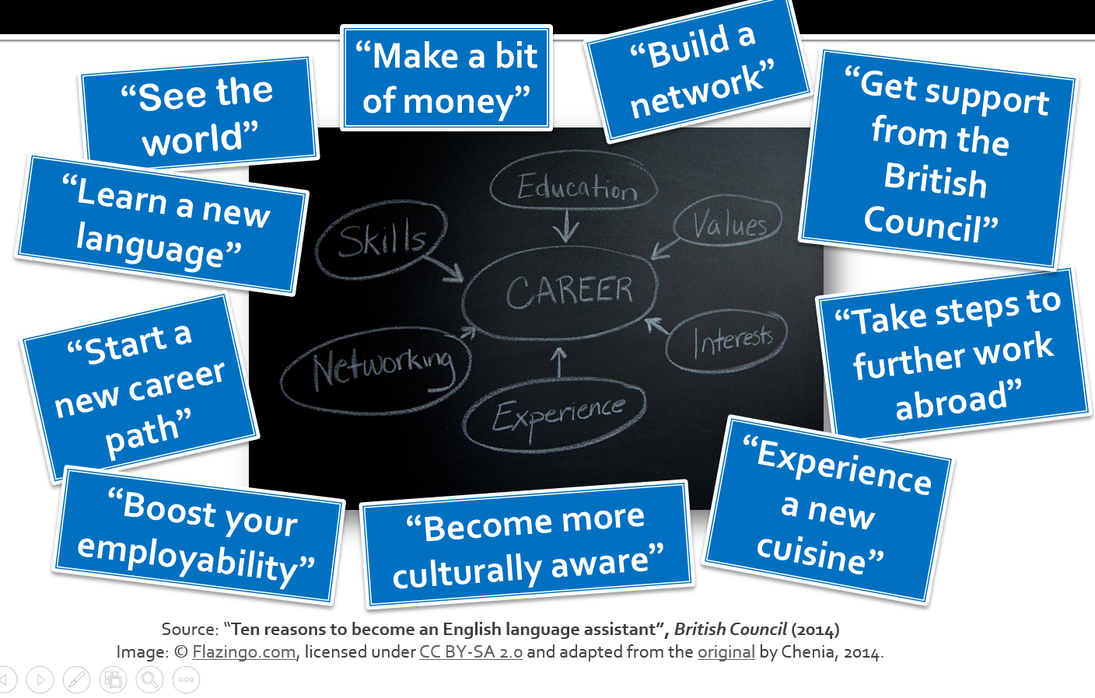
Why teaching abroad?
Think about this. Discuss:
What do you think the blogger meant by each of these phrases? Can you think of examples that could illustrate these assertions?
Are the same reasons you would have had for choosing this scheme?
Are all of them unique to Teaching assistantships?
Are all of them relevant or equally desirable to the candidates and to their future employers (the schools where they will be working)? Give examples.
Notes:
Notes:
Some examples that will be discussed later in the workshop will confirm many of these can be true, but it is important to highlight they don’t happen automatically. This workshop has the purpose to give them some strategies they can apply to maximize the opportunities the scheme offers.
You may want to highlight/bring up the next issue, that lead to the next activity: Is the English classroom the place for the assistant to learn the local language? What impact do you think this would have in your linguistic improvement?

Slide 5
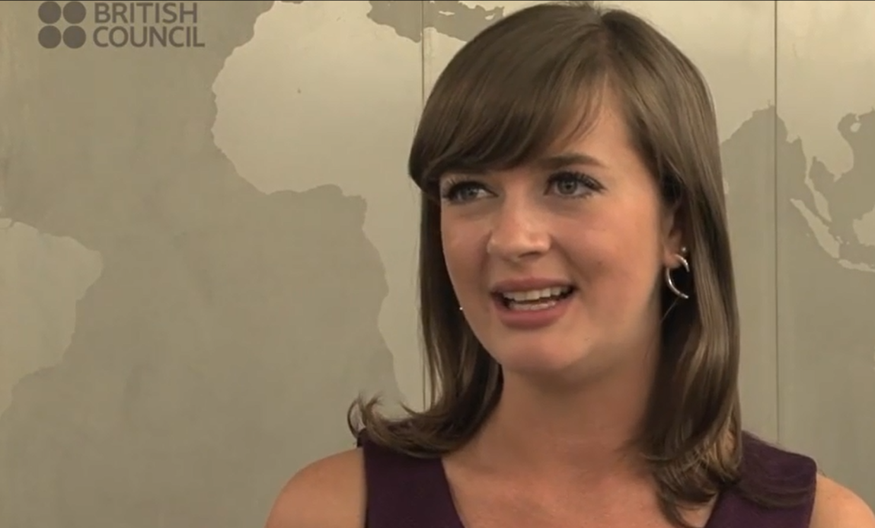
Why teach abroad?
“My Spanish has improved vastly, much more, I feel personally, than if I had been studying abroad”.
Sally Gascoigne: British Language Assistants (2013)
Notes:
Stage 2: Questioning common beliefs.
Activity 3: Viewing and commenting some promotional information available on the British Council’s Youtube channel.
Aim: To reflect on the promotional information available on the BC’s Youtube channel, particularly with regards to language learning. Contrast this to participants’ own expectations/understanding of the scheme in this respect.
Time: 5-7 minutes
Classroom arrangement: Individual (watching), then forum.
Procedure:
Before you play the video (2’ 13’’) to participants, ask them to pay special attention to what Sally Gascoigne says about her how her (Spanish) linguistic skills improved as a consequence of doing a Teaching Assistantship. Don’t project the quote until they have watched the video.
After playing the video focus participant’s attention on the quote: Do they agree? Gather their thoughts.
Notes: Switch to ‘Slide show’ view, and click on the image to access to the original video.
Source: British Council, 2013. British Council Language Assistants: Sally Gascoigne. Accessed 21 December 2015. Available from: https://www.youtube.com/watch?v=UP7s6-7OmS8

Slide 6
What the average student predicts a teaching assistantship does for their linguistic development (or not):
“[…] at school people have to speak English, but at university you need to speak French all the time”
(O121aAGM)
“I’m going to study at a university to maximize the opportunity to speak in the classes and things like that [...] in comparison... I think if I taught it would be mostly in English than in Spanish, so this is better for me”* (O152aNTV)
“As a student you’re with all the other Erasmus students all the time and with them you speak English”
(O106bKMcM)
“[...] because [as a TA] you are surrounded by Spanish all the time, but at a university very often you are with other English-speaking people, and you will not speak Spanish if you are with other English people”* (O151aNTV)
Notes:
Stage 2: Questioning common beliefs.
Activity 4a: Introducing qualitative data from the LANGSNAP project.
Aim: To illustrate the most common beliefs surrounding language learning and teaching assistantships, and to question whether there is enough evidence to hold this view, often observe amongst students, ML staff and even promotional literature/websites.
Time: 5-7 minutes
Classroom arrangement: Forum
Procedure:
- Show these quotes to the students. Explain they come from interviews with students who, like them, were preparing to spend a period abroad (these students were going for nine months). Do they agree with these opinions? Are these their worries too? Is there anything else they worry about or are any of these aspects something they don’t worry about at all? Gather their thoughts.
Notes:
- These quotes have been translated from their original French or Spanish. To read the full interviews, please visit: https://langsnap.soton.ac.uk/ (The code provided identifies the interview where the extract was taken).

Slide 7
Teaching and your linguistic development: What research has found.
A longitudinal study conducted by the University of Southampton, between April 2011 and September 2013, set out to investigate this important aspect of the year abroad:
Do differences in placement type impact on language development?
Notes:
Stage 3: Providing information and questioning common beliefs.
Activity 4b: Introducing the LANGSNAP project (some quantitative data).
Aim: To present quantitative data which questions the folk belief that prevails amongst students and ML staff regarding which scheme is better for linguistic development.
Time: 8-10 minutes
Classroom arrangement: Forum
Procedure:
- Follow the presentation on the screen (slides 7-10).

Slide 8
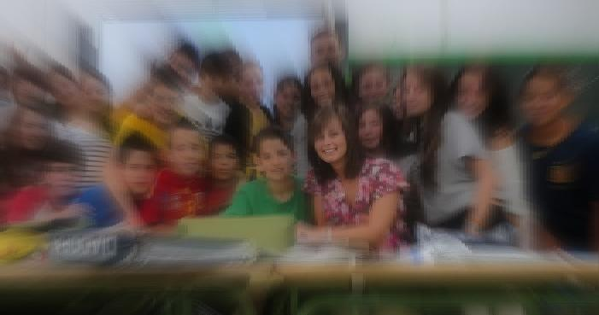
How the study was conducted:
48 UK-based participants. All undergraduate students of languages.
Mixed-methods approach to test:
Oral proficiency (elicited imitation)
Lexical diversity (oral interviews)
Fluency (spoken narrative)
 | France | Spain | Mexico | Total
University | 8 | 9 | 0 | 17
Teaching | 15 | 7 | 9 | 31
Notes:
Notes: For detailed information about the project, including methodology used and full results, please go to the project’s website: http://langsnap.soton.ac.uk/

Slide 9
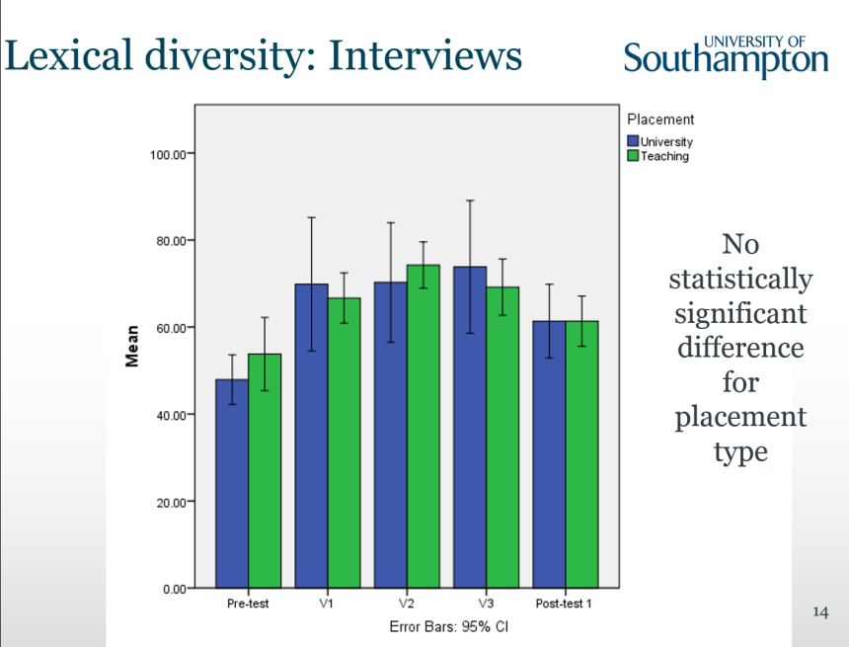
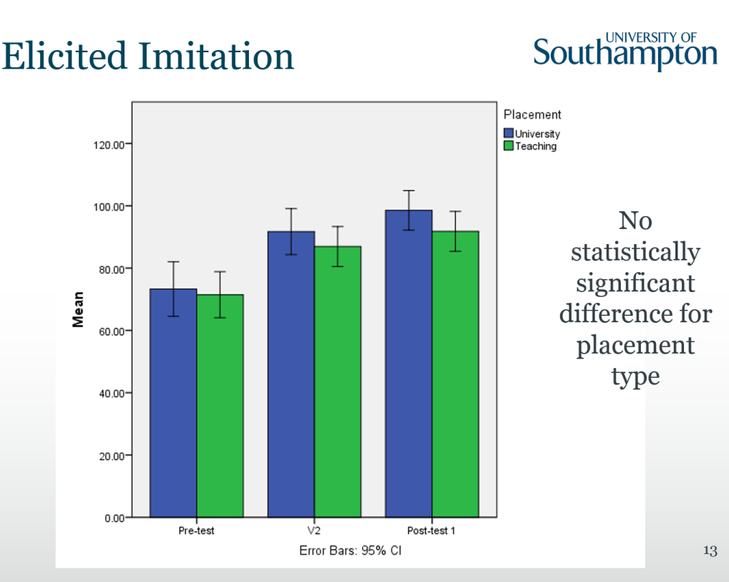
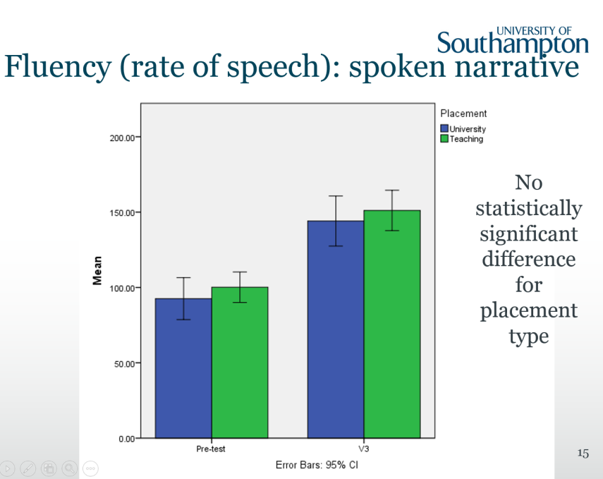
Results:
Notes:
Notes: For detailed information about the project, including methodology used and full results, please go to the project’s website: http://langsnap.soton.ac.uk/

Slide 10
Main findings:
No significant effect of placement type (teaching vs. university) on linguistic development for:
Oral proficiency
Lexical diversity
-or-
Fluency (speech rate)
Notes:
Notes: For detailed information about the project, including methodology used and full results, please go to the project’s website: http://langsnap.soton.ac.uk/
So, if language development is not the main aspect to think about when it comes to choosing a scheme, what is? What are the benefits and challenges of this scheme?

Slide 11
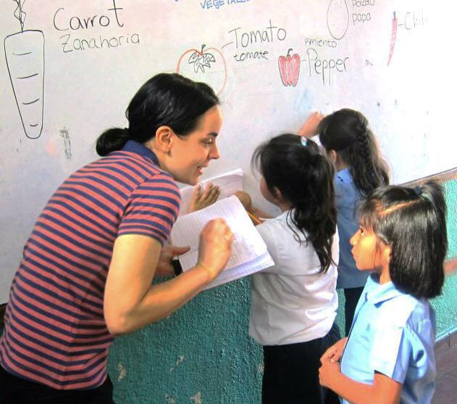
Some benefits and challenges of being a teaching assistant.
Notes:
Stage 4: Raising awareness (questioning common beliefs).
Activity 5a: Exploring the role of a TA
Aim: To contrast the ‘official’ description of the TAs’ activities available on the BC website with academic research on the topic, including LANGSNAP data.
Time: 8-10 minutes
Classroom arrangement: Forum
Procedure:
- Follow the presentation on the screen (slides 12-17).

Slide 12
What is the role of a TA?
What a Teaching Assistant does:
What a Teaching Assistant doesn’t do:
“Supporting the teaching of English in an overseas school or university
planning activities and producing resources to help students improve their English
introducing UK contemporary culture through classroom and extra-curricular activities”
“Teach subjects other than English
discipline pupils
cover for illness
mark work regularly.”

Slide 13
Skills employers usually look for in applicants:
“ […] it is mainly through developing problem-solving skills and drawing on personal resources that students manage to cope with new and sometimes challenging situations at work such as preparation for lessons, discipline problems when managing a class etc.”
(Giraud-Johnstone, 2012, 23)
Notes:
Please refer to the bibliography at the end of this presentation to read the full article.

Slide 14
Skills employers usually look for in applicants:
“ … the [assistantship] has also a strong influence on students’ development in terms of becoming more self-reliant and more responsible as well as gaining more independence”
(Giraud-Johnstone, 2012, 24)

Slide 15
Read again!

Slide 16

What is the role of a TA?
According to Giraud-Johnstone (2012):
According to the BC (2015):
“ […] it is mainly through developing problem-solving skills and drawing on personal resources that students manage to cope with new and sometimes challenging situations at work such as preparation for lessons, discipline problems when managing a class etc.”
The role of a TA is NOT to:
“Teach subjects other than English
discipline pupils
cover for illness
mark work regularly.”
Notes:
Notes: The ‘confused’ face is a visual opportunity to highlight the apparent contradiction between the sources. The next few activities introduce real-life cases of students who have done a TA or similar scheme.

Slide 17
What is the role of a TA?
Read the following quotes:
According to the BC (2015):
The role of a TA is NOT to:
“Teach subjects other than English
discipline pupils
cover for illness
mark work regularly.”
“I teach every day. I teach English, Sciences and Maths too” (151bNTV)
“But there are also problems with, for example, how children behave in that School […] especially the children in sixth grade, it’s really difficult… but also because, before, I was always with another teacher in the class, we worked together, but now, I have half of the class, and I’m on my own with them.” (180cPRM)
Notes:
Stage 4b: Questioning common beliefs.
Activity 5b: Introducing qualitative data from the LANGSNAP project.
Aim: To contrast some quotes from the LANGSNAP participants with the BC’s description of what a TA is not supposed to do.
Classroom arrangement: Forum
Procedure:
Show these quotes to the students. Explain they come from more interviews with LANGSNAP participants, who were interviewed once they were abroad.
Watch their reactions. Are they surprised? Gather their thoughts after you’ve shown them both quotes.
Notes: This slide contrasts some quotes from the LANGSNAP participants with the BC’s description of what a TA is not supposed to do. Remember these quotes have been translated from their original French or Spanish. To read the full interviews, please visit: https://langsnap.soton.ac.uk/ (The code provided identifies the interview where the extract was taken).

Slide 18
What would you do?

Slide 19

What would you do?
I am really not enjoying working for the British Council! I am in a tiny school in [region] and most of my timetable is teaching Science. I only have one English class! It is really hard because the students do not understand the topics in [local language] let alone English and I am not allowed to speak any [local language] to clarify, which makes things even harder. [...] they can ask me to prepare something as at the minute I just walk into a class and they give me a pen and say "Teach the digestive system, teach the skeleton, teach the layers of the Earth". I have not learnt these topics for years so I find it very difficult! There are even sometimes where I just stand in the corner so that the teacher can teach!
Notes:
Stage 4b: Planning together
Activity 6a: Discussing strategies to cope with possible scenarios: Teaching subjects through English.
Aim: To allow student to think of possible strategies BEFORE the workshop convenor provides any.
Classroom arrangement: Pair work/small groups.
Time: 5-7 minutes.
Procedure:
Project this quote (or provide the relevant hand-out).
Ask students to think about three possible solutions/suggestions they could give to the author of this e-mail.
What could they do from today to prepare for this possible scenario?

Slide 20
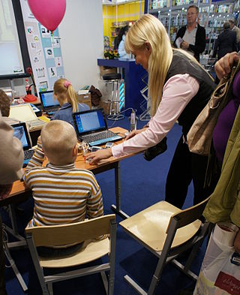
What would you do?
TA: “It’s a bit stressful when the teacher says to me: ‘Oh, today you are teaching the class’, but the children won’t listen to me”
Interviewer: Does she give you the plan?
TA: No, they give me the course book and that’s it!”
(174cNTV)
Notes:
Stage 4b: Planning together
Activity 6b: Discussing strategies to cope with possible scenarios: Planning a class in the last minute.
Aim: To allow student to think of possible strategies BEFORE the workshop convenor provides any.
Classroom arrangement: Pair work/small groups.
Time: 5-7 minutes.
Procedure:
Project this quote (or provide the relevant hand-out).
Ask students to think about three possible solutions/suggestions they could give to the author of this e-mail.
What could they do from today to prepare for this possible scenario?
Notes: You may want/need to clarify this is different from the last case, because this is a language class (not Science). Here the main challenge is learning you’ll teach a lesson a minute before the class starts.

Slide 21
Brainstorm some strategies:
Teaching English through content:
Coming up with a last-minute plan:
Notes:
Collate their thoughts from both cases.

Slide 22
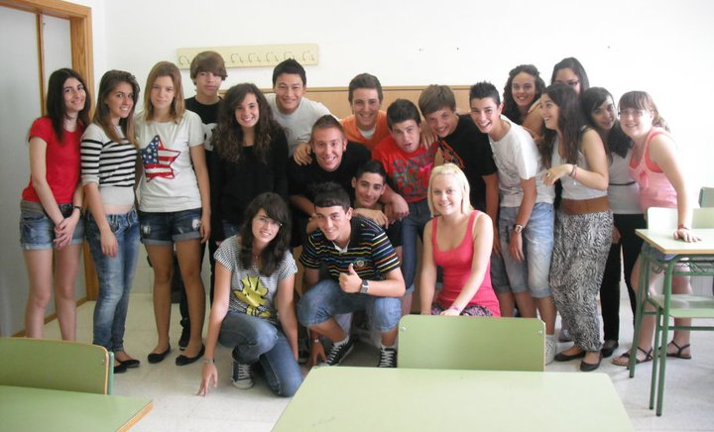
But, is it worth it?

Slide 23
What would you do?
Dear [tutor],
I would like to stay in [town, country] for ever! But I must go back to complete my studies. For this reason I am applying for a post as an International Student Engagement Assistant […]
I feel bad for having written [the previous e-mail] to you, becasue after I sent it, I started to understand how the school worked and the positive side of living in a small town in [region]. My opinions changed completely towards the end of the year, and after Christmas, I LOVED EVERYTHING! Now I am sad becasue I know I will miss [the town]. I feel very privileged now!!
Notes:
Stage 5: A balanced view.
Activity 1: Exploring the positive opinions expressed by returning students, or students who discussed their views towards the end of their period abroad.
Aim: To help students see that it is natural to develop negative/pessimistic feelings towards the host culture of their life abroad. Statistically, the experience as a whole seems to improve after a half point (for the LANGSNAP participants who stayed for 9 months, the break through was invariably “after Christmas”.
Classroom arrangement: Forum.
Time: 5 minutes.
Procedure:
Project this e-mail which shows how the perspective of the student who had expressed concerns about her experience changed.
Move on to the following quotes which also show a positive attitude towards the experience.
The conclusion to be reached here is that the process of adaptation takes months and changes and is cyclical, rather than something which happens in the first few weeks of arrival.

Slide 24

You may develop a special sense of achievement:
“Interviewer: And which are the best memories you have from Spain?
TA: Many from the time I spent with the children. I have many memories of what we did together… like that of a girl who couldn’t read the time in English, and she tied hard, but just couldn’t do it, she wouldn’t understand…
…but after I made a huge picture for her with many colours, she was suddenly able to tell the time. And for me, that was something that made me feel very proud, I’m proud of having been able to do that for her”
(167eNTV)
Image: U.S Army Corps of Engineers Europe District

Slide 25
Your confidence may improve and you may get a clearer idea of what you’d like to do in the future:
“My experience has reinforced the fact that I want to become a teacher. I wasn’t sure before, but after these months, I can see this is something I like and I can be good at. I have more confidence in myself and about my plans for the future”.
(167eNTV)
Image: NVO (2011)

Slide 26
Top tips?

Slide 27

Think about these*:
Be flexible
Plan well but be willing to improvise
Use your colleagues
Make friends outside the school
Keep appropriate assistant/student boundaries
Be aware of the way the school works
If a student does badly, don’t blame yourself
Notes:
Notes: Please see bibliography to access the full article.

Slide 28

Perhaps:
Browse through grammar and other EFL (English as a Foreign Language) text books (including teaching content through English)
You may not be an experienced teacher, but you are an experienced learner! Remember what you enjoyed doing in class!
Observe English classes in YouTube and think about the strengths and weaknesses of the classes you observe

Slide 29
Explore the following resources*:
List of websites with learning resources | https://morwennatakesoneurope.wordpress.com/2012/12/05/a-language-assistants-top-most-useful-websites-of-all-time/
Advice on conducting lessons | https://notatextbook.wordpress.com/2014/10/02/advice-for-an-english-language-assistant-abroad/
BBC Learning English (resources) | http://www.bbc.co.uk/learningenglish/
Lesson plan ideas | http://www.thirdyearabroad.com/work-abroad/teach-abroad/item/2148-lesson-plan-ideas-for-english-language-assistants.html
One-stop CLIL (Teaching resources) | http://www.onestopenglish.com/clil/
BC YouTube ‘Teaching English’ Channel | https://www.youtube.com/user/BritishCouncilTE
* Disclaimer: We are not responsible for the content of external links.

Slide 30
GOOD LUCK! ☺
Notes:
Please refer to the lesson plan and tutor’s notes accompanying this presentation to find a few follow-up activities students could develop on their own time as homework. They could also be used as preparation for a follow-up seminar to this workshop.
We hope you found this guide useful.
Dr Patricia Romero de Mills and the Langsnap team.

Slide 31
Credits and Bibliography
THE LANGSNAP TEAM (University of Southampton):
Prof. Rosamond Mitchell
Dr L. Patricia Romero de Mills
Laurence Richard
Dr Nicole Tracy-Ventura
Dr Kevin McManus
Claire St. John Eve (Research assistant)
Quotes from interviews to students extracted from:
Mitchell, et al Languages and Social Networks Abroad Project (LANGSNAP). 2013. Accessed 09
September, 2015. Available from: https://langsnap.soton.ac.uk/
IMPORTANT: This guide was designed by Dr L. Patricia Romero de Mills, Lansnap co-investigator. It was designed with the intention to be shared with all educators, administrators or other professionals who require to prepare undergraduates for study abroad. The materials can be modified and adapted to particular needs free of charge, but the intellectual property of this initiative must be acknowledged by citing the original guide, and the source where it can be found. All the credits to the Langsnap team and project must be clearly displayed on any modified versions you create. No modified versions of this work should be shared; professionals interested in modifying this original version must download it from:
For any questions please contact Dr L. Patricia Romero de Mills at: P.romero@soton.ac.uk

Slide 32
Credits and Bibliography
Bibliography:
“What I’ve learned from studying abroad” (Blog). The Guardian. http://www.theguardian.com/education/mortarboard/2014/may/06/students-study-abroad-tips
British Council. 2013. British Council Language Assistants: Sally Gascoigne. Accessed 21/12/2015. Available from: https://www.youtube.com/watch?v=UP7s6-7OmS8
British Council. 2105. ‘What will I do?’ Become a Language Assistant. Accessed: 22/12/2015. Available from: https://www.britishcouncil.org/language-assistants/become/what-will-i-do
Chenia, S. 2014. Ten Reasons to Become and English Assistant Vices Magazine, British Council. 16th December, 2014. Accessed 21/12/2015. Available from: https://www.britishcouncil.org/voices-magazine/ten-reasons-become-english-language-assistant
Giraud-Johnstone. 2012. “Assessing the Work Placement Abroad”. Scottish Languages Review. SCILT 25, 19-28.
Merrick K. (2012) Top Ten Tips for Surviving as a Language Assistant. TheThirdYearAbroad.com. Available from: http://www.thirdyearabroad.com/work-abroad/teach-abroad/item/1153-10-tips-survival-as-a-language-assistant.html. Accessed 22/12/2015.
Mitchell, et al. 2013. The influence of social networks, personality and placement type on language learning during residence abroad: Preliminary findings of the LANGSNAP project. Residence Abroad, Social Networks and Second Language Learning Conference, April 2013, University of Southampton. Available from: http://langsnap.soton.ac.uk/conferencePresnetations.html

Slide 33
Images:
Image on Slide 16, “Gnome-face-uncertain” by GNOME Icon artist. CC-BY-SA-3.0 Via https://commons.wikimedia.org/wiki/File%3AGnome-face-uncertain.svg
Image on slide 18, Fuentes, C. (2013) “Teaching in El Salvador.”
Image on Slide 20, “Biology class 06” by NVO. CC-BY-SA-3.0 Via https://commons.wikimedia.org/wiki/File%3AMIBF_2011_biology_class_06.JPG
Image on slide 24,U.S Army Corps of Engineers Europe District CC-BY 2.0
Image on slide 27 & 28, ClassroomClipart.com
Image on slide 29, NVO (2011)
Image on slide 30, Feehan, E. (2011)

