Slide 1
Being an International Student
Languages and Social Networks Abroad Project.
Pedagogical Guide 1
Designed by: L. P. Romero de Mills
Notes:
The time proposed for this workshop is 1:30hrs or 2 hours max.
The main aim is to provide students with an opportunity to reflect on the possible difficulties that could arise from studying abroad, in a different system of education.

Slide 2
Why study abroad?
Notes:
This blank screen indicates it’s time to discuss (we recommend pairs or trios).
Students will watch a video, but before they do so, get them to discuss their main motivation(s) to study abroad.
We don’t consider more than 5-7 minutes are necessary for this task.
After they have discussed, collect a quick list of their motives (perhaps, write a few of them on the board).

Slide 3
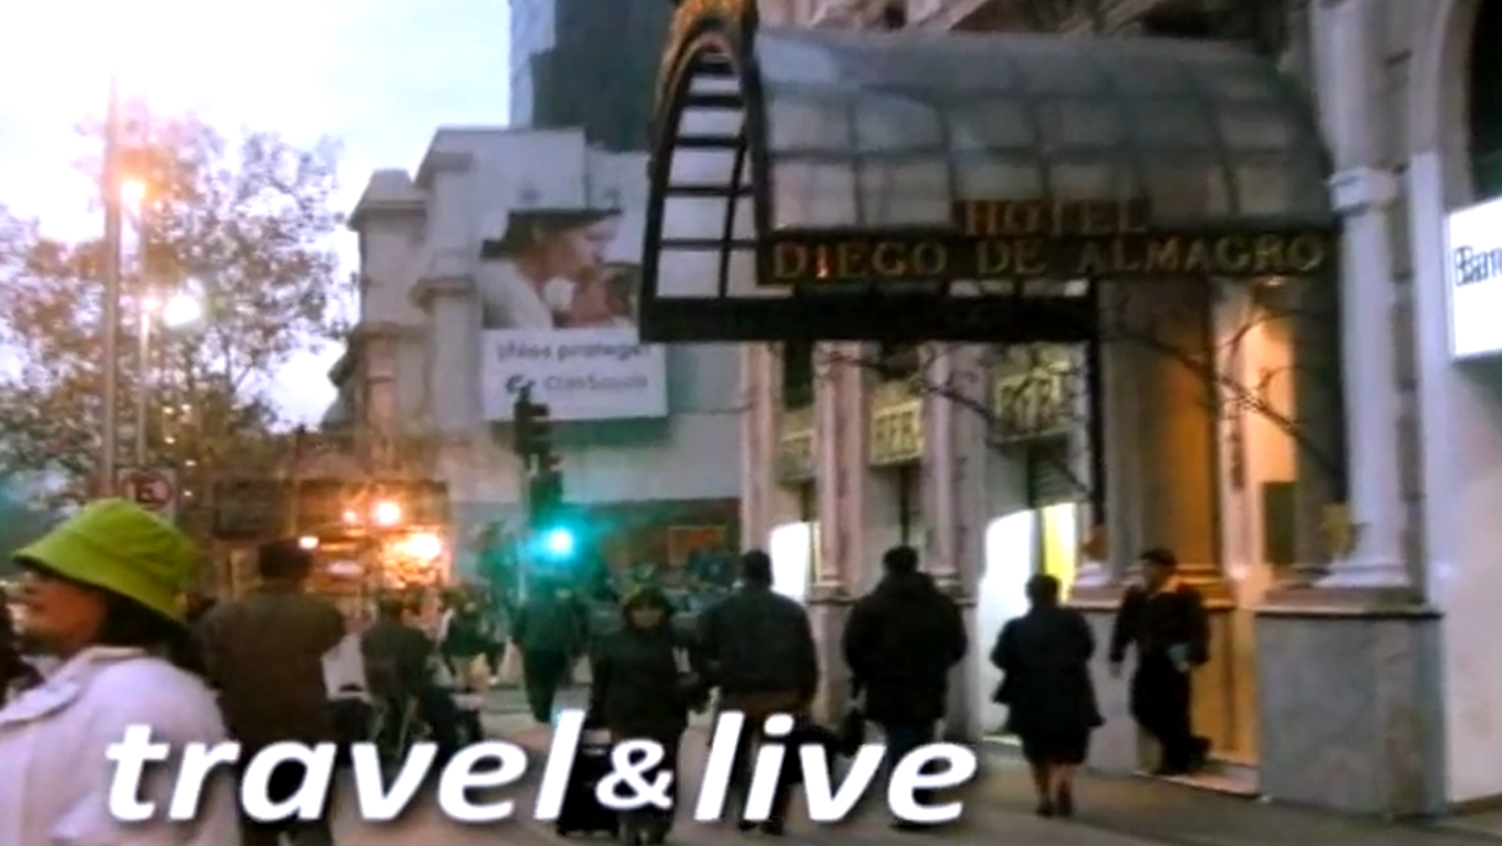
Why study abroad?
Notes:
Switch to ‘Slide show’ view, and click on the image to get to the original video.
Source: Negleiro, J. 2008. Why Study Abroad? Accessed 09 September 2015. Available from: https://www.youtube.com/watch?v=eikxZN5OZkc
Play the video (1’ 31”).
Allow a further 3-5 minutes for students to discuss their reactions in pairs or trios: Is this what they imagine their experience would be? Are some of the reasons/motivations illustrated in this video in the list they had gathered before?
Gather their thoughts.

Slide 4
What the average student predicts may be different between their life at home and abroad:
“I think it will be difficult because I am not familiar with the structure and modus operandi of the country. Like I don’t know how banks work” (163aEDR)
“It will be difficult to understand my university lectures” (168aEDR)
“I don’t think it will be too different because I will be a student at university and I will live with other students like I do here. That’s the same life, just in another language” (72aNTV)
“I will be able to go out more. I will study in the morning and relax in the evening. Because it seems that here, I’m always working or studying” (166aEDR)
Notes:
Show these quotes to the students. Explain they come from interviews with students who, like them, were preparing to spend a period abroad (these students were going for nine months).
Do they agree with these opinions? Are these their worries too? Is there anything else they worry about or are any of these aspects something they don’t worry about at all?
Does the video they have just watched illustrate these worries can actually be true?
** One possible thought to share, here: We hear returning students talking about “the best year of their life”, which is somehow illustrated by the video produced precisely by a returning student. But is studying abroad consistent fun and happiness throughout the semester/year? We don’t recommend you answer these question yourself. Leave it open to them to reflect on through the content of this workshop.
NOTE: These quotes have been translated from their original French or Spanish. To read the full interviews, please visit: https://langsnap.soton.ac.uk/ (The code provided identifies the interview where the extract was taken).

Slide 5
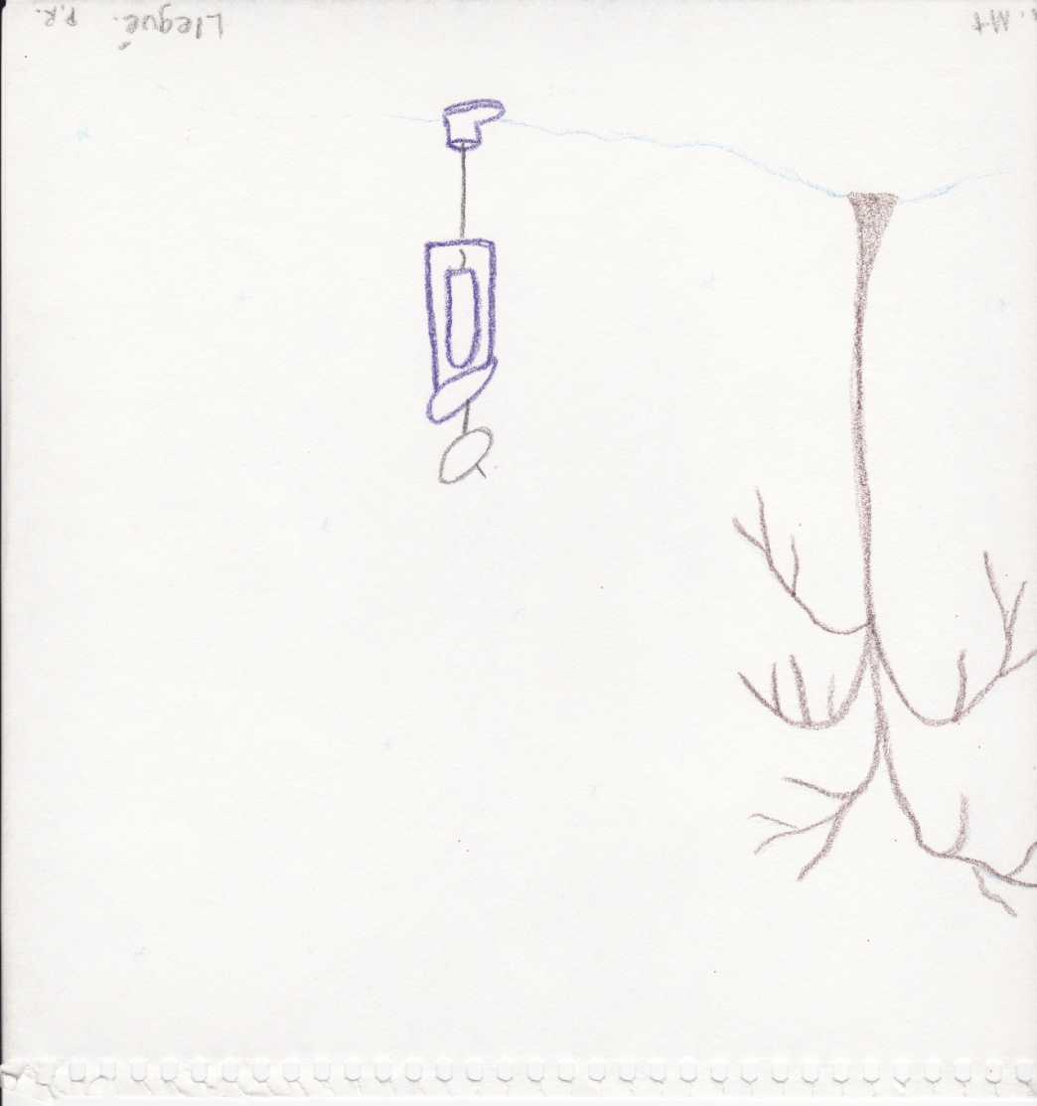
Notes:
Show this picture to students: where do they think it came from?
Explain to them this comes from the personal journal of an international student, during her first weeks after arriving to her new location (USA). Is this the same impression as the video has given us of life as a student abroad?
The next slide shows some of the possible reasons behind her feelings; despite having travelled with the same ideas of ‘fun’, ‘adventure’ and the intention to ‘explore the world’, the first few weeks proved challenging. But instead of explaining this to students, ask them if they can think of the reasons why this particular student felt rather nostalgic/disappointed once she arrived in her location (the next slide shows some first thoughts they may have foreseen or that can explain to them what happened if they haven’t deducted it already).

Slide 6
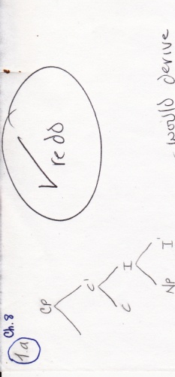
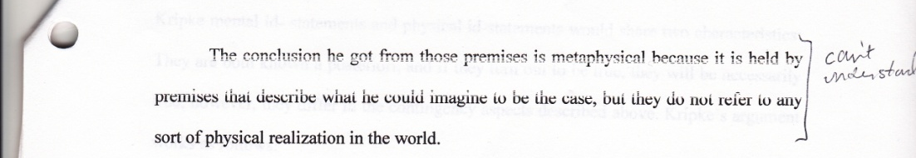


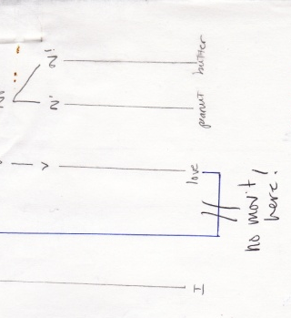
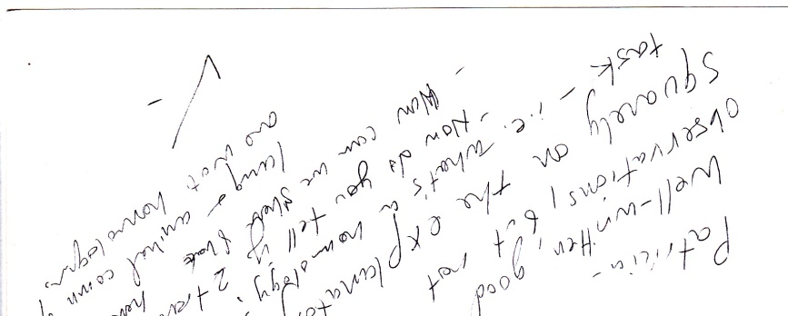
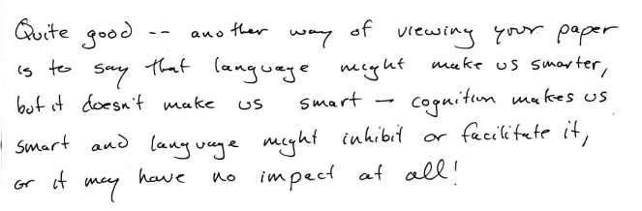
Notes:
These scans come from academic work belonging the same student, who at her home university, was normally placed in the top of her class. But abroad, her average mark was C- (for the first half of her period of residency). Can they think what went so wrong in her academic level?

Slide 7
Why did that happen?
Notes:
Time to discuss:
Can this result/discrepancy be explained by any of the ‘worries’ discussed previously?
Give students a few minutes to figure out why they think this student struggled a bit to improve her marks and to derive a few first conclusions from this first part of the workshop.

Slide 8
Read what some British students studying abroad have reported:
“For the 17th and 18th Century Literature [course] it is a bit difficult . The tutor makes reference to Ronsard, and I have never studied Ronsard, I don’t know who he is… and the tutor makes jokes […] he says “Oh, Erasmus students never know anything” (112bLRR)
“One subject I find very difficult is syntax, but that’s because I don’t have enough knowledge of English grammar, so it’s difficult to apply knowledge I don’t have, and everyone else has a grammatical foundation I don’t have… so it’s a bit difficult” (152dNTV)
Notes:
These quotes come from the same group of students interviewed before, but these particular contributions come from interviews carried our when they were half way through their period of residency.
What we see here, is examples that illustrate that the knowledge that students are expected to have may be different from what they actually know. For example, British students would not necessarily study who Ronsard is at school or A-levels, equally, they do not study (English) grammar in the same depth that students do in other countries. University tutors take for granted that university students know certain things, those they know are taught in their own country’s national curriculum!
The following slides develop this idea further.
NOTE: These quotes have been translated from their original French or Spanish. To read the full interviews, please visit: https://langsnap.soton.ac.uk/ (The code provided identifies the interview where the extract was taken).

Slide 9
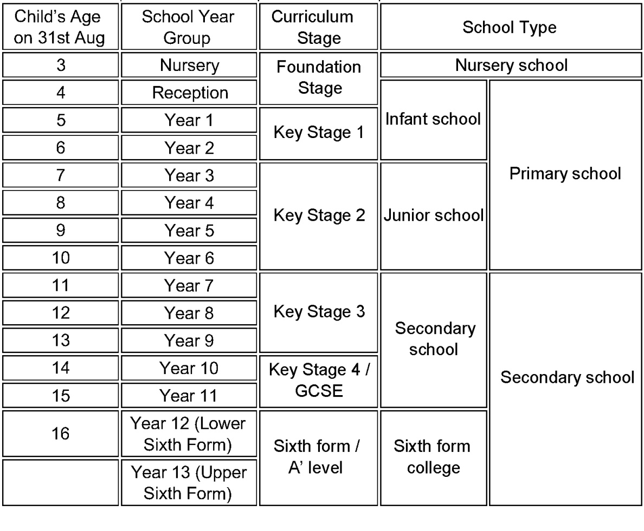
Be aware of your educational background:
Structure of the English education system:
Notes:
In this slide you could emphasize a salient difference, such as the fact that students in the UK students start their specialization at 16, choosing a limited number of A-Levels to focus on (although this table shows only the English system, the specialization occurs also in N.I., Scotland and Wales).

Slide 10
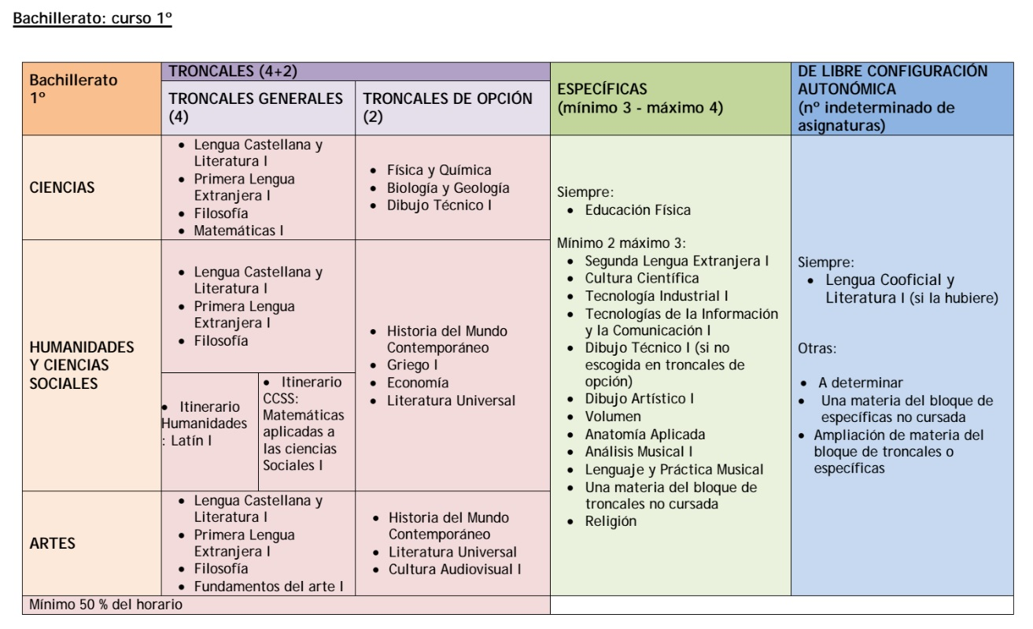
Compare (Bachillerato, Spain):
Notes:
In contrast, students in Spain, for example, do not specialize in a selected number of subjects, they cover a whole range of disciplines, even if these seem irrelevant for what they want to do in the future or at university. Here we see that students who do Sciences in Spain (at 16), MUST do Literature an Philosophy, which would be optional A-levels for UK students.
In sum, this table shows how European systems of education can differ in content and structure.
But, what does that mean for the student going abroad?
**This is a reform to be implemented in 2014-15. for the full details, please refer to:
Gobierno de España. 2013. Reforma del sistema educativo español: novedades y calendario de implantación. Edition 10-12-13. Accessed 09/06/2013. Available from: http://www.mecd.gob.es/dms/mecd/servicios-al-ciudadano-mecd/participacion-publica/lomce/20131210-boe/novedades-reforma-educaci-n-10-12-13/novedades%20reforma%20educaci%C3%B3n%2010-12-13.pdf.

Slide 11
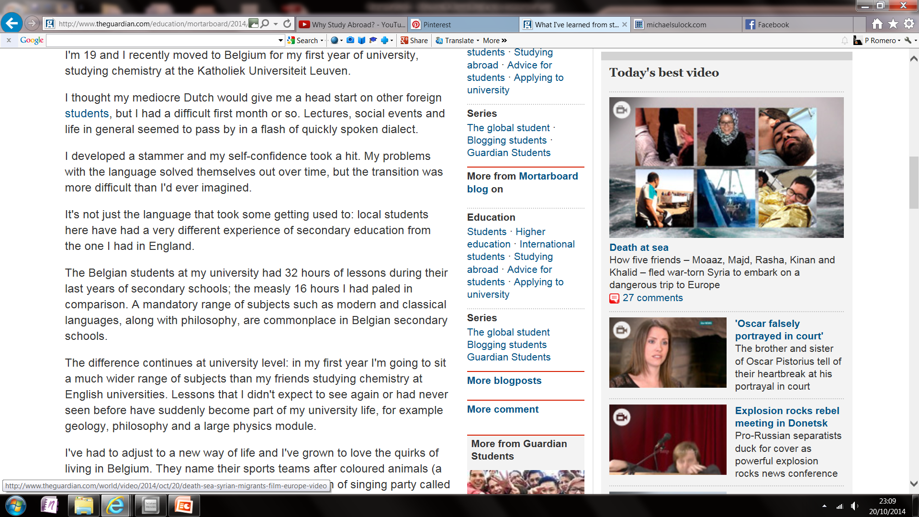
What happens abroad? Here the experience of a student doing a whole degree abroad:
Source: “What I've learned from studying abroad” The Guardian (2014)
Notes:
Read or allow students to read the following quotes from a newspaper article (The Guardian).
What this student is describing here, is precisely the impact that coming from a different education background could have in one’s experience as an international student.
The full article can be accessed in: Spijkers-Shaw, S. 2014. What I've learned from studying abroad The Guardian. 6th May, 2014. Accessed
09/09/2015. Available from: http://www.theguardian.com/education/mortarboard/2014/may/06/students-study-abroad-tips

Slide 12
Other experiences described by British students residing abroad:
[1] “It’s difficult to participate in our lessons because, for example, my History course, is just the tutor [speaking], he speaks for two hours and there’s no student participation, it’s just him doing all the talking” (121bKMcM)
[3] “It’s just life at university, it’s like being at school , it’s very different to our university in England; here there are a lot of students in one class, for example, 40 students, but in my [home] university, there are no more than ten students in my French class!” (121cKMcM)
[2] “It was very disorganized […] Sometimes I went to class and there was no teacher and I couldn’t understand why… ” (168bNTV)
Notes:
**Note that the word “EXPERIENCES” has been used for the title, as opposed to “issues/problems”, because it is important for students to start transforming these “unexpected experiences” into opportunities to grow, understand and to become more open-minded intercultural beings.
[1] Opportunities for students to contribute to the class
[2] Communication with students and organization of the university in general.
[3] Class-size
NOTE: These quotes have been translated from their original French or Spanish. To read the full interviews, please visit: https://langsnap.soton.ac.uk/ (The code provided identifies the interview where the extract was taken).

Slide 13
Other experiences reported by British students residing abroad:
[4] “Tutors here are very different. They have a very different attitude; you can’t say anything to them, you need to agree with them, and if you don’t agree with them, you can be in trouble…”
(163cNTV)
[5] “In my German class, we have to work really hard, we have to write lots of things, study grammar, because we normally don’t speak in class, it’s not a class based on speaking like in England; here the tutor prepares the exercises and we do them, and if we have questions, we ask…” (165cNTV)
[6] “…there aren’t lots of slides, so you need to write everything down, and that can be a bit difficult…” (152cNTV)
Notes:
[4] A different teaching-style/ Teacher-student relationship
[5] and [6] Learning styles/strategies.
NOTE: These quotes have been translated from their original French or Spanish. To read the full interviews, please visit: https://langsnap.soton.ac.uk/ (The code provided identifies the interview where the extract was taken).

Slide 14
Why did that happen?
Because we have all gone through different educational systems, which means, we know different things and have learned them in very different ways.
Notes:
The following slides are designed to simply be clicked on and to present a few conclusions on top.

Slide 15
Why did that happen?
Because we have all gone through different educational systems, which means, we know different things and have learned them in very different ways.
Therefore, our understanding of what counts as ‘knowledge’ and our way to provide evidence of the fact that we possess it, is not the same across countries.

Slide 16

What does your own culture understand by ‘knowledge’?
Knowledge
Notes:
This “pause” slide is a good opportunity to mention a few things:
Attempts have been made to rank al the education systems in the world, based on their academic achievement or performance (see for example, the OECD PISA Results obtained in 2012), but some are sceptical about the possibility to compare educational systems across the globe accurately and fairly, since there are so many variables to take into account (See for example, That & Must, 2012). Student mobility offers the opportunity to EXPERIENCE different systems, but not necessary better or worse.
It’s difficult to generalize what “knowledge means” for a WHOLE country!! And we must not forget countries are not monocultural, either… So there might be an idea of ‘knowledge’ and ‘education’ that is rather widespread, but then a particular tutor at university might have a different nationality to that of the locals… so the kaleidoscope gets complicated.

Slide 17
BUT as one participant concluded:
“…It’s not like what we have in England, but the quality of the content, the courses and the teachers is very high…” (152cNTV)
Notes:
This is just an opportunity to sum up, that none is a ‘better education system’, but simply, different.

Slide 18
Now, observe this other side of the experience:
Notes:
Ask students, what else is happening here that has not been mentioned before (language problems).

Slide 19
Difficulties also arise because, you are studying difficult subjects in a language other than your own!

Slide 20
Some Linguistic Challenges
Listening
speaking
reading
WRITING
Notes:
Before you provide them with the list, give them time to make their own lists of the linguistic challenges they may face in this respect. Some 3 per box (?)

Slide 21
Some Linguistic Challenges
Listening
speaking
Understanding lectures/lecturers
Following instructions
Following informal conversations
Understanding regional accents (or accents of other learners of the language you are trying to improve!)
Giving class presentations
Participating in social events
Asking for instructions/explaining a problem you have.
Using idiomatic expressions and colloquialisms
Notes:
**All of these examples emerged from our Langsnap qualitative data (students interviewed during their study abroad).
Is their list similar? Different?
Are any of the elements they have in their slit specific to life at university or are they transferable to other aspects of life?

Slide 22
WRITING
reading
Taking lecture notes
Writing essays and reports (style, register, conventions; think ‘knowledge’)
Using abbreviated language for texts, and social media.
Comprehending difficult academic content
Reading speed and dealing with fatigue
Understanding abbreviated language.

Slide 23
Brainstorm some strategies:
Before departure
Once abroad
Notes:
Allow students to come up with 2-3 strategies they think would work to deal/minimize the impact of these challenges. Here a few examples:
Before departure:
Watch lectures in the language (available in YouTube)
Build up glossaries of your subject-specific discipline by looking for articles in the equivalent to “Google Scholar” in the relevant languages.
Once abroad:
Ask permission to record the lectures.
Make sure you read about the topic to be covered in class before you go.

Slide 24
The vast majority of the instructions you are given abroad test more than your language skills…
“It thought it would be better organized… but the library, the administration, the organization is sometimes chaotic. It’s not like in England… ” (108bKMcM)
“It was very hard for me to choose my modules, the staff at the Student, and International offices were not very helpful… ” (164bNTV)
“I’m now used to the system here because it’s a bit different from England… the administration, mainly… I had a lot of difficulties finding my lectures because here you have to see a secretary from each department… and build up your own timetable, but if I were in my home university [in England] they do everything for you, it’s all prepared and ready for you ” (108bKMcM)
Notes:
Show these quotes to the students, they illustrate some common frustrations students report having felt regarding the administration of their university. Explain that this can also happen OUTSIDE the university, for example, when they open a bank account or try to sort out their visiting student status to the Police, which is required in some countries.
NOTE: These quotes have been translated from their original French or Spanish. To read the full interviews, please visit: https://langsnap.soton.ac.uk/ (The code provided identifies the interview where the extract was taken).

Slide 25

* procedures * Forms * Instructions * Call this person * Talk to the other* it’s not this desk * go to the office next door * broken link * sorry we are closed * come back tomorrow * it may take six weeks * ask in the next window * you need a signature * * procedures * Forms * Instructions * Call this person * Talk to the other* it’s not this desk * go to the office next door * broken link * sorry we are closed * come back tomorrow * it may take six weeks * ask in the next window * you need a signature * procedures * Forms * Instructions * Call this person * Talk to the other* it’s not this desk * go to the office next door * broken link * sorry we are closed * come back tomorrow * it may take six weeks * ask in the next window * you need a signature * procedures * Forms * Instructions * Call this person * Talk to the other* it’s not this desk * go to the office next door * broken link * sorry we are closed * come back tomorrow * it may take six weeks * ask in the next window * you need a signature * procedures * Forms * Instructions * Call this person * Talk to the other* it’s not this desk * go to the office next door * broken link * sorry we are closed * come back tomorrow * it may take six weeks * ask in the next window * you need a signature * * procedures * Forms * Instructions * Call this person * Talk to the other* it’s not this desk * go to the office next door * broken link * sorry we are closed * come back tomorrow * it may take six weeks * ask in the next window * you need a signature * * procedures * Forms * Instructions * Call this person * Talk to the other* it’s not this desk * go to the office next door * broken link * sorry we are closed * come back tomorrow * it may take six weeks * ask in the next window * you need a signature * procedure * forms * instructions * call this person…..
Photo credits: Felipe Ibazeta
Notes:
This pause allows you to reassure students and say confusion is NORMAL, if not a necessary mental state when one starts a life abroad. But there are things they can do to reduce the impact of this shock, for example, thinking of strategies they can put in practice such as keeping a reflective journal. It is advisable that they make contact with other students who have travelled to the same country or area. Alternatively, they could visit the website thethirdyearabroad.com for very every-day practical advice.

Slide 26
Understand your emotions:
enthusiasm
In love with the country
Nostalgia for your homeland
Disliking the country
settlement
Notes:
Explain to students that their emotions will change and develop throughout the year, and that these feelings are not linear; they will sometimes identify feeling they thought they had left behind. But it is all ok. The important thing is to sit back and reflect on the changes they identify on themselves. Writing a blog or journal helps with this process.

Slide 27
Be prepared, but don’t be scared!
“I found some courses that are really interesting, for example Sociology and the Environment. I’m very interested in environmental issues. And I also took some courses on the economies and politics of the developing countries… they were very informative for me … I learned a lot” (108bKMcM)
“I love my new classes, especially semantics. I have been able to look for many more subjects and to go in much more depth than I ever did in [my home] university”. (152cNTV)
“I’m much more comfortable with my Spanish now, also because, now, especially after my lectures, I think in Spanish!” (165cNTV)
Notes:
Extracts from interviews conducted towards the end of the period of residency.
NOTE: These quotes have been translated from their original French or Spanish. To read the full interviews, please visit: https://langsnap.soton.ac.uk/ (The code provided identifies the interview where the extract was taken).

Slide 28
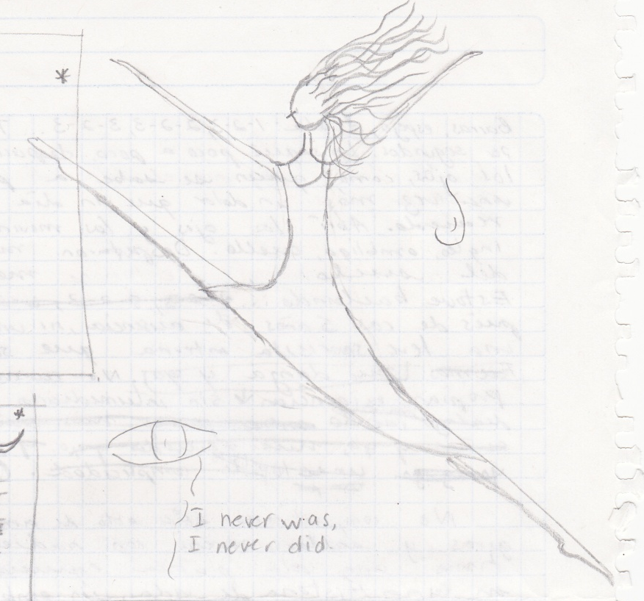
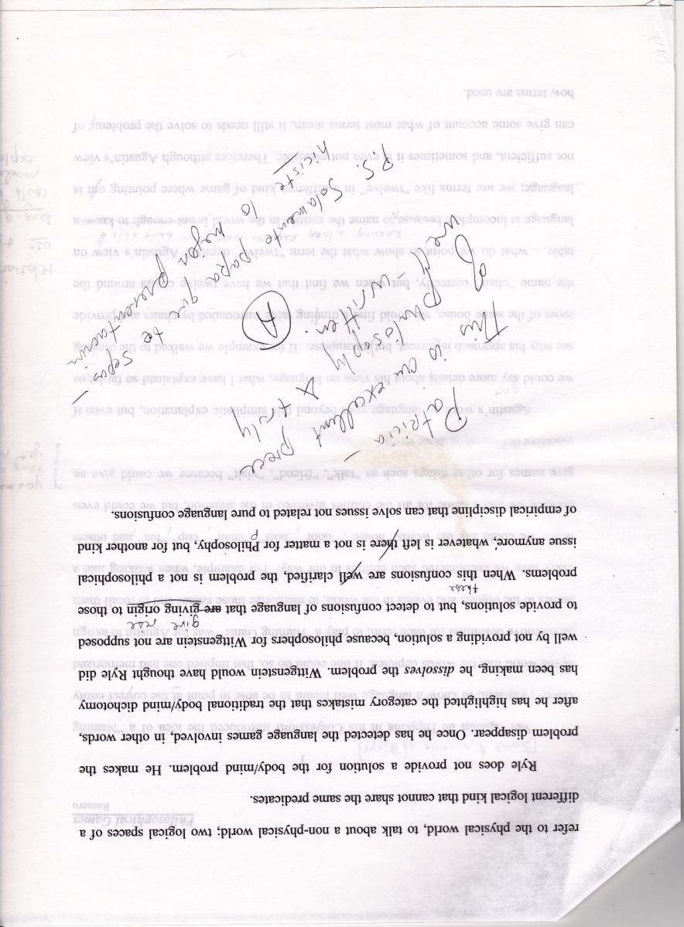
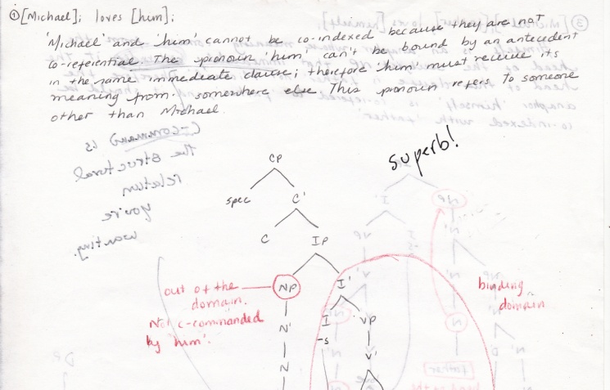
Time is key…
Notes:
Doodles and positive notes, from the same ‘case student’ mentioned at the start of the presentation.

Slide 29
Good luck!
Notes:
Please refer to the tutor’s notes accompanying this presentation to find a few follow-up activities students could develop on their own time as homework. They could also be used as preparation for a follow-up seminar to this workshop.
We hope you found this guide useful.
Dr Patricia Romero de Mills and the Langsnap team.

Slide 30
Credits and Bibliography
THE LANGSNAP TEAM (University of Southampton):
Prof. Rosamond Mitchell
Dr L. Patricia Romero de Mills
Laurence Richard
Dr Nicole Tracy-Ventura
Kevin McManus
Quotes from interviews to students extracted from:
Mitchell, et al Languages and Social Networks Abroad Project (LANGSNAP). 2013. Accessed 09
September, 2015. Available from: https://langsnap.soton.ac.uk/
IMPORTANT: This guide was designed by Dr L. Patricia Romero de Mills, Lansnap co-investigator. It was designed with the intention to be shared with all educators, administrators or other professionals who require to prepare undergraduates for study abroad. The materials can be modified and adapted to particular needs free of charge, but the intellectual property of this initiative must be acknowledged by citing the original guide, and the source where it can be found. All the credits to the Langsnap team and project must be clearly displayed on any modified versions you create. No modified versions of this work should be shared; professionals interested in modifying this original version must download it from:
For any questions please contact Dr L. Patricia Romero de Mills at: P.romero@soton.ac.uk

Slide 31
Credits and Bibliography
Bibliography:
Gobierno de España. 2013. Reforma del sistema educativo español: novedades y calendario de implantación. Edition 10-12-13. Accessed 09/06/2013. Available from: http://www.mecd.gob.es/dms/mecd/servicios-al-ciudadano-mecd/participacion-publica/lomce/20131210-boe/novedades-reforma-educaci-n-10-12-13/novedades%20reforma%20educaci%C3%B3n%2010-12-13.pdf.
Negleiro, J. 2008. Why Study Abroad? Accessed 09 September 2015. Available from: https://www.youtube.com/watch?v=eikxZN5OZkc
Organisation for Economic Co-operation and Development. 2015. Programme for International student Assessment 2012 Results. Accessed: 10/09/2015. Available from: http://www.oecd.org/pisa/keyfindings/pisa-2012-results.htm
Spijkers-Shaw, S. 2014. What I've learned from studying abroad The Guardian. 6th May, 2014. Accessed
09/09/2015. Available from: http://www.theguardian.com/education/mortarboard/2014/may/06/students-study-abroad-tips
Täht, K. and Must, O. 2013. Comparability of educational achievements and learning attitudes across nations. Educational Research and Evaluation: An International Journal on Theory and Practice. 19:1, 19-38.
“What I’ve learned from studying abroad” (Bolg). The Guardian. http://www.theguardian.com/education/mortarboard/2014/may/06/students-study-abroad-tips

Slide 32
Images
Image on slide 16, by Randy Robertson. CC BY 2.0
Image on Slide 22, “Confused Felipe” by Felipe Ibazeta. CC-BY-SA-3.0. Via https://commons.wikimedia.org/wiki/File:Confused_Felipe.jpg
Image on slide 23, by Esperales. CC BY 2.0

