Slide 1
What is Intelligence?
Claire St John Eve and Nancy Bui

Slide 2
Brainstorm: What is Intelligence?

Slide 3
“The ability to acquire and apply knowledge and skills” - Oxford Dictionary
“The ability to learn, understand and make judgments or have opinions that are based on reason” – Cambridge Advance Learner’s Dictionary
“A biological mechanism by which the effects of a complexity of stimuli are brought together and given a somewhat unified effect in behaviour” – J. Pearson
“Intelligence is what is measured by intelligence tests” – E. Boring

Slide 4
Aim of this session
To take a look at some different IQ tests and try to answer the question – what is intelligence?
Divide into groups of four

Slide 5
The American Australian IQ Test
10 minutes to complete the test in your groups.

Slide 6
ANSWERS

Slide 7
The Aboriginal IQ test
10 minutes to complete this test

Slide 8
ANSWERS

Slide 9
Reflection
How did we find the tests?
Did the second test assume any cultural knowledge that you didn’t have?
Was this fair?
Looking back: were there any cultural assumptions in the first test?

Slide 10
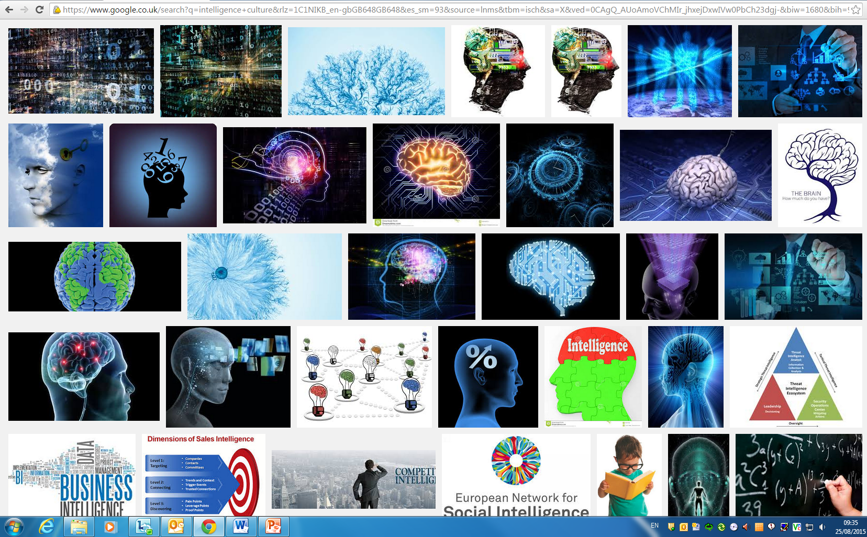
Reflection

Slide 11
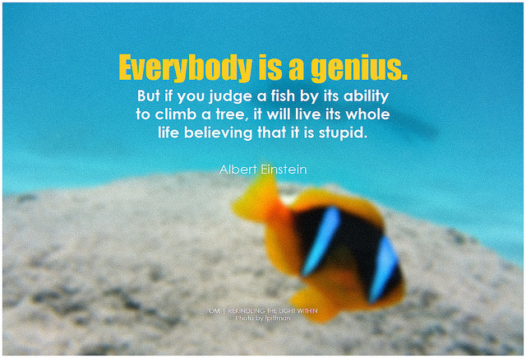
Thanks for taking part! Any Questions?

Slide 12
Credits and Bibliography
The Intercultural Connections Team (University of Southampton)
Claire St John Eve
Nancy Bui
Adapted from materials provided by Wilderdom, released under a Creative Commons License.

Slide 13
Credits and Bibliography
IMPORTANT: This guide was designed with the intention to be shared with all educators, administrators or other professionals who require to prepare undergraduates for study abroad. The materials can be modified and adapted to particular needs free of charge, but the intellectual property of this initiative must be acknowledged by citing the original guide, and the source where it can be found. All the credits to the Langsnap team and project must be clearly displayed on any modified versions you create. No modified versions of this work should be shared.
For any questions please contact Dr L. Patricia Romero de Mills at: P.romero@soton.ac.uk

