Slide 1
The Culture Card Experience
Languages and Social Networks Abroad Project.
Supplementary Teaching Material (Pedagogical Guide 3 - Beyond Tourism)
Designed by: C. L. St John Eve

Slide 2
Extreme Snap Tournament
Divide into table groups
Each table is given a rank
5 minutes to read the rules together, then NO SPEAKING
Every 5 minutes the tables rotate
Winners move up a table and losers move down a table.
Everyone at the winners’ table by the end of the game will receive a prize

Slide 3
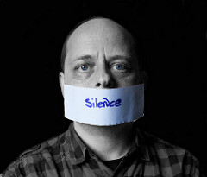
(REMEMBER: No verbal communication!)

Slide 4
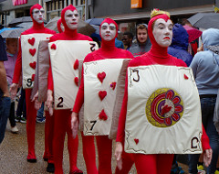
Reflection

Slide 5
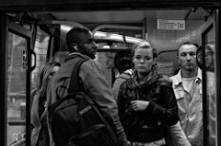
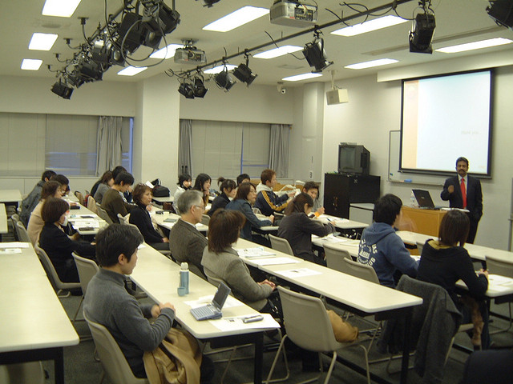
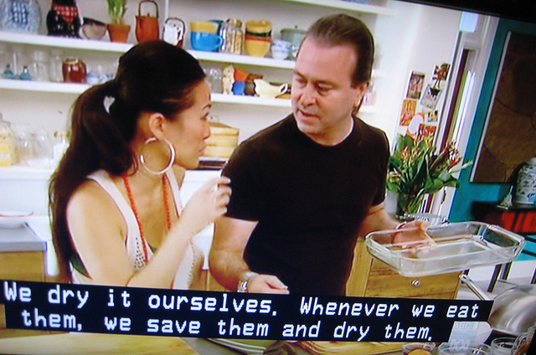
Where do cultures collide?
On the bus?
In a kitchen?
In a lecture?

Slide 6
The aim of the session was…
To experience the feeling of entering a new ‘culture’, and having to adapt in order to survive/succeed in that culture.
To understand the processes that take place when we meet someone of a different ‘culture’, who doesn’t seem to understand what seems obvious to us.
To reflect on our own coping strategies, and ways these could be applied to real life situations.

Slide 7
Thanks for taking part!

Slide 8
Credits and Bibliography
The Intercultural Connections Team (University of Southampton)
Claire St John Eve
Nancy Bui
Adapted from the ‘Barnga’ activity in Hall, S and Toll, S. “Interculture project report: Raising Intercultural Awareness in preparation for periods of residence abroad” (1999)

Slide 9
Credits and Bibliography
IMPORTANT: This guide was designed with the intention to be shared with all educators, administrators or other professionals who require to prepare undergraduates for study abroad. The materials can be modified and adapted to particular needs free of charge, but the intellectual property of this initiative must be acknowledged by citing the original guide, and the source where it can be found. All the credits to the Langsnap team and project must be clearly displayed on any modified versions you create. No modified versions of this work should be shared.
For any questions please contact Dr L. Patricia Romero de Mills at: P.romero@soton.ac.uk

Slide 10
Images
All images used under creative commons licenses.
Credit to (in order of image appearance):
David Pacey, Jun, Fabio Venni, RubyGoes, Sarvodaya Shramadana Movement

