Slide 1
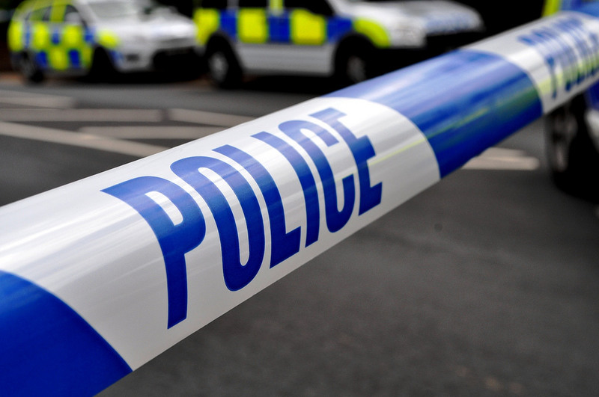
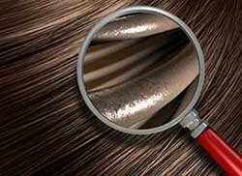
Forensic Lab 2
Fibre analysis
Notes:
https://www.flickr.com/photos/94418464@N08https://
http://www.forensicmag.com/article/2015/04/four-states-auditing-cases-involving-flawed-fbi-hair-analysis

Slide 2
The crime scene
The Forensics team have made a thorough search of the office carpet. The cleaner always comes to dust and vacuum at 6.00pm. Several different fibres were discovered; animal as well as human.
Notes:
http://scienceforwriters.blogspot.co.uk/2015/08/better-low-cost-dna-hair-analysis-for.html#!/2015/08/better-low-cost-dna-hair-analysis-for.html

Slide 3
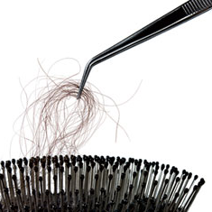
What is classified as a fibre?
A fibre is a thin thread of a natural or man made material.
Fibres are gathered at a crime scene with tweezers, tape, or a vacuum.
They generally come from clothing, curtains, wigs, carpets, furniture, and blankets.
Image Source: http://www.popularmechanics.com
Notes:
http://www.popularmechanics.com/science/health/a4548/4325797

Slide 4
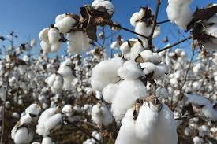
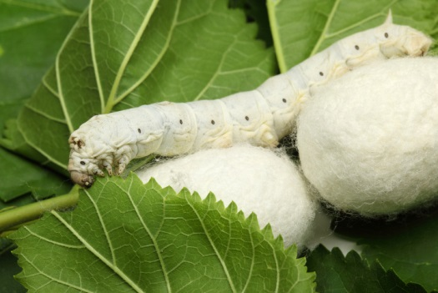
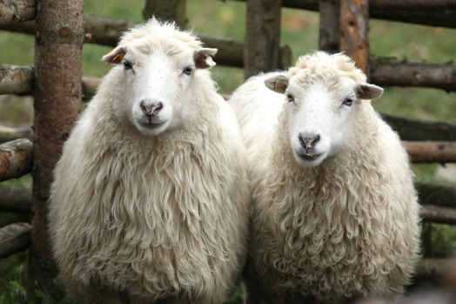
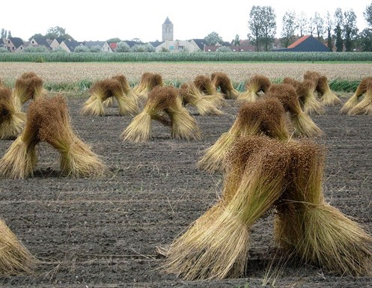
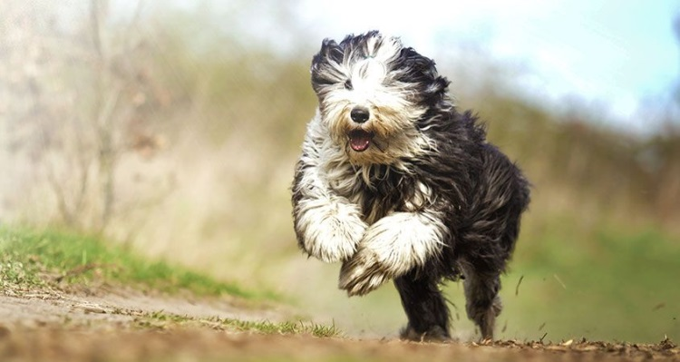
Natural Fibres
Cotton from a plant
Silk from the silk worm
Wool from sheep
Image source: http://creativecountrylife.com/?p=1514
Image source: http://inhabitat.com
Image source http://en-bure-bure.blogspot.co.uk/2012/02/ecological-felted-slippers-from-skudden.html
Linen from the flax plant
Hair fibres from animals
Image source http://www.belgianlinen.com
Image source https://www.cesarsway.com
Notes:
http://creativecountrylife.com/?p=1514
http://inhabitat.com/mit-creates-silk-pavilion-with-the-help-of-6500-silkworms/
http://en-bure-bure.blogspot.co.uk/2012/02/ecological-felted-slippers-from-skudden.html
https://www.cesarsway.com/dog-care/grooming/dog-fur-tells-a-lot-about-a-dog-health

Slide 5
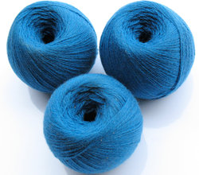
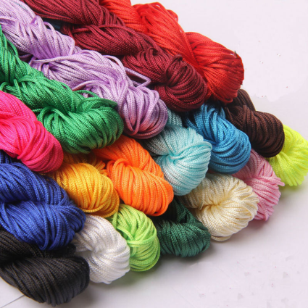
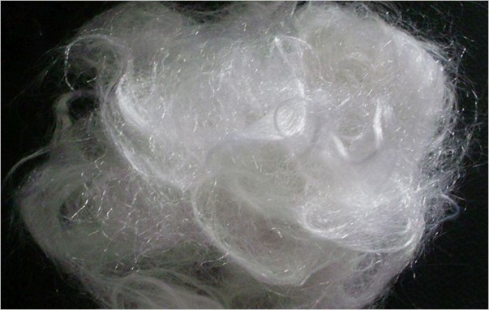
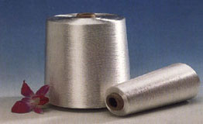
Man-made Fibres
More than half of all fibres used in clothes are man-made.
They include:
Image source https://dir.indiamart.com
Nylon
Acrylic
Image source https://www.aliexpress.com
Polyester
Image source: http://www.fibre2fashion.com
Rayon
Image source http://www.swicofil.com
Notes:
Http://www.fibre2fashion.com/news/polyester-news
https://www.aliexpress.com/w/wholesale-craft-nylon.html
https://dir.indiamart.com/impcat/acrylic-fiber.html
http://www.swicofil.com/products/200viscose.html

Slide 6
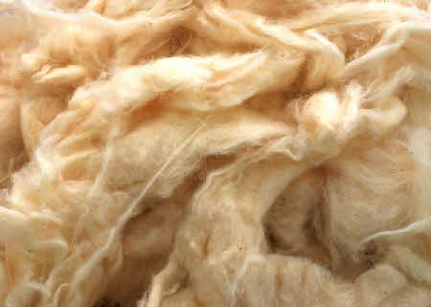
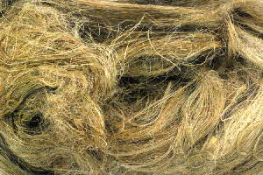
Natural Fibres
Plant fibres are made from a substance called cellulose.
Cotton is the most commonly used plant fibre which means the identification of a more unusual plant fibre at the crime scene could be significant.
Cotton
Linen
Image source http://www.wildfibres.co.uk/
Notes:
http://www.wildfibres.co.uk/

Slide 7
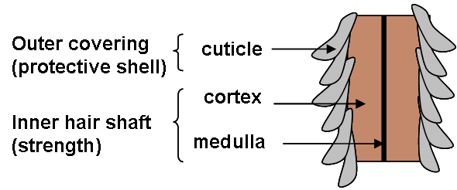
Hair
Individual strands of hair consist of a living part called the follicle and the rest, the shaft, which is dead.
The shaft is divided into 3 layers: the outer cuticle, the cortex and the internal medulla.
Image source: http://www.naturalinspiration.co.uk
Notes:
http://www.naturalinspiration.co.uk/blogs/hair/what-is-moisturised-hair/

Slide 8
Forensic analysis
Forensic scientists can look at hair under the microscope to find out a lot of information including:
which part of the body the hair came from
if it is Animal or human
if the hair has been dyed or bleached
if the hair has been straightened
DNA analysis, especially at the follicle.

Slide 9
Examine your own hair
Try shaking your hair to find a loose strand (on average
you lose over 100 a day)
Place it on a microscope slide and cover it with a piece of
sellotape to secure it.
Examine it under low and medium power.
Is you hair healthy or damaged?
Compare your hair with a friend.

Slide 10
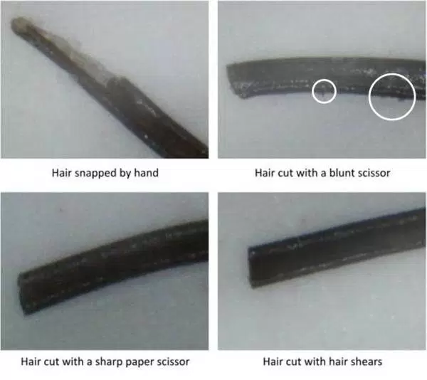
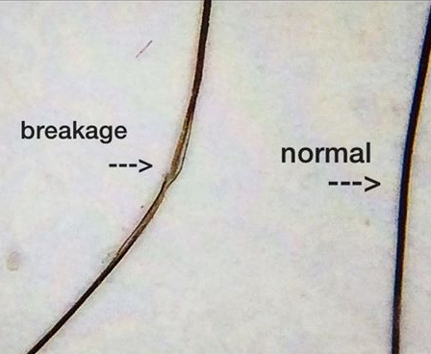
Things to look for….
Image source: http://www.imgrum.net/user/donovanmedical
Image source: https://i1.wp.com/blackgirllonghair.com
Notes:
http://www.imgrum.net/user/donovanmedical/508080108/1121185485574748032_508080108
https://i1.wp.com/blackgirllonghair.com/wp-content/uploads/2014/02/african_hair_microscope_cut_shears.jpg?resize=600%2C534

Slide 11
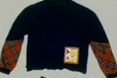
Real life crime.
Little Melissa Brannen was 5 years old when she went missing from a
Christmas party in 1989. Police suspected a man called Caleb Hughes of
abducting her but, without a body, they were going to struggle to prove it.
During a thorough search of his car forensic experts found clothing fibres.
One type was a rare rabbit fur that matched the coat that Melissa’s
mother had been wearing and the others came from a blue jumper. Police
managed to track down an identical jumper to the one Melissa had been
wearing when she disappeared.
The fibres matched proving she had been in his car.
Image source: http://www.charleyproject.org
Notes:
http://www.charleyproject.org/cases/b/brannen_melissa.html

Slide 12
Caleb Hughes
CONVICTED
Image source: http://www.charleyproject.org
Convicted of abduction
Punishment – 50 years in prison
Notes:
http://www.charleyproject.org/cases/b/brannen_melissa.html

Slide 13
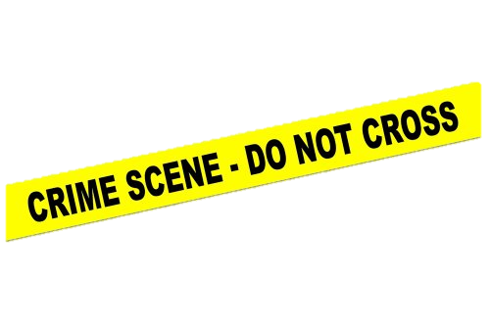
The Hospital crime scene
The Forensic team have mounted some of the hairs found in the office. They appear to be from some animals.
After interviewing the suspects we know the following:
-Suspect H has a pet rabbit
-Suspect C is a researcher working with mice.
-suspect B and E each have a cat.
-suspects F hunts rabbits and has dogs.
-suspect D has a Ferret
-suspect A has no pets and is allergic to animal fur.
-the CEO each has a dog.

Slide 14
Your next task
You will be given some sample slides of the animal hair found at the scene.
Draw what they look like under medium power in your workbook.
Can you see any differences between them?
What animal have they come from? (use the identification sheet to help)
Notes:
Samples are cat rabbit and dog.

Slide 15
Can you eliminate any suspects?
Scientists often need to use a high powered microscope to see the fine detail of a fibre.
The Biomedical Imaging Unit at Southampton General Hospital have used one of their high powered Scanning Electron microscopes to produce some high resolution images of the three fibres.
Examine the images carefully and note down any differences you can see.
Does this confirm/refute your initial ideas on which animals the hair fibres came from?

