Slide 1
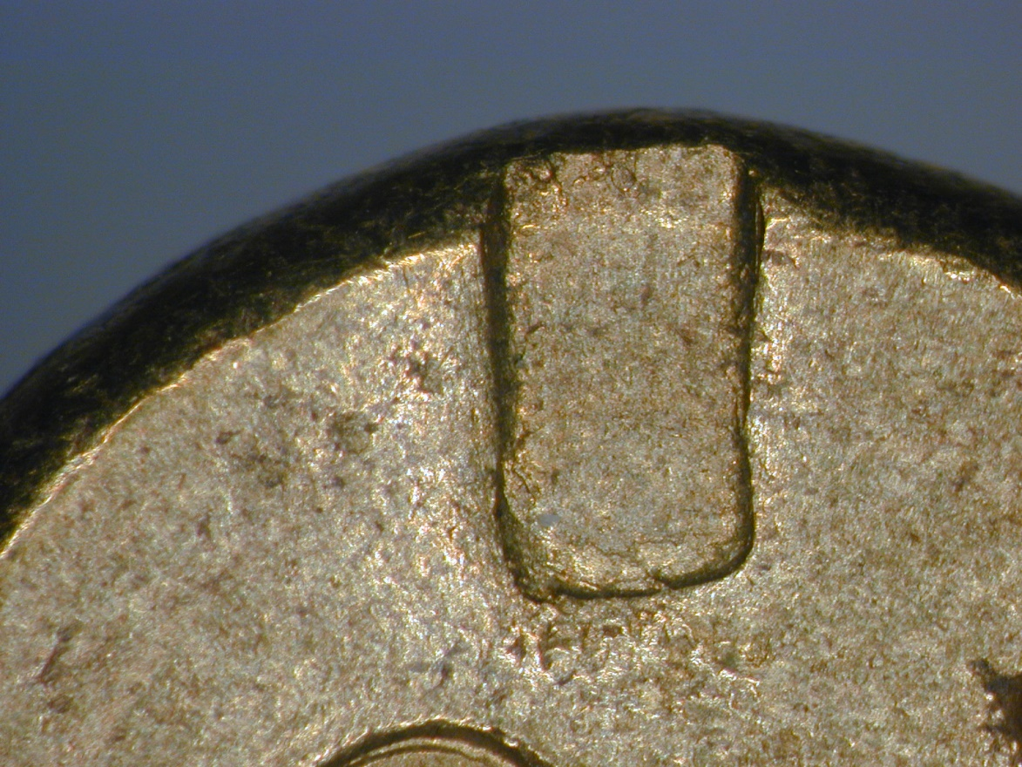
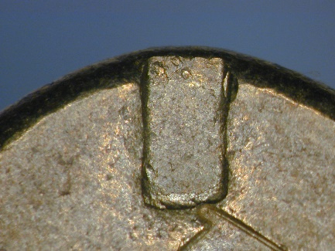
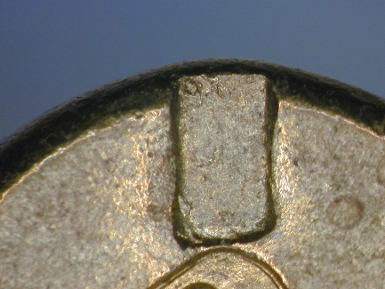
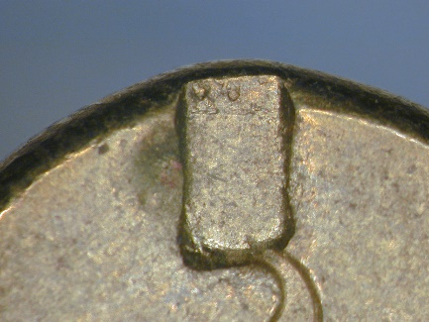
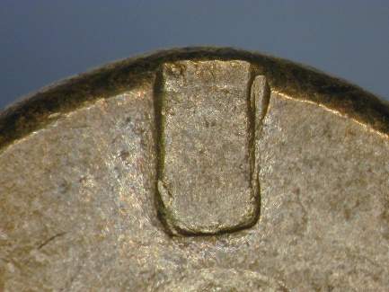
Gun 1
Outer edge often has 2 irregular, rounded, deeper pinpoint impressions on it
Sloping side to impression usually more pronounced on RHS compared to LHS
A rim firing gun
LHS corner somewhat sloping in with a sharper corner
RHS corner somewhat bulgy and rounded
Base of impression slopes up to RHS

Slide 2
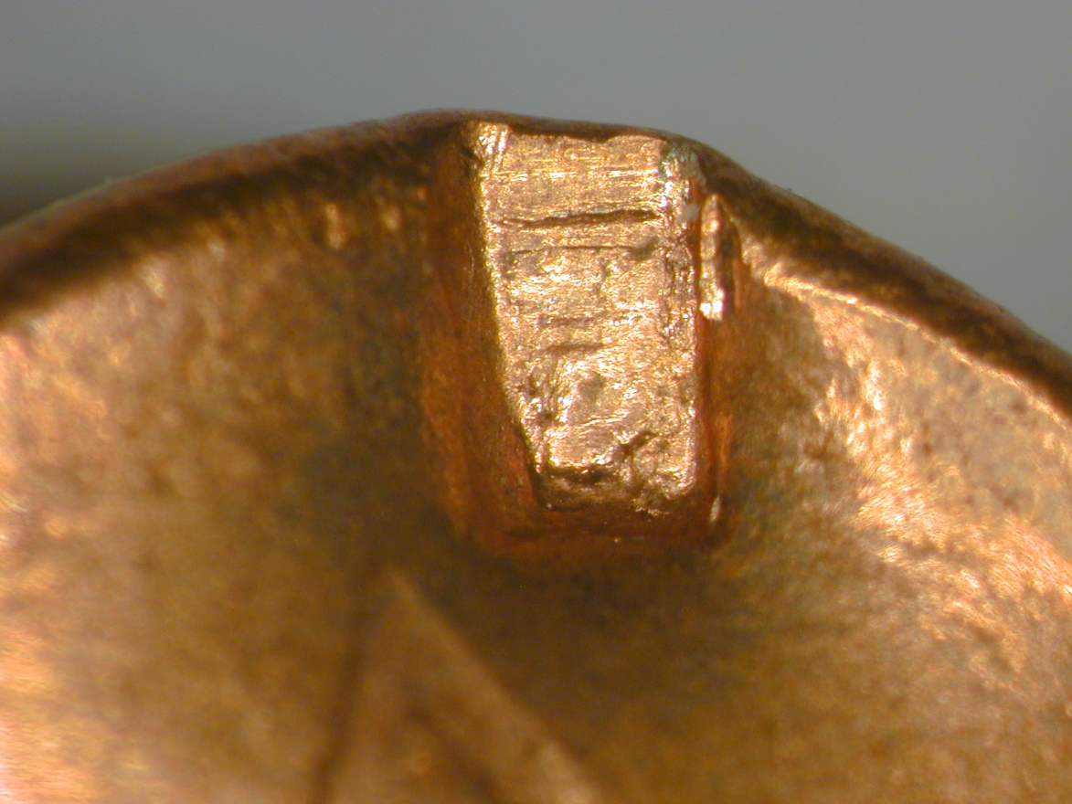
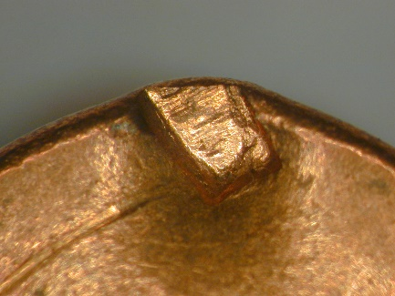
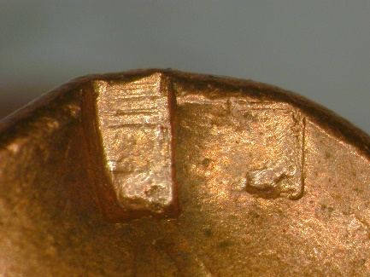
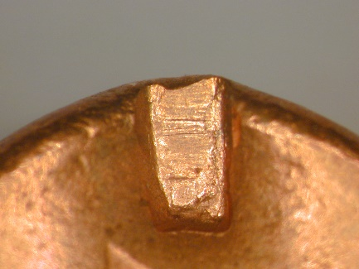
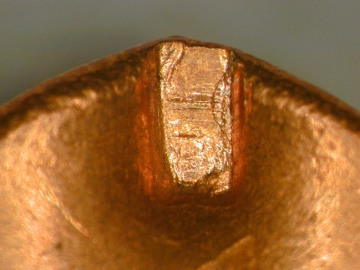
Gun 2
Another rim firing gun
Note that the angle of the impression seems to vary considerably between firings, suggesting that the cartridge can rotate slightly as it fires (maybe a rather worn chamber so the cartridge is a little loose?). Occasional firing pin stutter (firing 2).
Very obvious lateral striations in the impression. How consistent are they between firings?
Slopes in slightly on LH edge
RH bottom corner pretty square
Wall on LH edge not quite perpendicular so slope of side wall visible

Slide 3
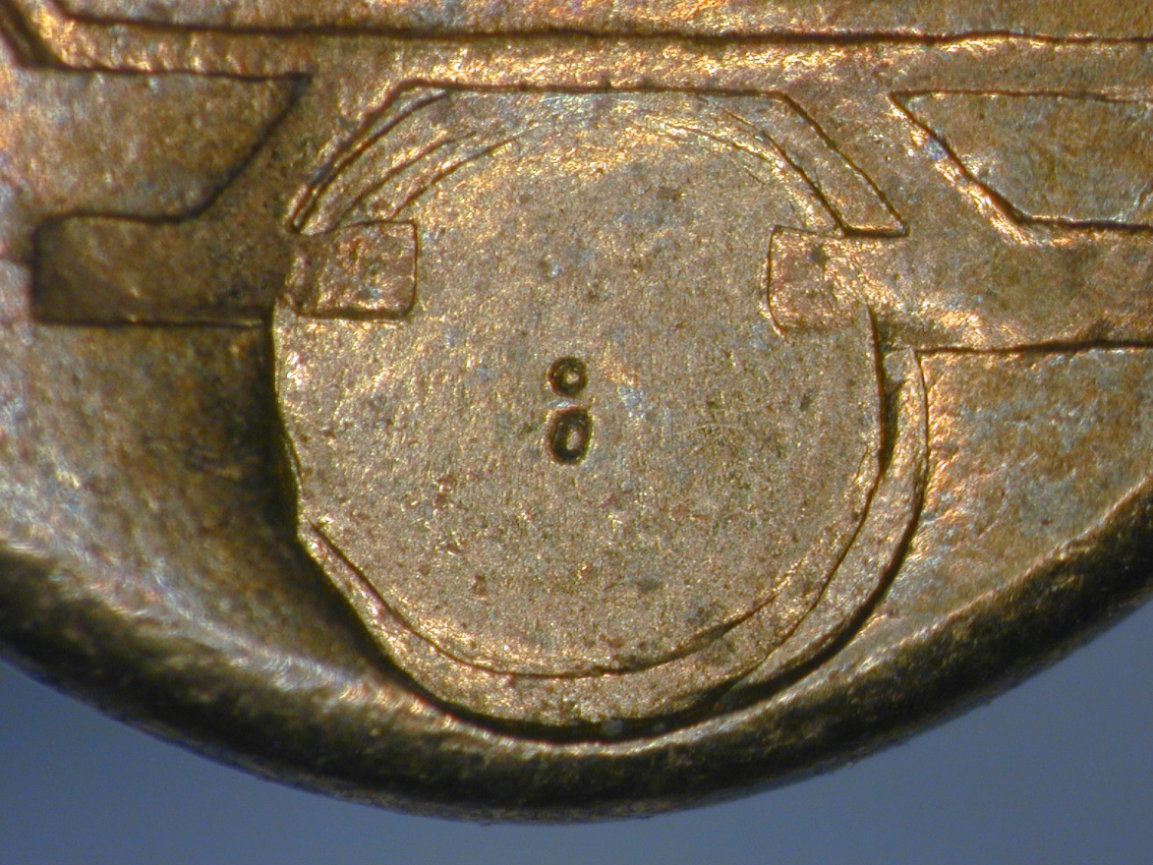
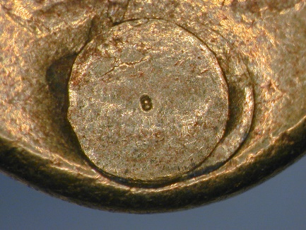
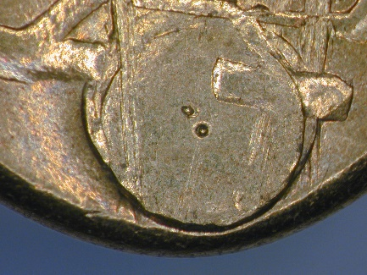
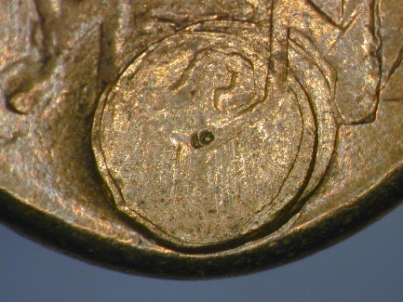
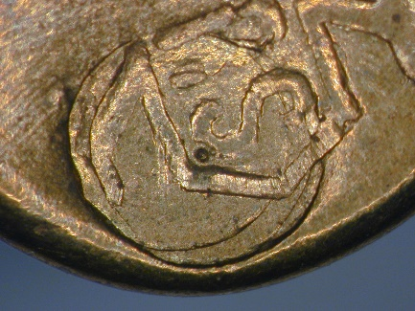
Gun 3
A completely different firing pin type. In this gun it is circular,flat and offset (so still rim firing of sorts) with a small, central pin prick projection.
Note this gun has a consistent “stutter in that the firing pin bounces and so hits the cartridge case twice; there are 2 superimposed circle and point impressions which differ in level of concentricity from firing to firing. Look closely at the 2 centre pin pricks on the 5 different firings, sometimes they are far apart (and on different firings a line between them lies at different angles), sometimes they are almost superimposed such that one overlaps the other. Which was the first to hit? On the 4th firing, the stutter is less obvious.

Slide 4
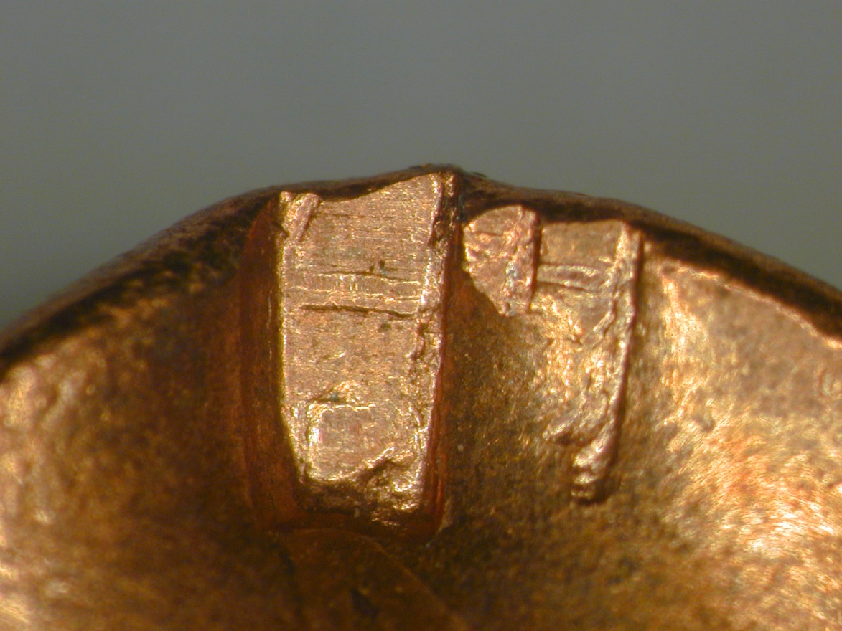
Cartridge from Crime Scene
What features does it have and how well does it match any of the test firings? (ignore colour of the metal)

