Slide 1
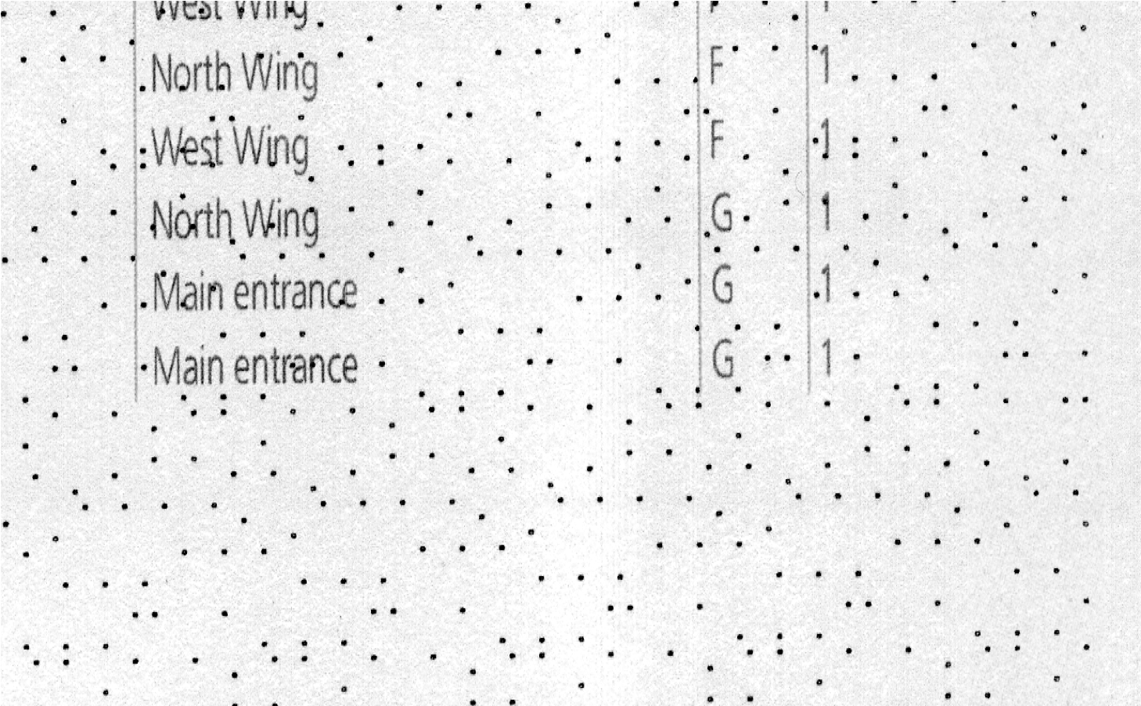
Crime Scene Map

Slide 2
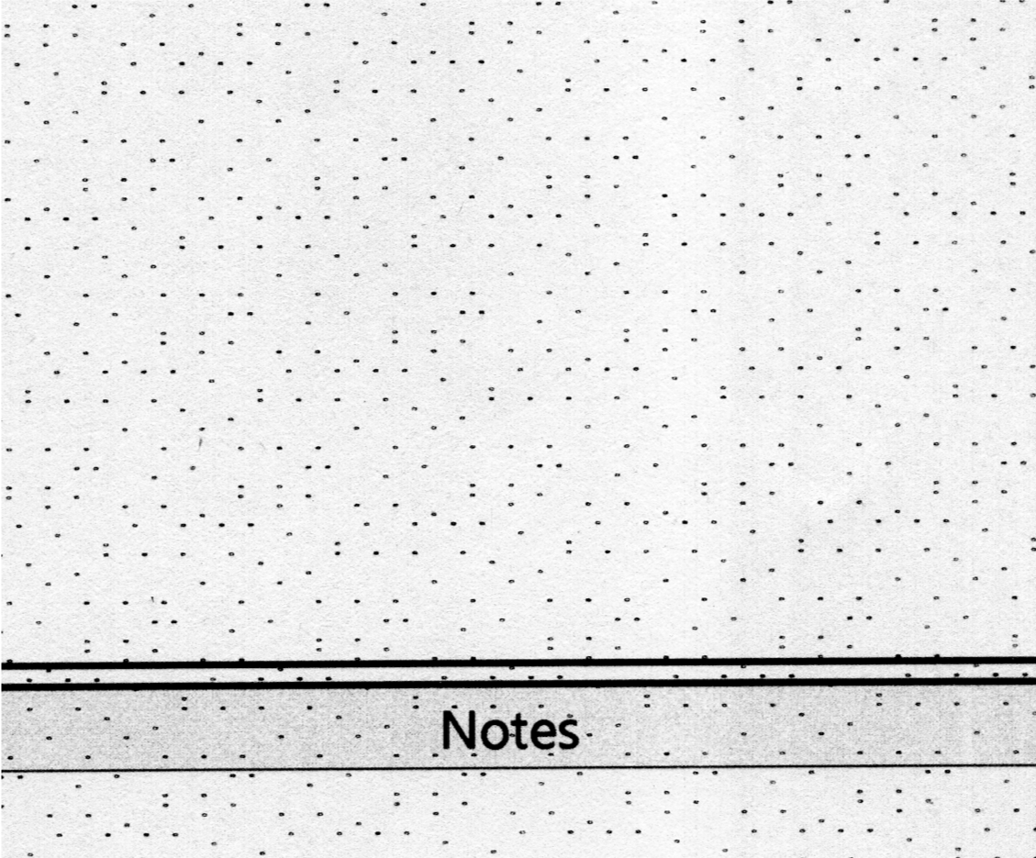
LF57

Slide 3
AB74

Slide 4
LB62

Slide 5
LB72

