Slide 1
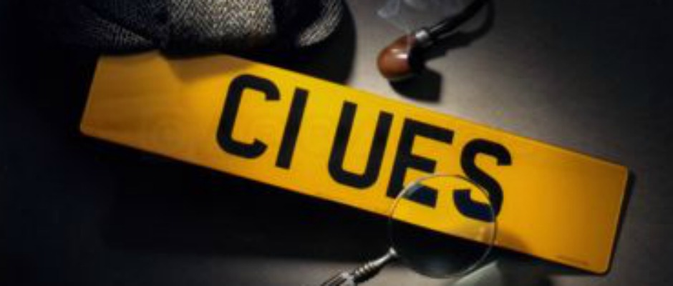
Notes:
http://nnimgt-a.akamaihd.net/transform/v1/crop/frm/storypad-35WVUfxfAJ5ewz9B7wdJW9B/e652233b-334f-4e5e-a632-b4f2725b7ef3.jpg/r63_7_576_336_w1200_h678_fmax.jpg
https://cecilymichelle.files.wordpress.com/2015/02/who-did-it.jpg

Slide 2
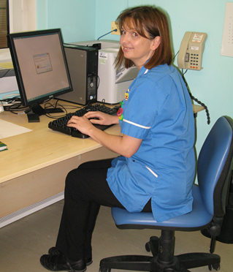
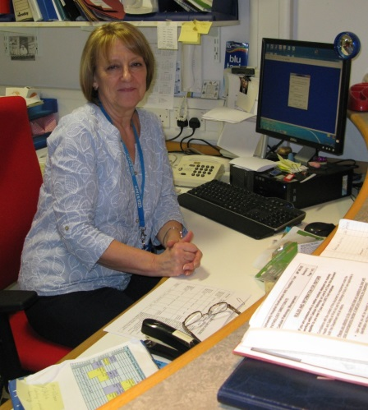
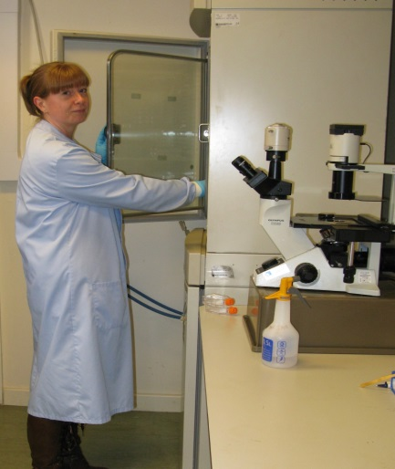
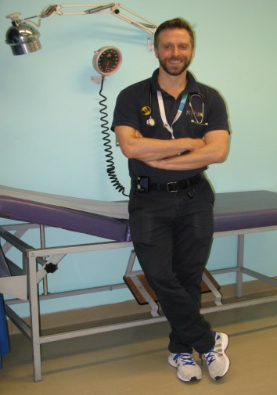
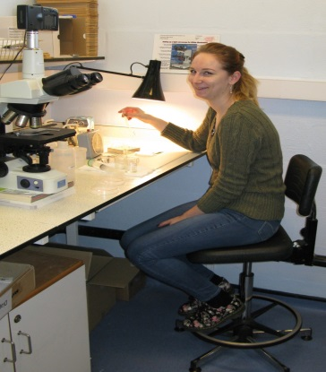
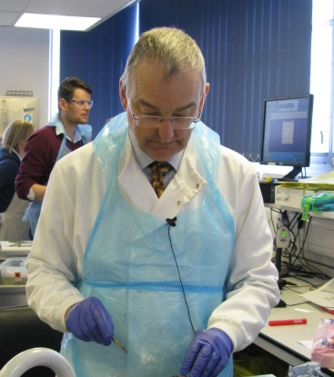
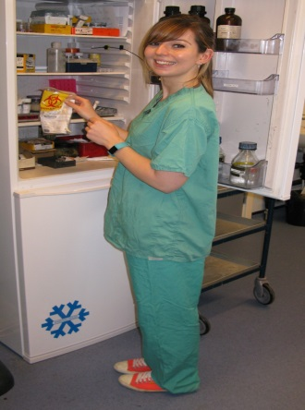
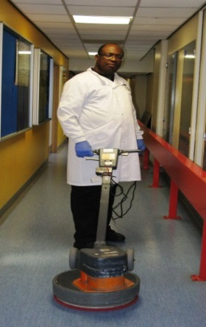
The Suspects
Suspect A
Amanda Oldfield Specialist Senior Nurse- BSc Hons
Suspect B
Andrea Jackson
Departmental receptionist
Suspect C
Dr Janice Angus - PhD
Research Scientist
Suspect D
Tom Leary – BSc Hons
Physiotherapist
Suspect E
Catherine Johnston Microscopist
– BSc Hons
Suspect F
Dr Norman Page
Consultant Pathologist M.B. FRCP
Suspect G
Regan McNeil
Operating Theatre Assistant-
QCF level 3
Suspect H
Balfour Jones
Hospital Cleaner

Slide 3
Sorting through the evidence
Any criminal court jury will have to deliberate and weigh up the evidence to decide if someone is guilty of a crime or not.
You now have to deliberate over the evidence to decide if you have sufficient and definitive evidence to either eliminate a suspect or support a charge of theft.
Notes:
https://i.guim.co.uk/img/static/sys-images/Guardian/Pix/pictures/2013/2/21/1361450946156/Jury-Room-010.jpg?w=300&q=55&auto=format&usm=12&fit=max&s=864a2d340a73cfe246dfe8284e6f9508

Slide 4
10 minutes

Slide 5
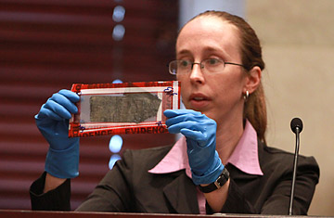
Present your case
You now have another 10 minutes to put together a maximum 1 minute presentation to say who you believe is innocent and/or guilty based on the evidence obtained.
Notes:
http://img.timeinc.net/time/daily/2011/1106/360_anthony_trial_evidence_0616.jpg

Slide 6
10 minutes

