Slide 1
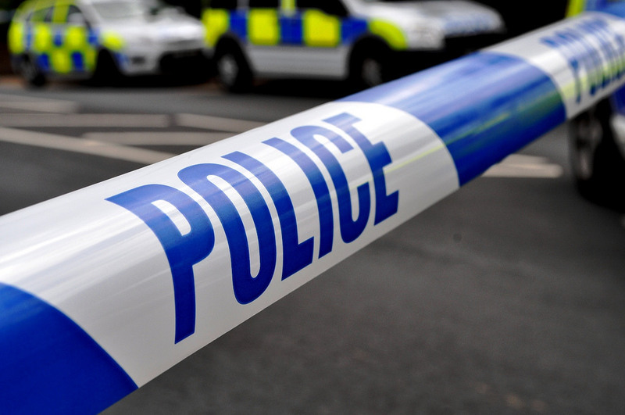
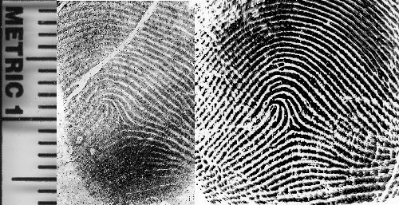
Forensic Lab 1
Fingerprint analysis
Notes:
https://www.flickr.com/photos/94418464@N08https://
https://www.newscientist.com/gallery/mg20527522600-guess-the-fingerprints/

Slide 2
The crime scene
Police would like you to check the door handle for fingerprints. This could provide them with a key piece of evidence.
Notes:
https://usingdata.wordpress.com/category/causal-analysis/why-why-why/

Slide 3
What are fingerprints?
The skin on the fingers and palms of our
hands is covered with little friction ridges.
We have these ridges to help us grip
things and help with our sense of touch.
No two people in the world have the same
fingerprints even identical twins!!!!!.
Anyone who is arrested and convicted of a
crime will have his/her fingerprints
recorded on a national database.

Slide 4
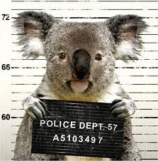
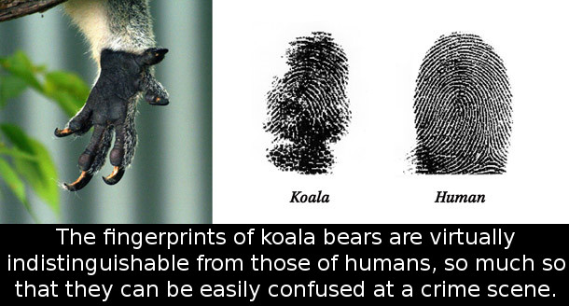
Koalas commit crimes?
We are not the only animal which has
unique fingerprints. Forensic scientists in
Australia have realised that Koalas have
prints that are so similar to humans that even
some experts thought they were human!
Image Source: http://www.maniacworld.com
Image Source: http://koalaland.com.au

Slide 5
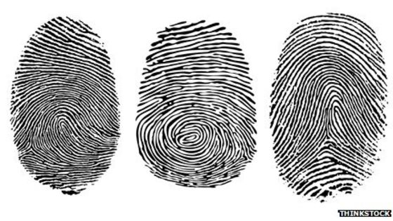
Fingerprint patterns
Fingerprint patterns are put into three
main groups:
Loop
Whorl
Arch
Image Source: http://wwwbbc.co.uk/news/magazine-19740979
.

Slide 6
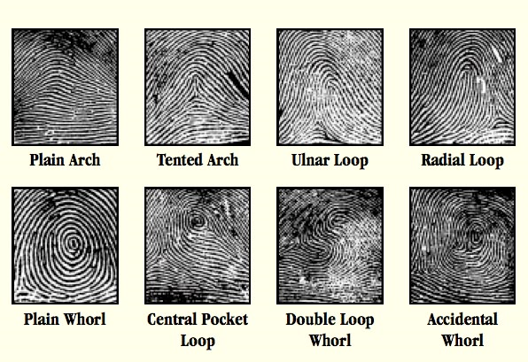
Fingerprint patterns
These groups can then be subdivided to
study more complex patterns.
Image source: http://www.viewzone.com/fingerprintsx.html

Slide 7
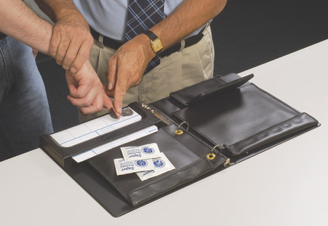
Examine your own fingerprints
Prepare a set of your own fingerprints by inking your
fingertips and then gently rolling each tip across the
recording section of your workbook.
Practice on some blank paper first!
Examine your prints using a hand lens so you can
identify the major patterns seen and record the
information.
Image source: http://www.transfarm.pl

Slide 8
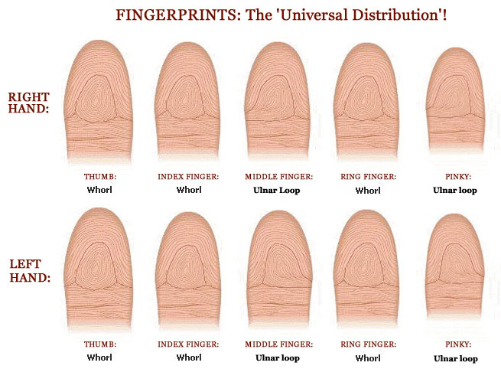
Did your group match the World most common pattern?
Image source http://www.handresearch.com/news/fingerprints-world-map-whorls-loops-arches.htm
Notes:
Answer Key for workbook sheet:
A – 1, B – 7, C – 9, D – 11, E – 3, F – 10, G – 6, H – 2, I – 4, J – 12, K – 5, L – 8

Slide 9
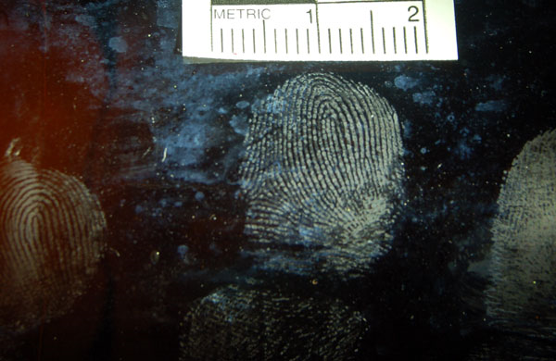
Crime scene – lifting a print
Our skin is very oily/sweaty so it leaves a pattern on everything we touch. Forensic scientists use several different methods to lift and record prints, depending on the type of surface they are examining.
Examples include:
Lasers
Power/tape lifting
Magnetic powder
Photography
Superglue/chemical fuming
Image source
http://www.forensicsciencesimplified.org/prints/how.html

Slide 10
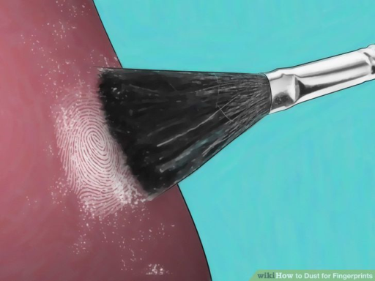
Lifting a print off a hard surface
Pick up a clean microscope slide by its edges and place it in the middle of a clean paper towel.
Wipe you forehead with a finger and then press it firmly onto the slide to leave a latent print
Carefully dip the tip of your brush into the powder and gently tap off any excess powder.
Hold the brush upright in between the palms of your hands over the fingerprint area of the slide.
Gently rub your hands back and forth to rotate the brush with the tip just touching the surface.
Keep going until the fingerprint is covered
Image sourcehttp://www.wikihow.com/Dust-for-Fingerprints

Slide 11
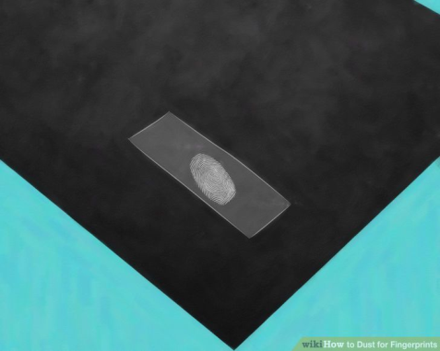
Lifting a print off a hard surface
Tap the edge of the slide to dislodge any loose powder.
Take a piece of sticky tape and roll it over the print. Use a sideways action to press it (NOT DOWNWARDS).
Peel it off and seal it in the box on your worksheet.
Repeat for other powders.
Image sourcehttp://www.wikihow.com/Dust-for-Fingerprints

Slide 12
Real life crime.
Between 1984-85 a serial killer nicknamed the Night
stalker ( Richard Ramirez) terrorised the residents of
Los Angeles, California.
The police had a lot of forensic evidence from the crime
scenes but none which told them who the criminal was.
They finally tracked him down when a witness spotted a
car leaving one of the crime scenes. Even though
Ramirez had wiped the car clean before he abandoned
it, forensic scientists found a single fingerprint on the
rear view mirror.

Slide 13
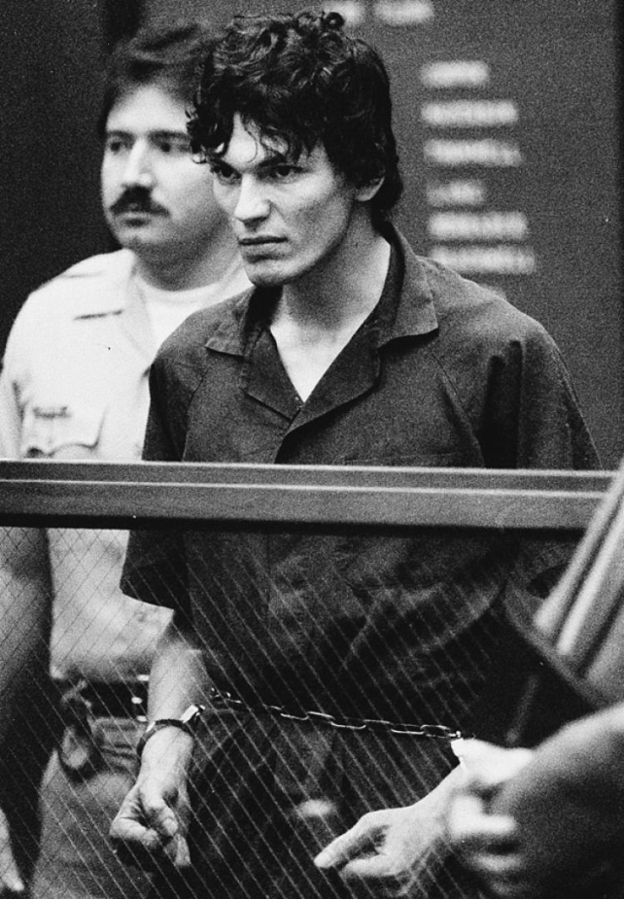
The Night Stalker.
CONVICTED
Image source
http://www.nydailynews.com
Convicted of 13 murders and 5 attempted murders.
Punishment - the death penalty
Notes:
For information: He died on death row.

Slide 14
The Hospital crime scene
You have been given a door handle from the crime scene.
Use the best fingerprint powder to see if you can lift any prints from it.
If so does it match any of the suspects?

