Slide 1
Fizz, Bang, Wallop
Chemistry

Slide 2
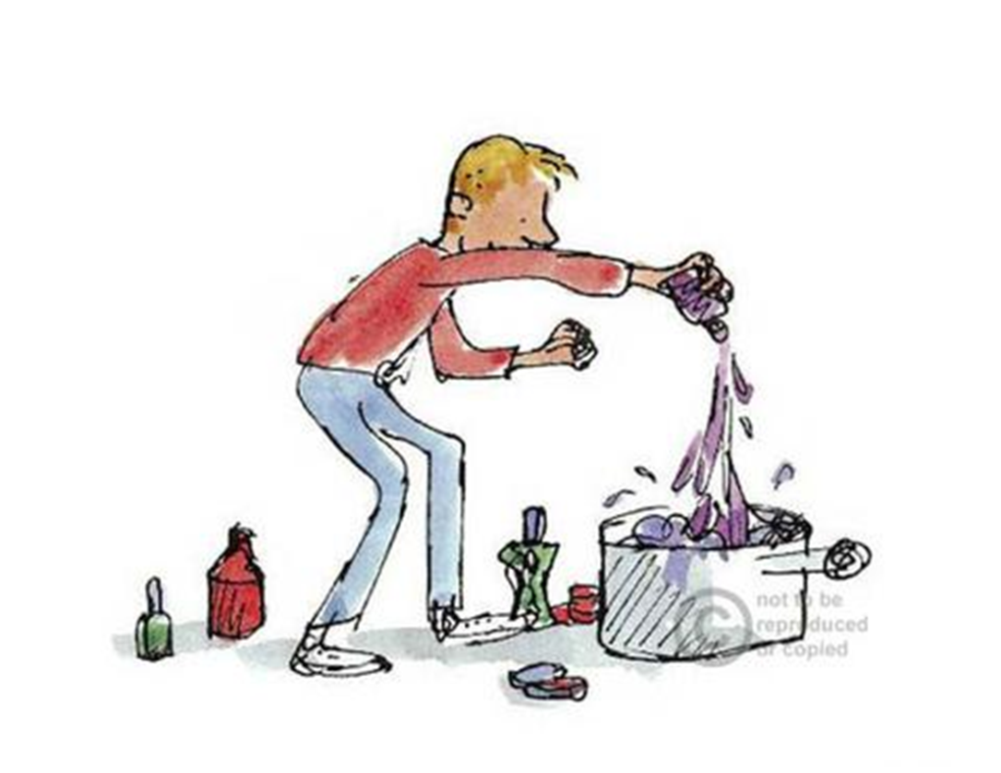
There was an old stick lying on the bench that had been used for stirring paint. George picked it up and started to stir his marvellous concoction. The mixture was as thick as cream, and has he stirred and stirred, many wonderful colours rose up from the depths and blended together, pinks, blues, greens, yellows and browns.

Slide 3
George needs to learn the order of the substances he used to make the marvellous medicine.
One way George could do this is by trying to remember the colour that each substance makes.
How can we work out which substances make which colours?

Slide 4
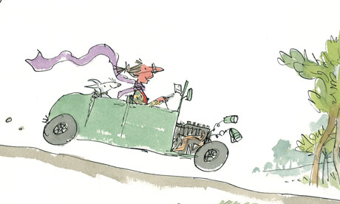
How can we do this?
Granny wants to turn the car right. How does she let the driver behind know what she is going to do?

Slide 5
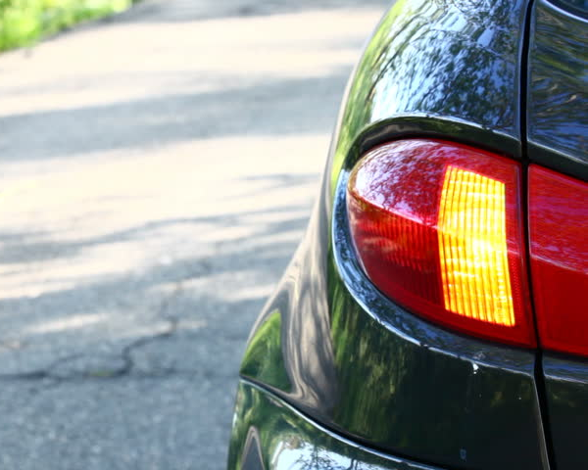
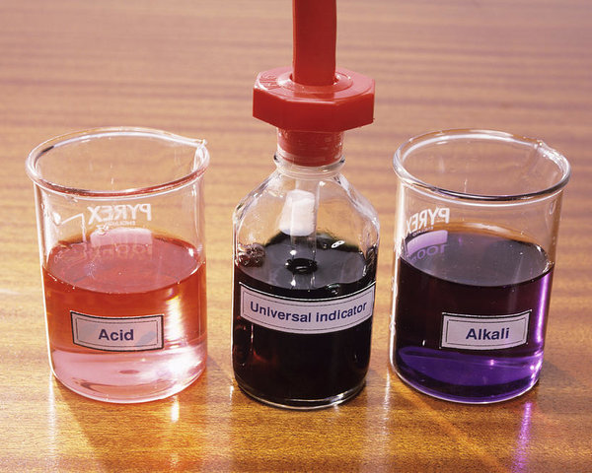
Indicators
Car drivers use indicator lights to tell drivers which way they are going.
Scientists use universal indicator to help them find out information about substances.

Slide 6
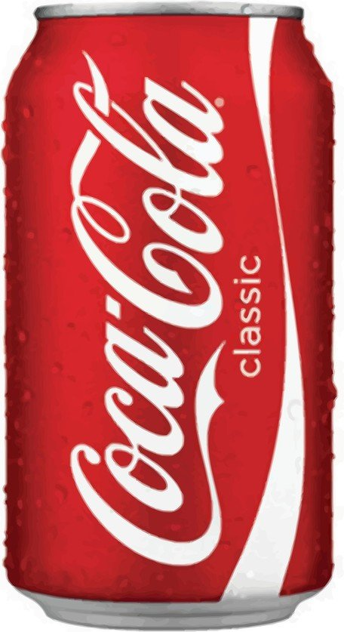
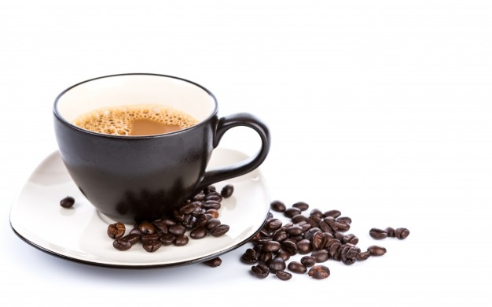
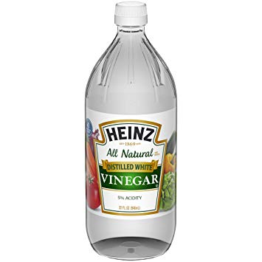
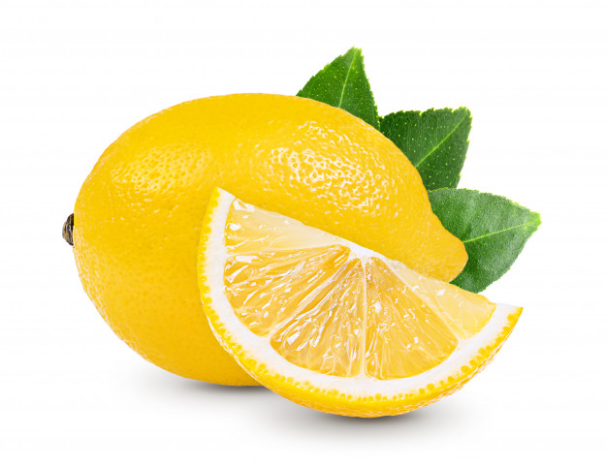
What types of substances are there?
What is the connection between all these items?
Acids

Slide 7
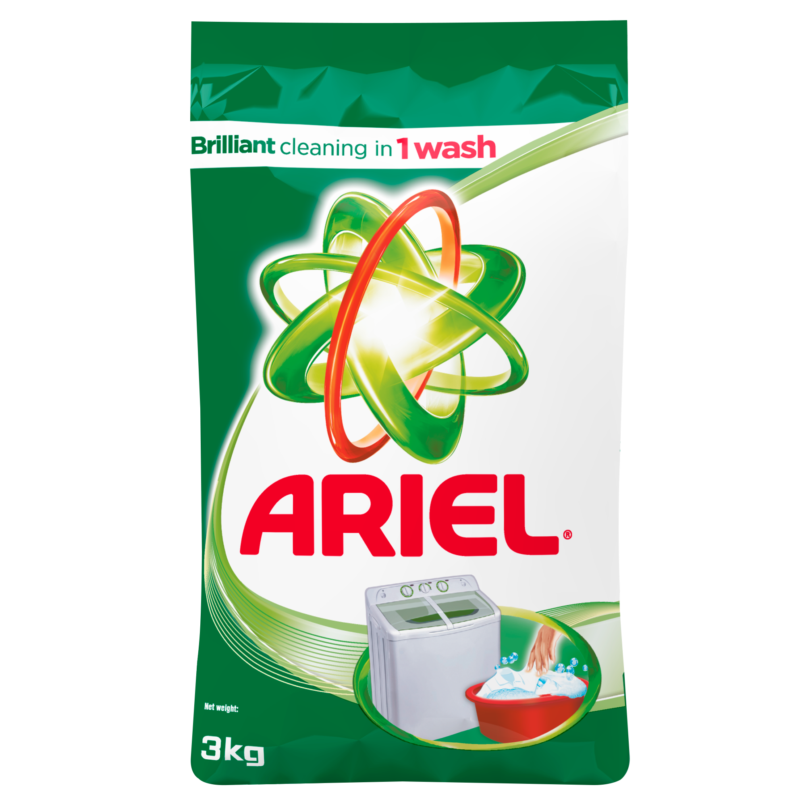
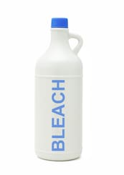
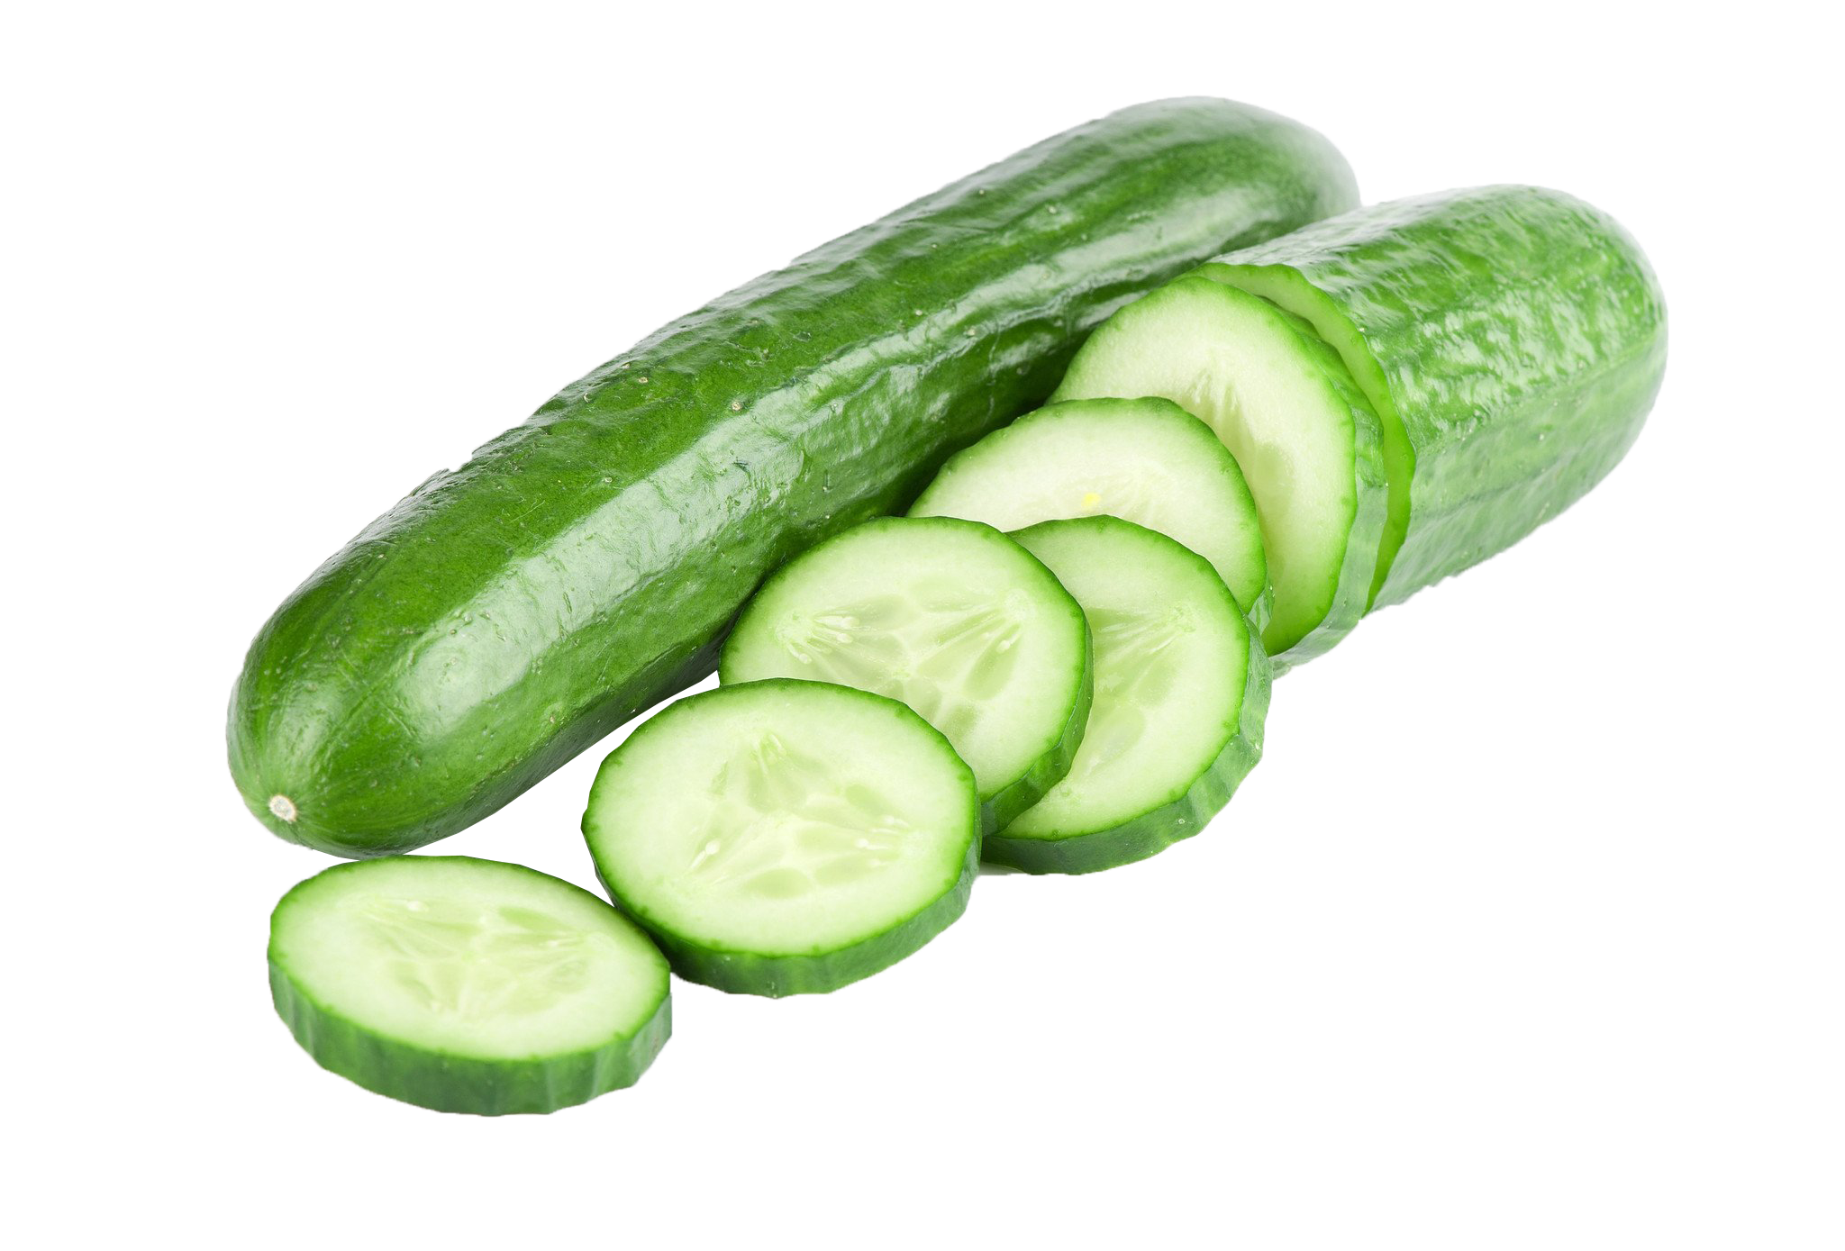
What types of substances are there?
What is opposite of acids?
Alkalis

Slide 8
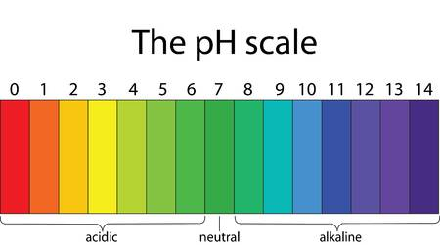
George can use Universal Indicator to check if his substances are acids or alkalis.
The indicator will change colour.

Slide 9
Testing time!
Put one drop of the substance into a well of the spotting tray
Add one drop of Universal Indicator
Observe what happens to the colour
Repeat for all the different substances, remembering to use a new well each time.

Slide 10
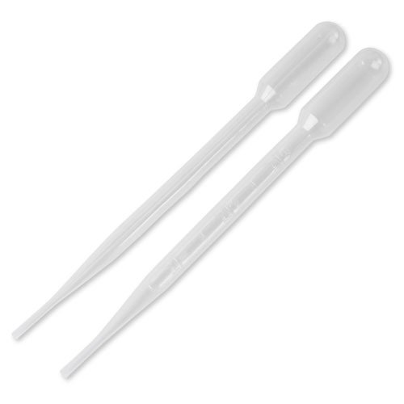
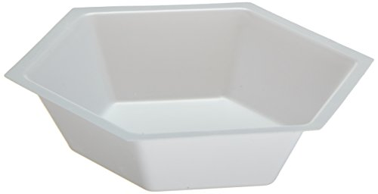
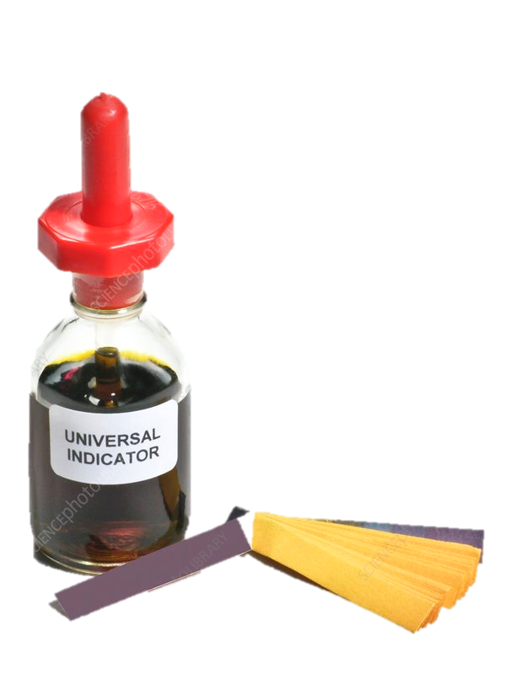
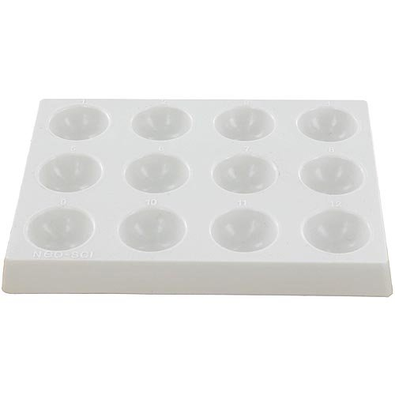
Equipment

Slide 11
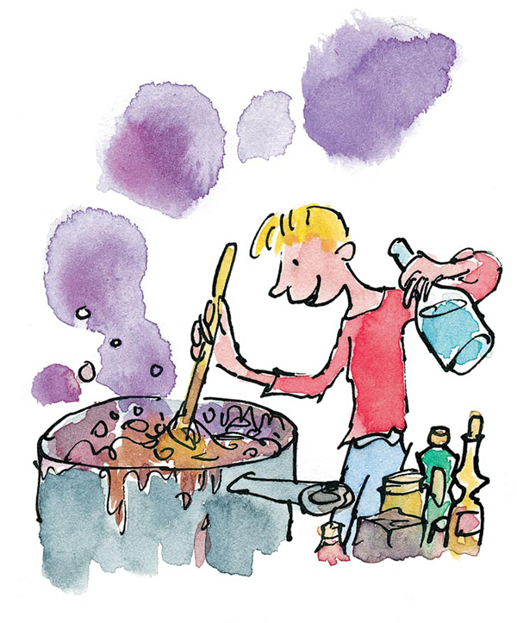
It was wonderful to stand there stirring this amazing mixture and to watch it smoking blue and bubbling and frothing and foaming as though it were alive.

Slide 12
George has to make sure his ingredients go into the pot in the correct order to make his marvellous medicine.
How can he find out which mixture of ingredients gives the longest fizz?

Slide 13
Which mixture of ingredients gives the longest fizz?
What is your key question?
How are you going to investigate your question?
What factors are you going to control?
What is your independent variable? What are you going to control?
What resources/equipment will you need?
How will you record your results?
How will you make sure your results are accurate?

Slide 14
Complete your observation worksheet
Pick your favourite minibeast to draw.
Label its main features.
Which group does it belong to? How do you know that?

