Slide 1
Granny’s Minibeast Menu
Classification

Slide 2
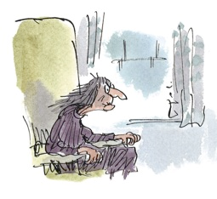
‘Cabbage doesn’t taste of anything without a few boiled caterpillars in it. Slugs too.’ ‘Not slugs!’ George cried out. ‘I couldn’t eat slugs!’ ‘Whenever I see a slug on a piece of lettuce,’ Grandma said, ‘I gobble it up quick before it crawls away. Delicious.’

Slide 3
George decides to try and cheer Granny up by finding her some tasty treats from the garden.
However, he is not really sure what similar mini beasts his granny might like if he can’t find any slugs.
What minibeasts are similar to slugs?

Slide 4
Minibeast groups
Minibeasts come in all shapes and sizes
Can you put the different minibeasts into groups?
How will you group them?

Slide 5
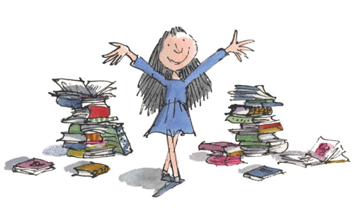
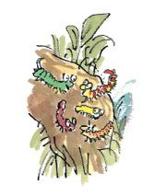
Why do we need to classify creatures?
Imagine going to a library where all the books were jumbled up!
How is the library organised so that Matilda can find books?
We sort out all the living creatures in the world into groups according to the similarities between them
This is called classification

Slide 6
Classification keys
We can use a classification key to help us identify which group a creature belongs to
Minibeasts belong to a group called invertebrates, which means they have no backbone

Slide 7
George has found a mysterious minibeast, and he is not sure what group of invertebrate it belongs to.

Slide 8
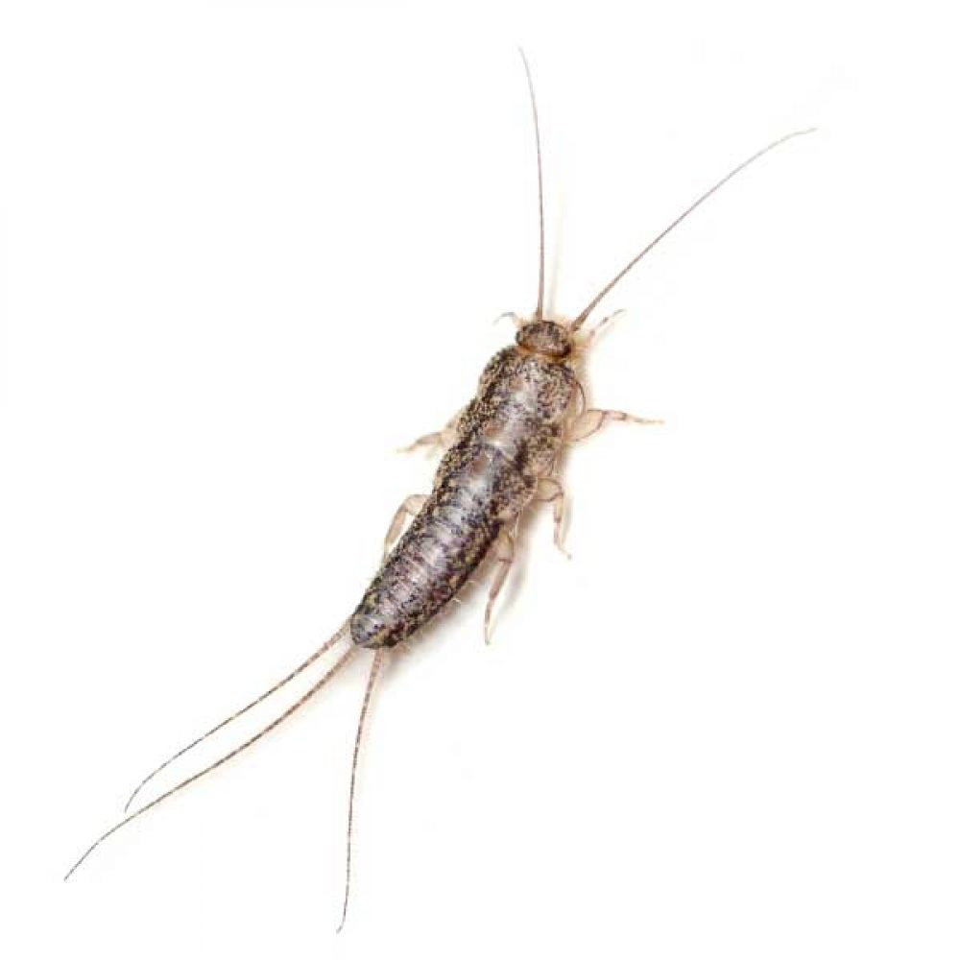
Which invertebrate is this minibeast?
Can you look closely at the picture can help George work out which group it belongs to by using the classification key?
Insect
The answer is…

Slide 9
Hello Friends,
Granny is very grumpy today and I thought she might like to munch on a few insects. I think that there lots of minibeasts hiding outside! I have seen some butterflies, spiders and ants in my garden over the last few days but now I need your help!
Can you look around outside to see what minibeasts you can find? I have sent you lots of things to use to find the minibeasts. Look at them closely and work out what minibeasts you can spot.
You will need to be very quiet and careful when looking for minibeasts. We don’t want to scare or hurt them. Remember to put them back where you found them if you are allowed to pick them up.
From George

Slide 10
We’re going on a bug hunt!
We are going to look around the school for some minibeasts
Use pooters to suck up minibeasts from the ground or on leaves
Look in pitfall traps to find minibeasts on the ground
Spoons, forceps or potters should be used to handle the minibeasts

Slide 11
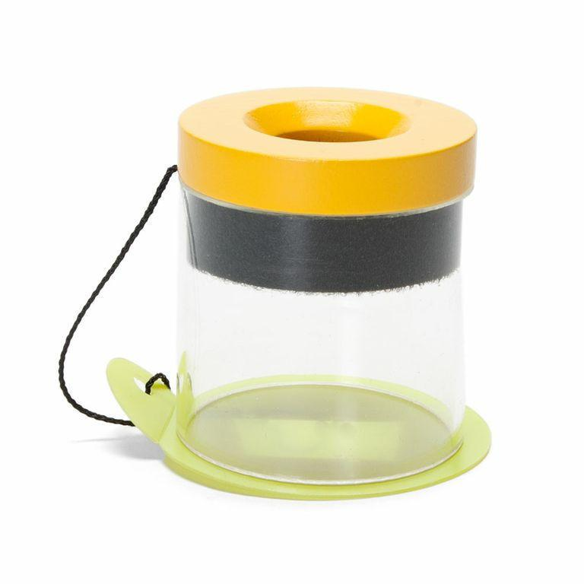
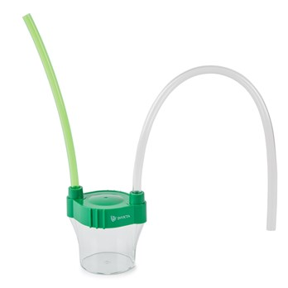
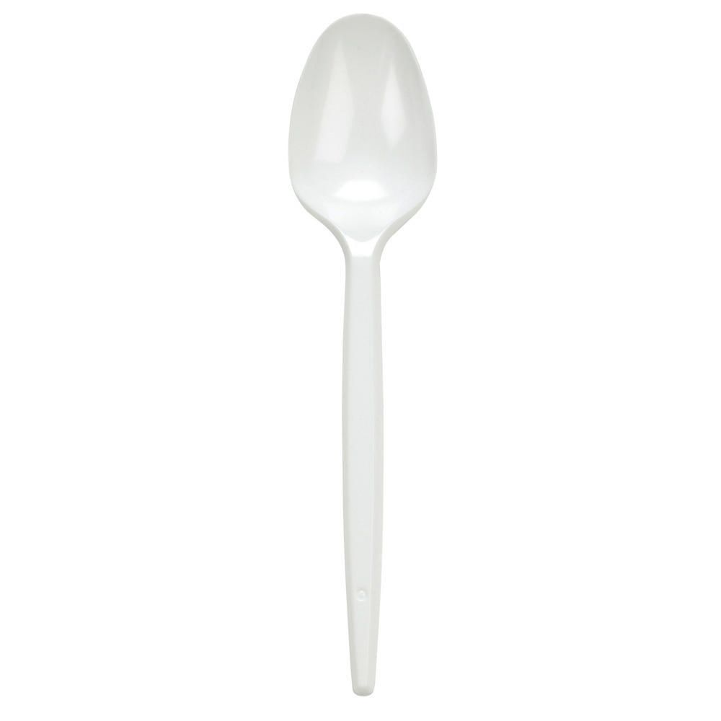
Equipment

Slide 12
Complete your observation worksheet
Pick your favourite minibeast to draw.
Label its main features.
Which group does it belong to? How do you know that?

