Slide 1
Granny’s Cup of Tea
Dissolving

Slide 2
‘How much sugar in your tea today, Grandma?’ George asked her. ‘One spoon,’ she said. ‘And no milk.’

Slide 3
George has to make the tea very quickly as Grandma is a very grumpy and impatient lady!
He needs to make sure the teaspoon of sugar dissolves quickly.

Slide 4
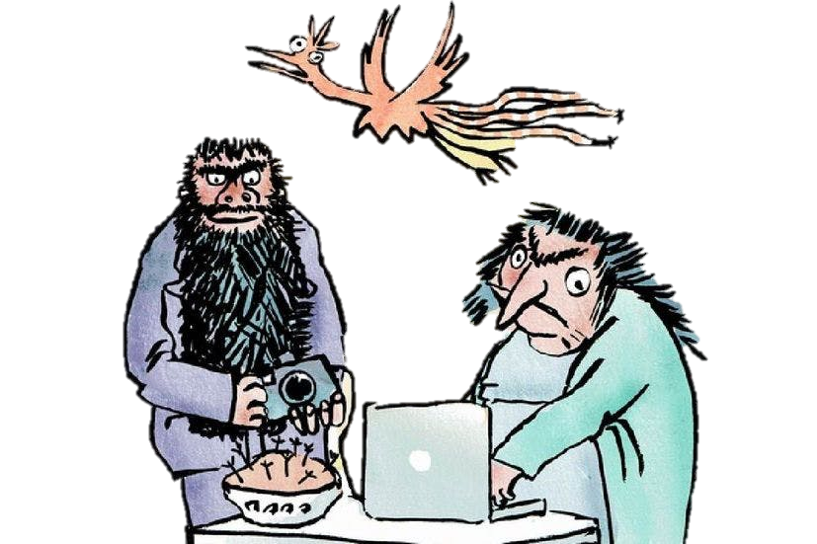
What will affect how quickly the sugar can dissolve?
A sugar lump will dissolve quicker than a spoonful of sugar
If we had a bigger cup, the sugar would dissolve faster
If we stir the tea, the sugar will dissolve quicker

Slide 5
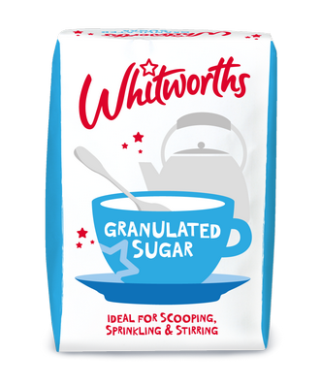
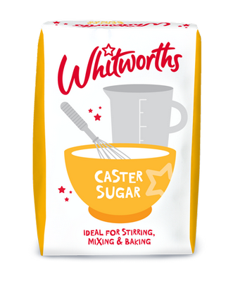
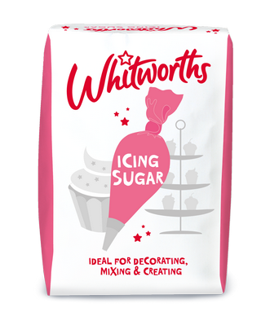
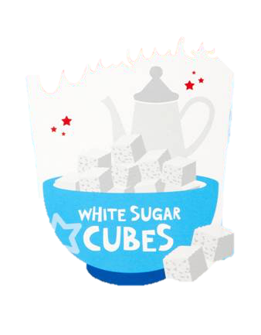
George is making Granny’s cup of tea.
He notices that there are 4 types of sugar in the kitchen cupboard.

Slide 6
Which sugar should George use?
What is your key question?
How are you going to investigate your question?
What factors are you going to control?
What is your independent variable? What are you going to control?
What resources/equipment will you need?
How will you record your results?
How will you make sure your results are accurate?

Slide 7
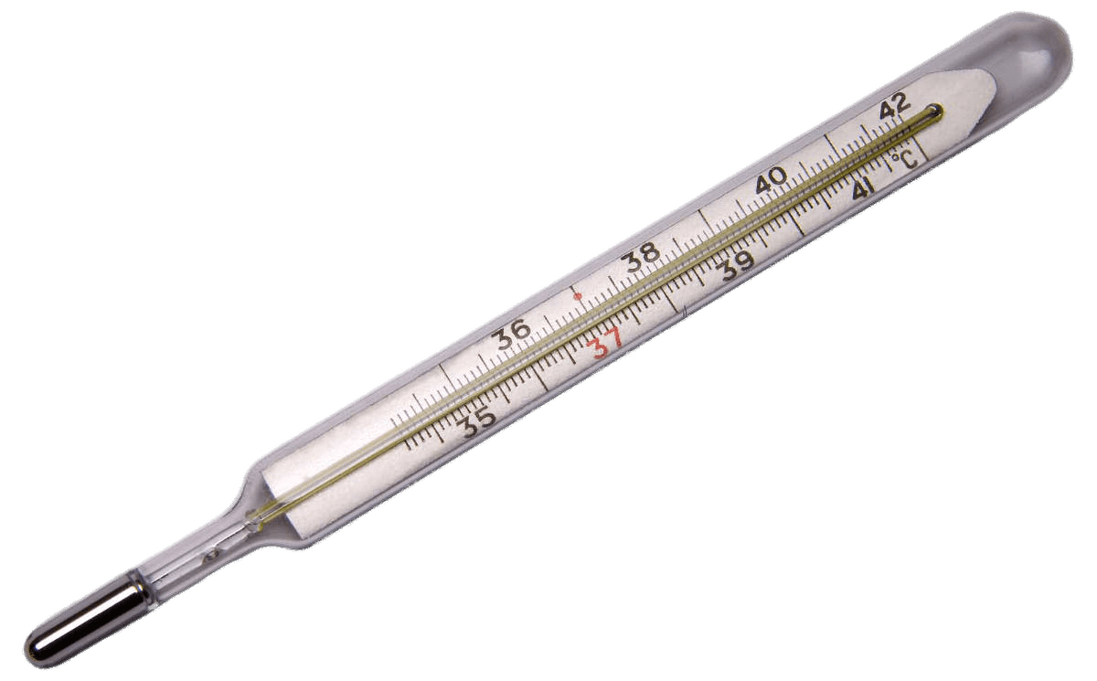
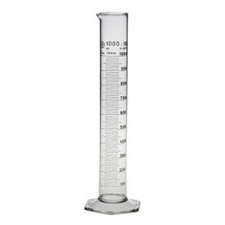
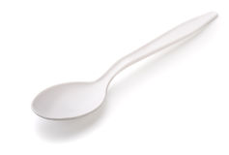
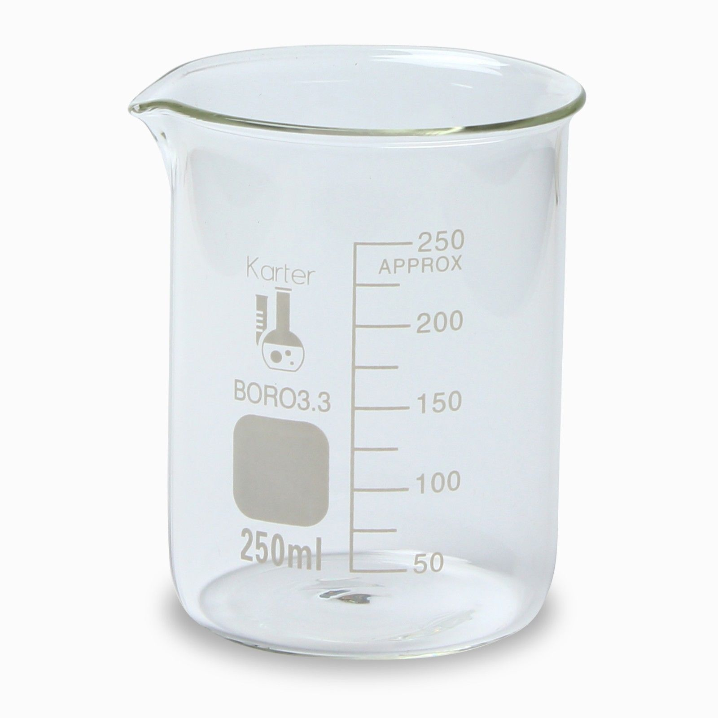
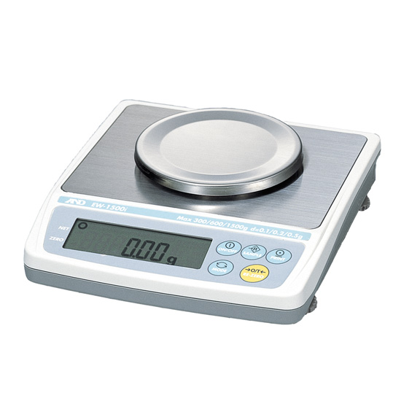
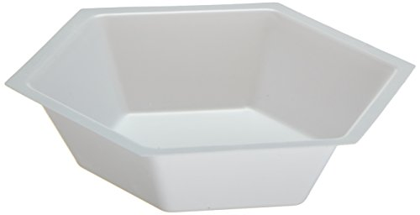
Equipment

Slide 8
Complete your investigation worksheet
What is your prediction?
Make observations throughout your experiment.
What can you conclude?

Slide 9
George went into the kitchen and made Grandma a cup of tea with a teabag. He put one spoon of sugar in it and no milk. He stirred the sugar well and carried the cup into the living room. Grandma sipped the tea. ‘It’s not sweet enough,’ she said. ‘Put more sugar in.’

Slide 10
Challenge!
George accidentally put two more spoons of sugar in Granny’s tea!
How might George be able to remove it?
Oh no!!

