Slide 1
Electrocuting Granny
Electricity and Circuits

Slide 2
It was exactly as though someone had pushed an electric wire through the underneath of her chair and switched on the current.

Slide 3
George wonders what he could do if the medicine doesn't work.
He could electrocute Granny!
What would George need to make electricity?
I could electrocute Granny!

Slide 4
What is actually happening in a simple circuit?

Slide 5
What is actually happening in a simple circuit?
Scientific symbols

Slide 6
What does a battery do?
FLOW OF ELECTRICITY
A battery makes little particles in the wires start to move
Particles are called electrons
Electricity is the flow of electrons in the wire

Slide 7
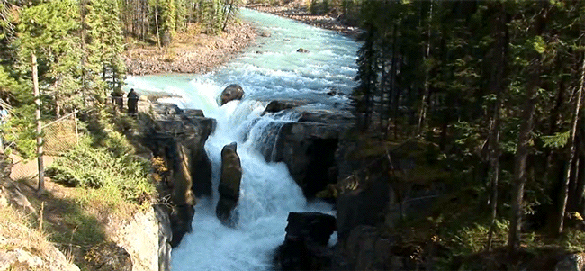
What is the current?
The flow of water particles in a river is called a current.
The flow of electrons in a circuit is called a current.
The current tells us how fast the electrons are moving.

Slide 8
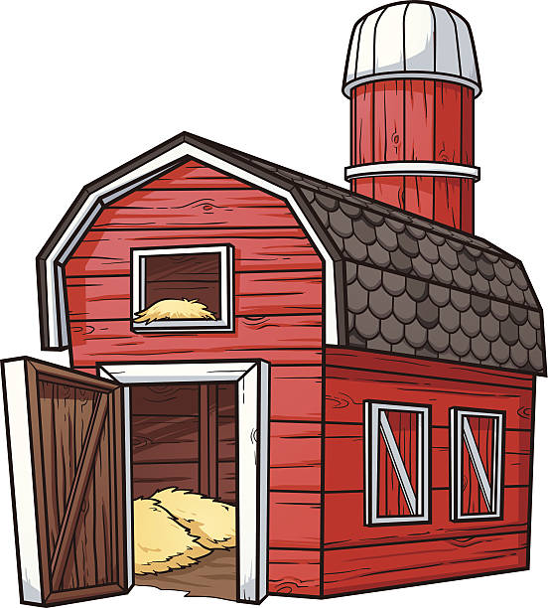
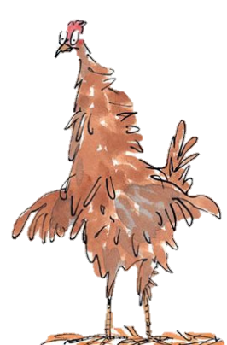
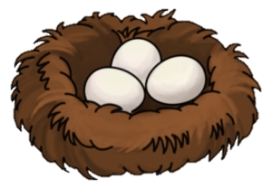
What is the voltage?
Imagine that…
Electrons are George’s chickens
Battery is a chicken barn, providing food
Bulb is the nest

Slide 9
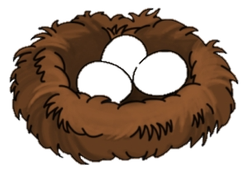
What is the voltage?
George’s chickens
When George’s chickens go through the barn they are warm and get food.

Slide 10
What is the voltage?
George’s chickens
After being fed, the chickens have enough energy to move around.
The barn gives the chickens the “push” to move.
This push is called voltage.

Slide 11
What is the voltage?
George’s chickens
The chickens then transfer some of their voltage the nest, causing there to be eggs.

Slide 12
What is the voltage?
Simple circuit
Electrons go through the battery
Battery gives the electrons the “push” to move
The push is known as the voltage
Electrons transfer some of voltage to bulb so that it lights up

Slide 13
Can you draw a simple circuit?

Slide 14
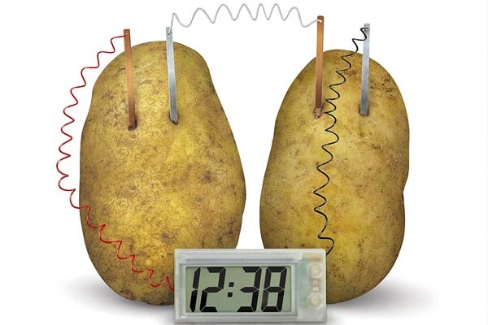
George can’t find any batteries around the farm.
What else could he use?
George remembers seeing a potato clock before.
Do you think we could use other vegetables?

Slide 15
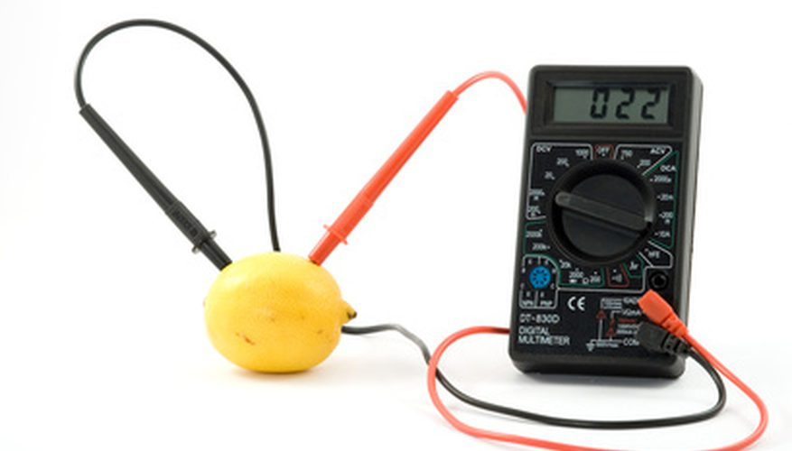
Which fruit or vegetable should George use?
How to make a fruit or vegetable battery
Plug wires into the meter
Insert metal into the fruit/vegetable
Connect crocodile clips to the metal
Write down the reading on the meter
Repeat with different fruit and vegetables

Slide 16
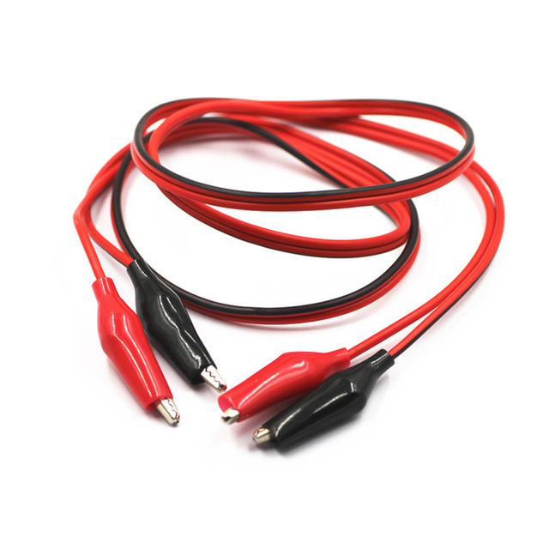
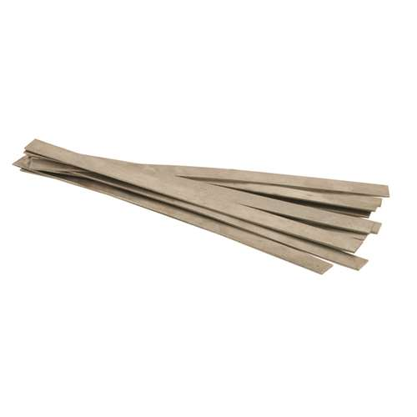
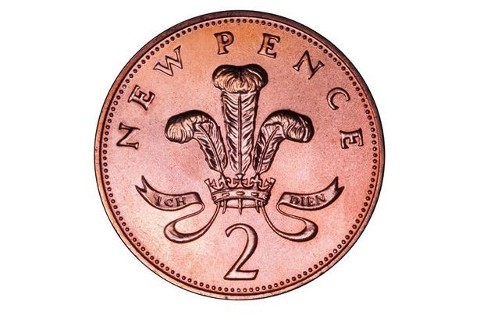
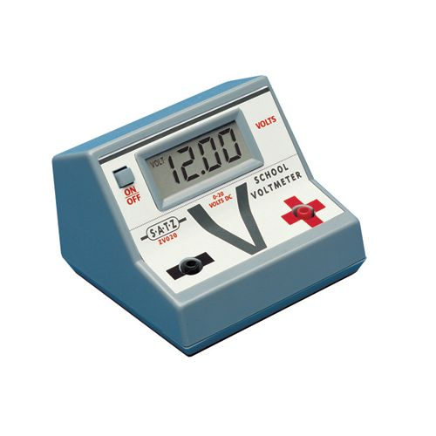
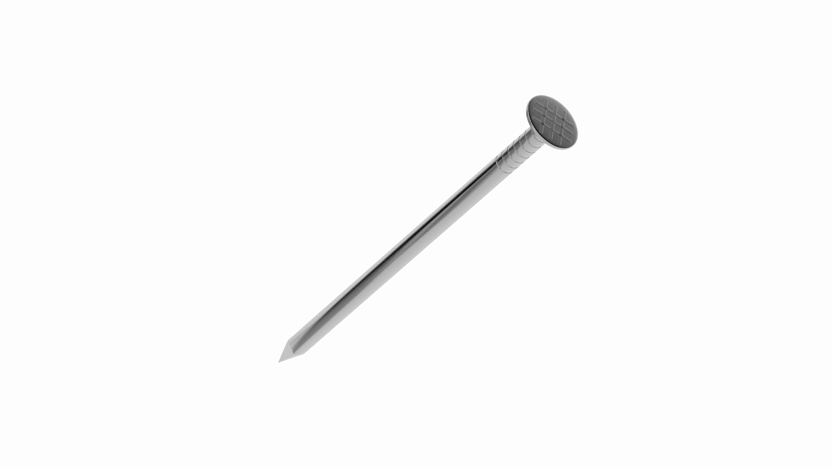
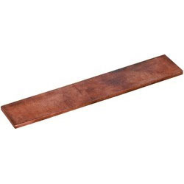
Equipment

Slide 17
Complete your investigation worksheet
Record the voltage for each fruit/vegetable.
Make observations throughout your experiment.
What can you conclude? Which fruit/vegetable produced the highest voltage?

Slide 18
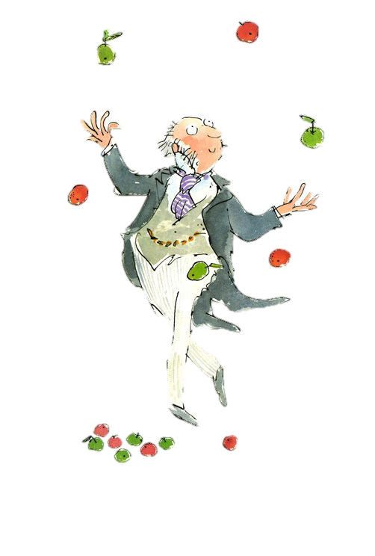
Challenge!
Which fruit or vegetable should George use? Why?

