Slide 1
Hybrid Electric Vehicle Fuel Consumption Optimization Challenges
8 Feb 2018
Boli Chen

Slide 2
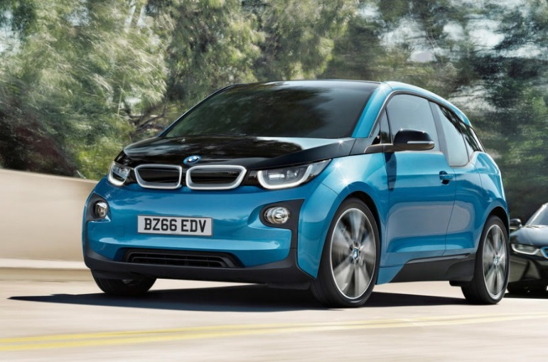
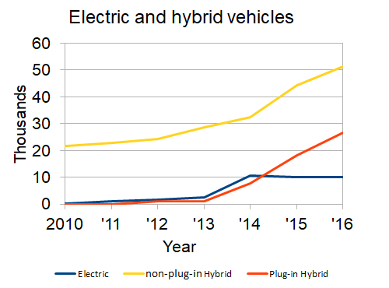
Hybrid Electric Vehicles
Multiple power sources: engine + battery
A variety of architectures
  Series
    Nissan e-note, BMW i3 range extender
  Parallel
    Pre-or Post-transmission
      e.g., KIA Optima, Honda CR-Z
    Through the road
      e.g., BMW i8
  Split power
    e.g., Toyota Prius, Lexus CT
Charging solutions: Plug-in or non-plug-in
UK car market:
2,690,000 new cars (2016)
2.8% are hybrids
66% of hybrids are non-plug-in HEVs

Slide 3



Series HEV Model
fuel
tank
IC engine
electric generator
AC/DC rectifier
battery
DC/DC converter
DC link & inverter
electric motor/ generator
D
medium size passenger car
  mass 1500 kg
  combustion engine 86 kW
  electric motor 120 kW
  battery 1.5kWh 300V
model states
  vehicle: speed, travelled distance
  fuel mass
  battery: state of charge,
  battery temperature, state of health (only for monitoring)
model inputs
  Battery power (can be negative)
  Engine power
  Mechanical braking power

Slide 4
Optimization Challenges
  Driving Speed Optimization (OCP 1)
    Conventional
    Extension to hybrid
  Energy Management of Hybrid Energy Sources (OCP2)
    Conventional approaches
    A Globally tuned heuristic method
  Driving speed and power split simultaneous optimization (OCP 3)
    Case study based on real-world driving data
    Combine optimization vs two-step optimization
  Auxiliary Systems
    Engine Cooling
    Battery cooling
    EM + cooling combined optimization

Slide 5

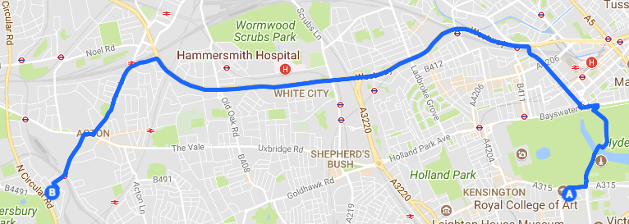

Driving Speed Optimization
  Drive mission:
    road geometry
      heading
      curvature
      slopes
    travel time i.e., average speed
Solved extensively for conventional vehicles
Example: 1km Straight road
Pulse and glide (PnG): rapid acceleration to the maximum followed by a period of coasting or gliding down

Slide 6

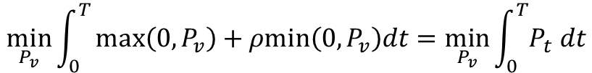
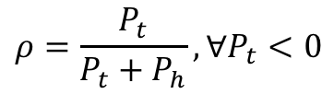



HEV Driving Speed Optimization
Extension to a hybrid vehicle
Energy recovery factor:
$$ρ=\frac{P_{t}}{P_{t}+P_{h}}, ∀P_{t}<0$$
$$P_{v}= P_{t}+P_{h}$$
$P_{t}$: total power from powertrain
$P_{h}$: mechanical braking power
$P_{v}$: total driving power
OCP formulation:
$$\min_{P_{v}}{\int_{0}^{T}{max\left(0,P_{v}\right)+ρmin\left(0,P_{v}\right)dt=\min_{P_{v}}{\int_{0}^{T}{P_{t} dt}}}}$$
Subject to
  Constraints:
    speed limit
    Adherence of tires (acceleration ellipse/diamond)
  Boundary condition: Travel time

Slide 7
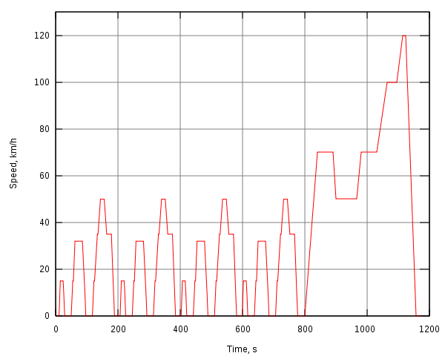

HEV Energy Management
Energy management of Hybrid energy sources
  Speed profile is given
    Standard test cycles e.g., EUDC, WLTP, etc.
    Real driving speed profiles
  Control Target: Fuel minimization + Charge sustaining
  Solve the optimal power split
Algorithm | Optimality | Vehicle Model | Real-time
DP | Optimal | Highly simplified | No
PMP | Optimal or Sub-optimal | Simplified | No
Receding Horizon (MPC) | Optimal or Sub-optimal | Medium-fidelity | Conditional
ECMS | Sub-optimal | High-fidelity | Conditional
Rule-based | Sub-optimal | Realistic | Yes

Slide 8
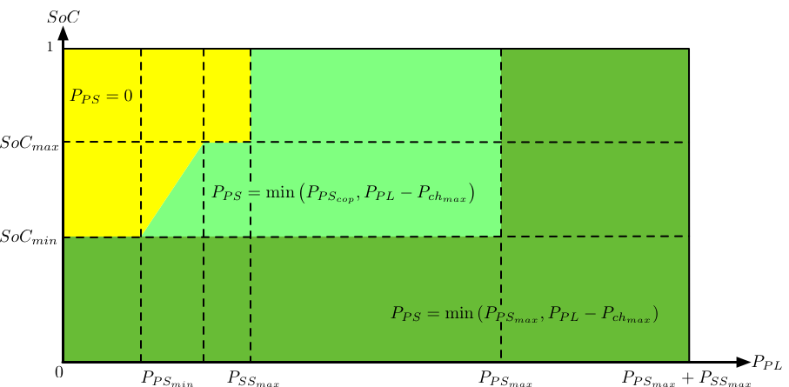
Globally Tuned Heuristic EM Strategy
Threshold changing + load leveling operating rules
Three design parameters
determine where and when to operate PS
The method is inherently charge sustaining
Highly resembles DP solutions for simple model --- 1%-2% fuel increase for the WLTP cycles
Slightly better than ECMS for complex model

Slide 9
Simultaneous Optimization of Speed and EM
Speed optimization
Speed constraints
Route
Driving speed
Travel time
Optimization algorithm
HEV powertrain model
Power split
operation constraints
Energy management
Advantages:
removes the necessity of knowing a priori the driving cycle, which is unknown in practice
removes the necessity of speed prediction, which can leads to a sub-optimal solution
Saves more fuel than two-step optimization
the drive mission can be easily defined by the user or measured by a navigation system
can be extended to incorporate uncertainties, e.g., road traffic, traffic lights
Disadvantages:
increased complexity

Slide 10
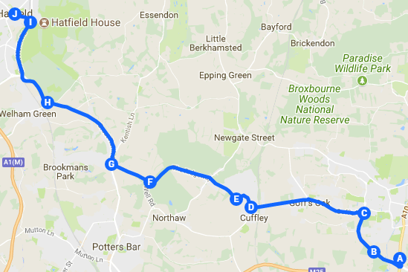
Case Study: Rural Road Driving in the UK
  distance ∼18.9 km
  travel time 22 mins
  average speed 51.3 km/h
  scarce traffic
Data collected with ADAM

Slide 11

Optimal Control Formulation
Objective
Minimize fuel consumption
$$\min_{u}{m_{fuel}}$$
Control inputs
jerk of the associated power inputs: battery, ICE, brake
for smooth controls
avoid unrealistic jerky manoeuvres.
Constraints:
Operation: power and SOC limits
Safety and comfort: speed limit, acceleration diamond
Boundary conditions:
Initial and terminal conditions: SOC, power inputs, travel time
Solver:
PINS – a PMP based OCP solver

Slide 12
    Comparative Results
Advantages of optimized speed profile:
  More efficient and foresighted
  Strictly obeys the speed limit
 | Combined | Two steps | EM
Battery life [km] | 157500 | 127700 | 89573
Average fuel consumption [km/L] | 26.06 | 24.51 | 16.9

Slide 13
Comparative Results
The influence of the road slope behaves like additive disturbance
The energy recovery factor affects the optimized speed
The minimum fuel of the speed only optimization is influenced by the selection of energy recovery factor

Slide 14
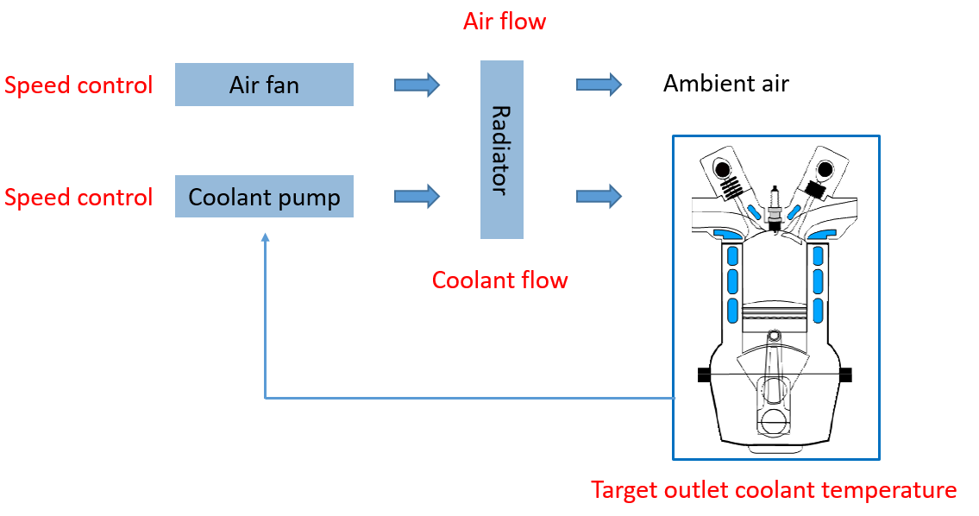
Auxiliary Systems – Engine cooling
HEV thermal management (cooling)
  Engine
    the most power consuming actuator: pump + fan
    Ideal coolant temperature 90 °C
Convective heat transfer
Chemical energy
Waste heat
Cooling system
Propulsion

Slide 15
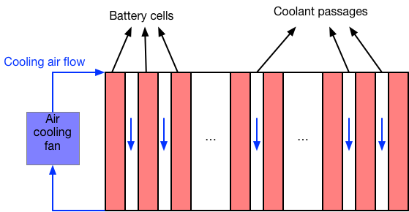
Auxiliary Systems – Battery Cooling
  Battery
    Cooled by the AC system
    Ideal operational temperature: 15 °C- 35 °C
Internal resistance
Ohm heating
Convective heat transfer
Air cooling

Slide 16
Optimal Control Formulation
EM + thermal management
Control target
Minimize fuel consumption
Keep battery temperature 15 °C- 35 °C
Keep engine coolant temperature 90 °C
“soft” constraints
Drive cycle:
  average speed 50km/h
  4km travel distance
Control inputs
Power split: battery, engine, brake power
Battery cooling: power taken by AC system
Engine cooling: pump speed and fan speed
Very high complexity
Further simplification is needed for cooling systems
Solver:
PINS – a PMP based OCP solver

Slide 17
Comparative Results
No cooling : optimized power split (without cooling)
Optimal cooling: simultaneous optimization of power split and the operation of the cooling systems
More battery is used when the cooling is taken into consideration
  Battery generates less heat
  More efficient cooling
Blue: engine Red: battery Green: brakes
Solid: with cooling Dashed: without cooling
PID cooling (non-optimal): optimized power split (without cooling) + PID controlled cooling systems
Cooling control | Average fuel [km/L]
No cooling | 29.1
Opitmal cooling | 28.5
PID cooling | 28.3
The improvement of optimization over PID is about 0.7%.
It is expected to reach about 1.5% after further improvement of optimization scheme

