Slide 1

Developing for Drivers Human Factors in Fuel Efficient Driving
Green Adaptive Control for Future Interconnected Vehicles
Dr. Craig Allison
8th February 2018
Imperial College, London

Slide 2

Content
Eco-Driving
Cognitive Work Analysis
Design With Intent
Getting Involved…
www.g-active.uk
Dr. Craig Allison

Slide 3
Eco-driving
Changing driving style can significantly impact fuel usage whilst driving (Barkenbus, 2010)
Eco-driving approach leads to reduced fuel use and reduced emissions with no significant increase in journey time (Barth & Boriboonsomsin, 2009)
Reduced fuel use makes eco-driving both ecologically and economically beneficial (Kurani, Sanguinetti, & Park, 2015)

Slide 4

How Do I Eco-Drive?
Lessen Vehicle load
Avoiding use of air conditioning
Ensure good vehicle maintenance
Gentle acceleration
Avoiding traffic jams
Gentle breaking
Driving below the
speed limit
Limit engine
RPM

Slide 5
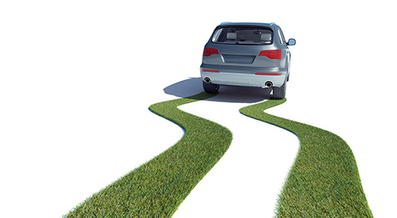
How do we encourage Eco-driving?
Driver Training
Feedback

Slide 6
Driver Training
Eco-driving training courses are effective at reducing fuel usage by 5.8%, as measured using vehicular systems (Beusen et al., 2009)
Eco-driving training has been demonstrated to reduce fuel usage in a variety of both simulator and on-road studies by an average of 9% (Kurani et al., 2015)

Slide 7

Long Term Effectiveness of Training
Geiler and Kerwien (2008) found that despite an initial fuel saving of 7% after training, 10 months later, saving had dropped to 4%
Wahlberg (2007) found an eco-driving training course, saved 6% fuel after training, however 12 months later, fuel saving had been reduced to 2%
Zarkadoula et al., (2007) following an eco-driving training course, overall fuel usage dropped by 10.2%. This figure had dropped to a 4.35% saving just two months after the course

Slide 8
Feedback
Training alone is insufficient to maintain long term fuel use reduction
Feedback is essential in maintaining drivers ability to regulate their behaviour and encourage long term fuel use reduction (Lauper et al., 2015)
Providing feedback and educating drivers about their current and alternative driving styles is essential in eliciting long-term behaviour change (Tulusan, et al., 2012)

Slide 9
Developing Feedback and Interventions
Understanding Driving Constraints
Cognitive Work Analysis
Design With Intent

Slide 10

Observed behaviour can be confusing…
Images copyright Herbert A. Simon
www.g-active.uk
Dr. Craig Allison

Slide 11

Identifying context can help explain behaviour
Images copyright Herbert A. Simon
www.g-active.uk
Dr. Craig Allison

Slide 12
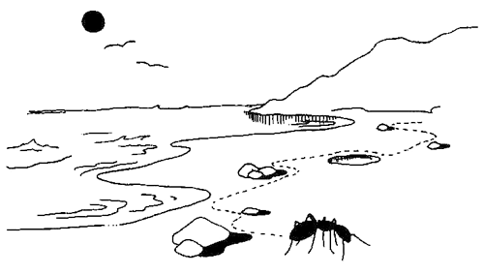
…and inform options to change behaviour
Images copyright Herbert A. Simon
www.g-active.uk
Dr. Craig Allison

Slide 13
Cognitive Work Analysis
Behaviour is shaped and informed by constraints
Constraints can be physical, spatial, temporal, legal, skill based, etc…
Understanding these constraints will allow the development of more targeted, effective and accepted interventions

Slide 14
Cognitive Work Analysis
Cognitive Work Analysis (CWA) is a framework for understanding complex socio-technical systems, characterised by interactions of people and technology (Stanton & Bessell, 2014)
CWA can act as a key tool when developing and designing innovative systems (Rasmussen et al., 1990)
CWA seeks to understand the constraints that frame the working system, to understand what is possible and not possible within the confines of the system
CWA seeks to understand and support users needs for improved efficiency and safety (Stanton et al., 2013)

Slide 15
Cognitive Work Analysis Phases
5 Key Phases (Vicente, 1999)
Work Domain Analysis (WDA)
Abstraction Hierarchy
Control Task Analysis (ConTA)
CAT
Strategies analysis (StrA)
Flow Diagram
Social Organisation and Cooperation Analysis (SOCA)
SOCA-CAT
Worker Competencies Analysis (WCA)
SRK Framework

Slide 16
Work Domain Analysis
Developed an Abstraction Hierarchy for a system to support Eco-Driving
Mapped the domain under investigation
3 Functional Purposes
8 Values and Priorities
5 Purpose Related Functions
39 Object Related Purposes
29 Physical Objects

Slide 17
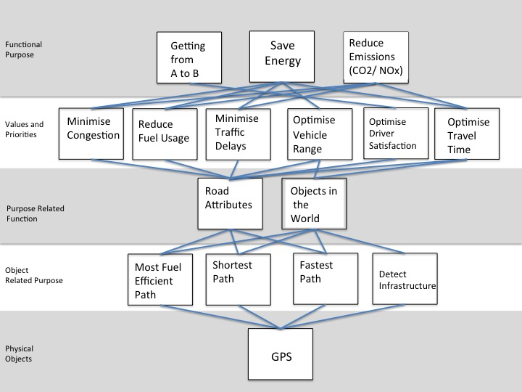
Work Domain Analysis

Slide 18
Control Task Analysis
Control Task Analysis (CAT) considers the contextual constraints that impact the system via the use of Contextual Activity Template
All Object Related Processes, identified within the Abstraction Hierarchy, are considered across different potential situations
The key objective of the CAT is to identify whether a task is typically completed within a given situation, can be completed within the situation, or whether the task is not possible within the situation

Slide 19
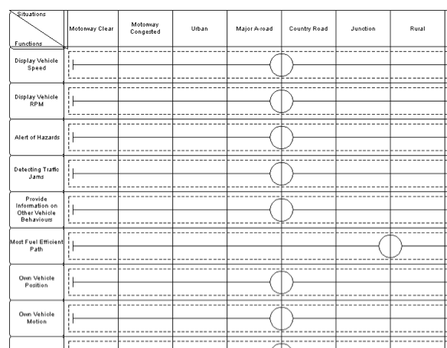
Control Task Analysis

Slide 20
Strategies Analysis
The strategies individuals use to operate a system can vary significantly under different conditions
An individual may have access to different strategies at different times, depending on external factors, for example time constraints or accessibility of required tools/ knowledge
Mapped the different approaches drivers can take to decelerate, accelerate, manage headway and maintain current speed

Slide 21
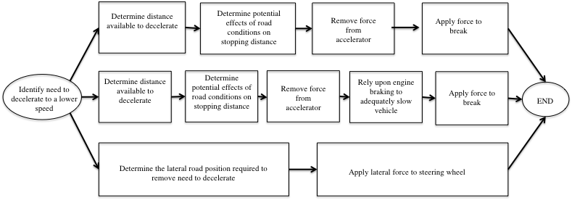
Strategies Analysis

Slide 22
Social Organisation and Cooperation Analysis
Social Organisation and Cooperation Analysis (SOCA) seeks to identify which agents, both human and non-human, can control and influence a situation
SOCA can be seen as a way to map the agents who have responsibilities within different work situations, multiple actors can influence or constrain a situation, be it sequentially or simultaneously
Useful for considering which tasks can be reallocated in existing systems to improve efficiency, for example away from a human to automation (Naikar et al., 2006)

Slide 23
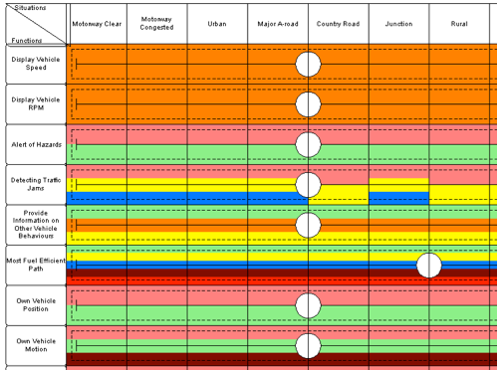
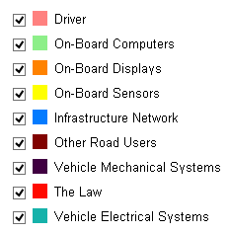
Social Organisation and Cooperation Analysis

Slide 24
Worker Competency Analysis
Worker Competencies Analysis considers the abilities of the agents, human and non-human, completing the work
Considers the psychological constraints opposed to the physical and design constraints considers previously
Utilises the Skills, Rules, Knowledge (SRK) Taxonomy, documenting the behaviour and cognitive processes that an individual may manifest completing the activities
Skill based behaviour is automatic, associated with expert users, knowledge based behaviour is associated with extensive cognitive processes and associated with novice users

Slide 25
Worker Competency Analysis
 | Skill | Rule | Knowledge
Display Vehicle Speed |  | If vehicle in motion, then provide visual representation of vehicle speed.
Display vehicle RPM |  | If vehicle engine is operational, provide visual display of engine RPM.
Control Cabin Humidity | Activate cabin humidity controls to minimise required fuel use and minimise the disruption high cabin humidity can have on the driving experience. | If cabin humidity rises above a set threshold, then activate controls to reduce cabin humidity. | Consideration of CUR reg30 regulation regarding visibility of cabin.
Alert of Hazards | Consistently monitor the upcoming road environment and scan for potential hazards. | Monitor the current and developing road situation for potential hazards. | Follow guidance presented in highway code to maintain alertness of potential hazards.
Detecting Traffic Jams | Consistently and proactively monitor road situation for upcoming signs of traffic jams. | Monitor current road situation for traffic jams. | Follow guidance presented in highway code for identifying congested traffic.

Slide 26
Taking CWA Forward
Cognitive Work Analysis maps the constraints that operate around a system
Provides a technology agnostic approach, considering both human and technological agents in the same analysis
BUT the final outcome of the CWA analysis is not a complete workable design of the envisaged system or interface
Need to progress CWA with the use of Design Methods

Slide 27
Design Methods
Design methods are tools which can be used to facilitate design, help the users generate ideas and structure thinking on particular topics (Daalhuizen, 2014)
One appropriate and easy to use design method is the “Design with Intent” (DWI) toolkit (Lockton, Harrison & Stanton, 2010)
The DWI toolkit can be viewed as a collection of design patterns that can be used to guide the development of novel systems and interfaces
DWI acts as a “Suggestion tool”

Slide 28

Design With Intent
Consists of 101 design cards, divided between 8 key lenses, each of which loosely correspond to the themes of the card
Each DwI card comprises of a short title, labeling the card, colour coded to its particular lens, a question the designers can ask of their system, and a photograph of a real world example of the design card
Ran a workshop, progressing the CWA insights to develop potential interventions which could be developed and tested

Slide 29
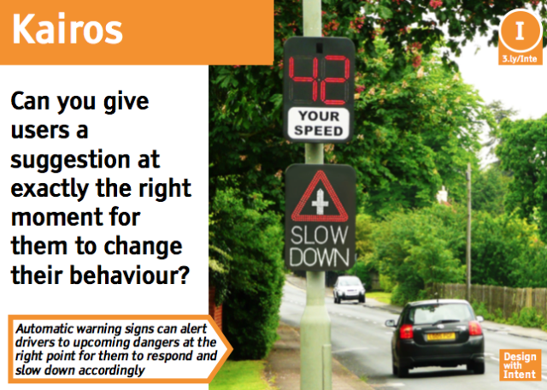
Design With Intent

Slide 30
Design With Intent
Workshop generated 138 ideas to encourage fuel efficient driving
Distilled into 14 testable interventions

Slide 31

Get Involved…
But how good are the ideas we generated?
What interventions would you like to interact with in your car?
How effective do you think the interventions would be?
Please complete a short questionnaire and let us know your feedback!
www.g-active.uk
Dr. Craig Allison

Slide 32
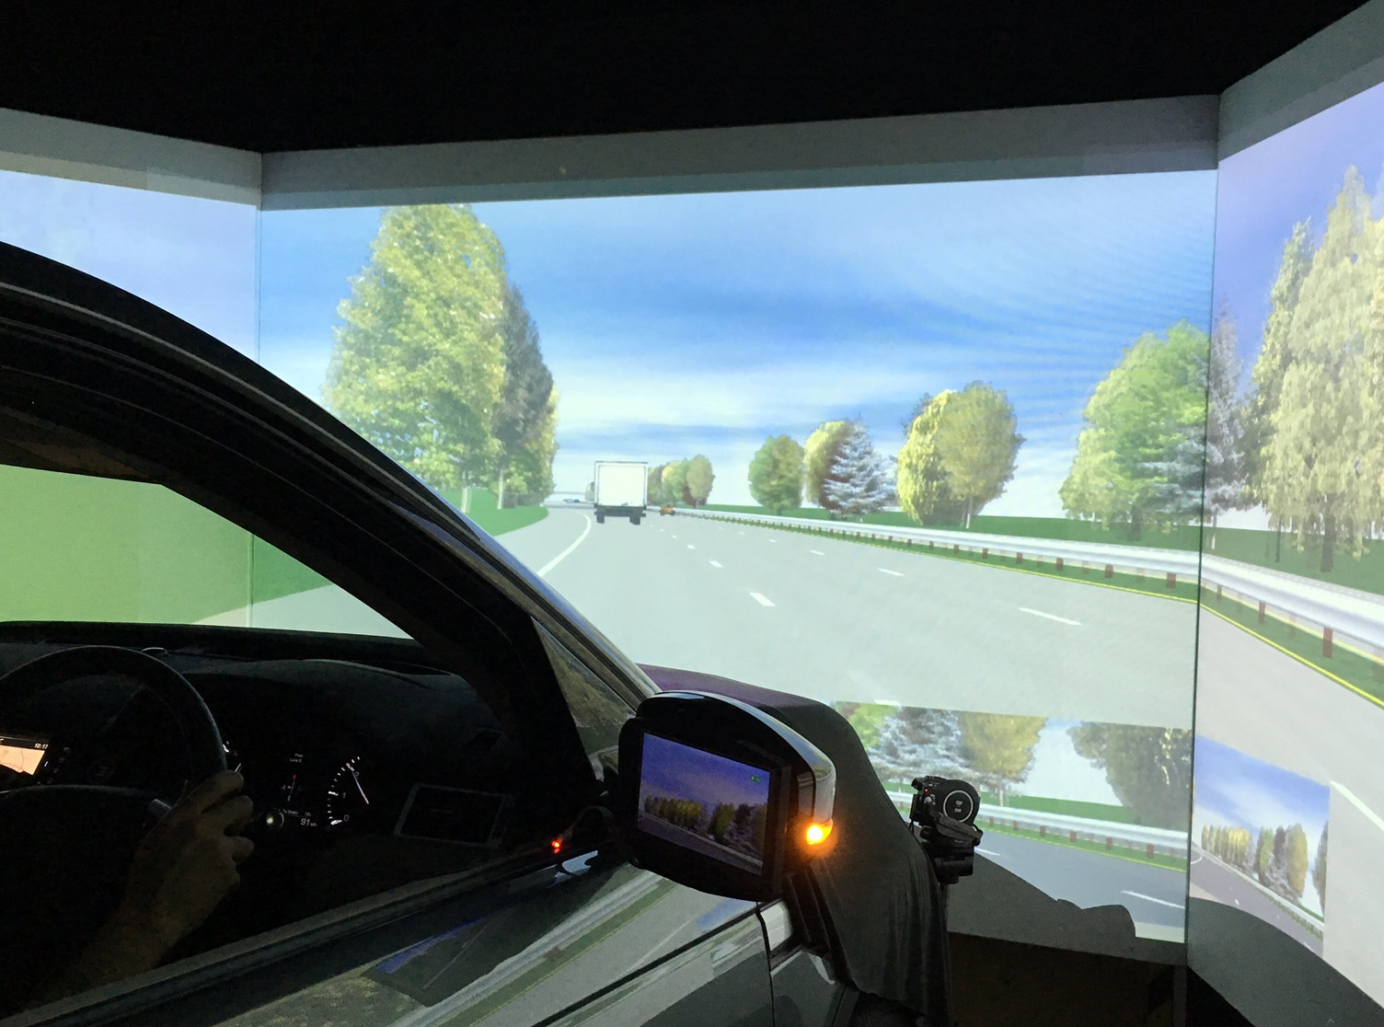
Get Involved…
We have prepared initial interventions for simulator studies, currently in progress.
We are looking for people to participate in our simulator studies in Southampton
If you are interested please leave your contact details with us and we will arrange a convenient time and date for you to take part
www.g-active.uk
Dr. Craig Allison

Slide 33
Summary
Introduced the concept of Eco-Driving, behavioral means of reducing fuel use
Presented an overview of Cognitive Work Analysis, and applied this to fuel efficient driving
Introduced Design With Intent design toolkit, to further the ideas generated within CWA
Presented ways for you to get involved with G-ACTIVE, via questionnaire and simulator study
www.g-active.uk
Dr. Craig Allison

