Slide 1
Questions that include equations
Adam Warren

Slide 2
Just type
Simple equations can be typed

Slide 3

The equation of the tangent plane to the graph of z = (x-y)(xy-1) at S = (2,1,1) is:
z = 2x – y – 4
z = 2x + y + 4
z = -2x + y – 4
z = -2x – y + 4
none of the above
60
Countdown

Slide 4
Microsoft Equation Editor
More complex equations can be created using the Equation Editor – the following example has four equations.
Office 2010: Insert tab > Equation
They need a white background, so I added a white rectangle first.
I also moved and resized the answers and response chart so they fitted on the slide.

Slide 5
Which of these is the formula that defines the volume of a sphere?
Equation A
Equation B
Equation C
Equation D
Equation E
10
Countdown

Slide 6
Screen-grab equations
The equations in the following example were clipped from PDF journal articles.
The PDF Reader has a built-in Snapshot tool that can be accessed from Select & Zoom in the Tools menu.
Note that there isn’t room on the first slide for the chart, so this is a ‘two slide’ question.

Slide 7

Which of these equations determines the distribution function? (Please vote on next slide)
A)
B)
C)
D)

Slide 8
Which of these equations determines the distribution function?
Equation A
Equation B
Equation C
Equation D

Slide 9
Not just equations, but graphs
The following example uses equation diagrams that were copied from WolframAlpha using a screen-grab program.
The question uses Turning Point’s Picture Question type.

Slide 10
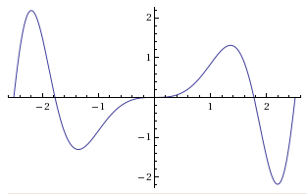
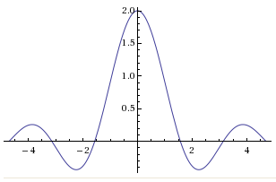
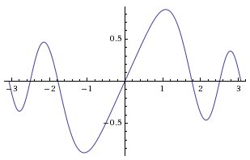
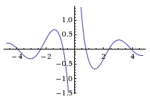
Which graph shows the function y = 1/x sin 2x ?
Graph A
Graph B
Graph C
Graph D
1.
2.
3.
4.

Slide 11
Adam Warren
a.j.warren@soton.ac.uk

