Slide 1


Slide 2
What is Mentoring?
Mentoring
ECRspaceglobal
This resource was originally created by Dr Julie Reeves and Dr Tania Alcantarilla at the University of Southampton

Slide 3
This resource is useful for anyone, including early career researchers, who would like to hold a short training session (of 30 or 60 minutes) for mentors and/or mentees.
Early career researchers – you can establish your own mentoring scheme if there isn’t one in your area or institution. You can invite mentors and mentees to join the scheme.
Mentoring
If you use or re-purpose this PowerPoint, please attribute to ECRspaceglobal

Slide 4
What is Mentoring?
“Mentors are people whom, through their action and work,
help others to achieve their potential.”
(GF Shea, Mentoring: A guide to the basics)
Informal
“Mentoring is a one-to-one, non- judgmental relationship in which an individual voluntarily gives time to support and encourage another. This is typically developed at a time of transition in the mentee's life.”
(Active Community Unit, Home Office)
Mentee-Centred
Mentoring
“A Mentor facilitates personal and professional growth in an individual by sharing the knowledge and insights that have already been learned by them, sometimes over many years.”
(US Department of Human Resource Management)
Unbiased
4
Notes:
Mentoring is a process in which a more skilled or more experienced person, serving as a role model, teaches, sponsors, encourages, counsels and befriends a less skilled or less experienced person for the purpose of promoting the latter’s professional and/or personal development. Mentoring functions are carried out within the context of an ongoing, supportive relationship between the mentor and the mentee.
Discuss differences between: mentoring, supervising, coaching and counselling
Start talking about confidentiality and a safe environment to discuss professional issues that matter to you

Slide 5
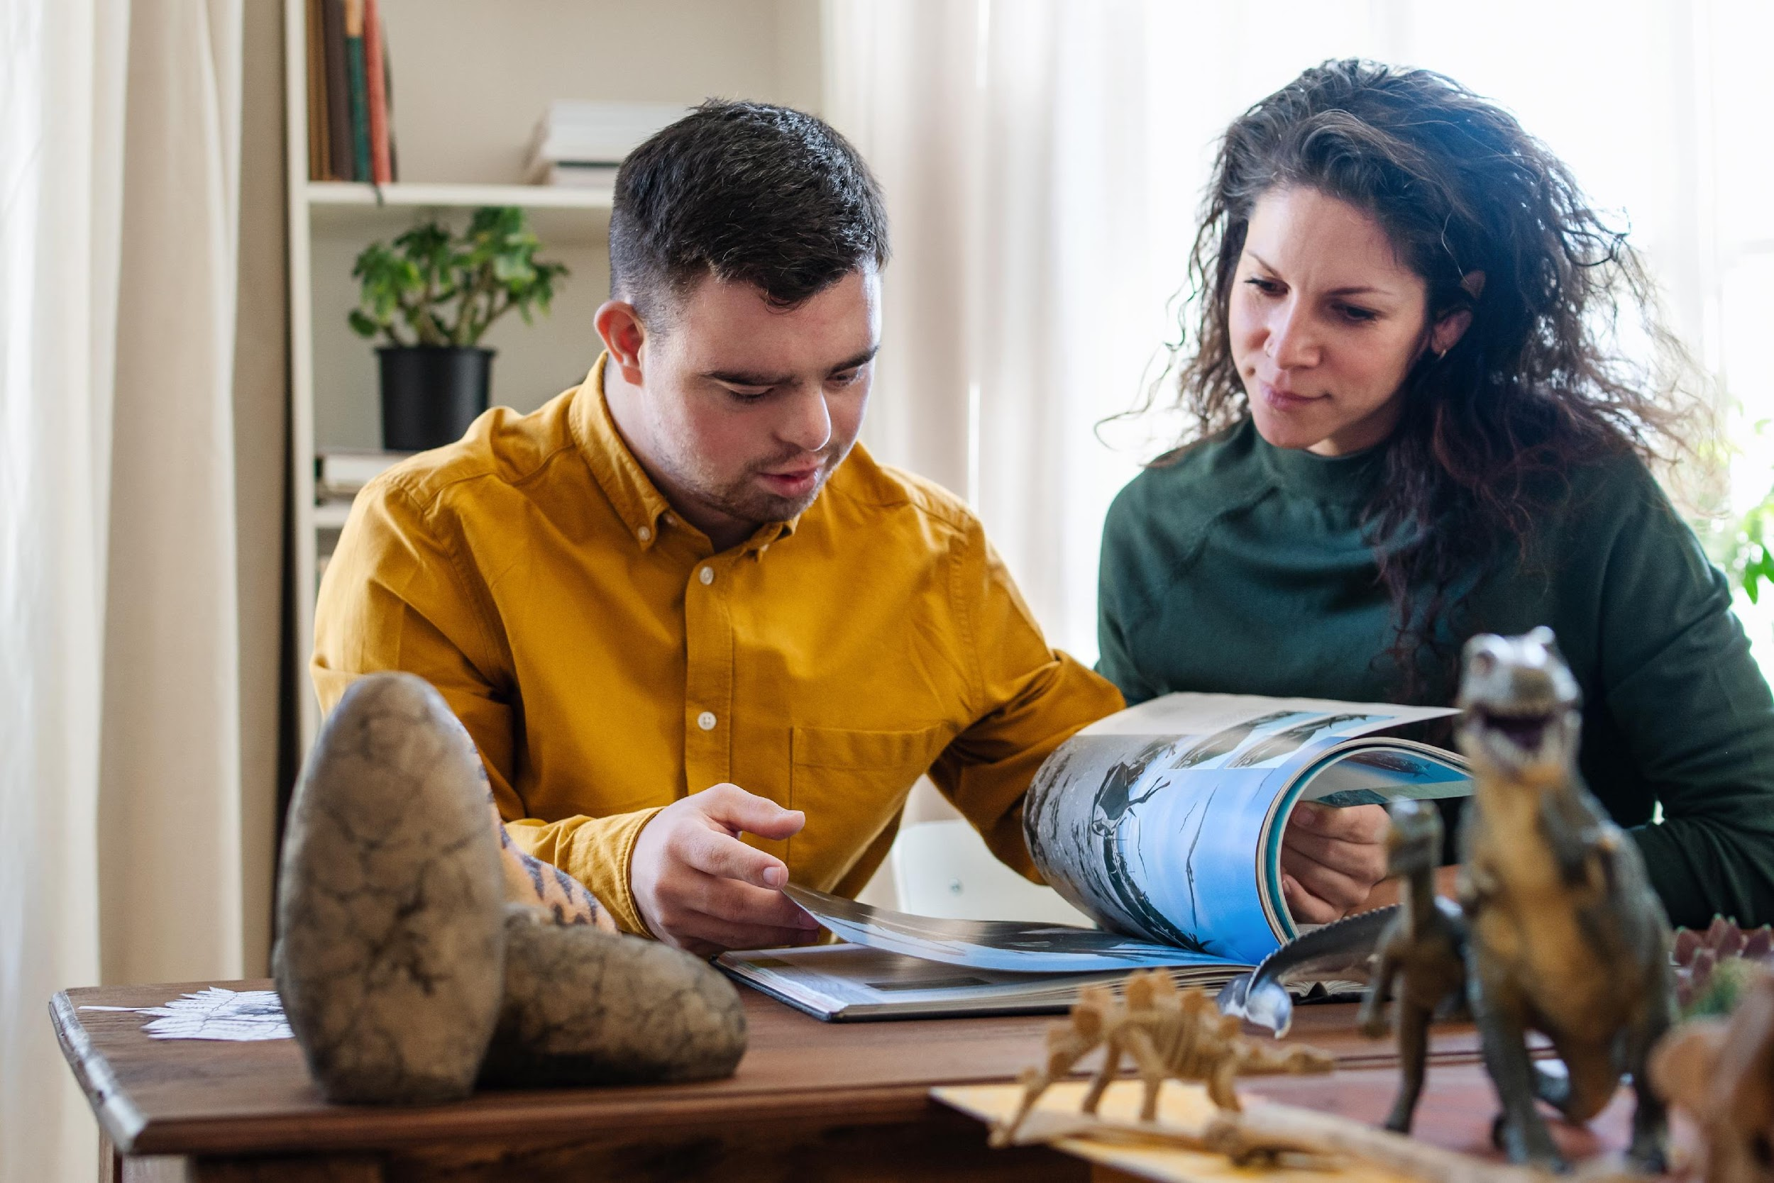
What is your experience?
Do you have any experience of mentoring?
Either being mentored or of mentoring others?
ACTIVITY: Please discuss with a partner, in a small group or write your thoughts down
Notes:
(5mn)
Participants to introduce themselves.
If there is a full house (30-20) to do Introductions by tables, i.e. participants only introduce themselves to each other on their table

Slide 6
Effective Mentorship – What does it entail?
A one-to-one relationship between a mentor and a mentee where the mentor is an expert
Guidance and learning
A broadening experience for both parties
Flexible, to meet the needs of both parties
A positive and trusting relationship
Open, but confidential
ACTIVITY: Can you suggest others?
Notes:
What does it entail?
Go through handout

Slide 7
Benefits for mentors –What are they?
Develop personal leadership skills
Raise personal profile
Extend networks
Recognition of skills and expertise
Critical reflection of own practice
Broadens perspective
Influence, pass on knowledge, skills and experience
Sense of satisfaction
ACTIVITY: Can you think of other benefits?
Notes:
What are they?
For mentors:
It is an opportunity to provide support, encouragement and recognition
It is an opportunity to challenge: to stretch your mentee an move their development forward
It is an opportunity to develop your leadership skills: in the sense that the mentor is responsible to manage the mentoring relationship. The mentee is responsible to drive it, but the mentor is responsible of managing it

Slide 8
Benefits for mentees?
ACTIVITY
What do you think the benefits are for mentees?
Please list them
Notes:
This can be carried out individually and then compare notes with others; in a pair discussion or as a small group activity.
Suggestions can be collated in a Plenary/whole group feedback discussion.

Slide 9
Mentoring
ACTIVITY:
Do you have any concerns about mentoring – as a mentor or a mentee?
Please share with the group and we will use our collective wisdom to address them.
Notes:
Concerns can be explored in pairs, small groups and the whole group.

Slide 10
A framework: The GROW Model
The GROW model is a useful tool for exploring motivations and for moving from ideas to action. Mentors and mentees can discuss:
Goal setting
Reality checking
Options
What, When, Who and the Will
Notes:
(5mn)
Goal: agree and understand what the mentee wants from the session. Make sure the mentee goals are SMART
Reality checking: explore with your mentee facts and feelings around the issue you want to discuss on the session, problem or topic. Try to get all the facts out in the open
Options: Think about actions for your mentee. What options and ideas does the mentee have to move the situation forward. Try to provide choices, choices empower your mentee. Do not impose your ideas. If there are any, try to tackle any negativity/limiting beliefs from the mentee
What, When, Who and the Will: check that your mentee feels confident in what he/she has agreed to do. Be flexible, if your mentee does not feel confident actions can change at this point

Slide 11
Goal
Reality
Options
Way Forward
What do you want to achieve?
What is the current situation?
What could you do?
What will you do?’
GROW Model
The Goal dimension focuses on establishing what the mentee wants to achieve, providing clear direction and purpose for the mentoring conversation and relationship.
Primary Purpose
Establish Direction: Create a clear, specific target that guides all subsequent discussion and action
Generate Motivation: Help the mentee connect emotionally with their desired outcome
Provide Focus: Ensure conversations remain productive and purposeful rather than wandering
Create Measurement Criteria: Define what success looks like so progress can be tracked
The Reality dimension involves conducting an honest, comprehensive assessment of the current situation, including resources, constraints, challenges, and existing progress.
Primary Purpose
Establish Starting Point: Understand where the mentee currently stands in relation to their goal
Identify Resources: Recognize existing skills, knowledge, relationships, and assets available
Recognize Obstacles: Surface challenges, barriers, and constraints that need to be addressed
Eliminate Assumptions: Replace assumptions and perceptions with factual assessment
Create Self-Awareness: Help the mentee see their situation more objectively
The Options dimension involves creative exploration of possible approaches, strategies, and solutions that could help bridge the gap between current reality and desired goals.
Primary Purpose
Generate Possibilities: Brainstorm multiple potential pathways and strategies
Expand Thinking: Move beyond obvious or first-instinct solutions to consider creative alternatives
Increase Choice: Provide the mentee with multiple options rather than a single prescribed solution
Encourage Ownership: Allow the mentee to generate their own solutions rather than receiving advice
Build Confidence: Demonstrate that there are usually multiple ways to address any challenge
The Way Forward dimension focuses on commitment, action planning, and accountability, transforming insights and options into concrete steps and measurable progress.
Primary Purpose
Create Commitment: Help the mentee choose specific actions and commit to taking them
Develop Action Plans: Transform options into detailed, actionable steps with timelines
Establish Accountability: Create systems for tracking progress and maintaining momentum
Anticipate Obstacles: Prepare for potential challenges and develop contingency plans
Ensure Follow-Through: Bridge the gap between intention and implementation

Slide 12
2 Valuable Skills
Active listening:
  Have you talked to someone and noticed they were not really listening to you?
  How did it make you feel?
Active questioning:
  There are a range of active questions you can use, i.e. ask ‘how’, ‘why’ and ‘tell me more’ questions, and questions that create deeper responses - ‘what if…’ or ‘what would you change/do differently…’
  How you use these questions can affect your impact on those you are helping, advising or securing commitment.
Notes:
This can be an Activity for pairs, small/whole group discussion or questions for individual reflection.

Slide 13
Good Luck!
ECRSglobal
ECRspaceglobal
This resource was originally created by Dr Julie Reeves and Dr Tania Alcantarilla at the University of Southampton

