Slide 1
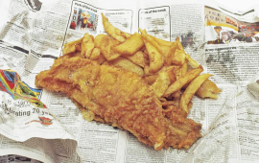
FISH and chips has battered its competition to be crowned the UK’s favourite fast food - 2012
Do you know the type of fish used in your local chippy?

Slide 2
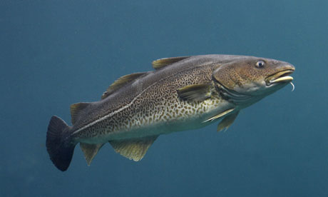
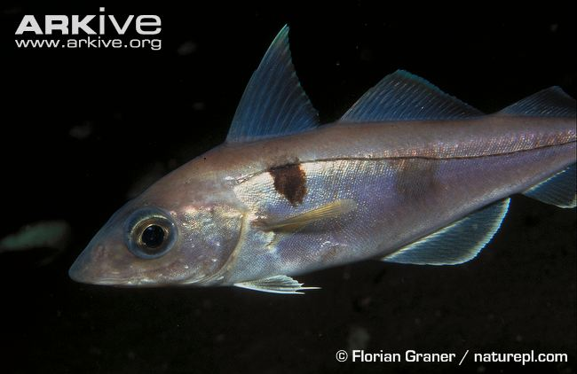
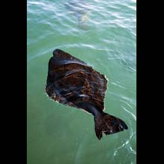
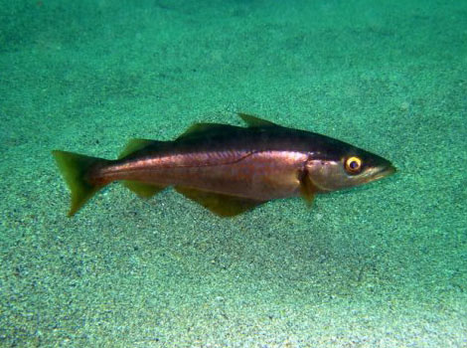
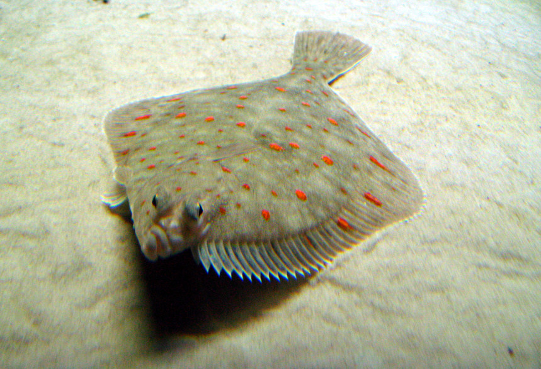
The answer is….
Atlantic Cod 61.5%
Haddock 25%
Halibut
+
Pollock
+
Plaice
+ others = 13.5%

Slide 3
Task 3: Watch the video and explain what sustainable fishing is and how we can stop over fishing.
Task 1: Watch the video clip and write a list of the factors that effect Fish stocks.
Click here for a video on Changes in fish stocks.
Task 2: Study the worksheet and write about patterns you can spot.
Click here to see a video on managing fish stocks.
Task 4: Complete the worksheet
Notes:
http://www.bbc.co.uk/learningzone/clips/why-have-fish-stocks-decreased-in-the-north-sea-pt-1-2/4687.html

Slide 4
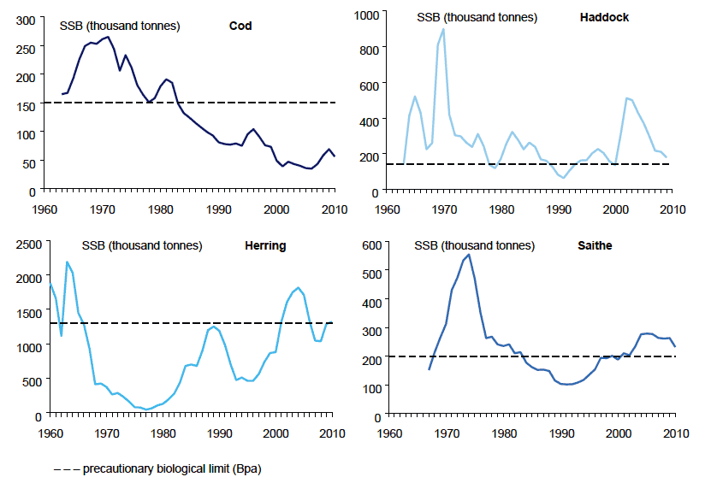
Worksheet 1: What patterns can you see in North Sea Fish Stocks from 1960-2010?
Compare stocks from at least two dates to support your answer.

