Slide 1
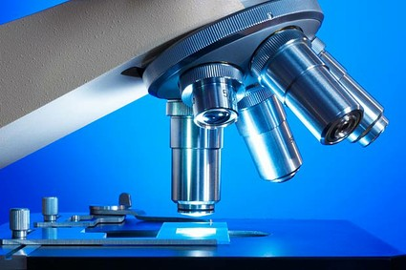

Scientific research
By the end of this lesson I will be able to:
Explain what research is and why we do it.
Understand what it might be like to be a researcher.
Describe some of the methods researchers use.
Think about planning my own research.

Slide 2

Write down one new thing you learnt about research during your visit to the university

Slide 3
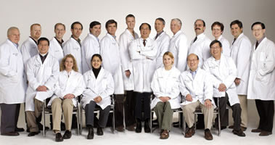
You are at a research conference..
How old are you?
What do you research?
How did you become a researcher?
Why do you enjoy your research?
What do you do in the rest of your life?
You have one minute to introduce yourself to you fellow researchers
Why do researchers go to conferences?

Slide 4
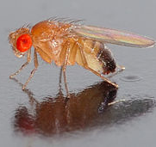
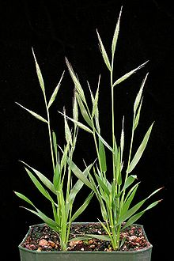
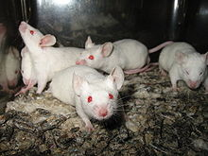
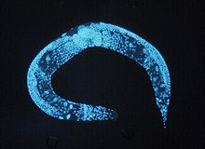
Model organisms
http://www.youtube.com/watch?v=zYsX1MvIM7o&list=PL2C92863F336A6430
Grass (purple false brome)
Related to all major cereal crops.
Small and simple genome
Physically small
self-fertilises
short lifecycle
simple growth requirements
Fruit fly (Drosophila)
Many genes and similar to humans but much simpler/ smaller genome
Some behaviour similar to humans
Studied for 100 years so well understood.
Quick generation time (12 days)
Very cheap and easy to produce
Lots of offspring
What do they have in common?
microscopic worm (C. elegans)
Very simple genome
Easy and cheap to keep (will survive being frozen)
Small with a quick lifecycle
Produces 1000s of offspring
Transparent so that processes inside can be seen.
Has many similar reactions to humans like alcohol withdrawal.
Mouse
Very similar to human anatomy and genome.
Similar behaviours to humans
Small with quick lifecycle.
Produce lots of offspring.
Cheap

Slide 5
Model organisms
Which organism would you use for each of the following research questions and WHY?
What are the effects of a new pesticide on the genes of wheat plants?
How effective is a new drug used to treat diseases caused by parasitic worms?
What are the possible effects of obesity on the human liver?
What role do genes play in mating behaviour?

Slide 6
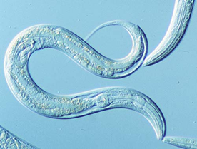
http://www.youtube.com/watch?v=zjqLwPgLnV0
You will have a chance to carry out some research of your own into how C.elegans reacts to alcohol!
How can you make your research ‘good’ research?
http://www.abc.net.au/catalyst/stories/2974732.htm

Slide 7
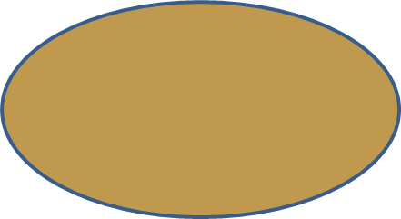
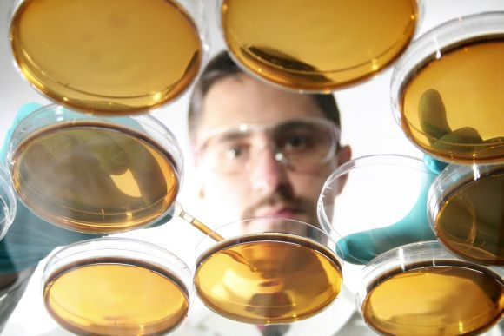
What makes good research?
Ask a question. Do some research to find out if other people have tried to answer this question already.
The scientific method tries to ensure that all researchers work in the same way and produce results that reflect reality as accurately as possible.
Communicate your findings with other scientists.
Based on your research, form a hypothesis and design an experiment to prove/ disprove it.
The scientific method….
Improve and repeat method if needed.
Other people should be able to repeat your experiment and get the same results you did.
Your experiment must be a ‘fair test’ and your results must be reliable.
Analyse your results. Do they prove your hypothesis? Are your findings similar to those of other scientists?

