Slide 1
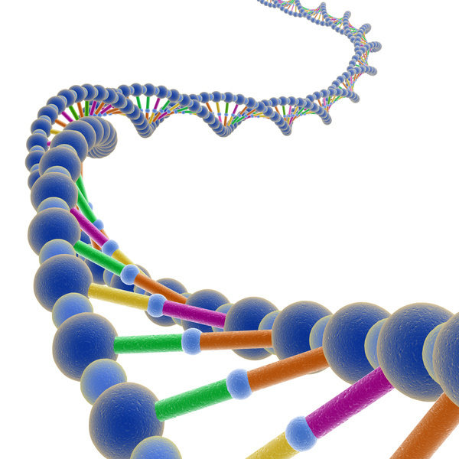
How does DNA control our characteristics?
By the end of this lesson I will be able to:
Describe the structure of DNA
Explain how the structure of DNA controls the production of proteins.
Describe genetic engineering in simple terms.

Slide 2
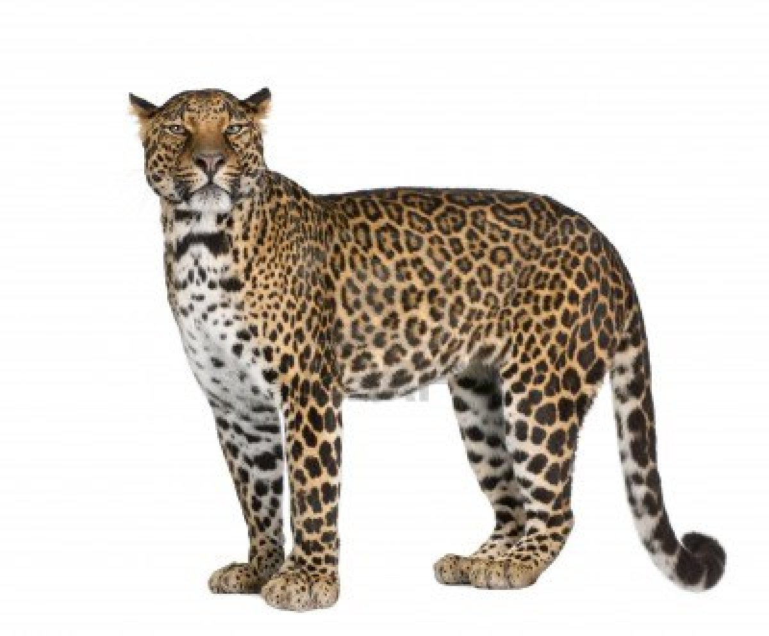
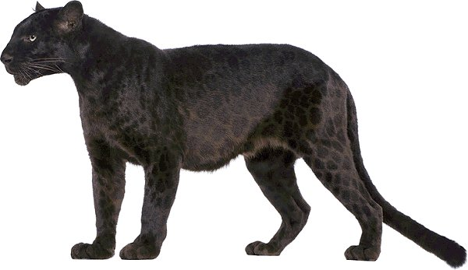
Spot the difference! Are these different species?
What caused the most obvious difference between these animals?
http://www.youtube.com/watch?v=GPtCkZj4kkk&list=PLf8itN5A4DdG17mUFeOlw2h0geT9mUoc_
http://www.youtube.com/watch?v=6przuR7ITfY&list=PLf8itN5A4DdG17mUFeOlw2h0geT9mUoc_

Slide 3
10 minute experts!
Proteins | Genes and DNA
In pairs, discuss what you already know about proteins. Now use page 13 in your booklet to answer the following…. What do proteins look like? Where do we get our proteins from? What do we use proteins for? | In pairs, discuss what you already know about genes and DNA. Now use page 14 in your booklet to answer the following…. Where do our genes come from? Where in the body do we find genes? What are our genes made from? How does DNA work??

Slide 4
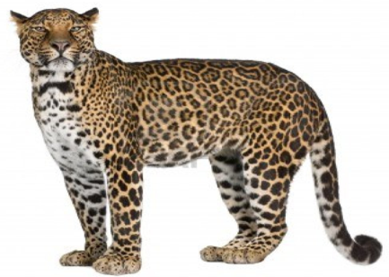
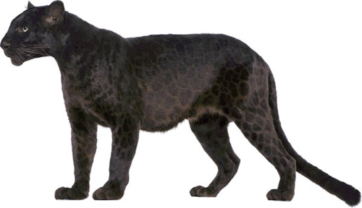
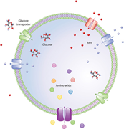
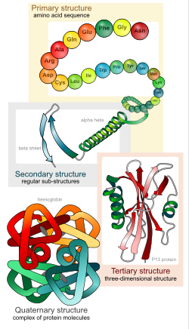
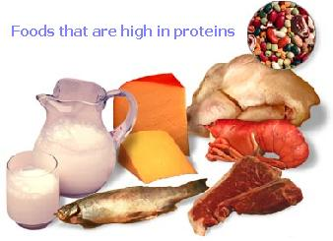
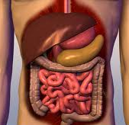
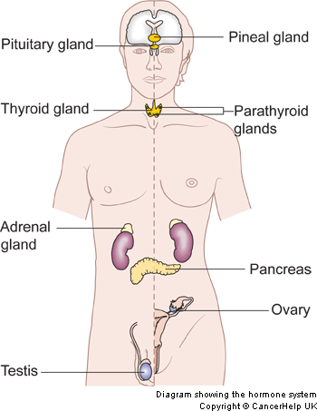
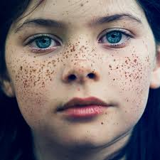
Proteins
Cells
Enzymes
Hormones
We get the protein we need from the food we eat. Our bodies break them down into their building blocks so that we can put them together again in a different order to make the different proteins we need.
Pigments

Slide 5
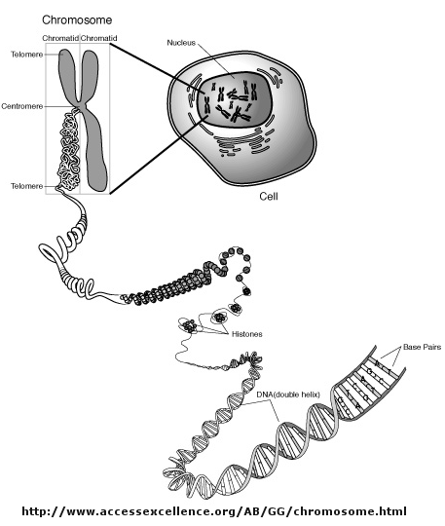
The structure of genes….
Gene for fur colour
RNA to be read by cell (U replaces T).

Slide 6
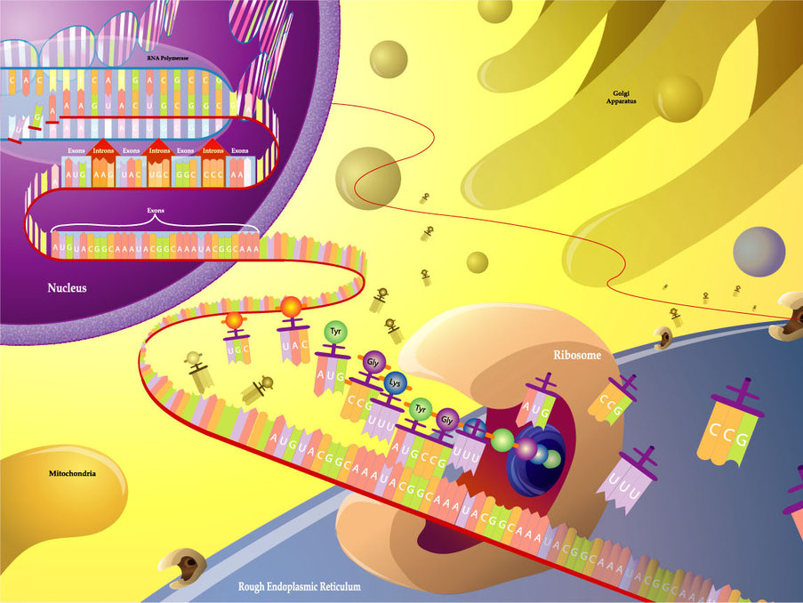

Slide 7
Build your own protein….
U
U
U
U
U
Which bases would pair with this single strand of DNA to make RNA for the cell to read ?
Which protein do you have?
Digestive enzyme
(8, 10, 14, 8, 20, 15, 10, stop)
Pigment for blue eyes
(8, 10, 15, 8, 19, stop)
Testosterone
(8, 10, 5, 15, 19, 20, 1, stop)
Melanin
(8,10,15,5,19,8,8, stop)
Second base
First base |  | U | C | A | G |  | Third base
 | U | UUU 1 UUC 1 UUA 2 UUG 2 | UCU UCC 6 UCA UCG | UAU 10 UAC 10 UAA stop UAG stop | UGU stop UGC 17 UGA 17 UGG 18 | U C A G
 | C | CUU CUC 2 CUA CUG | CCU CCC 7 CCA CCG | CAU 11 CAC 11 CAA 12 CAG 12 | CGU CGC 19 CGA CGG | U C A G
 | A | AUU 3 AUC 3 AUA 3 AUG 4 | ACU ACC 8 ACA ACG | AAU 13 AAC 13 AAA 14 AAG 14 | AGU 6 AGC 6 AGA 19 AGG 19 | U C A G
 | G | GUU GUC 5 GUA GUG | GCU GCC 9 GCA GCG | GAU 15 GAC 15 GAA 16 GAG 16 | GGU GGC 20 GGA GGG | U C A G
REMEMBER: in reality……
proteins can be thousands of amino acids long, (so genes are pretty long too).
Amino acids have chemical names not numbers (you don’t need to know them now)

Slide 8
Use what you have learnt about proteins and DNA to explain our Panther.

Slide 9
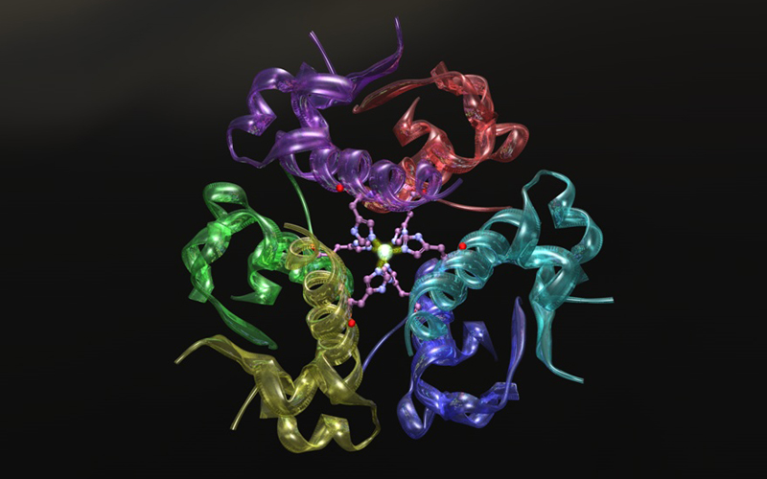
Some proteins save lives….
The problem
Other animals make insulin but it is costly to collect (has to be done as soon as animal is slaughtered).
You can’t extract it from living people or animals because we only produce what we need.
The source needs to be reliable.
We need a lot of it.
http://www.youtube.com/watch?v=_OOWhuC_9Lw

Slide 10
How can we produce enough human insulin to treat the people who need it?
How do healthy people produce insulin?
What is insulin?
How could we get another organism to produce HUMAN insulin on an industrial scale?
What organisms can you think of that reproduce really fast?

Slide 11
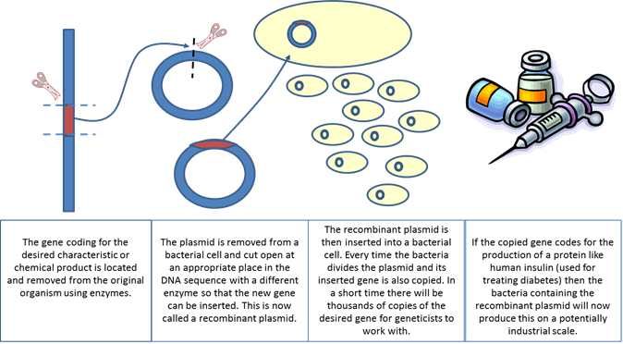
http://www.youtube.com/watch?v=zlqD4UWCuws

