Slide 1
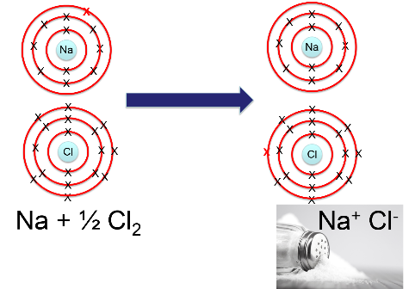
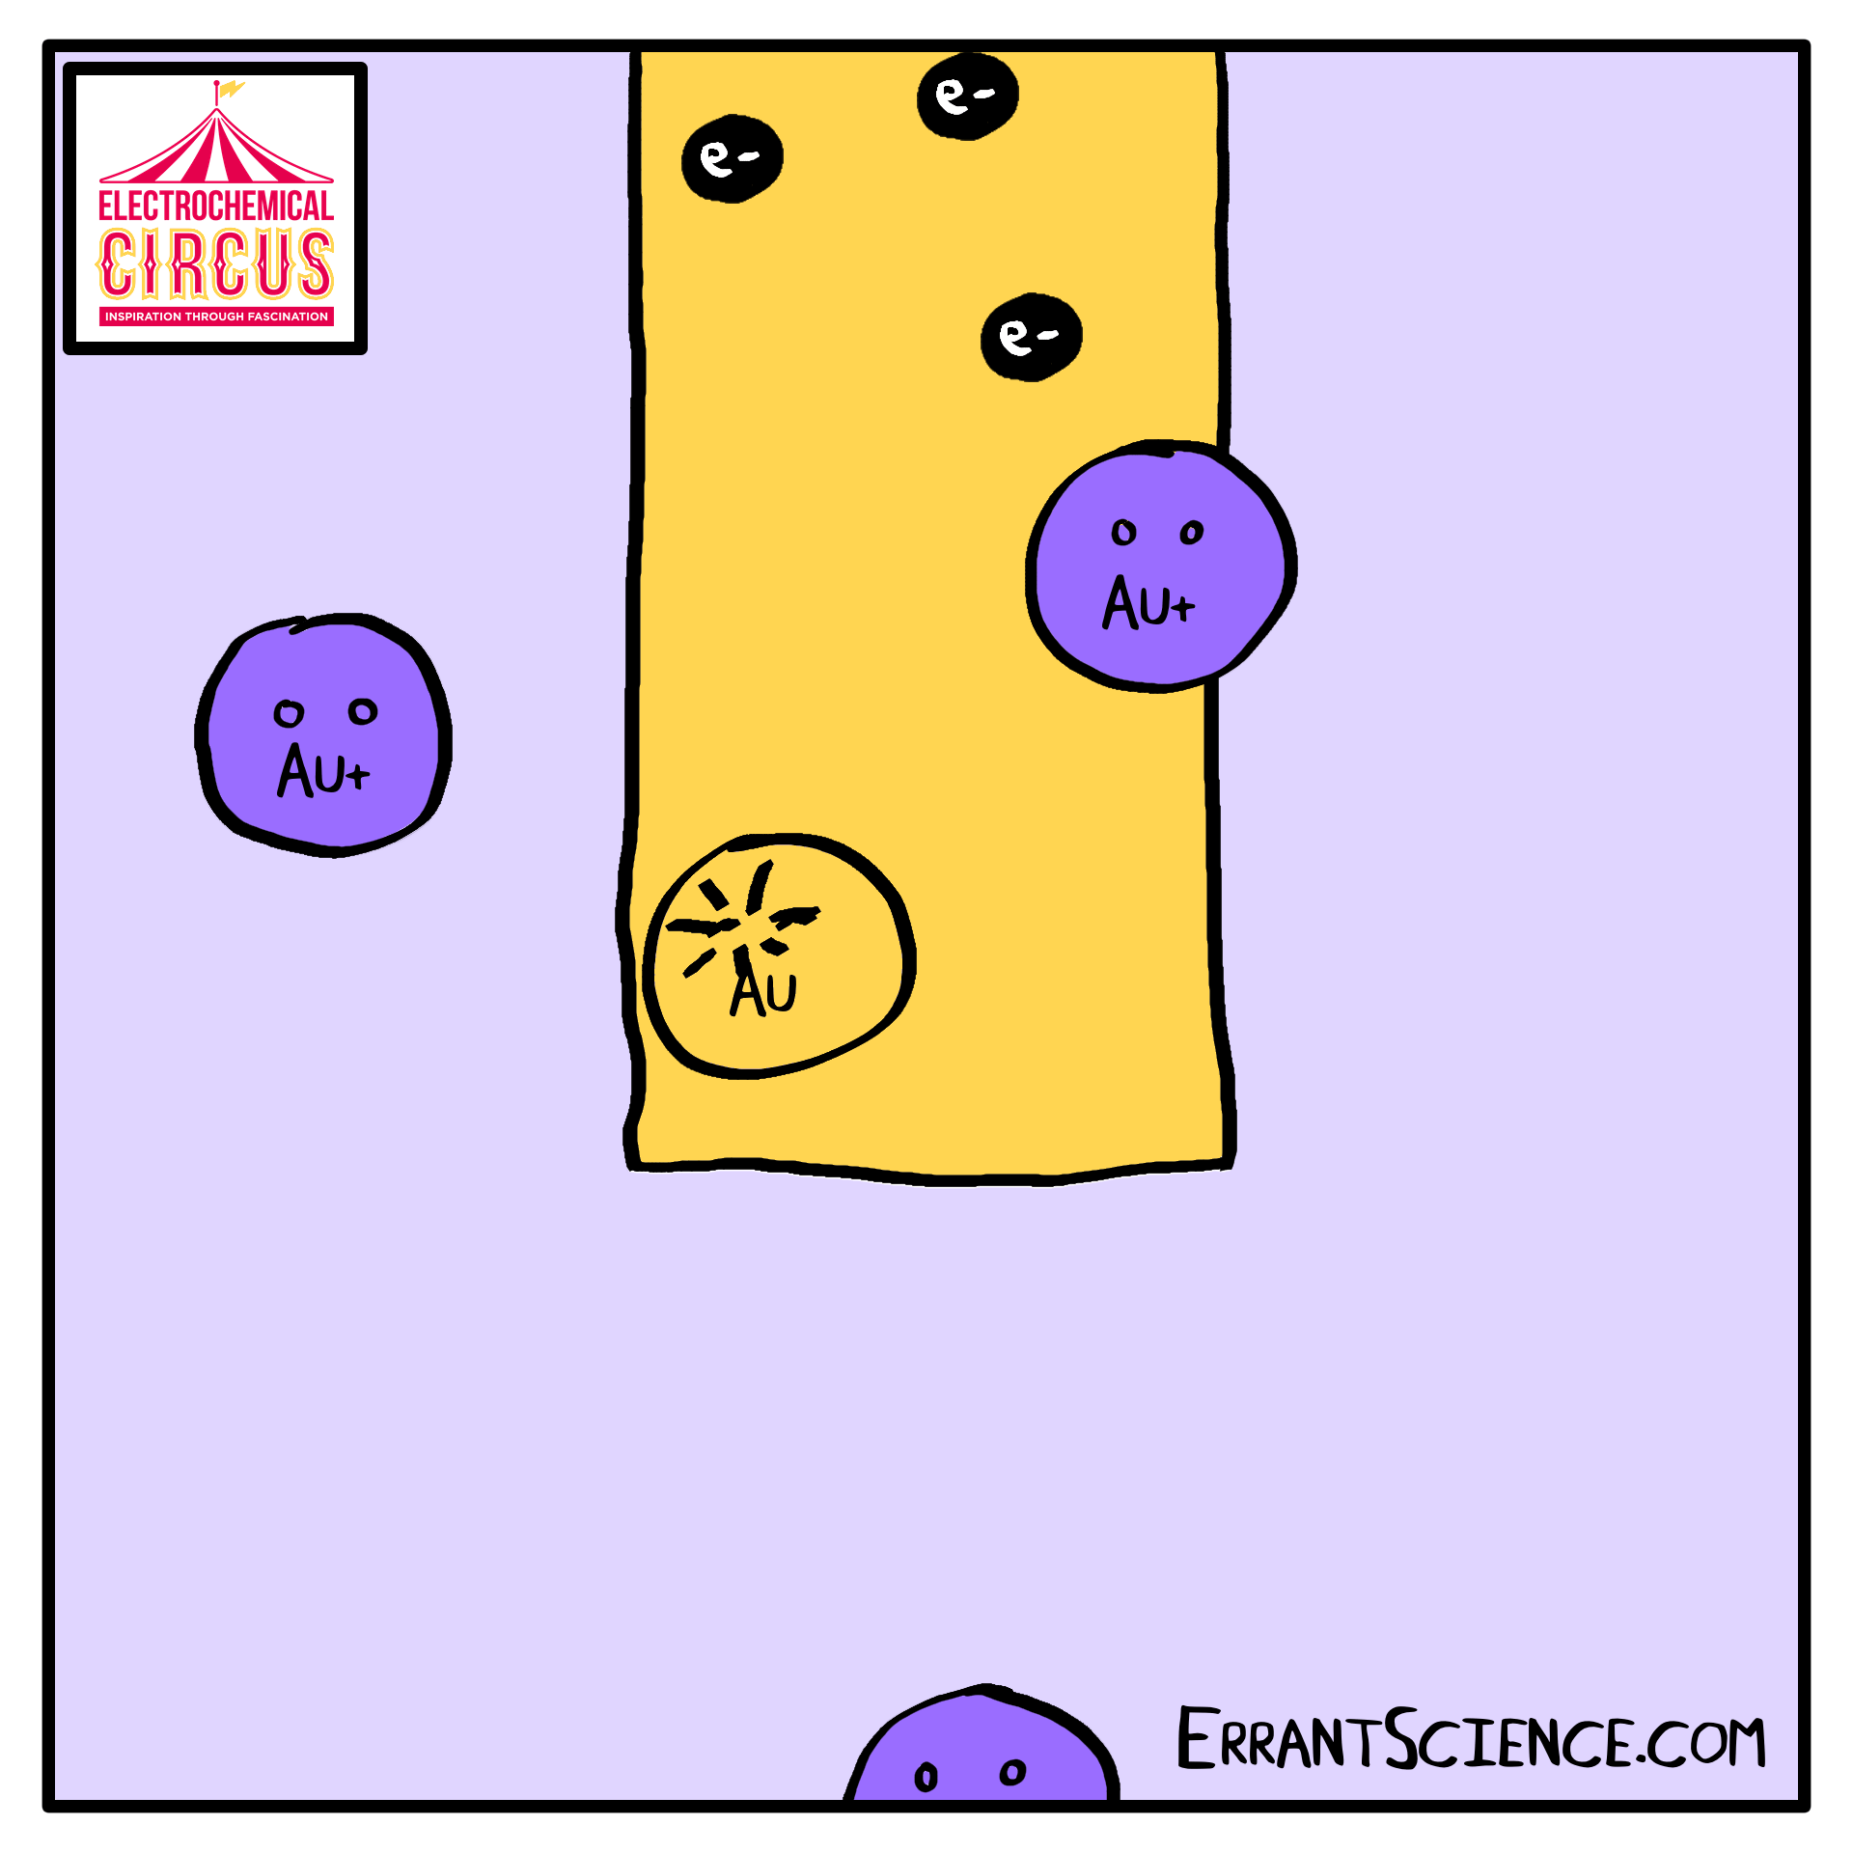
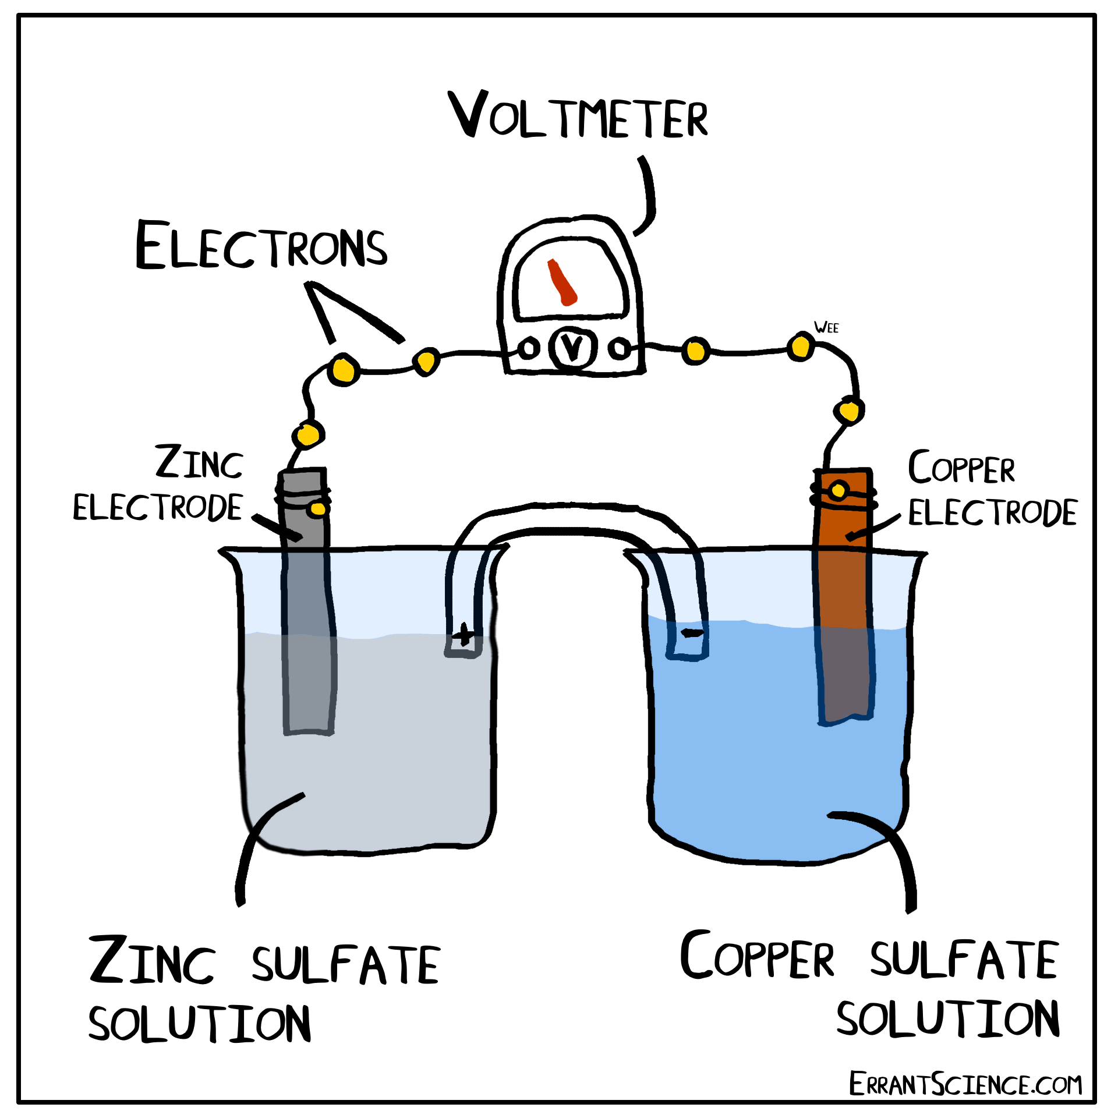
Redox reactions
In “redox” reactions one chemical species becomes oxidised while the other becomes reduced.
We can use the mnemonic OILRIG to help us remember that:
Oxidation is loss of electrons
Reduction is gain of electrons
… which you might remember from earlier studies.
So, in the reaction of sodium and chloride to make salt, the following are happening:
Sodium is being oxidised to Na⁺
Chlorine is being reduced to Cl⁻
Many electrochemical reactions are also redox reactions, such as in our gold plating experiment:
Gold ions in solution are reduced to form gold metal on the electrode:
Au⁺ + e⁻ → Au (s)
Similarly, in the Daniell Cell,
Zinc is oxidised to form zinc ions in solution:
Zn (s) → Zn²⁺ + 2e⁻
Copper is reduced from ions in solution to copper metal on the electrode
Cu²⁺ + 2e⁻ → Cu (s)

