Slide 1
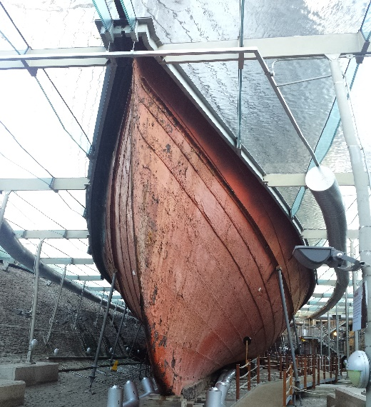
Corrosion
Corrosion is a process that occurs naturally and involves the chemical transformation of refined metals to more stable forms.
The term corrosion generally refers to the electrochemical oxidation of a metal in reaction with an oxidant (often oxygen or sulfur)
One of the most common forms of corrosion is rusting, in which iron is turned into iron oxide, and produces a characteristic orange colour.
One of the most famous examples of rusting is the hull of the steamship SS Great Britain.
Brunel’s iron ship is kept in a humidity-controlled environment to help preserve its structure which is like lace in some places.
More information can be found on the University of Cardiff website:
https://www.cardiff.ac.uk/research/impact-and-innovation/research-impact/saving-heritage-ironwork-from-the-ravages-of-rust
Corrosion is slowed down by the process of galvanisation, during which a sacrificial metal, often zinc is used to coat the item.

