Slide 1
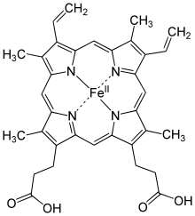
Advanced Case Study: Haemoglobin
Haemoglobin is the iron containing protein in blood that reversibly binds oxygen. This is quite a feat of engineering, we need hydrogen or carbon at very high temperatures to reduce iron ore. Haemoglobin can do all this at room temperature. Bind too weakly and not enough oxygen will be carried, but too strongly and it the oxygen won’t be able to be removed where it is needed. A form of haemoglobin also scavenges oxygen in the roots of beans where it would poison (deactivate) the nitrogen-fixing enzymes (biological catalyst).
You have learned about iron in several oxidation states. Metallic iron, like all metals, has an oxidation state of (0). The outer electrons (valence) are taking place in metallic bonding, but there are still the same amount of them around. In Fe^{II}, iron has two electrons involved in bonding to something more attractive to electrons. Oxygen needs two electrons to fill its outer shell, so Fe₂O₃ has:
O₃: 3 × (-2) and the iron will balance that -6, so two iron atoms will be in the (+3) state.
In haem (the metal bit of haemoglobin) the structure of the metal site and the protein help with reversible binding.
Haem has been studied with x-rays and infra-red spectroscopy to determine the oxidation state.
Structure Authors: Paoli, M. Liddington, R., Tame, J., Wilkinson, A., Dodson, G., doi:10.2210/pdb1GZX/pdb,
Mol Authors: Mol* (D. Sehnal, A.S. Rose, J. Kovca, S.K. Burley, S. Velankar (2018): doi:10.2312/molva.20181103), and RCSB PDB.
RCSB and PDB, 09/2020.

